Slide 1
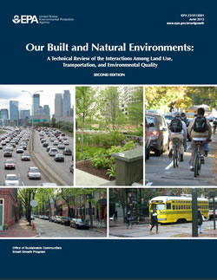
Our Built and Natural Environments: A Technical Review of the Interactions Among Land Use, Transportation, and Environmental Quality
Melissa G. Kramer, Ph.D.
July 24, 2013
2:00-3:00 Eastern

Slide 2
Background
Decisions about how and where we build communities impact the natural environment.
2nd edition updates 2001 edition with information available as of October 2012.
Intended audience:
Federal, state, and local government agencies
Real estate developers and investors
Communities across America

Slide 3
The Built Environment Has Direct and Indirect Effects on the Natural Environment
Notes:
This slide sums up the rationale for the whole report:
Patterns of development, transportation infrastructure, and building location and design—all of these things we call the built environment—directly affect human health and the natural environment.
But there are indirect effect as well because how we develop influences decisions people make about how to get around and determines how much people travel.
We’ll go through all of these effects on human health and the natural environment in more detail later.

Slide 4
Document Overview
Trends in land use, buildings, and travel behavior
Environmental consequences of these trends
Effects of different types of development on the environment
Where we build
How we build
Notes:
Here’s an overview of the report as well as this presentation:
First,
Second,
Third,
We’ll pause between each of these sections for questions

Slide 5
Document Overview
Trends in land use, buildings, and travel behavior
Environmental consequences of these trends
Effects of different types of development on the environment
Where we build
How we build
Notes:
Here’s an overview of the report as well as this presentation:
First,
Second,
Third,
We’ll pause between each of these sections for questions

Slide 6
Population
Data source: U.S. Census Bureau
Notes:
So first let’s look at population.
The U.S. population grew from about 76 million in 1900 to about 312 million in 2011.
Note that most of the population growth occurred in census-defined urban areas, while the rural population remained relatively constant.
In 1900, just 40 percent of the population lived in urban areas; in 2010, more than 80 percent did.
The census defines most suburban areas as urban, so this reflects largely a suburbanization of the population more than an urbanization.

Slide 7
Metropolitan Area Size
Virtually every metropolitan region in the U.S. has expanded substantially in land area since 1950.
Urbanized area increased 2.5 times faster than population growth between 1950 and 2010.
Urbanized area continued to grow even in areas losing population.
Source: U.S. Census Bureau
Notes:
You can see this by looking at how metropolitan area size has changed. Essentially all metropolitan regions have expanded their land area significantly since 1950.
For the 39 largest urbanized areas combined, urbanized area increased 2.5 times faster than population growth between 1950 and 2010.
In fact, for a number of cities urbanized land area grew even during periods of regional population decline: Pittsburgh, Milwaukee, Detroit, St. Louis, Cleveland, New York, Chicago, and Kansas City.

Slide 8
Developed Land
1982: Nearly 71 million acres of land developed
2007: More than 111 million acres (57% increase)
Over this 25-year period, the U.S. population increased about half as much (30%).
Of the newly developed land:
Nearly half (17,083,500 acres) was forestland.
About one quarter (11,117,500 acres) was cropland.
The remainder was pastureland, rangeland, or other rural land.
Sources: U.S. Forest Service 2009 and U.S. Census Bureau
Notes:
We can see one effect of this expansion in metropolitan area size by looking at statistics on developed land.
According to the USDA Natural Resources Inventory, as of 1982, close to 71 million acres of non-federal land were developed nationally.
By 2007, the number of acres rose to more than 111 million, a 57 percent increase.
By comparison, over this 25-year period, the population of the United States increased only about half as much (30 percent).
Of the newly developed land, nearly half had been forestland and about one quarter had been cropland.

Slide 9
Housing Units
Data source: U.S. Census Bureau
Notes:
Drilling down a little bit now to look at how housing has changed.
The total number of homes in the United States has grown steadily.
Between 1940 and 2010, the national housing inventory grew more than 250 percent, adding nearly 100 million homes, while population at a little over half that rate (134 percent).

Slide 10
Average Size of Single-Family Homes
Data source: U.S. Census Bureau
Notes:
You can see here that as the number of housing units increased, so did the average size of houses.
Single-family homes built between 2000 and 2005 were 29 percent bigger than homes built in the 80s and 38 percent bigger than homes built before 1950.
The national average for single-family residences went from less than 1,700 square feet in 1973 to more than 2,500 square feet in 2007 and then dropped slightly.

Slide 11
Average U.S. Household Size
Data source: U.S. Census Bureau
Notes:
This trend toward larger homes happened while average household size was decreasing.
It went from 3.6 people in 1947 to 3.0 in 1973 and 2.6 in 2010.
It was shifts in the composition of households that drove this trend.
In 1940, only 8 percent of households had only one person. This increased to 28 percent by 2011.
In 1940, 51 percent of households had children under 18. That dropped to 29 percent by 2011.

Slide 12
Building Energy Use
Data source: U.S. Energy Information Administration
Notes:
Not surprisingly, as the size of homes grew, so did building energy use.
The building sector’s energy use quadrupled between 1950 and 2010 while the population roughly doubled and the housing stock more than tripled.
In 2011, the U.S. building sector accounted for 41 percent of domestic energy use and 7 percent of global energy use.

Slide 13
Building Water Use
Data source: U.S. Department of Energy
Notes:
Along with energy use, water use grew too.
…by 27 percent in the building sector between 1985 and 2005, even as overall water use in the country grew by less than 3 percent.
In 2005, the residential and commercial building sectors accounted for 10 percent of all water consumption in the United States, up from 8 percent just 20 years earlier in 1985.

Slide 14
Building Construction Waste Production
Data source: U.S. EPA
Notes:
We don’t have data tracking how building construction waste production changed over time, but we do have some estimates for single points in time.
EPA estimated that in 2003 the building sector produced 170 million tons of construction, renovation, and demolition waste. Another estimate was 209 million tons in 2002.
Although renovation of a building produces less waste than if you were to construct a new one, considerably more renovation activity occurs, making it a larger contributor to overall amounts of waste.

Slide 15
Impervious Cover
One estimate: 40,006 square miles—an area slightly smaller than Kentucky
4% increase between 2001 and 2006
Arizona: 8.9% increase
Georgia: 8.4% increase
South Carolina: 7.9% increase
Most cities have levels of impervious cover known to stress or seriously degrade watersheds.
One study of 18 cities in the 2000s showed a 0.31% increase per year while canopy cover declined.
Sources: Xian et al. 2011; Nowak & Greenfield 2012.
Notes:
All of this development creates roofs, roads, driveways, sidewalks, and patios. We can look at the proportion of a watershed that is covered with impervious surface as a good indicator of the degree to which development affects water ecosystems and water resources, something I’ll explain more later.
One estimate of impervious cover in the contiguous United States was 40,000 square miles, an area slightly smaller than the state of Kentucky, a 4 percent increase over 5 years.
Most cities have levels of impervious cover that are known to stress or even seriously degrade water quality. Estimates for 18 cities in the United States found that the percentage of impervious cover grew in the mid to late 2000s on average by 0.3 percent per year, or 24 square feet per person per year, at the same time that these cities lost tree canopy cover.

Slide 16
Roads
Data source: Federal Highway Administration
Notes:
You can see where some of this impervious cover is coming from by looking specifically at roads…
In 2010, the United States had more than 4 million miles of public roads.
The amount of annual road construction was greatest during the 1910s and then leveled off until another period of expansion in the 50s and 60s.
Although the rate of new road construction has slowed since then, 115,000 lane miles of public roads were built between 2000 and 2005, and another 277,000 lane miles were added in the following five years.

Slide 17
Parking
2010: More than 240 million cars, buses and trucks in the U.S.
One estimate of total parking in the United States: 820 million spaces cover 8,500 square miles
When combined with space devoted to roads: 23,900 square miles of land is paved for driving and parking—nearly the size of West Virginia.
Sources: Federal Highway Administration 2010; Chester et al. 2010
Notes:
Parking structures and parking lots also cover a lot of land.
In 2010, there were more than 240 million cars, buses, and trucks registered in the United States, and each requires a place to park.
Estimates of the total parking inventory in the United States vary widely.
A 2010 study estimated 820 million parking spaces covering 8,500 square miles.
If you combine that with the amount of space devoted to roads, 24,000 square miles of the United States is paved for driving and parking, an area nearly the size of West Virginia.

Slide 18
Vehicles per Household
Data source: Federal Highway Administration
Notes:
Not surprisingly, along with increases in road, there was an increase in the number of vehicles households own.
In 1969, 79 percent of U.S. households owned one or more vehicles.
By 1995, that figure had grown to 92 percent.
However, more recently the trends seems to be changing.
Between 2001 and 2009 the number of households with no vehicle grew by nearly 1 million, rising from 8.1 to 8.7 percent of all households.

Slide 19
Growth in Vehicle Miles Traveled (VMT) and Population
Data sources: U.S. Census Bureau; Federal Highway Administration
Notes:
While the population roughly doubled between 1950 and 2011, from about 152 million to 312 million people, vehicle travel during this same period increased nearly sixfold, from around 460 billion VMT to nearly 3 trillion VMT.
You can see that growth in VMT appears to have leveled off in the past couple of years. Many people have speculated as to why this has occurred, but the answer isn’t entirely clear yet.
It’s also not clear whether the trend will continue, particularly as the rate of economic growth increases, but there are many indicators that suggest we may have reached a saturation point.

Slide 20
Means of Transportation to Work
Data source: U.S. Census Bureau (reported by U.S. Department of Energy)
Notes:
Although we’ve seen tremendous growth in biking rates in some cities and towns in recent years, overall since the middle of the last century, relatively few people have gotten to work by using public transportation, carpooling, biking, or walking, and these forms of commuting have declined steadily in most areas.
In 1960 2.5 times as many people took public transportation to work as in 2010, and 3.5 times as many people walked to work.

Slide 21
Future Trends
2010 to 2050
Population growth: 42%
New housing: 52 million units
Replacement housing: 37 million units
One estimate of acres that will be lost between 1997 and 2060:
Rural land: 60-85 million acres
Forests: 24-38 million acres
Cropland:19-28 million acres
Rangeland: 8-11 million acres
Sources: Vincent & Velkoff 2010; Ewing et al. 2008; Wear 2011
Notes:
So where does it look like all of this is heading?
The U.S. population is projected to grow 42 percent between 2010 and 2050, from 310 million to 439 million.
Researchers estimate that between 2005 and 2050, the United States will need 52 million new housing units and 37 million units will likely be built to replace existing homes.
Consistent with these projections, the U.S. Forest Service 2010 assessment forecasts that between 1997 and 2060, we’ll lose as much rural land as the size of New Mexico, as much forest land as the size of Florida, as much cropland as the size of Tennessee, and as much rangeland as Vermont and New Hampshire put together.

Slide 22
Document Overview
Trends in land use, buildings, and travel behavior
Environmental consequences of these trends
Effects of different types of development on the environment
Where we build
How we build
Notes:
So let’s pause here before moving to the next section.
OK, so now that we’ve covered some of the status and trends in land use, buildings, and travel behavior, let’s move on to what the environmental consequences of this development have been.

Slide 23
Environmental and Human Health Impacts
Habitat loss, degradation, and fragmentation
Degradation and loss of water resources
Degradation of air quality
Heat island effect
Greenhouse gas emissions and global climate change
Health and safety
Notes:
Here’s an over view of the issues that I’ll cover in this section.
I’ll move right into the loss of habitat.

Slide 24
Loss of Wetlands
Data source: U.S. Fish and Wildlife Service (Dahl 2011)
Notes:
Looking first at wetlands…
In the late 1700s, the lower 48 states had an estimated 221 million acres of wetlands, but we have less than half those acres today.
The annual wetland losses measured since the 1950s have decreased due to protection under the Clean Water Act, and wetland acreage even increased between 1998 and 2004 due to restoration efforts.
However, estimates are that 14,000 acres of wetlands were lost annually between 2004 and 2009, and development was responsible for 23 percent of that loss.

Slide 25
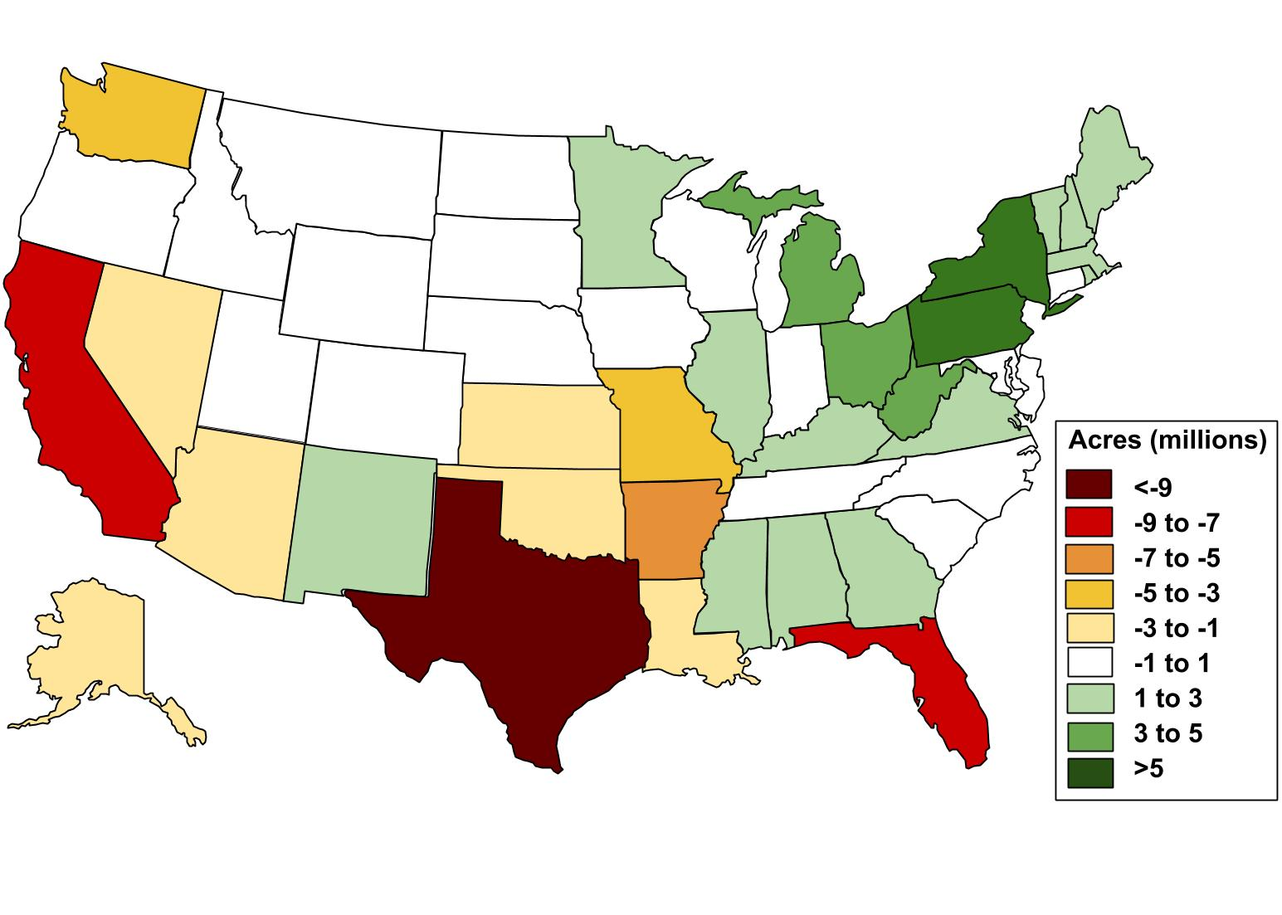
Change in Forest Area, 1907-2002
Data source: Ramankutty, Heller, and Rhemtulla 2010
Notes:
Most of the forest loss in the United States occurred in the 17th to 19th centuries.
Researchers have estimated that forest covered just over 1 billion acres, or 46 percent of the land in the United States, in 1860. By 1907, almost 300 million acres or 34 percent were lost mainly to create cropland.
Since 1907, forest cover in the United States overall has been relatively stable. However, there’s a lot of variation across regions.
The northeastern United States has had a great deal of forest regrowth on abandoned cropland, while a lesser amount occurred in Appalachia and around the Great Lakes.
Other parts of the United States experienced significant declines since the early part of the 20th century, particularly Texas, California, and Florida.

Slide 26
Habitat Degradation
Lawns have relatively low infiltration rates; often require irrigation, fertilizer, and pesticides; and require energy for mowing.
Non-native plants found in many managed landscapes can reduce the abundance and diversity of insect herbivores, reducing the energy available in food webs.
Some of these non-native species have become invasive. Invasive species are at least partly responsible for the listing of about 42% of the species that are threatened or endangered.
Photo source: this lyre lark (derya) via flickr.com
Sources: Tallamy & Shropshire 2009; Pimentel et al. 2005
Notes:
It’s not just habitat loss though. Habitat degradation is also significant.
In particular, suburban lawns and landscaped areas that proliferated as development sprawled outside of cities have a number of ecological effects, many of which are relatively well understood—lawns can’t absorb as much rainwater as other vegetated areas, they often require irrigation, fertilizer, and pesticides, and they require energy for mowing.
But probably less well understood is the fact that we’ve replaced literally millions of acres of native vegetation with primarily non-native ornamental plants. For the organisms that depend on native plants for food, shelter, and places to rear their young, this is a still-growing problem.
In fact, homeowners and landscapers often choose non-native species specifically for their resistance to insects. But if ornamental plants can’t serve as food for the same number and same diversity of herbivores, that decreases the energy available for food webs. Many studies have documented that non-native plants reduce the number and diversity of insect herbivores that feed birds and other wildlife.
Beyond these effects, a small subset of introduced non-native species spread widely or quickly and become what we call invasive, leading to substantial ecological and usually economic effects. Invasive species are at least in part responsible for the listing of about 42 percent of the species that are threatened or endangered.

Slide 27
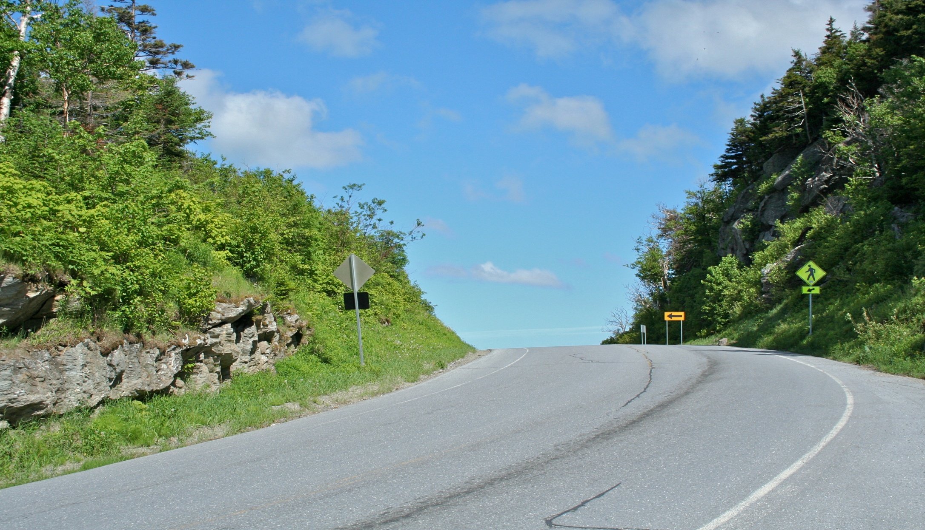
Effects of Roads
Habitat destruction and fragmentation
Many species cannot survive along road edges. Species density tends to increase with distance from roads.
Estimates of land ecologically affected by roads: 20% to 50% of the United States
Animal mortality
1 to 2 million collisions between vehicles and large animals per year
Major cause of death for 21 animals on the federal threatened or endangered species list
Sources: Federal Highway Administration 2008; Coffin 2007; Riiters & Wickham 2003; Forman & Deblinger 2000
Notes:
A big part of habitat degradation is also roads.
Roads directly destroy habitat but they also fragment habitat which makes finding food, mates, and breeding sites difficult or even impossible.
Many studies have found that species density tends to increase with distance from roads because many species simply can’t survive along road edges.
Researchers have tried to define and quantify the zone of land around roads that the road system directly affects ecologically.
One analysis found that this zone covered 20 percent of the land area in the United States as of 2000. Another concluded that the figure was as high as 50 percent.
And then beyond habitat degradation there is direct animal mortality.
The Federal Highway Administration estimated that there are 1 to 2 million collisions between vehicles and large animals a year.
Road mortality is a major cause of death for 21 animals on the federal threatened or endangered species list.

Slide 28
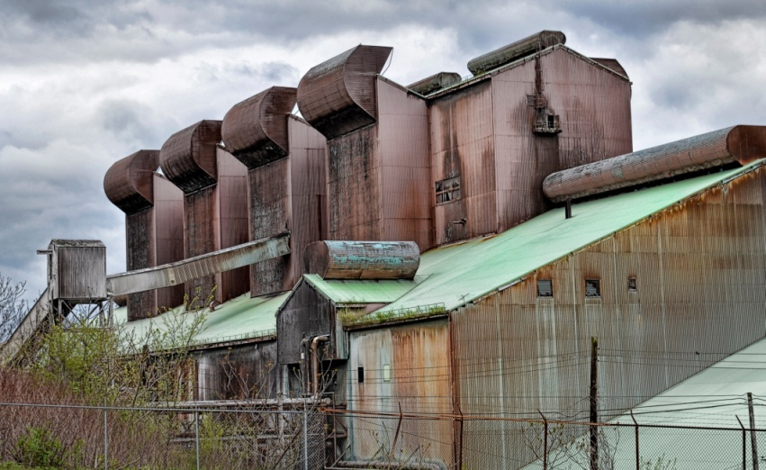
Land Contamination
Between 235,000 and 355,000 sites in the U.S. are contaminated with hazardous waste and petroleum products:
Atlanta: 4% of land area
Cleveland: >7% of land area
Milwaukee: 7.5% of land area
Poor and minority neighborhoods often have a disproportionately high number of brownfields.
Photo source: Bob Jagendorf via flickr.com
Sources: EPA 2004; Leigh & Coffin 2005; McCarthy 2009; Lee & Mohai 2011
Notes:
Another aspect of habitat degradation is land contamination.
In 2004, EPA estimated that between 235,000 and 355,000 sites in the United States were contaminated with hazardous waste and petroleum products.
In specific cities these sites can cover more than 7 percent of the land area. And poor and minority neighborhoods often have more than their share of these sites

Slide 29
Degradation of Water Resources
Urban-related stormwater runoff is thought to be responsible for the impairment of:
51,548 miles of rivers and streams
858,186 acres of lakes, reservoirs, and ponds
1,877 square miles of bays and estuaries
270 coastal shoreline miles
452 square miles of ocean and near coastal area
13,867 square miles of Great Lakes open water
But the majority of U.S. waters have not been assessed.
Source: EPA
Notes:
We have some data on what this all means for water resources.
States report the results of water body assessments to EPA where we collect it into a database. That shows that most sources of impairment are directly or indirectly related to the built environment.
You can see the figures here for how much of our water is impaired by urban stormwater runoff.
And these estimates are likely low because stormwater discharges can be difficult to identify and most U.S. waters have not even been assessed.

Slide 30
Effects of Development on Stream Hydrology
Removing vegetation decreases evapotranspiration.
Impervious surfaces increase runoff:
Water recharge is reduced.
Floods more frequent and severe.
Water temperature increases.
Streamflow is altered at 86% of monitoring stations in developed areas.
Sources: National Research Council 2009; Carlisle et al. 2011
Notes:
Development also causes pretty fundamental changes to how water moves around. It’s really just a cascade of effects.
First, removing vegetation decreases the amount of precipitation that evaporates from the earth’s surface and transpires from plant surfaces.
Then impervious surfaces increase the amount of water that runs off the land.
This then (1) reduces the amount of water that recharges streams and underground storage areas (2) makes floods more frequent and severe during wet periods,
The temperature of the water tends to increase as well because dark, impervious surfaces transfer the heat they have absorbed to the water that runs over them.
These changes in the water cycle due to development are widespread. A study of almost 3,000 U.S. stream monitoring stations found that 86 percent differed in some way from a relatively undisturbed area.

Slide 31
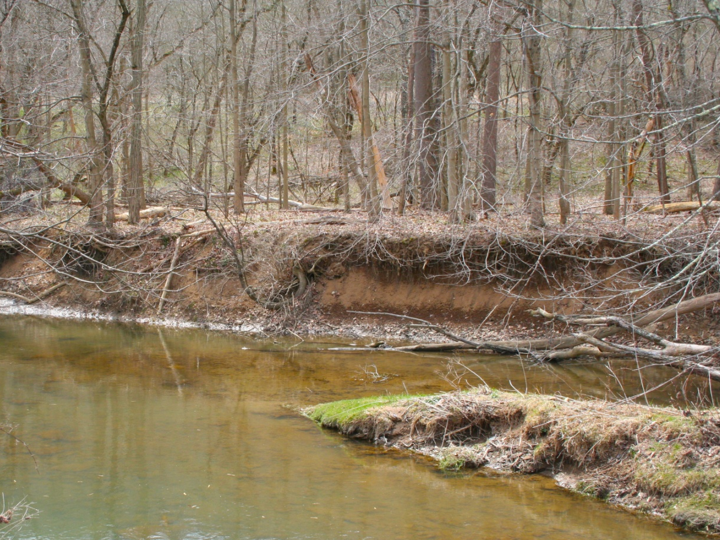
Effects of Development on Stream Geomorphology
Increased flow causes:
Erosion
Wider, deeper channels
Lower flow levels
Sources: National Research Council 2009; Booth & Bledsoe 2009
Notes:
These hydrologic changes due to development also cause visible changes to the form of stream systems.
You’ve probably seen streams like this all over and may not have even known you were looking at a degraded streambed.
What happens is increased flow washes out woody debris and uproots trees and other vegetation, which destabilizes stream channels.
Natural regeneration rates rarely compensate for the losses meaning that over time streams lose more and more of their canopy cover.
Erosion can eventually lead to stream bank collapse, which deepens and widens channels, which can shift normal flow levels many feet below their original level.

Slide 32
National Air Pollution Emissions by Source Sector, 2010
Data source: U.S. EPA
Notes:
Of course we haven’t just polluted our water. We’ve polluted the air too.
Now, we have had dramatic reductions in vehicle emissions since 1970, but the fact is these gains would be even greater if not for the approximately 250 percent increase in driving since then.
More than 38 percent of national carbon monoxide emissions and 38 percent of nitrogen oxide emissions come from highway vehicles.
Stationary sources like power plants that provide energy to homes, offices, and industries are also major sources of pollution.
In fact, as of 2012, almost 160 million people, about half the U.S. population, still live in counties that don’t meet air quality standards, most frequently for ozone and particulate matter.

Slide 33
Indoor Air Pollution
Biological pollutants
Volatile organic compounds (VOCs)
Asbestos
Incomplete combustion products of solid fuels
Radon gas
Polychlorinated biphenyls (PCBs)
Polybrominated diphenyl ethers (PBDEs)
Notes:
And indoor air can be a problem too, unfortunately. Indoor air pollution results from a whole host of products we bring into our homes, including personal care products, cleaning products, paints, plastics, and upholstery. Here’s a list of the bad characters here.
And they can cause a range of health effects (depending on the compound) from eye and respiratory irritation to cancer and possibly immune, reproductive, nervous, and endocrine system effects.

Slide 34
Heat Island Effect
Cities can be 6-8°F warmer than outlying areas due to:
Dark pavement and roofs that absorb and reflect more heat.
Fewer trees and less vegetation that reduce shade and evaporative cooling.
Increased heat can be a health hazard:
Heat stroke
Increased air pollution
Sources: Frumkin 2002; Stone 2008
Notes:
Another effect of impervious surfaces beyond water quality problems is that they also affect the temperature of surrounding areas through what is known as the heat island effect.
Most of us know that cities can be as much as 6 to 8 degrees warmer than outlying areas.
This is due to two complementary forces: dark pavement and roofs absorb and reflect more of the sun’s heat, while the relative scarcity of trees and other vegetation reduces shade and cooling through evapotranspiration.
Increased heat is itself a health hazard, as heat stroke can lead to hospitalization and even death.
In addition, as temperatures rise, more VOCs are emitted from vehicles and the rate of ozone formation increases.
Use of air conditioning also increases and, along with it, so does air pollution as regional power plants ramp up production.

Slide 35
U.S. Greenhouse Gas Emissions by Economic Sector, 2010
Data source: U.S. EPA
Notes:
Of course another big environmental effect of development is greenhouse gas emissions.
Industrial activity accounts for the largest portion, but it’s followed closely by transportation.
And together the residential and commercial sectors account for just over a third of total U.S. greenhouse gas emissions.

Slide 36
U.S. Greenhouse Gas Emissions, 1990-2010
Data source: U.S. EPA
Notes:
If we look over time, transportation emissions increased 19 percent between 1990 and 2010.
A 4 percent decline in transportation emissions between 2008 and 2009 is due in part to decreased economic activity.
As it began to rebound in 2010, transportation emissions increased again by 1 percent.
Emissions from the residential and commercial sectors also increased relatively steadily between 1990 and 2010: by 25 percent in the commercial sector and 29 percent in the residential sector.

Slide 37
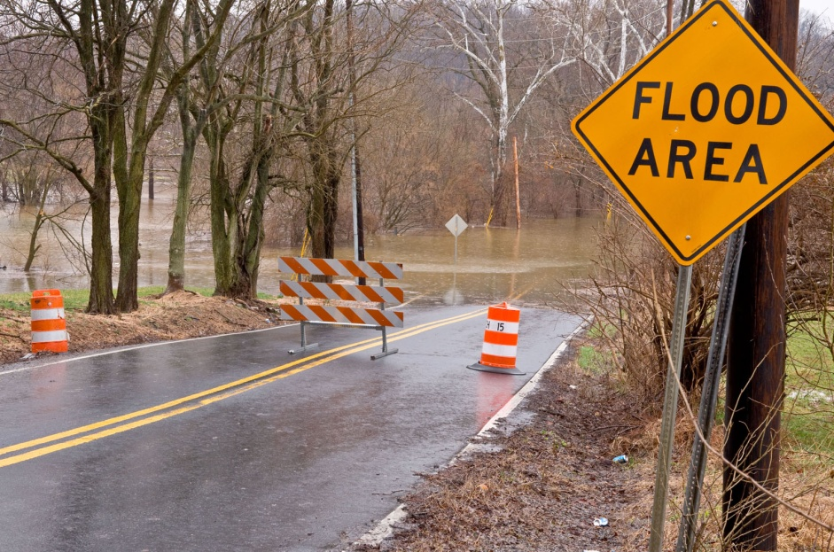
Effects of Global Climate Change
Increased temperature
Rainfall changes
More frequent and intense extreme weather events
Stronger winter storms
Increased wildfires
Rising sea level
Shrinking sea ice
Source: U.S. Global Change Research Program 2009
Notes:
We know that greenhouse gas emissions are responsible for global climate change. Already we have observed a number changes in the United States.
For the sake of time I won’t go through the list here but you can see the range of effects that we’ve already experienced.

Slide 38
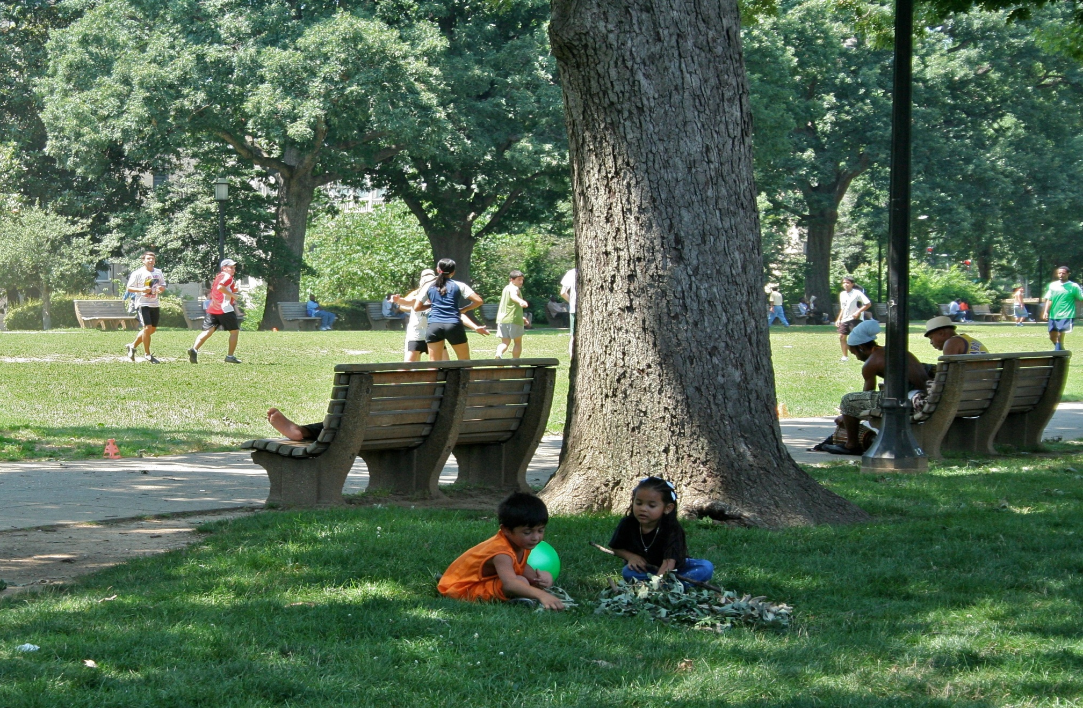
Activity Levels, Obesity, and Chronic Disease
How we build our communities affects:
The amount of time we spend in cars.
The opportunity, practicality, and necessity of physical activity.
The degree of land use mix and county-level measures of sprawl both likely affect the incidence of obesity.
As the number of minorities and poor increases in an area, the number of facilities for physical activity and recreation often decreases.
Sources: Frank et al. 2006; Frumkin 2002; Feng et al. 2010; Ferdinand et al. 2012; Gordon-Larson et al. 2006
Notes:
The heat island effect and global climate change affect public health, but there are other public health impacts from the built environment.
How we build affects the amount of time people spend in their cars and the opportunity, practicality, and necessity of walking and biking.
These factors can influence overall physical activity levels and therefore the risk of obesity and chronic disease.
There is a lot of work on the association between the built environment and obesity, but broad conclusions are hard to reach due to differences across studies. Nevertheless, a 2010 literature review found the evidence was strong enough to conclude that the degree of land use mix and county-level measures of sprawl likely affect the incidence of obesity.
Some subpopulations are more affected by obesity and related chronic disease than others.
A possible contributing explanatory factor is the number and quality of recreational facilities available.
A national analysis showed that as the number of minorities and people of lower socioeconomic status increases in an area, the number of physical activity and recreational facilities often decreases.

Slide 39
Vehicle Crashes
Data sources: National Highway Traffic Safety Administration; U.S. Department of Transportation
Notes:
Another aspect of public health is the risk of being injured or dying in a vehicle crash.
In 2010, 33,000 people died in the United States in vehicle crashes, down from 51,000 in 1966. The safety gains over this period would have been greater but for the increase in VMT. While vehicle fatalities per 100 million VMT declined 80 percent, the number of fatalities per number of people declined only 60 percent over this period.
In spite of this overall downward trend, traffic fatalities are a leading cause of death for many cohorts. Car crashes are the third leading cause of death in terms of years of life lost given the young age of so many car crash victims and the number of years they would have been expected to live if they had not died in a car crash.
And high as it is, the number of traffic fatalities pales in comparison to the number of people injured. In 2010, over 3 million people suffered non-fatal traffic-related injuries, almost 100 times the number that died.

Slide 40
Document Overview
Trends in land use, buildings, and travel behavior
Environmental consequences of these trends
Effects of different types of development on the environment
Where we build
How we build
Notes:
So let’s pause here again before moving to the next section.
Now after talking about how dire things are, I’ll move into some of the things we can do about it.

Slide 41
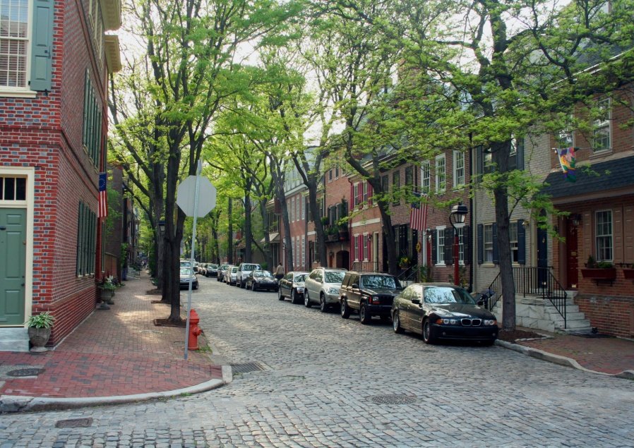
Effects of Different Types of Development on the Environment
Where we build
Safeguarding sensitive areas
Locating development in built-up areas
Focusing development around existing transit
How we build
Compact development
Mixed-use development
Street connectivity
Community design
Destination accessibility
Transit accessibility
Green building
Notes:
There are a number of ways to mitigate the environmental effects of development that we just talked about.
We can improve the environmental performance of development by carefully choosing where we build and how we build. I’ll go through each of these topics in more detail now.

Slide 42
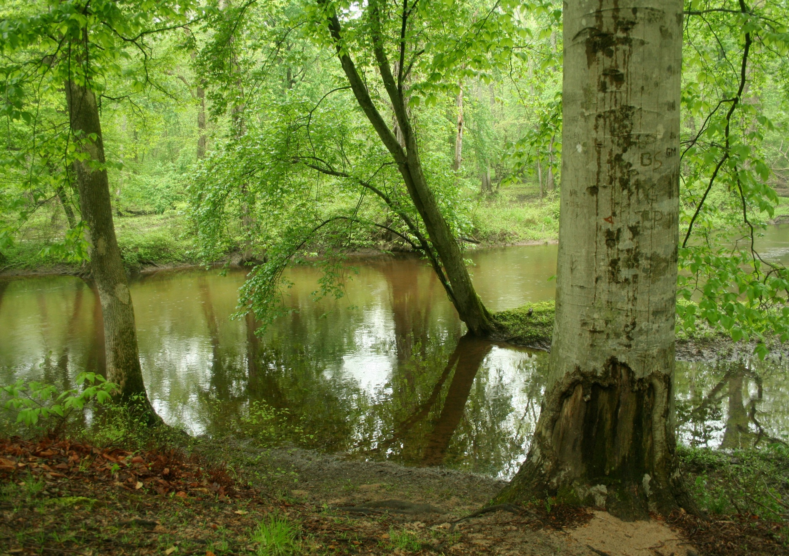
Safeguarding Sensitive Areas
Communities can encourage development:
Where transportation, utilities, and public services already exist.
Adjacent to built-out communities.
On brownfields and greyfields.
Such development can remove pressure to develop farmland and sensitive natural areas that serve important ecological functions and provide scenic/recreational areas.
Notes:
First, in terms of where we build, it’s important to protect sensitive ecological areas.
Communities can do this by encouraging development where three is existing infrastructure for transportation, utilities and public services, where built out communities already exist, and on brownfields and greyfields.
Putting development in these places not only uses existing infrastructure but also removes pressure to develop other places that serve valuable ecological functions.

Slide 43
Importance of Infill Development
Many cities have populations far from their peak, suggesting existing infrastructure could accommodate more people.
2006 estimate: California has half a million infill parcels.
Among 20 metropolitan regions, 21% of new home construction in 2000-2009 occurred in previously developed areas; in some regions infill development exceeded 60%.
Cleanup and redevelopment of brownfield and hazardous waste sites can bring substantial environmental and health benefits.
Sources: Landis et al. 2006; EPA 2012
Notes:
Infill development is central to this idea.
A 2006 analysis estimated that California had nearly half a million potential infill parcels that cover 220,000 acres.
An EPA analysis of residential construction trends supports the idea that many metropolitan regions can support a significant amount of infill development. Among 20 metropolitan regions, 21 percent of new home construction between 2000 and 2009 occurred in previously developed areas. In some regions, the figure exceeded 60 percent
Many infill locations have at least the potential for environmental contamination. The cleanup and redevelopment these sites can bring substantial environmental and health benefits by allowing safe disposal of environmental contaminants and opportunities to reuse and recycle construction and demolition debris from buildings.

Slide 44
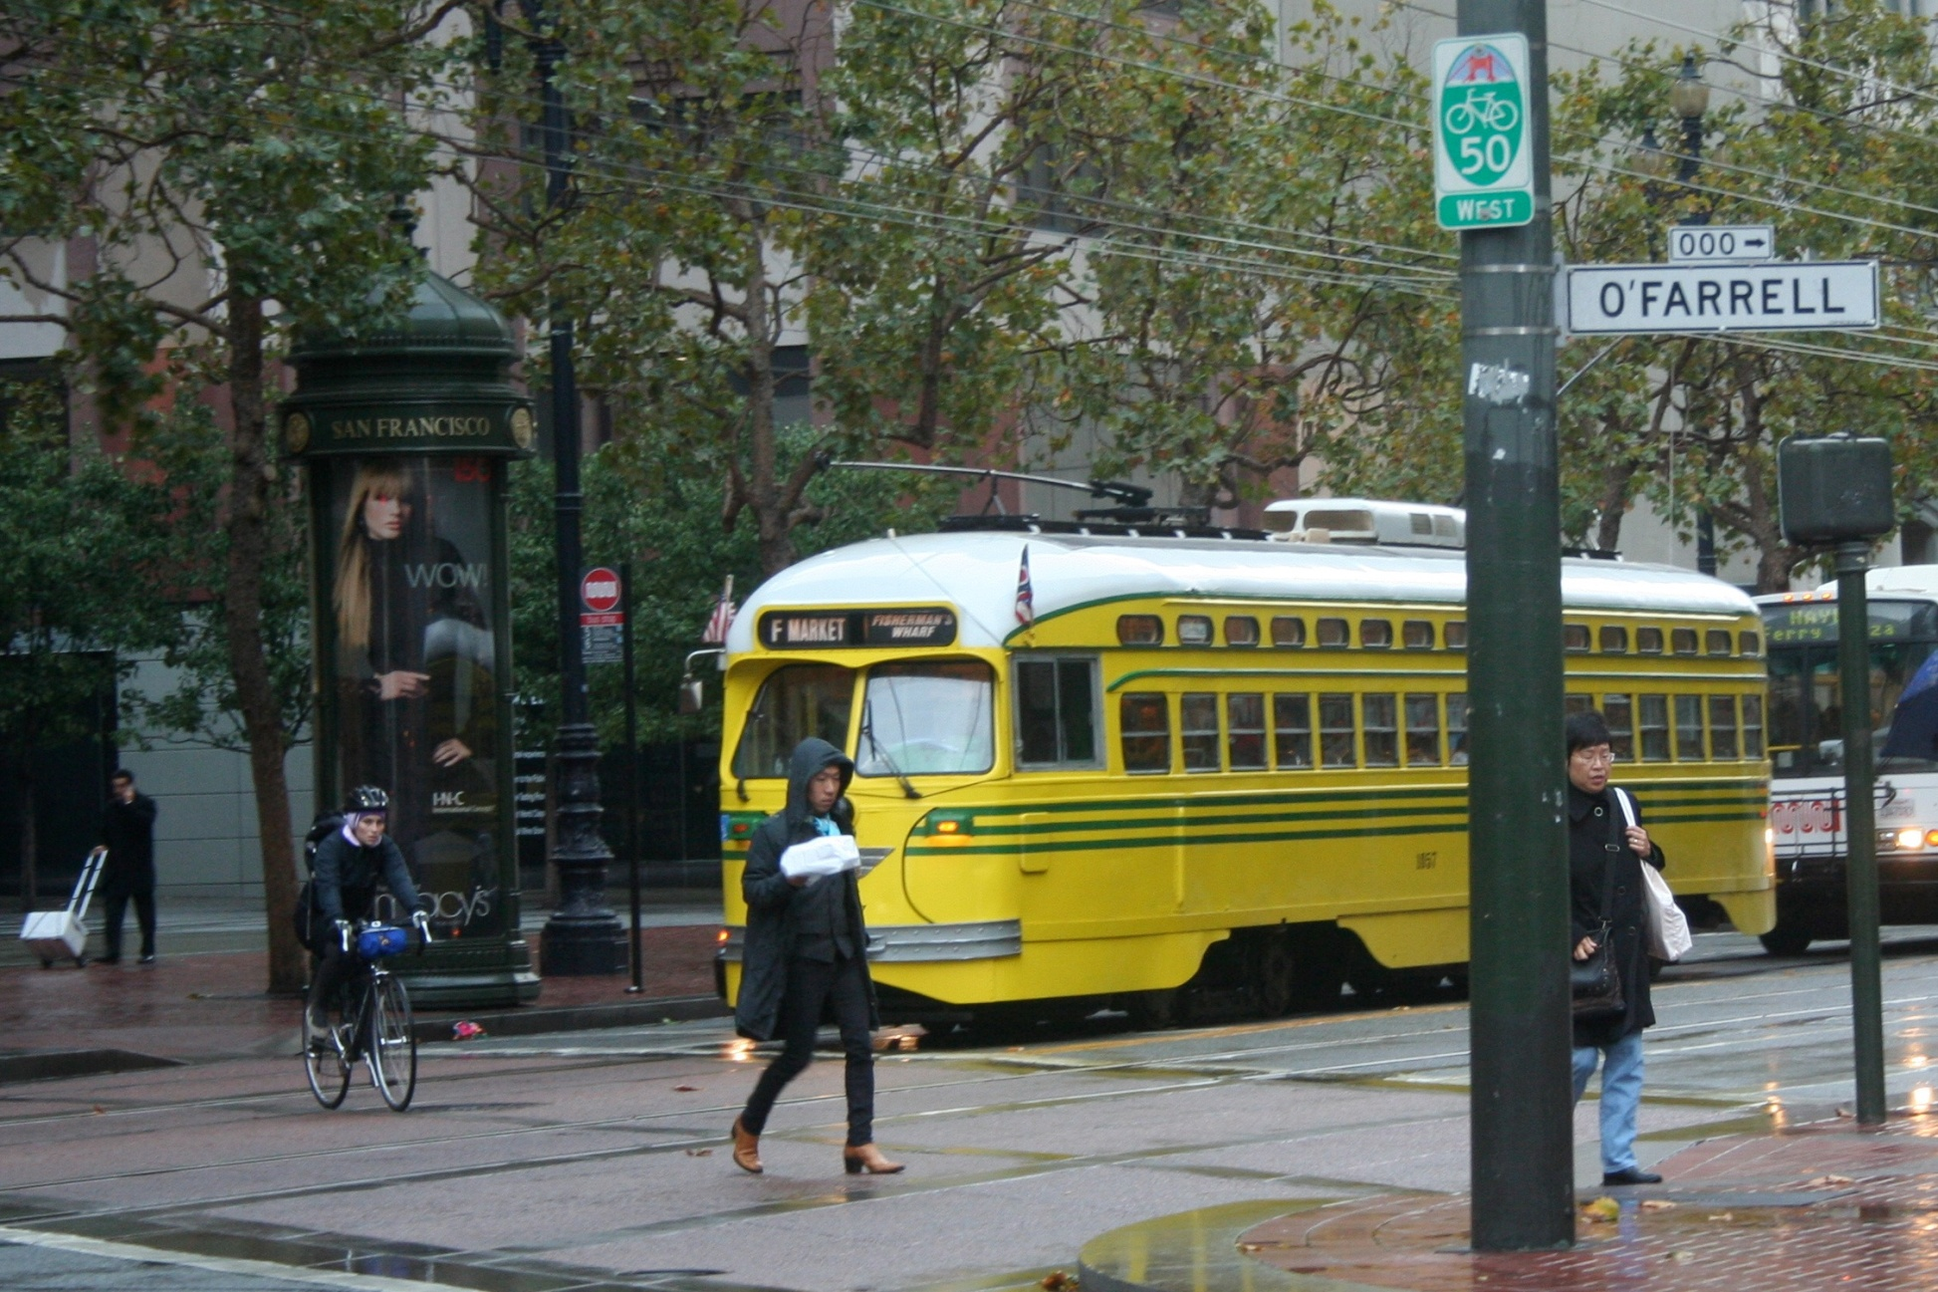
Benefits of Focusing Development Around Transit Stations
A bus carrying 20 passengers consumes only about 1/3 of the energy that would be needed if each person drove alone.
Public transit also provides mobility to people who cannot or choose not to drive.
Across 17 transit-oriented development projects, 47% fewer trips than projected occurred.
People living in transit-oriented developments are 2-5 times more likely to use public transit.
Sources: Davis et al. 2012; Arrington & Cervero 2008
Notes:
Focusing development around transit systems is also beneficial.
We know that transit systems with fast, frequent, and dependable service attracts riders and can reduce driving along with air pollution and greenhouse gas emissions.
A bus carrying 20 passengers consumes only about one-third of the energy that would be needed if each passenger drove a private vehicle.
A study of 17 projects in four areas of the country compared actual vehicle trip rates with those predicted using the Institute of Transportation Engineers manual, which is often used to project local traffic and parking impacts. Across the 17 projects, about 47 percent fewer trips occurred than projected.
A 2008 review of the literature found that people living in developments near transit are two to five times more likely to use transit for commuting and nonwork trips than other people living in the same region.

Slide 45
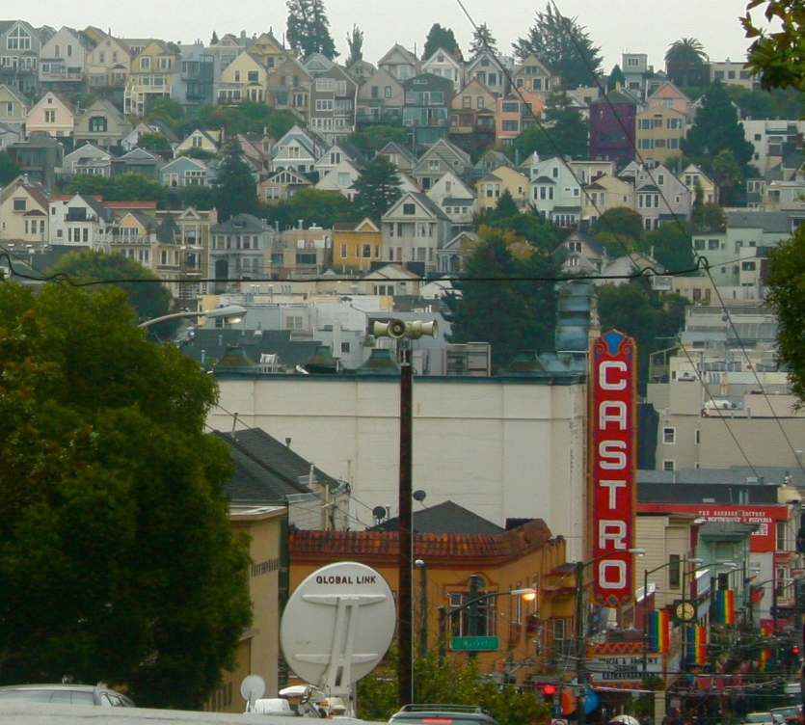
Compact Development
The greater the population and employment density of an area, the less the area’s residents tend to drive.
Density is strongly correlated with:
Mixed residential, commercial, institutional areas.
Destinations close together.
Sidewalks.
Public transit service.
Source: Kuzmyak 2003; Transportation Research Board of the National Academies 2003; Dulal et al. 2011
Notes:
Shifting now from where we build to how we build…
The density of people in a community is a good indicator of how much people will drive and how much they will get around by foot or by bike.
Although the size of the effect is uncertain, in general, the greater the population density of an area, the less the area’s residents tend to drive.
The most recent reviews note that high residential and employment density are most strongly associated with reduced driving when coupled with other factors such as mixed land uses and public transit service.
In fact, density is strongly correlated with many of the characteristics that make driving long distances unnecessary and make other forms of transportation appealing alternatives

Slide 46
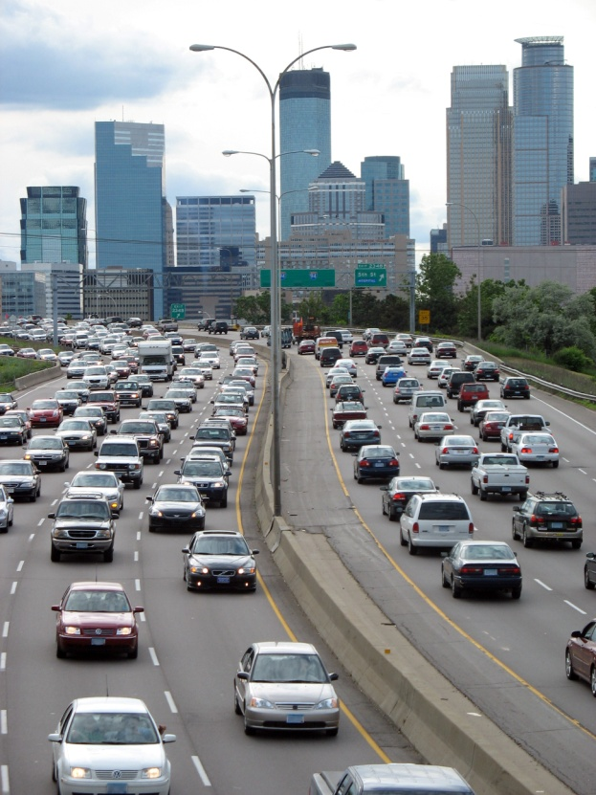
Compact Development and Air Pollution
Study of 100 metro regions: highest emitting regions emit almost 2.5 times as much CO₂ per resident as the lowest-emitting regions.
Study of 45 metro regions: least compact regions had 60% more high ozone days than most compact regions.
Meta-analysis: Nationally, compact development plus other strategies could reduce VMT 10-14%, reducing U.S. transportation CO₂ emissions 7-10%.
Photo source: drouu via stock.xchng
Sources: Southworth & Sonnenberg 2011; Stone 2008; Ewing et al. 2008
Notes:
Several studies have considered the link between density, driving, and air pollution.
One study estimated the carbon dioxide emissions of 100 of the largest metropolitan regions of the United States. Per capita emissions varied considerably across regions. The highest emitting region (Bakersfield, California) emitted almost 2.5 times as much carbon dioxide per resident as the lowest-emitting region (New York City).
A study of 45 of the largest metropolitan regions over 13 years found a positive correlation between how sprawling the region is and both emissions of ozone precursors and the number of high ozone days. The study found that the least compact regions had 60 percent more high ozone days than the most compact regions.
A 2008 meta-analysis suggested that within a region, compact development in combination with other strategies, such as increasing land use mix and ensuring that destinations are easily accessible from around the region, could reduce VMT significantly, by as much as 20 to 40 percent.
Nationally, total VMT could be reduced by 10 to 14 percent, leading to a 7 to 10 percent decline in total U.S. transportation carbon dioxide emissions.

Slide 47
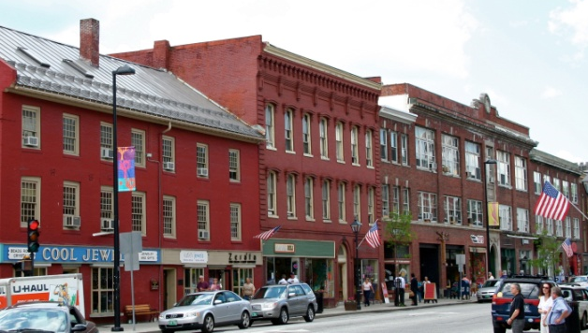
Mixed-Use Development
Mixed-use development can reduce VMT by:
Decreasing trip lengths.
Providing transportation options.
Reducing car ownership.
A study of 239 mixed-use developments across six metro regions showed that 30% of trips were short, located entirely within the development.
Sources: National Research Council 2009; Ewing et al. 2011
Notes:
Mixing land uses is another way to reduce VMT.
Putting destinations closer together can minimize travel distances and allow trips to be made by walking and bicycling rather than by driving.
Easy walking and biking access to jobs and shopping reduces the need to even own a car at all.
Researchers studied 239 mixed-use developments across six U.S. metropolitan regions for which good household travel data were available. The results showed that on average, three out of every 10 trips in a mixed-use development are relatively short and remain entirely within the development, adding no traffic to surrounding streets.

Slide 48
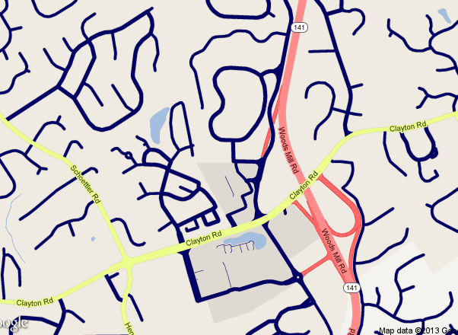
Street Connectivity
Street hierarchies discourage walking and biking, leading to driving for even short trips.
Locating retail and commercial uses on arterial streets and funneling all traffic to these arterials can make streets more dangerous.
Street connectivity can also reduce car use and emissions.
Sources: Dumbaugh & Rae 2009; Dumbaugh & Li 2010; Ewing & Cervero 2010; Stone 2008; Frank et al. 2006; Fan & Khattak 2008
Notes:
Another strategy is to make sure streets are well connected.
Many communities contain a hierarchy of dead-end local streets with strictly residential uses (like these shown in blue).
They lead to collector streets that have all retail and commercial activity (like these shown in yellow).
These collector streets lead to highways that connect communities (shown here in red).
Many communities created these kinds of hierarchical street patterns in the belief that they improve traffic safety because they have wider and straighter streets, fewer intersections, and lower neighborhood traffic volumes.
However, traffic safety studies don’t support this belief.
For example, an analysis in San Antonio, Texas, found that locating retail and commercial uses on arterial streets away from residential areas and designing roads to funnel all traffic through an area on these arterials actually made streets more dangerous.
Studies show that the degree of street connectivity is also associated with the amount of car use compared to walking and transit use, the number of high-ozone days per year, and the amount of nitrogen oxide and VOC emissions.

Slide 49
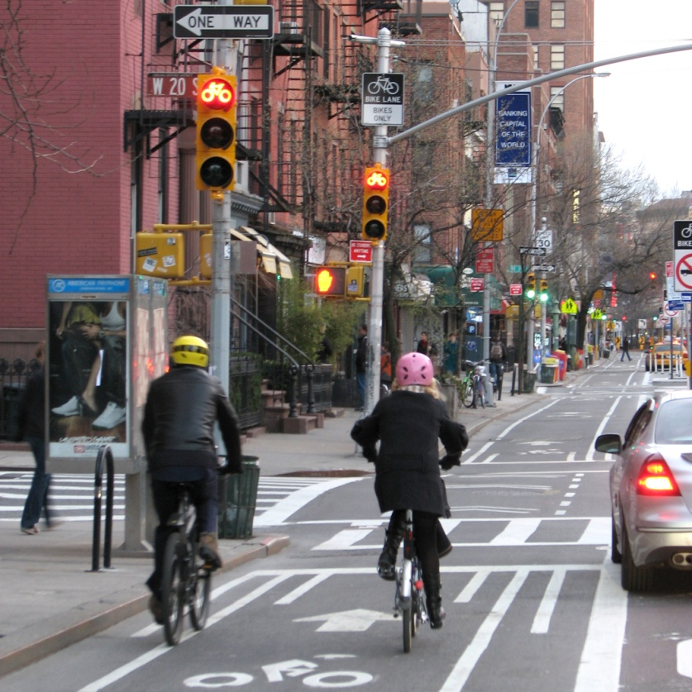
Community Design
Many factors can improve the environment for walkers and bicyclists, e.g., sidewalks, crosswalks lighting, shade trees, bike paths and lanes, bike parking.
Roads are safest with street design elements that slow down drivers, e.g., narrow lanes, traffic-calming measures, street trees.
Green street design can also improve water quality.
Photo source: Kyle Gradinger/BCGP via flickr.com
Sources: Giles et al. 2011; Ewing & Dumbaugh 2009; Brattebo & Booth 2003; Bean et al. 2007
Notes:
There are other aspects of communities design that can make a difference.
A lot of factors can make walking and biking safer and more pleasant. Things like sidewalks, street trees, and bike parking.
Roads have also been shown to be safest when there are design elements that slow down traffic.
And street design that incorporates features to capture and filter rainwater can improve water quality.

Slide 50
Destination Accessibility
Meta-analysis: Destination accessibility is the measure most strongly associated with VMT and the amount people walk.
Studies show various measures of destination accessibility are important: neighborhood accessibility, urban contiguity, and population centrality.
Sources: Ewing & Cervero 2010; Krizek 2003; Bechle et al. 2011; Clark et al. 2011
Notes:
A couple of studies have found that a critical measure for reducing driving is how accessible destinations are. A meta-analysis found that destination accessibility is actually the measure of the built environment that is most strongly associated with VMT and the amount people walk. …Meaning that any centrally located development is likely to generate less car traffic than a remotely located development regardless of its characteristics.
But studies show that other measures of destination accessibility are important predictors of driving behavior, including:
How easy it is to travel within and between neighborhoods by a variety of options, including by car, transit, walking, and biking.
How much development occurs isolated from other developed areas, and
How a population is distributed relative to a central business district.

Slide 51
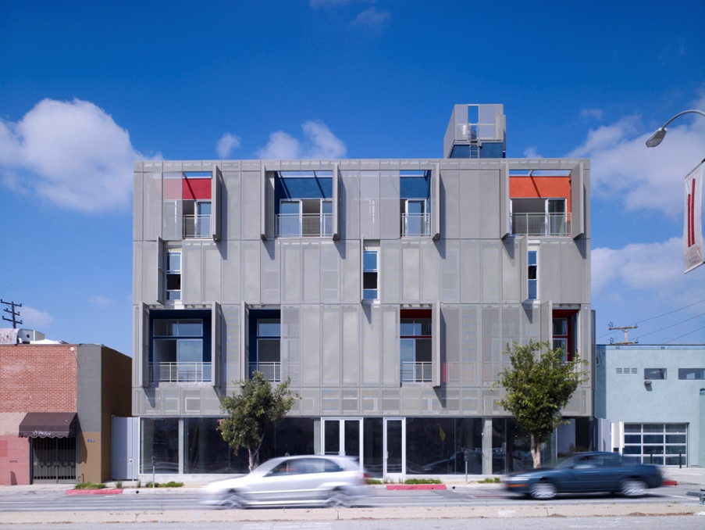
Green Building
Carefully choosing site location
Limiting environmental impacts of construction and renovation practices
Conserving water and energy in building operations
Using building materials safe for occupants
Designing sites to capture and reuse stormwater
Photo source: Calderoliver via Wikipedia Commons
Notes:
How we build our communities involves not just the layout of streets and buildings, but also the materials and approaches we use to construct the buildings. The term green building refers to the practice of using resources efficiently and reducing impacts on human health and the environment in all phases of a building’s lifecycle from pre-design, siting, design, and construction, to operations, maintenance, renovation, and ultimately demolition. Green building encompasses many aspects, including (see list)
Just to illustrate potential advantages of green building approaches:
Studies have shown that using combination of energy saving strategies and technologies could reduce annual energy use by a factor of three to four for new buildings and two to three for existing buildings.
And using available water-efficient appliances and fixtures could reduce water use 30% and energy use by 60%.

Slide 52
Scenario Planning
Scenario planning studies look at how the combined effects of land use strategies could improve the environmental outcomes of development.
A meta-analysis of many regional studies showed that the United States could reduce VMT 17% below current trends between 2007 and 2050 by:
Increasing average regional density by 50%.
Directing development to infill locations.
Mixing land uses.
Coordinating transportation investments.
Source: Bartholomew & Ewing 2008
Notes:
These strategies I’ve discussed rarely exist in isolation. Scenario planning studies are used to look at the combined effects of several strategies under a range of plausible trends to project likely future outcomes.
Many regions across the country have conducted scenario-planning exercises.
A meta-analysis of those scenarios that considered the impact of land use decisions on transportation suggested that increasing average regional density by 50 percent, directing development to infill locations, mixing land uses, and coordinating transportation investments could reduce VMT 17 percent below current trends between 2007 and 2050.

Slide 53
Find Our Built and Natural Environments at http://epa.gov/smartgrowth/built.htm
Melissa Kramer
kramer.melissa@epa.gov
(202) 564-8497
Notes:
So I’ve covered a lot of the report, but there are a lot more studies and results contained in it, so I’d encourage you to get the full report online.
I’m also happy to help answer questions or direct you to specific information you might be looking for.
I think we have time for a couple more questions.

