Slide 1
TRI Data Quality Activities
-- An Overview
Velu Senthil
Toxics Release Inventory Program

Slide 2
Best Readily Available Information
Use readily available data (including monitoring data) collected pursuant to other provisions of law
Where such data are not readily available, use reasonable estimates
If available data known to be non-representative, facilities must make reasonable estimates using the best readily available information
Base reasonable estimates using published emission factors, material balance calculations, or engineering calculations
Do not use emission factors or calculations if more accurate data available
TRI does not require additional monitoring or measurement beyond what other laws/regulations require or are part of routine plant operations
What is readily available can change over time (e.g., new information)
Recommendation: Carefully document decision making used (e.g., assumptions
& calculations)
2

Slide 3
How Does EPA Help to Ensure the Quality of TRI Data?
TRI data quality efforts – year-around
Guidance, outreach, training, assistance
TRI-MEweb, Data Processing Center
Electronic Facility data profiles
Data quality calls
Enforcement

Slide 4
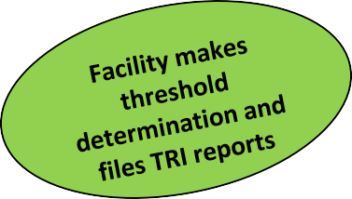
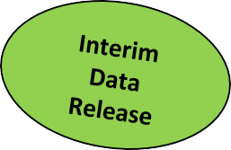
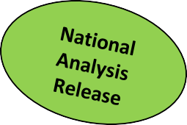
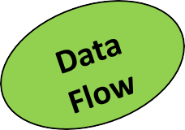
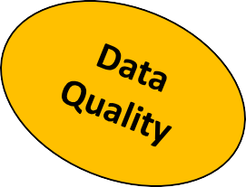
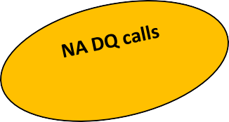
TRI Reporting Data Flow and Data Quality Activities
EPA
Receives Reports
TRI-MEweb & DPC verify reports
CDX - Central Data Exchange DQ - Data Quality DPC - Data Processing Center NA - National Analysis TRI - Toxics Release Inventory TRI-MEweb – Toxics Release Inventory Made Easy Web

Slide 5
TRI Guidance
Guidance
General
Reporting Forms and Instructions
Chemical Specific
Industry Specific
Questions & answers
Guide Me

Slide 6
Training, Assistance and Outreach
Online training
Basic
Advanced
Classroom training
Some regions
Private parties
TRI Assistance
Call center
Regional and HQ staff

Slide 7
TRI ME web, TRI DPC, eFDP
TRI ME web
TRI DPC
eFDP

Slide 8
Why Data Quality Calls?
Conduct Data Quality Calls bi-annually – Summer & Winter
National Analysis Data Quality Calls in Summer: focused on National Analysis
Ad Hoc Data Quality Calls in Winter: focused on specific issues
Benefits of Data Quality Calls
Assures higher-quality National Analysis dataset
Delve directly into specific data quality issues
Identify enhancements for TRI-MEweb
Compare TRI data to other EPA datasets

Slide 9
Analyses for Data Quality Calls
Engineering Analysis
Industry-Specific
Chemical-Specific
Increasers / Decreasers Analysis
Other Data Quality Issues
Persistent Bioaccumulative Toxic (PBT) Chemicals
HAPs, Carcinogens, RSEI
TRI-MEweb Certification Issues, P2 issues
Comparison of TRI Data with Other EPA & Non-EPA Data
National Emissions Inventory (NEI)
Discharge Monitoring Reports (DMR)
Chemical Data Reports (CDR)
Biennial Reporting System (BRS)
Risk Management Program (RMP)
Tier II Reports
9

Slide 10
NEI Data
Office of Air and Radiation (OAR) releases National Emissions Inventory (NEI) data once every 3 years
Hazardous air pollutants (HAPs) from industrial facilities
Use data from states, TRI and facilities’ test data
Most of the HAPs are also listed on TRI chemical list
Hypothesis: Certain facilities that report to NEI are also expected to report to TRI
Many TRI sectors are also covered in NEI
TRI listed HAPs

Slide 11
Comparison of NEI-TRI Air Releases
Downloaded NEI data from Emissions Inventory System (EIA) Portal
Adjusted NEI and TRI CAS numbers
Combined EIS-TRI crosswalk table with updated information
Identified facilities with significant variations of air release values between TRI and NEI

Slide 12
CDR Data
Office of Chemical Safety and Pollution Prevention (OCSPP) collects chemical data reports (CDR) from manufacturing facilities
Manufacturing volumes, number of employees and other information
5015 individually listed chemicals on TSCA Inventory
Approximately 770 chemicals reported to CDR
Overlaps with 271 TRI chemicals and chemical categories
Hypothesis: Certain facilities that report to CDR are expected to report to TRI
Chemical manufacturing industry sectors
TRI listed chemicals
Exceeds employee threshold

Slide 13
DMR Data
Office of Waste Management (OWM) issues NPDES permits
Facilities submit Discharge Monitoring Reports (DMRs) to states and EPA works with states to populate that data in ICIS-NPDES
Reporting frequency varies as specified in permits
DMR tool pulls information from NPDES database
Hypothesis: Certain facilities with NPDES permits are expected to report to TRI
Covered industry sector
TRI listed chemicals
Exceeds activity threshold amounts

Slide 14
TRI-Tier 2 Comparison-1
Background on Tier 2 and TRI
States maintain Tier 2 Reports
Several TRI Chemicals are reported under Tier 2 Reporting
What is Included in this Analysis?
– Approximately 25 states
R1: CT, MA, NH, VT, ME, & RI
R2: NJ, & NY R3: VA
R4: AL, FL, GA, MS, NC, SC, & TN
R6: AR, & TX
R7: IA, & NE
R5: MI, MN, & WI
R9: AZ, & NV
R10: ID & WA
R8: ND, MT, & UT

Slide 15
TRI-Tier2 Comparison-2
Most States do not give access to their Tier 2 Reports
Hypothesis: Certain facilities that report Tier 2 Reports are expected to report directly to TRI (under section 313 of EPCRA)
Manufacturing industry sectors
TRI listed chemicals
Exceeds employee threshold

Slide 16
TRI-Tier 2 Comparison-3
Analytical Approach
Downloaded Tier 2 data from E-Plan, individual states and regional Tier 2 coordinators
Confirmed chemical identity between Tier 2 and TRI chemicals using Chemical Abstracts Service (CAS) numbers
Obtained NAICS and number of Employees for Tier 2 facilities
Matched Tier 2 facilities with FRS and TRI database
Identified possible TRI non-reporters and never-reporters
Double-checked facilities’ operational status

Slide 17
TRI-RMP Comparison
Hypothesis: Certain facilities that report RMP Reports are expected to report directly to TRI (under section 313 of EPCRA)
RMP industry sectors also be covered under TRI
TRI listed chemicals and RMP chemicals
Exceeds employee threshold
Quantities in-Process
Identified non-reporters and never-reporters

Slide 18
Results and Follow Up
Results
Under-Reporters / Over-Reporters
Non-Reporters
Chemical
Facility
Never-Reporters
Follow Up
Data Quality Calls
Enforcement

Slide 19
TRI Facilities Revisions – RY07-14
RY | Total Facilities | Total Facilities* | #Facilities that Revised* | Percent Revised
2007 | 23359 | 23126 | 2015 | 8.7%
2008 | 22769 | 22555 | 1864 | 8.3%
2009 | 21894 | 21698 | 2026 | 9.3%
2010 | 21737 | 21542 | 1423 | 6.6%
2011 | 21742 | 21562 | 2094 | 9.7%
2012 | 21847 | 21708 | 1178 | 5.4%
2013 | 21897 | 21772 | 1005 | 4.6%
2014 | 21783 | 21657 | 546 | 2.5%
*These counts omitted multi-establishment facilities.
TRI Facilities Revision Rate - RY07-14
30000
15.0%
20000
10.0%
10000
5.0%
0
2013 2014
Percent Revised
0.0%
2007
2008
2009
2010
2011
2012
Total Facilities*
#Facilities that Revised*
19

Slide 20
Revisions of Facilities with New and Existing
Tech Contacts – RY07 - 14
RY | Total Facilities* | #Facilities that Revised* | Percent Facilities with No New Tech Contacts that Revised | Facilities with no new Tech. Contacts* | Facilities with atleast one new Tech. Contact* | # Facilities that revised and had a new Tech. Contact* | Percent Facilities with New Tech Contacts that Revised
2007 | 23126 | 2015 | 7.5% | 16805 | 6321 | 749 | 11.8%
2008 | 22555 | 1864 | 7.6% | 16796 | 5759 | 580 | 10.1%
2009 | 21698 | 2026 | 8.8% | 17200 | 4498 | 507 | 11.3%
2010 | 21542 | 1423 | 5.9% | 17120 | 4422 | 418 | 9.5%
2011 | 21562 | 2094 | 9.2% | 16425 | 5137 | 575 | 11.2%
2012 | 21708 | 1178 | 4.9% | 16661 | 5047 | 361 | 7.2%
2013 | 21772 | 1005 | 4.0% | 16562 | 5210 | 335 | 6.4%
2014 | 21657 | 546 | 2.4% | 16589 | 5068 | 142 | 2.8%
*These counts omitted multi-establishment facilities.
TRI Facilities with New and Exixsting Tech Contacts Revisions - RY07-14
15.0%
10.0%
5.0%
0.0%
2010 2011 2012 2013
Percent Facilities with No New Tech Contacts that Revised Percent Facilities with New Tech Contacts that Revised
2007
2008
2009
2014
20

Slide 21
Scope of TRI Program Data Quality Activities
EPA undertakes a range of data quality efforts so that EPA can assure TRI data users that published TRI information is of known quality and of sufficient quality to meet the needs of intended end uses.
TRI Data Quality Assurance and Control Model
1) Detection of anomalies / reporting issues
3) Identification and implementation of changes that would remediate known errors and reduce the prevalence of reporting errors in the future
2) Investigation of potential reporting errors
4) Review of the efficacy of the remediation actions
21

Slide 22
Enforcement
Data Quality
Over-reporting
Under-reporting
Non-Reporters
Facility
Chemical(s)
Never Reporters

Slide 23
Summary
TRI Program is committed to helping facilities submit high quality TRI data:
Data Quality Calls
Guidance
TRI-MEweb
Training
TRI Information Center
Outreach

Slide 24
Contact Information
Velu Senthil: (202)-566-0749; senthil.velu@epa.gov

Slide 25
Help us Improve!
You will receive an email with a link to a survey to review the course(s) you attend at the Emissions Inventory Training Workshop.
Please take a few moments to let us know about your experience this week.
We welcome your feedback!

