Slide 1
Background on Ammonia and EPA Methods for Key Ammonia (NH3) Sectors in the National Emission Inventory
Tesh Rao, Jesse Bash
US EPA, OAQPS/ORD
May 16, 2018
Notes:
Jesse and I will give you some background on ammonia as an air pollutant and methods we use for the most important sectors in the NEI for ammonia emissions.

Slide 2
General Information
Trainers
Tesh Rao, EPA, OAQPS
  Rao.Venkatesh@epa.gov
  919-541-1173
Jesse Bash, EPA, ORD
  Bash.Jesse@epa.gov
  919-541-0862
Notes:
Contact information for the trainers.

Slide 3
Course Outline
1:00-1:15 pm Introductions: Trainers and Attendees
1:15-1:50 pm General background on NH3 air quality and emissions
1:50-2:05 pm Short Break
2:05-2:55 pm CMU (Carnegie Mellon University) FEM (Farm Emissions Model) for estimating Livestock Emissions (EPA methods)
2:55-3:15 pm 2014 NEI (National Emissions Inventory) v2, 2017 NEI plans for Livestock
3:15-3:30 pm Short Break
3:30-4:25 pm EPA methods for estimating Fertilizer Emissions
4:25-4:40 pm 2014 NEI v2, 2017 NEI Plans for Fertilizer
4:40-5:00 pm Last set of questions/comments/suggestions, end of class
Notes:
Training will cover some background on NH3, CMU model for livestock, ORD methods for fertilizer NH3 emissions, and take a look at the NEI 2014 v2 data for these sectors.

Slide 4
Course Objectives
To introduce you to some background on NH3 and key sectors in the inventory
To introduce you to CMU’s FEM for estimating livestock NH3 emissions which was used as the basis for EPA estimates for the 2014 NEI
To introduce you to EPA/ORD’s methods for estimating fertilizer NH3 emissions, which was used as the basis for EPA estimates in the 2014 NEI
Outline 2014 results and plans for the 2017 NEI for both sectors
To provide you an opportunity to ask questions about all of the above
To offer collaboration on these important sectors, and listen to any suggestions/comments you may have moving forward
Notes:
We would like to bring everyone up to speed on why ammonia is becoming a more important pollutants to air quality management in the US. We will then introduce you to models in our NEI that are used to compute NH3 emissions from livestock and fertilizer. We will cover why we believe we many need to improve the models moving forward based on current model to monitor comparisons.

Slide 5
Background on NH3
Notes:
Section slide.

Slide 6
NH3 is a significant air pollutant because of its impacts to land, water, and human health
Eutrophication, Deposition, and Fine PM formation are all important issues when you have excess NH3
Notes:
NH3 is a key contributor to eutrophication, deposition and fine PM formation processes. Thus, it’s important to characterize the emissions for NH3 accurately.

Slide 7
Some Background on NH3
Brief look at NH3 and atmospheric chemistry
Policy relevance of NH3
  Precursor insignificance demonstrations
  SIP development examples
  Standard-setting and regional haze
Model-measurement comparisons
  Suggest that NH3 emissions are too low
  Deposition issues
Emission inventories
  Sectors of importance as we move to the 2017 NEI focus
Resource-sensitive projects that need to be completed to address perceived shortcomings in inventories, measurements, and modeling of ammonia
  The emissions inventory is one of those key projects that need to be completed
Notes:
We will discuss background today that will lay the groundwork for discussing emissions of NH3. The background topics we will discuss include: atmospheric chemistry, policy relevance of ammonia, model to measurement comparisons, emission inventory issue as well as projects we have to address the identified needs in some of these areas.

Slide 8
NH3 and atmospheric chemistry
NH3 is the primary basic gaseous compound in the atmosphere
NH3 is directly emitted (it’s not formed by photochemical reactions)
NH3 combines with gaseous acids (e.g., sulfuric acid and nitric acid) to form corresponding PM constituents (e.g., ammonium sulfate and ammonium nitrate)
Favorable meteorological conditions for ammonium nitrate formation are low temperature and high relative humidity, which often occur in winter or at night
PM formation can be limited by the availability of NH3 or the availability of acids (e.g, nitric acid formed from NOx emissions)
  Understanding which PM precursor limits PM formation is often critical for AQ management
Notes:
NH3 is the primary basic gaseous compound in the atmosphere, it’s directly emitted and it combines with gaseous acids in the atmosphere to form PM. PM formation is mainly governed by availability of NH3 (or acids), which plays a role in control program options for fine PM

Slide 9
Policy Relevance:
Precursor Demonstrations, SIP Development, Regional Haze, Standard Setting
Notes:
Introductory Slide

Slide 10
Precursor Insignificance Demonstrations
NH₃ is a PM_{2.5} precursor under Clean Air Act subpart 4 nonattainment area provisions (January 2013 ruling)
Precursor insignificance demonstrations based on AQ modeling can be used to remove NH₃ as a precursor for attainment plans and nonattainment New Source Review (NH₃ is not a Prevention of Significant Deterioration precursor)
Precursor insignificance demonstrations are attractive because they can potentially avoid consideration of RACT(Reasonably Available Control Technology)/RACM (Reasonably Available Control Measures) controls
CARB will likely submit a demonstration for the San Joaquin Valley (SJV) where results will depend on the percent reductions in NH₃ selected for modeling
The SJV demonstration (and demos for Cache Valley Utah and other areas) could depend on the accuracy of the modeling inventories
Notes:
NH3 is presumed to be a PM2.5 precursor. All modeling used for precursor insignificance demonstrations must include analysis of NH3 and it’s resulting chemistry to form fine PM.

Slide 11
SIP Development
South Coast Air Basin
  Projects funded by the Coordinating Research Council found that NOx emission reductions cause PM_{2.5} disbenefits, whereas NH₃ reductions produce PM_{2.5} benefits
  Authors conclude that South Coast is pursuing the wrong control strategy by targeting NOx emission sources
  EPA modeling for 2010 indicates that NH₃ reductions produce PM_{2.5} benefits under current conditions, but we have found issues with our NH₃ modeling in South Coast (discussed below) and have not examined responsiveness for future years
Salt Lake, Cache, and Utah Valleys
  The limiting precursor (NH₃ or NOx) for PM_{2.5} nitrate formation is uncertain
  Utah has been adding non-inventory NH₃ emissions into model grid cells domain-wide to improve model performance
  Recently, the model-added NH₃ has been found to have a large impact on sulfate formation in clouds and has raised questions about the reliability of the approach
  New data have recently become available from a 2017 field campaign, but these data have yet to be analyzed or compared with model predictions
Notes:
As part of their SIP development process in the South Coast, modeling has shown NH3 reduction benefits PM2.5 reductions. In other areas like Salt Lake City and in Utah, additional NH3 emissions have been added to the inventories to improve model performance.

Slide 12
Standard Setting and Regional Haze
Standard Setting
  Secondary NOx/SOx/PM NAAQS: Ecosystem effects of PM ammonium deposition are included in the review, and CASAC (Clean Air Scientific Advisory Committee) has highlighted the importance of NH₃:
    August 2017 letter: “Ammonia emissions are increasing in many regions of the U.S. and the CASAC recommends that EPA consider the need for developing National Ambient Air Quality Standards for reduced forms of nitrogen during the Risk and Exposure Assessment and Policy Analysis phases of this NAAQS review”
  PM NAAQS: Will likely be asked to consider NH₃ emission controls in Risk/Exposure/Impact analyses
Regional Haze (RH) Planning
  Under-predictions of nitrate in the southwest in regional photochemical models, possibly related to under-predictions of NH₃, present challenges to developing RH SIPs for the 2nd implementation period (2018-2028)
  Modeling to address BART (Best Available Retrofit Technology) provisions of the RH program can be sensitive to assumptions about background levels of NH₃, which are uncertain
Notes:
In dealing with both the primary and secondary PM NAAQS, NH3 has to be dealt with as it relates to deposition and PM levels in the atmosphere. For Regional Haze, underpredictions of nitrate in the Southwest have to be addressed by also looking at NH3 emissions and NH3 background levels.

Slide 13
Comparisons of AQ Model Predictions of NH₃ with Measurements/Monitoring
Notes:
Introductory Slide

Slide 14
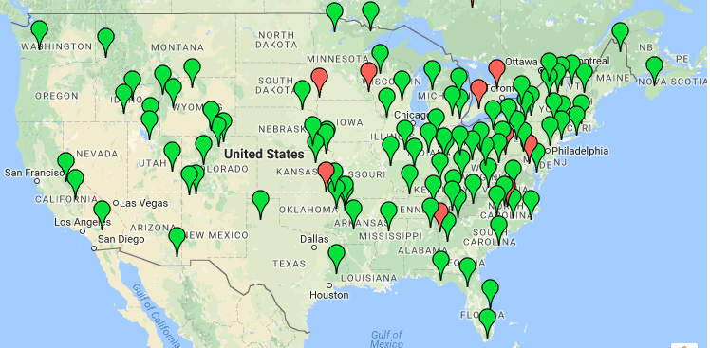
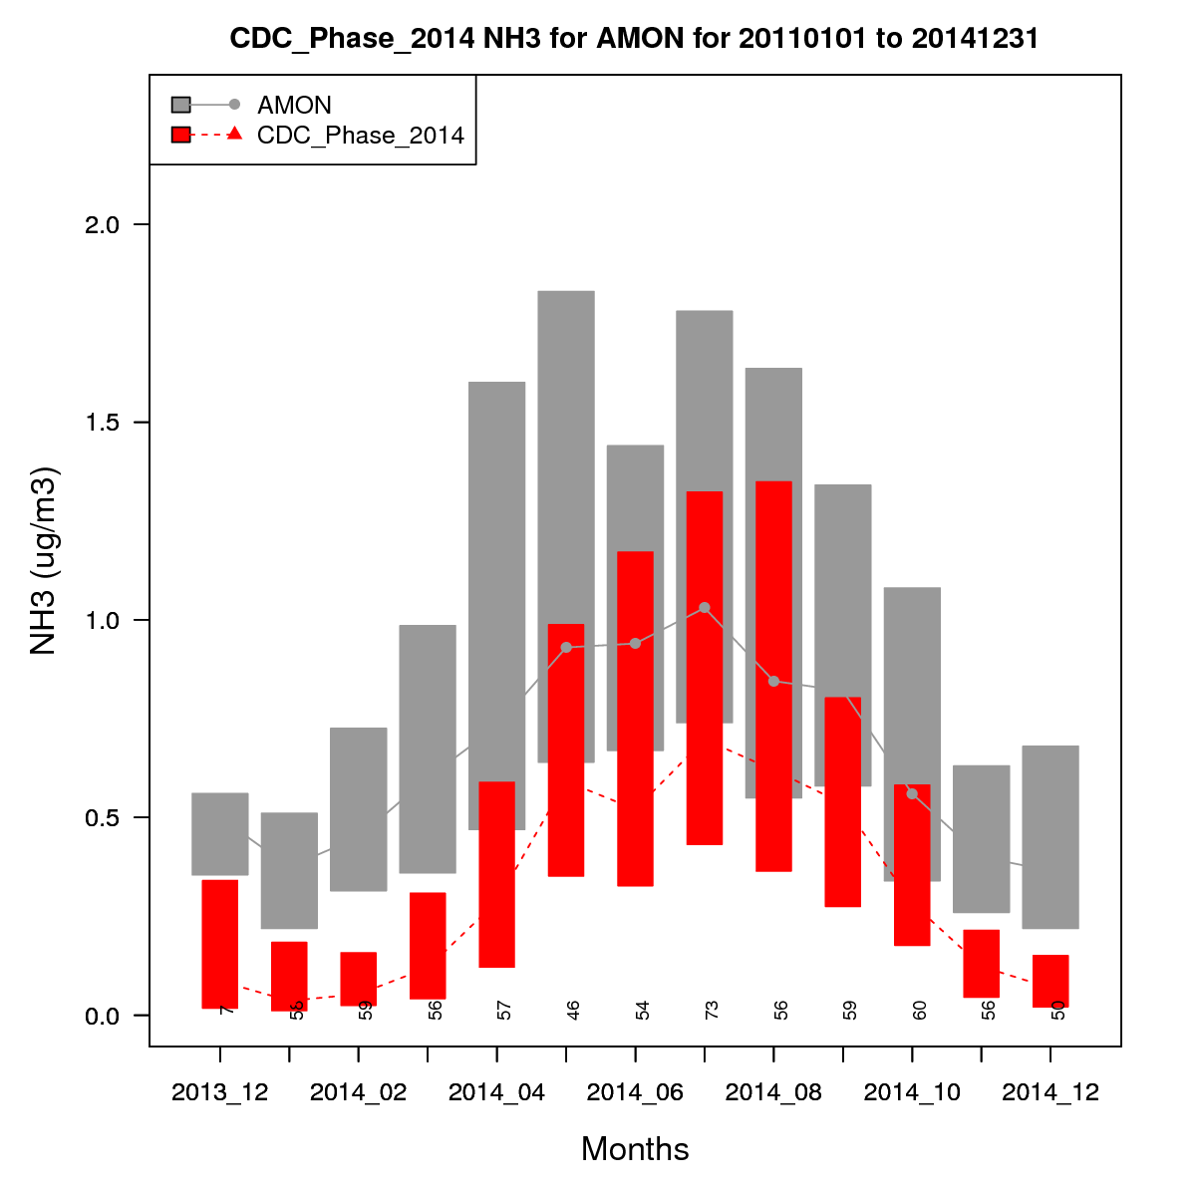
Ammonia Monitoring Network (AMoN)
AMoN provides a national picture of two-week average NH₃ concentration at mostly rural sites
2014 CMAQ NH₃ predictions are compared with AMoN measurements (figure, left)
Seasonal profiles of the observations are generally captured by the model
However, the model underestimates observed concentrations
Source: Jesse Bash
Notes:
Comparison to the AMoN monitoring network shows models capture seasonal patterns of noted NH3 observations but consistently underpredict concentrations measured. AMoN is a largely rural network of NH3 monitors.

Slide 15
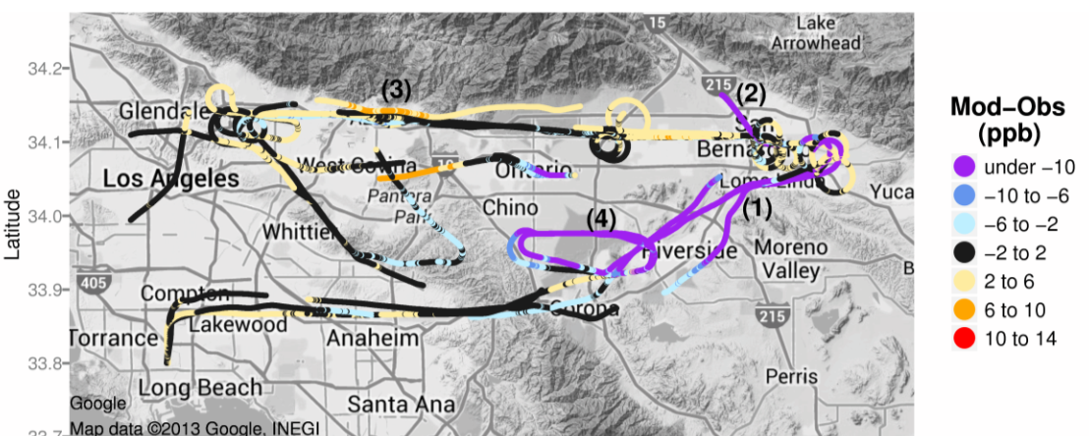
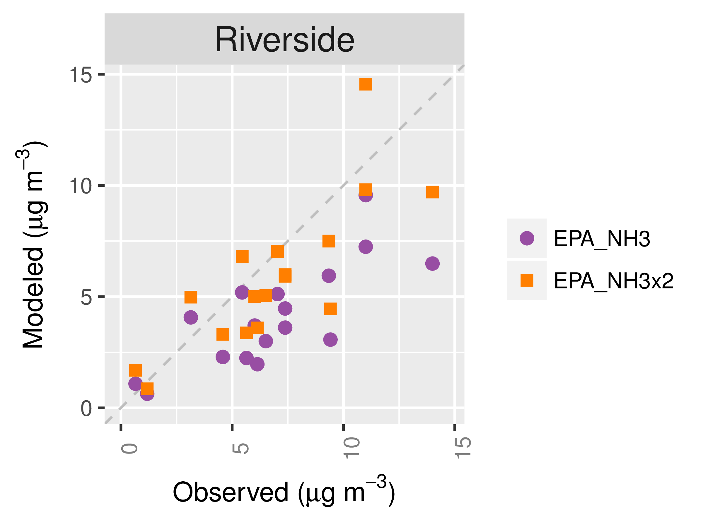
Aircraft Measurements in South Coast Air Basin (CalNex-2010)
NH₃, Modeled - Observed
Nitrate
NH₃ is under-predicted for aircraft transects near Riverside downwind of Chino dairy facilities (e.g., markers (1) and (4), above left)
NH₃ is over-predicted for transects along San Gabriel Mountains near Pasadena, e.g., (3)
Nitrate predictions in Riverside are sensitive to NH₃ emissions (above, right), and increased NH₃ emissions lead to better model performance in Riverside
Source: Kelly et al. (2014) Fine-scale simulation of ammonium and nitrate over the South Coast Air Basin and San Joaquin Valley of California during CalNex-2010. Journal of Geophysical Research-Atmospheres 119(6): 3600-3614.
Notes:
Aircraft measurements in the South Coast Valley of CA show a mix of results with regard to NH3. In some places it’s underpredicted, in some places overpredicted. It is seen that nitrate concentrations are very sensitive to NH3 emissions in this area, meaning PM formation is a function of levels of NH3 emissions

Slide 16
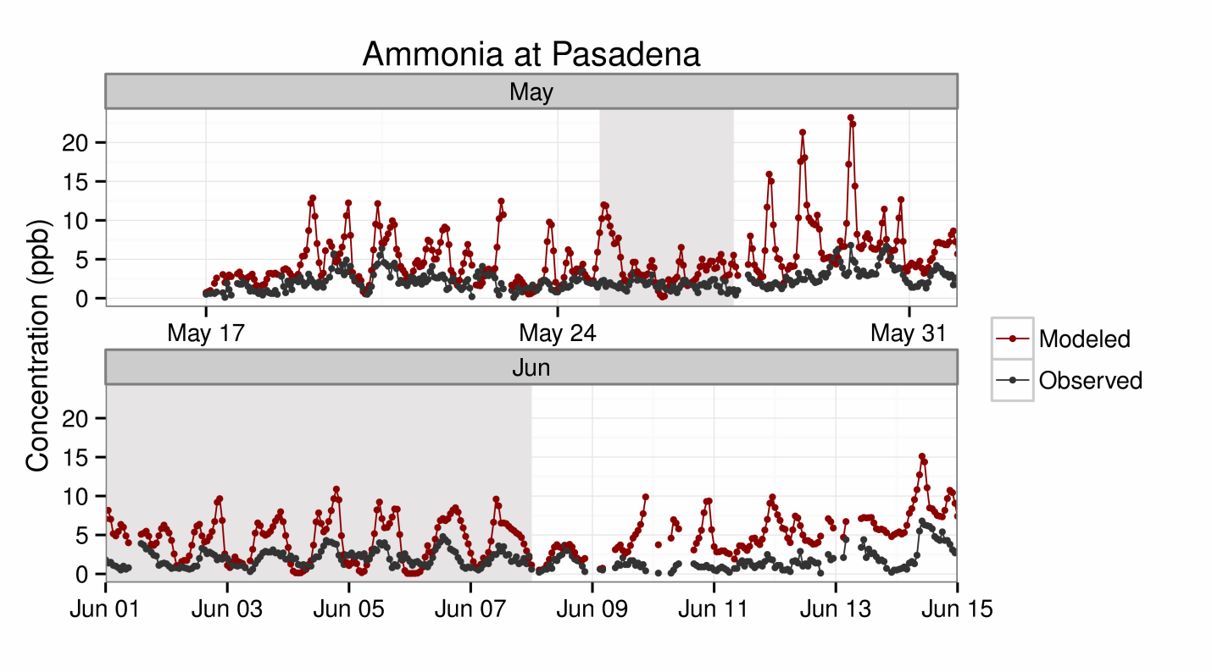
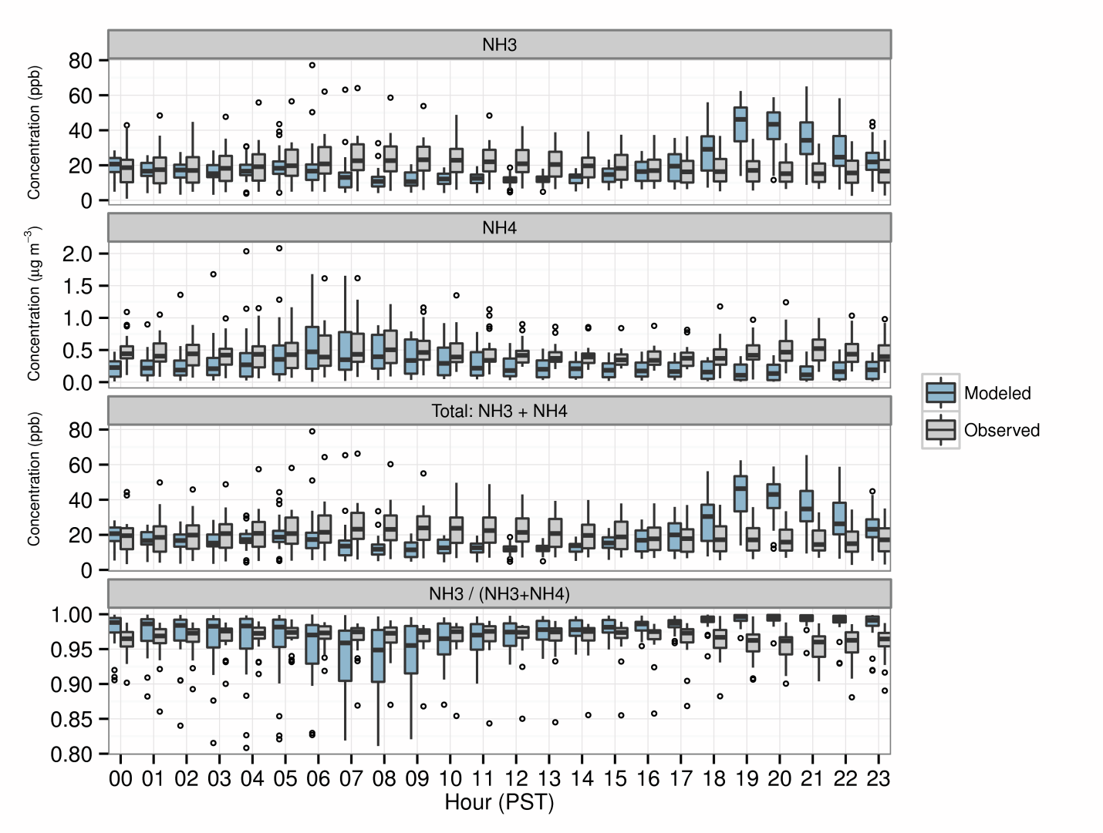
Pasadena and Bakersfield Ground Sites (CalNex-2010)
In Pasadena, NH₃ tends to be over-predicted especially at night, consistent with aircraft transects in this region on previous slide
Some overpredictions occur overnight and could be related to underestimated vertical mixing in the model
In Bakersfield, NH₃ is underestimated during the day when emissions are highest but is overestimated in the evening, possibly due to issues with nighttime mixing in the model
Bakersfield, 22 May – 28 June 2010
Source: Kelly et al. (2014) Fine-scale simulation of ammonium and nitrate over the South Coast Air Basin and San Joaquin Valley of California during CalNex-2010. Journal of Geophysical Research-Atmospheres 119(6): 3600-3614.
Notes:
In Pasadena and Bakersfield, CA NH3 tends to be overpredicted at night, but that is likely related to model performance and not emissions strength. In Bakersfield, during the day, when NH3 emissions are highest, the underpredictions are clear.

Slide 17
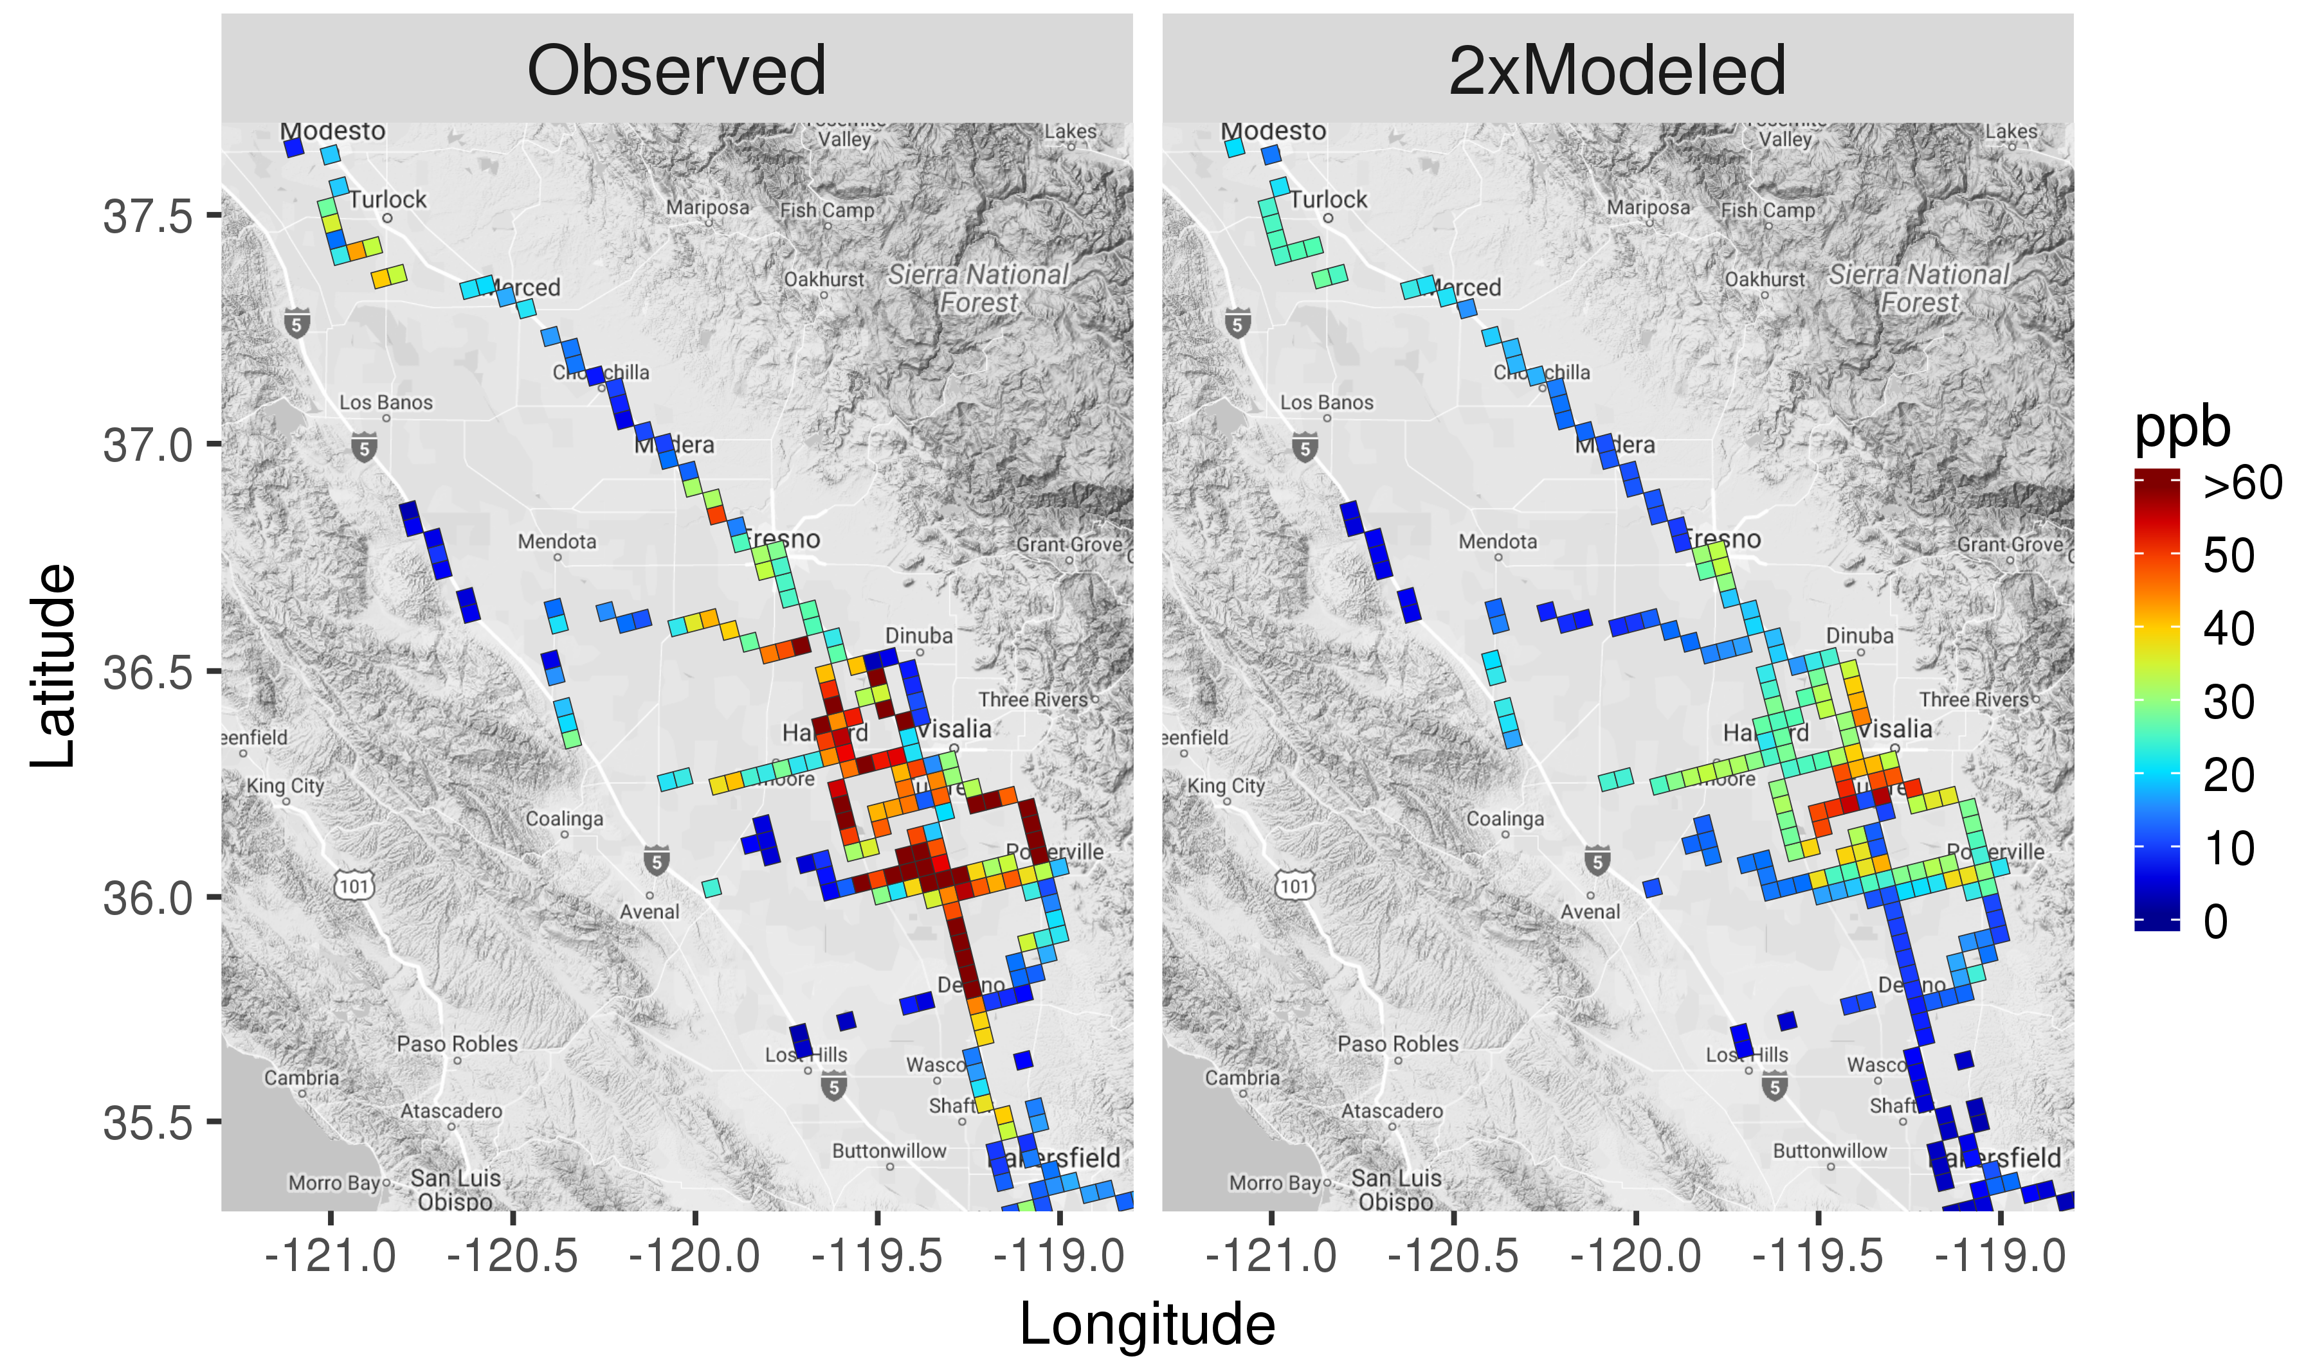
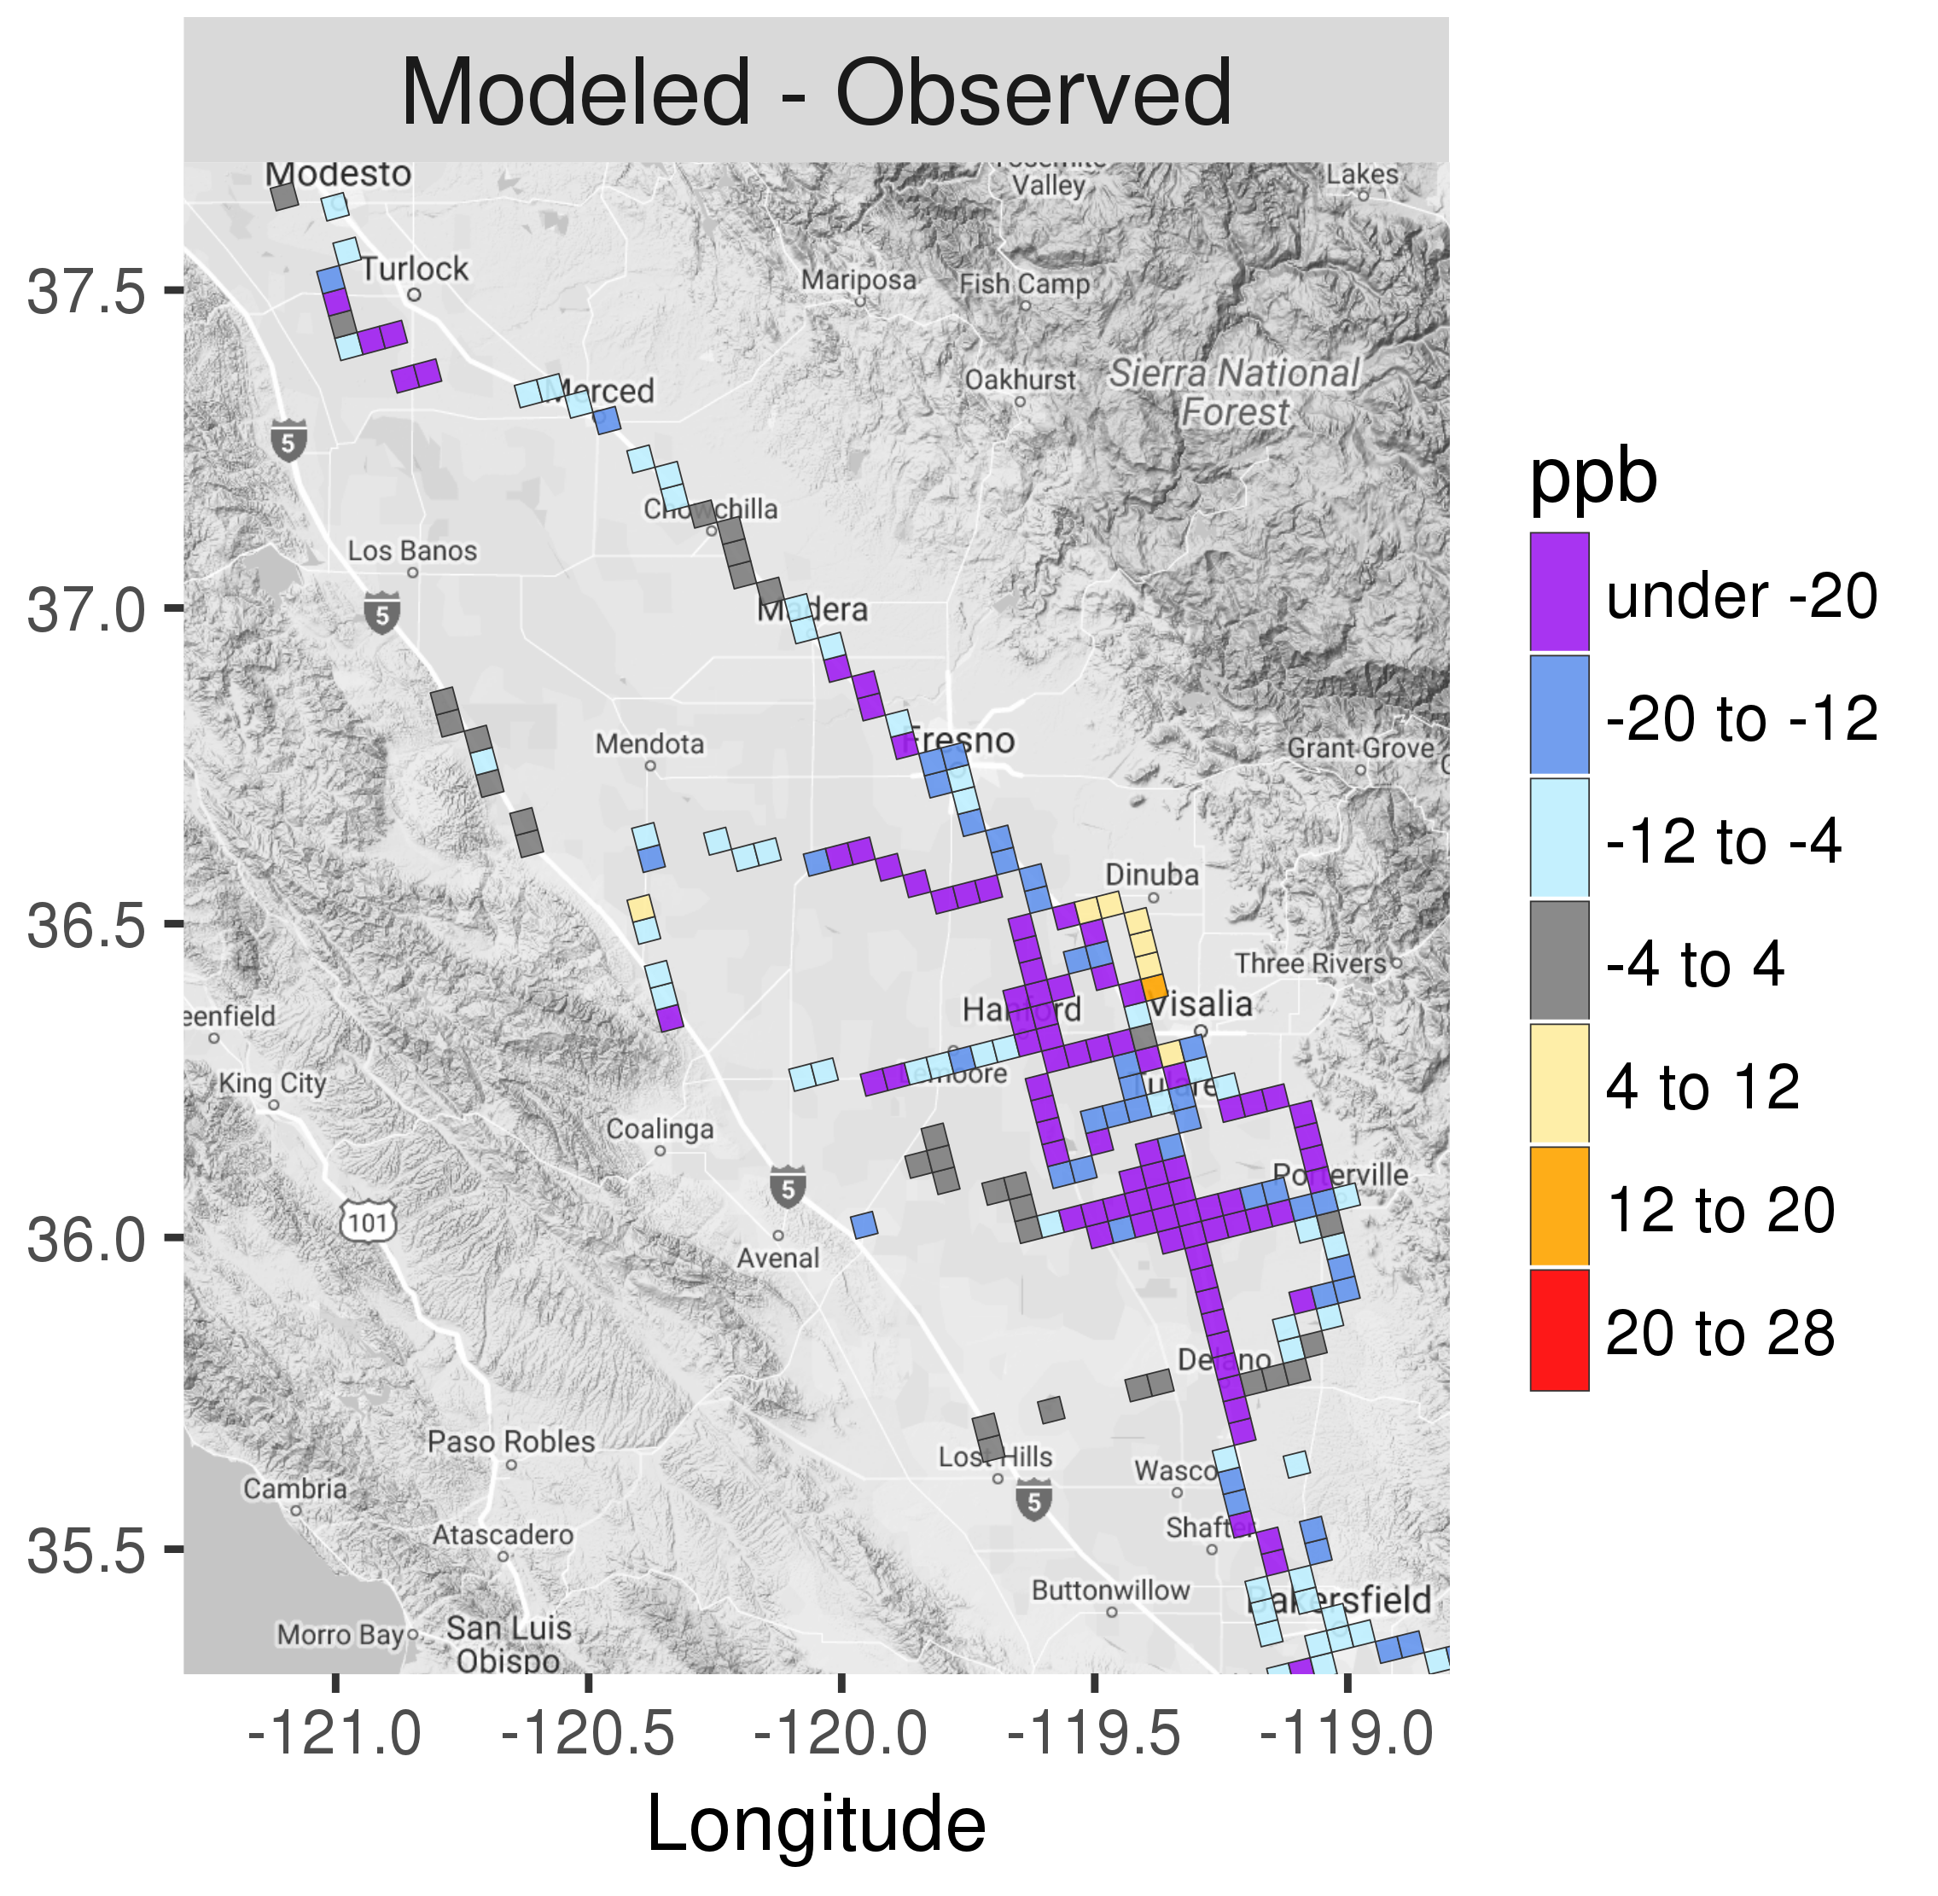
2013 San Joaquin Valley DISCOVER-AQ
Turlock
Turlock
Turlock
Fresno
Fresno
Fresno
Hanford
Hanford
Hanford
Bakersfield
Bakersfield
Bakersfield
Some consistency in observed and modeled spatial patterns of NH₃ in SJV, but concentrations are underestimated significantly in source regions
However, in contrast to South Coast, model predictions of nitrate are not very sensitive to NH₃ emissions in SJV (i.e., NH₃ is not the limiting precursor) (not shown)
Source: Kelly et al. (2017) Modeling NH₄NO₃ during the 2013 San Joaquin Valley DISCOVER-AQ campaign [in prep]
Notes:
In San Joaquin Valley, CA, NH3 is severely underpredicted in NH3 source regions (like AFOs) using aircraft measurements. Nitrate is not shown to be sensitive to NH3 levels in this part of the country.

Slide 18
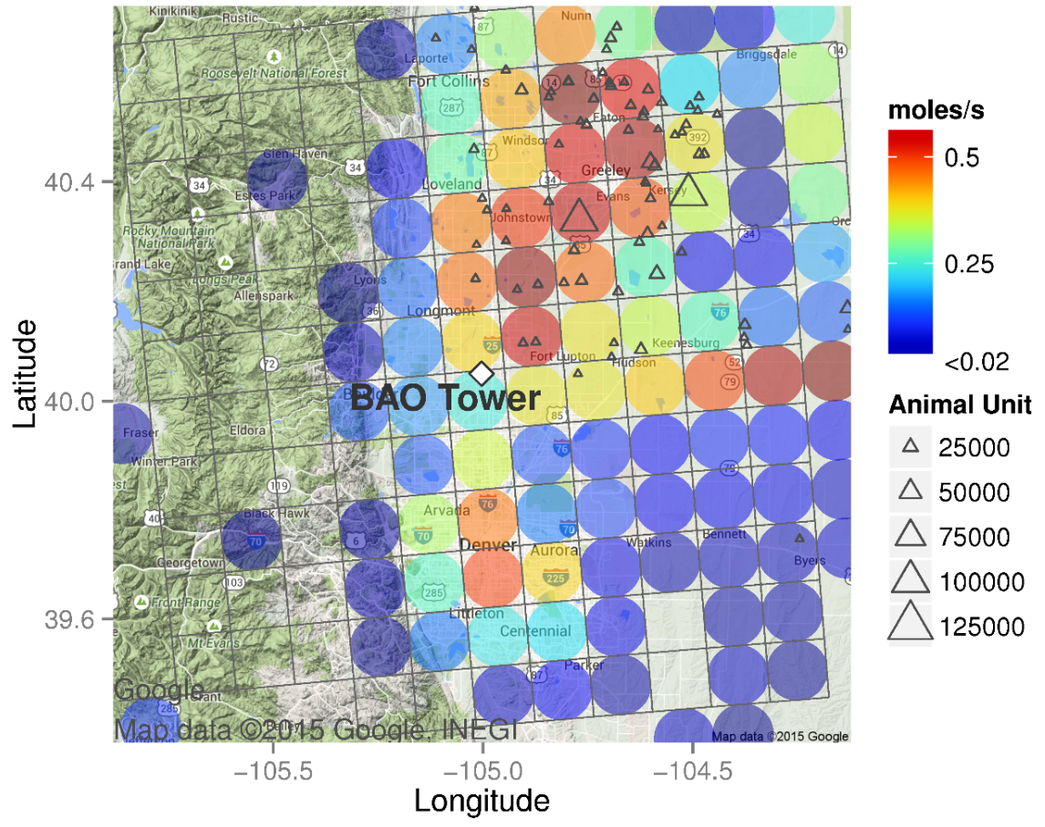
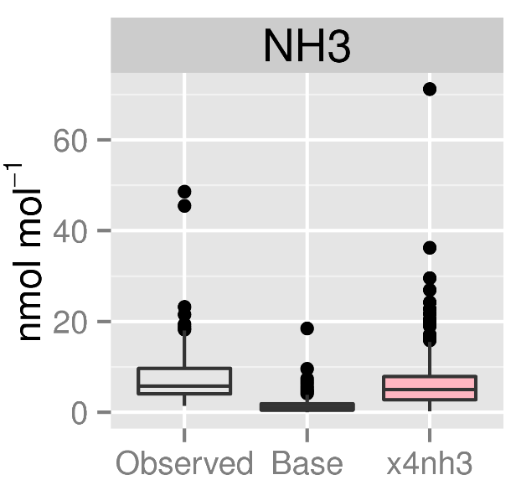
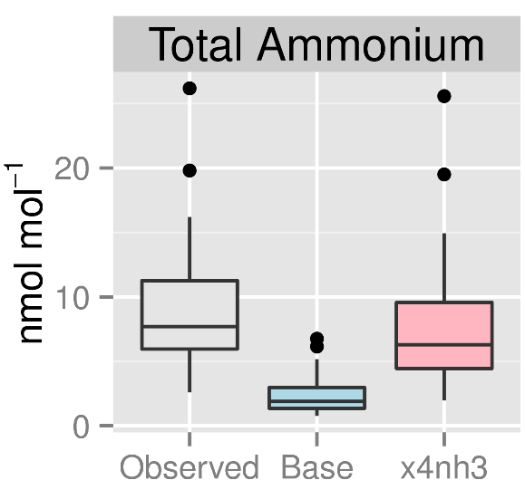
NE Colorado: Boulder Atmospheric Observatory
NHx
RMNP
Greeley
~33 km
Denver
NH₃ and NHx (NH₃ + NH₄⁺) are underestimated in the base simulation at the Boulder Atmospheric Observatory (BAO) southwest of the Greeley high-emission region
Closer agreement between model and measurements when NH₃ emissions are increased by a factor of four
Colors indicate average NH₃ emissions in model cells
BAO: Boulder Atmospheric Observatory
RMNP: Rocky Mountain National Park
Source: Kelly et al. (2016) Simulating the phase partitioning of NH₃, HNO₃, and HCl with size-resolved particles over northern Colorado in winter. Atmospheric Environment 131:67-77.
Notes:
NH3 is underestimated in CO as well when model to measurement analyses is conducted. It’s shown here that if ammonia emissions are increased by a factor of 4, one gets closer model output comparisons with measurements.

Slide 19
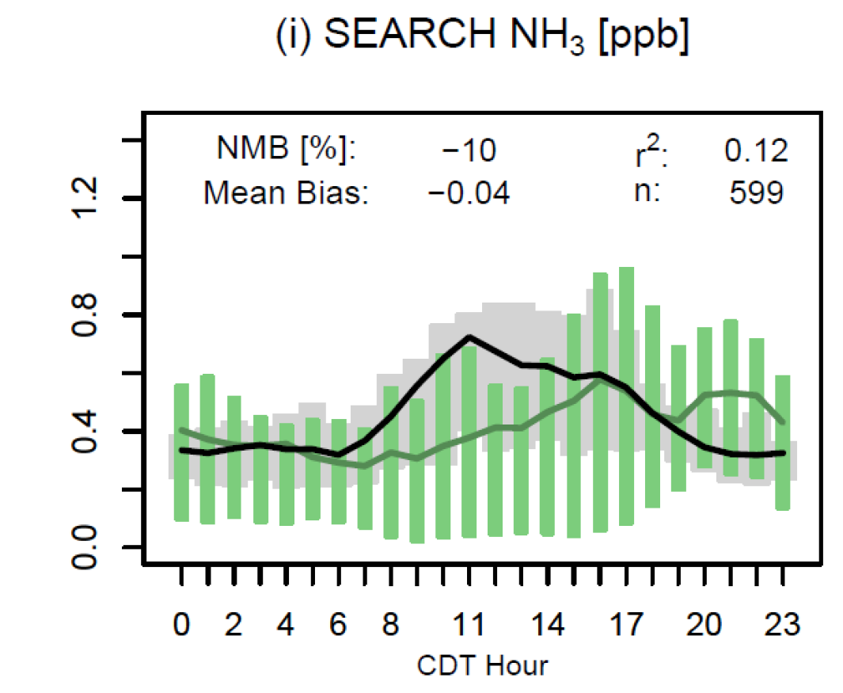
Southeastern Aerosol Research and Characterization (SEARCH) Study
At the SEARCH site in Centreville, AL, model predictions are of similar magnitude as observations during summer of 2013
Some differences in diurnal profiles
Our modeling seems to show that the match between model-predicted NH3 and observations is better in the SE US
Source: Pye et al. (2015) Modeling the current and future roles of particulate organic nitrates in the southeastern United States, Environmental Science Technology
Notes:
EPA’s modeling seems to show that in the SE US, model to measurement levels of NH3 are much better. Measurement data comes from the SEARCH network of NH3 monitors, specifically the one in Centerville, AL (suburban location).

Slide 20
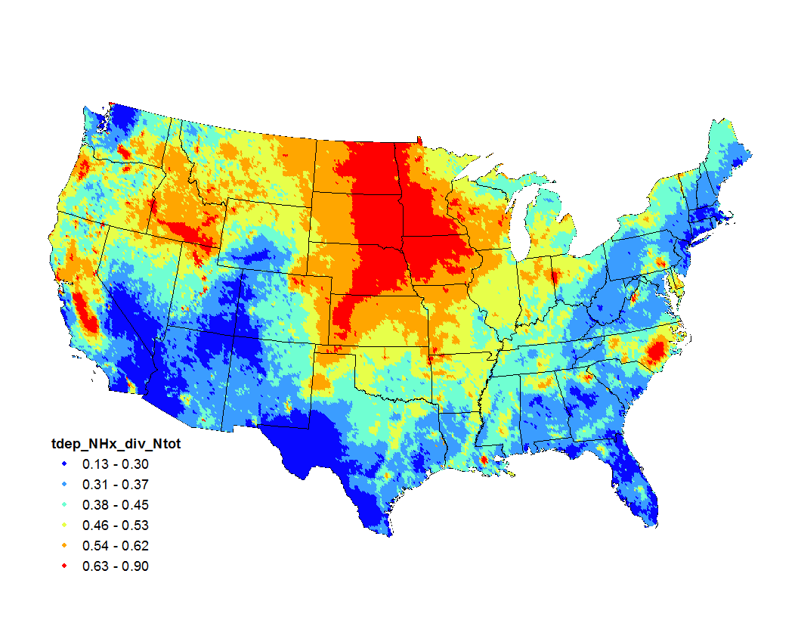
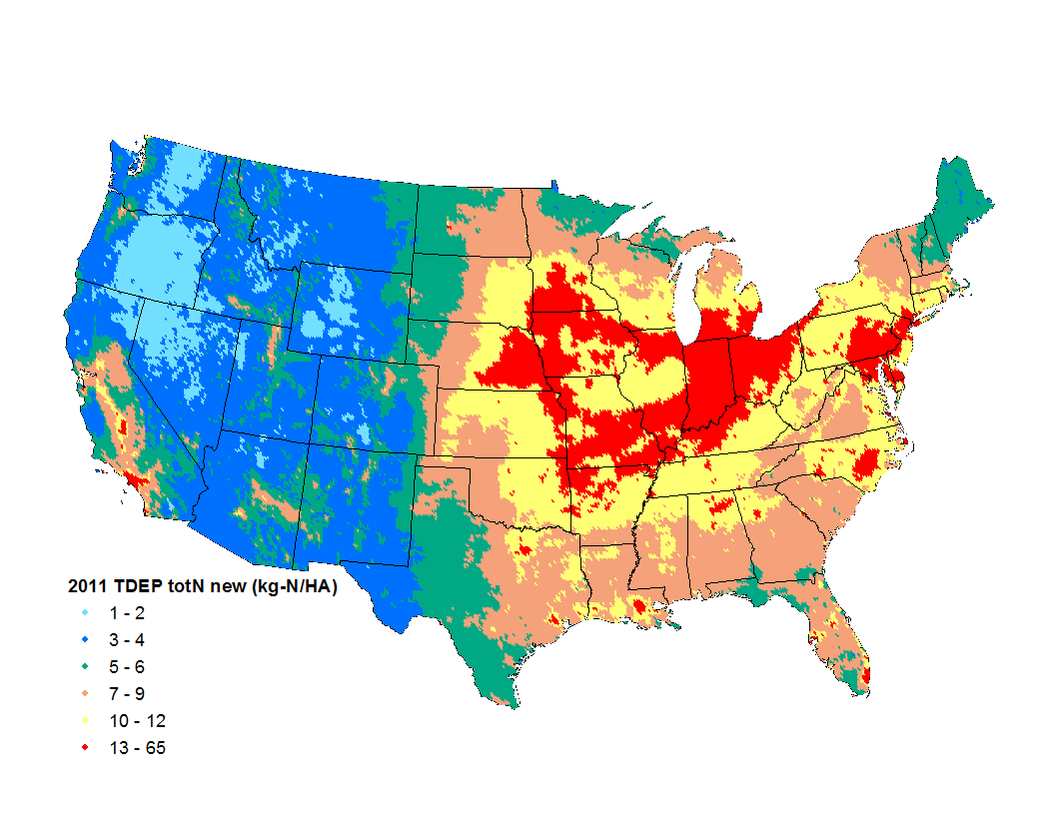
Deposition of NHx relative to total N
NH₄ + NH₃ = NHx, which nationally makes up nearly half of all nitrogen deposition
Based on NADP TDEP (fused CMAQ and CASTNET) data
2011 Ratio of NHx to total N deposition
2011 total N deposition
Source: NADP TDEP
Notes:
NH4 + NH3 = NHx makes up ~ 50% of total nitrogen deposition in many parts of the country.

Slide 21
Summary of NH3 Model Evaluations
National evaluations with AMoN data suggest the model is biased low but has a reasonable representation of seasonal patterns
Evaluations for regions with large livestock operations indicate that the model has significant under-predictions in these areas, although modeled emissions are elevated in these regions compared to surrounding areas
For some areas/periods (e.g., SEARCH and Pasadena), model predictions are in reasonable agreement with measurements or are biased high
Overall, model evaluations suggest that emissions are too low in many areas; however,
  NH₃ is highly variable in space/time, so we need to use caution in interpreting short snapshots from field campaigns or sparse monitoring
  Issues with modeling the fate and transport of NH₃ likely explain a portion of the model-measurement differences
  Issues with the spatial allocation of emissions could explain a portion of the differences
Notes:
National results seem to indicate that models can produce the seasonal changes in ammonia well but underestimate absolute concentration levels. In strong NH3 source regions like AFOs, the model severely under-predicts ammonia concentrations. More work is needed to better understand how much of this disconnect is due to low NH3 emissions in the inventories.

Slide 22
General Emissions Inventory Issues related to NH3 emissions
Notes:
Introductory Slide

Slide 23
What is the issue?
Many papers have suggested that NH3 emissions may be too low in certain key sectors in the NEI based on modeling results and other analysis
EPA’s modeling is also showing an under-prediction between model output and monitored NH3 values
It remains unclear which sources may be underestimated—but Ag sources have been implicated, since they contribute most NH3 totals in the NEI
Notes:
Both literature and EPA-based work shows that NH3 emissions are likely low due to model evaluations. It’s not totally clear which sectors contribute most to these under-predictions, but Ag-based sectors are implicated most since they contribute the most NH3 emissions in the inventory.

Slide 24
NH3 in the 2014 NEI v2, ~ 3.6 millions tons total
Notes:
This is a summary of which sectors contribute most to NH3 emissions in the 2014 NEI v2. There are total of 3.6 million tons of NH3 total in the 2014 NEI v2, 80% of that total comes from Ag livestock and Ag Fertilizer sectors. Fires contribute about 11%

Slide 25
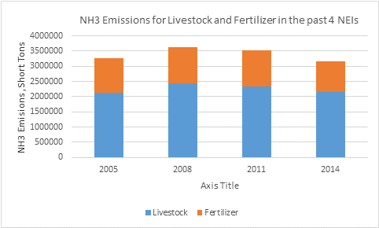
NH3 in the 2014 NEI v2, continued…
Top 15 EIS Sectors for NH3 in the 2014 NEI, Emissions shown in Short Tons (Total NH3 = 3.6 Million Tons)
Ag Livestock emissions have been fairly constant over time in the NEI. Fertilizer is actually seen going down from 2011 to 2014
Notes:
Another summary of the 2014 NEI v2, top 15 sectors shown in the table. The two highest NH3 emitting sectors trended at the bottom, and the trends are either flat or going down (emissions decreasing).

Slide 26
Emissions changes over time show NH3 to be stagnant
Notes:
This shows emission trends from 1990-2014. The point to be made is that NH3 emissions have been stagnant over that time.

Slide 27
Inventory-Related Issues
Ag Livestock
  Sector with most NH3 emissions in inventory
  For the 2014 NEI, used a revised CMU model that was run by a graduate student working for Peter Adams
  We have the source code, but more work needed to use for other emissions years
    EPA also working on analysis of NAEMS data and Emissions Estimation Models
    For NEI work, collaboration between OAQPS and ORD on-going. Considering additional university collaboration (only for NEI efforts)
Ag Fertilizer
  ORD provides emissions estimates based on their bidirectional (bidi) approach
  Research and model revisions continue (much more on this later)
Mobile Sources
  NH3 emissions have not been investigated by EPA for some time. Not currently an agency priority for mobile sources.
Fires
  OAQPS/ORD testing project is expected to give updated emission factors (EFs) for possible future use in EPA fire emissions approaches
Notes:
Some details on the most important sectors in the NEI for ammonia. This training only focuses on the Ag livestock and fertilizer, which are the two top emitting sectors, though some work on improving emissions is on-going in the fires sector.

Slide 28
Short Break: Be back in 15 minutes please!
Notes:
Break slide

Slide 29
CMU’s Farm Animal Ammonia emissions model (FEM)
Model developed by Carnegie Mellon University 2016
Notes:
Introductory Slide

Slide 30
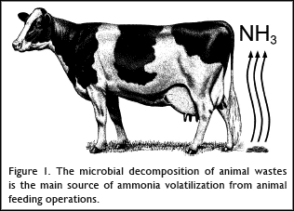
Microbial Decomposition of manure from Livestock
Ammonia is a common by-product of animal waste due to the often inefficient conversion of feed nitrogen into animal manure (urine + feces). Livestock and poultry are often fed high-protein feed, which contains surplus nitrogen, to ensure that the animals' nutritional requirements are met. Nitrogen that is not metabolized into animal protein (i.e., milk, meat, or eggs) is excreted in the urine and feces of livestock and poultry where further microbial action (conversion of urinary urea to ammonia…the enzyme Urease, released in feces, reacts with urinary urea to form NH3) releases ammonia into the air during manure decomposition.
Notes:
Protein from livestock feed that doesn’t get metabolized exits via excreta with high nitrogen content, which converts to ammonia mostly via urease enzyme in urine.

Slide 31
2014 NEI Efforts for Livestock Waste Ammonia Emissions
EPA was able to leverage work done via EPA’s Science to Achieve Results (STAR) grant to CMU, which enabled EPA to use an updated version of the CMU model to estimate livestock NH3 emissions in the 2014 NEI. Alyssa McQuilling (graduate student of Dr. Peter Adams at CMU) ran the model for v1 of the 2014 NEI.
We could not control deliverables nor understand the intricacies of the model as well as we wanted due to the structure of the grant and timing issues
We do have gaps in our current methods, and we are trying to improve these for the 2017 NEI
I am not an expert on the intricacies of the CMU model, and if there are questions that I (or others here) cannot answer, I will get you an answer as we begin to work on the 2017 NEI
Notes:
For the 2014 NEI, EPA leveraged Star Grant work at CMU to have them develop our inventory using the model they developed using EPA funds. The timing was a little late and thus we did not have complete control of deliverables in this effort. These methods do have gaps which we will try to improve upon in the 2017 NEI as we have brought the code in house for 2017 efforts.

Slide 32
Sources of information
Alyssa McQuilling Thesis, February 2016
  "Ammonia Emissions from Livestock in the United States: From Farm-Level Models to a New National Inventory" (2016).
  http://repository.cmu.edu/cgi/viewcontent.cgi?article=1704&context=dissertations
Alyssa McQuilling and Peter Adams, publication, September 2015
  “Semi-empirical process-based models for ammonia emissions from beef, swine, and poultry operations in the United States,” Atmospheric Environment 120:127 - 136 · September 2015
Various presentations made by CMU professor Peter Adams on this subject
2014 v2 TSD, available currently on this FTP site: ftp://newftp.epa.gov/Air/nei/2014/doc
Notes:
Sources for this information include Alyssa McQuillings CMU thesis on the subject, Alyssa’s and Peter Adams’ publications on the issue as well as various presentations made by Peter Adams (of CMU) on the subject. The 2014 NEI v2 TSD also contains details on these methods.

Slide 33
General Overview of Semi-Empirical Process-Based Models for NH3 from Livestock
Farm-level emission factors in the literature vary by an order of magnitude due to the variations in manure management practices and meteorology
It is essential to capture this variability in emission inventories used, for example, for atmospheric modeling
Here (as the details will highlight), through a nitrogen mass balance with losses controlled by mass transfer resistance parameters, which vary with meteorological conditions, are tuned to match literature-reported and NAEMS-based (National Air Emissions Monitoring Study) EFs
Variations due to management practices are captured by having tuned factors that are specific to each set of practices
The resulting farm emissions models (FEMs) explain between 20 and 70% of the published EFs and typically estimate EFs within a factor of 2
Notes:
Broad overview of Semi-Empirical Process-Based Model for NH3 from Livestock: 1) Farm-level emission factors (EFs) in the literature vary by an order of magnitude for NH3 emissions based on manure management practices, 2) our model needs to capture these variances, 3)here a nitrogen balance is used via mass-transfer controlled mass loss to describe emissions losses at each step, 4)variations are described by “tuning” the model with real data describing each step of the manure management process, 5)results show that these Farm Emissions Models are able to describe 20-70% of published EFs and actually estimate EFs within a factor of 2

Slide 34
Ammonia Emissions Variability
Emissions depend on a variety of factors including
  Meteorology
  Management Practices
  Manure Characteristics
Lots of variability, how to build an inventory??
The approach here with the “updated” CMU FEM Model: emissions model instead of use of emission factors
Notes:
NH3 emissions depend on meteorological conditions, management practices, and manure characteristics. There is a lot of variation that needs to be built into an inventory method. Here the approach is to use an emissions model instead of direct use of emission factors. That’s the general concept behind the CMU FEM Model.

Slide 35
Scatter plot example of Manure Application NH3 Emissions
Scatter plot of fraction of input nitrogen volatilized as
ammonia, comparing application sub-model predictions
and experimental data showing range of measured data
(Pinder, et al., 2004) ---shows the variability that can be encountered
Notes:
This is just one example of a scatter plot that shows how variable NH3 can be. Shown here for application practices is the amount of NH3 that volatilizes as experimental data vs model, and the amount of variation can be seen by examining the vertical errors for a given point in time on the x-axis, for example.

Slide 36
Primary Meteorological Factors Affecting Ammonia Emissions, in general…
Temperature – temperature, emissions
  Higher temperature increases volatility of ammoniacal nitrogen
Wind speed – wind speed, emissions
  Higher wind speed decreases surface resistance
Precipitation – precipitation, emissions
  Precipitation allows for greater ground infiltration
pH also very important factor, will address later in presentation
Notes:
Primary meteorological processes affecting ammonia emissions include temperatures (increase in T causes emissions to go up), wind speed (increase in WS causes emissions to go up), and precipitation (an increase in precipitation causes emissions to come down). pH is also a key factor, as it plays a big role in partition of ammonia between gas and particle phase.

Slide 37
Process-based Models
Emissions ~ Nitrogen/Resistance (Wind, Temp)
Volatilization
Volatilization
Volatilization
Feed
Housing/grazing/
feedlot
Storage
Application
Animal
Excreta
Losses to soil, groundwater and biota
Track Nitrogen through manure management process
Includes mass balances and mass transfer laws
Goal is that such a model can capture the variability seen in measurements
Notes:
The concept behind CMU’s process based FEM for NH3 emissions is to track nitrogen through the manure management process. This primarily involves mass balances and mass transfer laws. The goal is that such a model can capture the variability seen in actual measurements.

Slide 38
Overall objectives and goals
We want to build a national emissions inventory. We would like the data to also be applicable to air quality models
Therefore, the model’s focus should be on:
  Unbiased emission factors
  Seasonal cycle (daily variation would be even better)
  Regional scale variability in EFs
  Computational efficiency
  Scalability (do we have national inputs to drive model)
For Livestock, this leads to the following compromises
  Tune model to measurements rather than using “First Principles”
  Omit “details” when we don’t have national data (ventilation rates, for example) or no systematic regional variation
  Predicting results for an “average” farm, rather than a specific farm
Notes:
Before getting into details of the CMU model, it is a good idea to state some general objectives and goals. The idea is that we want to build a national emissions inventory; it’d be good if the model outputs are also applicable to air quality models. One thing that this leads to is that predicting results for an “average” farm will result instead of a specific farm.

Slide 39
Approaches
MORE PROCESS ORIENTED
MORE EMPIRICAL
Constant Emission Factors, Emissions = g/animal/day
x
# of Animals
Empirical Emission Factors, Emissions = F(temp, wind, etc.)
Semi-Empirical Process Model
First Principle Process Models
Notes:
There are several approaches to take in building this type of a model. There are the more empirical approaches (constant to met-varying EFs multiplied by activity) and there are very process oriented models, which would rely on first principles. The CMU model falls in the middle tilted towards the more process oriented model, and is referred to as a “semi-empirical process” model.

Slide 40
This approach versus earlier CMU work
Early 2000s, Rob Pinder did…
  process-based model for dairy only
  completed inventory using surrogate seasonal cycles for other livestock types
This work, Alyssa McQuilling…
  applied same process-based model framework to beef, swine, poultry
  first national inventory completely based on process-based modeling
  used NAEMS data
  various other updates
Notes:
This work builds upon earlier work done at CMU by Rob Pinder and others. The earlier model was for dairy cows only. This work takes that dairy module and builds the same methods into 4 other major animal types: beef, swine, poultry layers, and poultry broilers (chickens). This is the first national inventory produced using these methods.

Slide 41
Emissions Measurements (of NH3)
Historical Measurement Campaigns
National Air Emissions Monitoring Study
Short-term monitoring deployments
Many researchers, many farms
Limited monitoring reporting of farm and measurement conditions
Spread of measurements poor (by season for example)
At the time of this work, 1-3 years of data collection (long-term measurements of seasonal cycles)
Consistent measurement techniques
Extensive monitoring of meteorological and farm management conditions
Notes:
To tune this model, emission source measurements of NH3 are needed. Both historical measurement campaign data as well as data from the National Air Emissions Monitoring Study (NAEMS) were used for this work. Each has advantages and disadvantages, but since the NAMES data was designed to understand these types of processes better, it has better coverage and more useful meta-data.

Slide 42
NAEMS Measurements
National Air Emissions Monitoring Study
~ 2 year measurement campaign
Dairy, swine, and chicken farms
Better contextual data
Long-term measurements, 2007-2010 … evaluate seasonal and daily variability
https://www.epa.gov/sites/production/files/2017-09/documents/_epaoig_20170919-17-p-0396.pdf
Notes:
A map showing NAEMS study sites, over its two year tenure. Also shown are the animals and practices that were monitored for emissions at each of the sites.

Slide 43
Objectives
Build process-based FEMs for all livestock types
  Dairy cows (basically carried forward from previous work), Beef Cattle, Swine, Layer Chickens, Broiler Chickens
Evaluate the model(s), especially for seasonal and daily variability (using NAEMS data, for example)
Build National Inventory (the 2014 NEI in our case)
See if results help improve air quality modeling evaluations
Notes:
Once again objectives: build process based FEMS for all livestock types; evaluate the model, especially for seasonal and daily variability (using NAEMS data for example), build a national emissions inventory (2014 NEI), and see if results help improve air quality modeling evaluations

Slide 44
Methods: Details
Emissions ~ N/Resistance (Wind, Temp)
Volatilization
Volatilization
Volatilization
Feed
Housing/grazing/
feedlot
Storage
Application
Animal
Excreta
Losses to soil, groundwater and biota
Each farm has a manure management train with mass balances on: 1) ammoniacal nitrogen, 2) urea, and 3) manure volume
Each component (e.g., housing, storage, …) has NH3 volatilizations and thus ammonia emissions
Notes:
In this method, each farm has a manure management train with mass balances on nitrogen, urea, and volume of manure. Each component (housing, application, etc.) has NH3 volatilizations (since we want to account for ammonia in gas form) and thus ammonia gaseous emissions.

Slide 45
Methods: Details, part 2
Volatilization
Volatilization
Volatilization
Housing/grazing/
feedlot
Storage
Application
Animal
Excreta
Emissions Computed:
EF = {A * [TAN] * H*}/r
Losses to soil, groundwater and biota
EF: Emissions Factor ------------------→ Key Output
A: Surface Area Fouled by Manure ----------→ Model Parameter
H*: Henry’s Law Equilibrium Constant ---------→ Model Parameter
[TAN]: Total Ammoniacal Nitrogen Concentration --------→ Mass Balance
r: Mass Transfer Resistance Parameter--→ TUNED TO OBSERVATIONS
Notes:
The key equation for each box in the diagram (which is part of the manure management train) is shown in red, where you have Emissions Factor as the key output, and “A” which is an area measure, “H*” which is Henrys Law Constant (function of pH), “TAN” which is the nitrogen concentrations gotten from mass balances and “r” which is the mass resistance parameter. Keep in mind that it’s “r” that is tuned to the observations.

Slide 46
FEM Submodel Flow
Data flows through each submodel:
Inputs
Outputs
Submodel
(e.g. swine storage)
Nitrogen and water
From literature or previous submodel
Daily Average Emission Factor
Adjusted parameters
Nitrogen and water balance
(goes to next submodel)
Meteorological data
From National Climate Data Center (NCDC)
Mass balances on each sub-model
What isn’t emitted remains in the same sub-model
Transfers between sub-models only occur when “Scheduled” based on farming practices.
  For example, housing manure may be cleaned out daily and take to storage for dairy cows but less often for poultry
  Similarly, manure is taken out of storage and applied at various points in the year
Notes:
There are mass balances conducted on each sub-model. What isn’t emitted generally remains in same sub-model. Transfers with sub-models only occur when there are “scheduled” events, like clean outs. Note the inputs and outputs from each sub-model, with the key output being a “daily average emissions factor.”

Slide 47
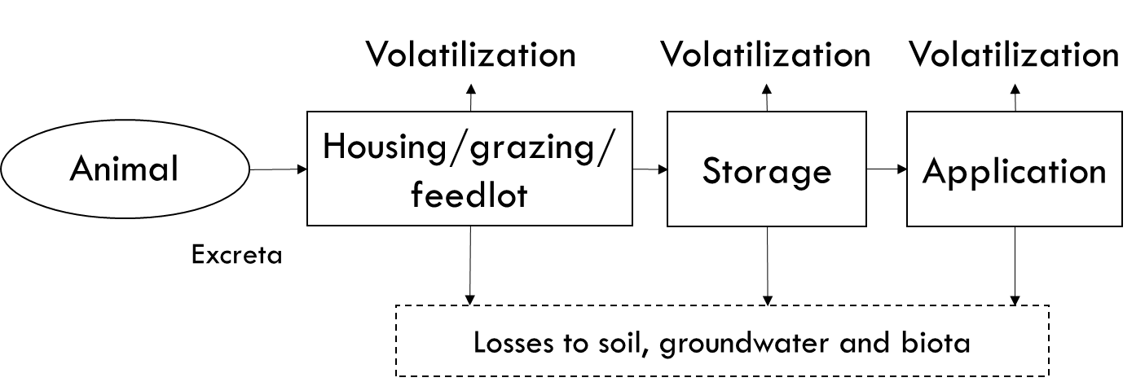
Methods: Details
Emissions Computed:
EF = {A * [TAN] * H*}/r
SURFACE RESISTANCE:
Tuned to match measured EFs!!
r_{s} = function (Meteorology and Practices)
e.g. for Beef Feedlots
r_{s}=H₁T + H₂u + C
Where H₁ and H₂ are constants and tuned to capture variability due to temperature and windspeed
r = r_{a} +r_{b}+ r_{s}
Aerodynamic and quasi-laminar resistances: standard atmospheric theory
Notes:
Here a few more details on the main equation are provided, and more specifically about the resistance factors. Note that two of the r’s, rsuba and rsubb come from theory and are not dependent on measurements, but rsubs is tuned to observations. Rsubs is termed the surface resistance and is a function of meteorology and practices, and thus is the term that gives daily and seasonal resolution to the emission factors.

Slide 48
The “r” resistance term is very important!!
Each box has its own equation for r. E.g. storage has its own equation and housing has a different one. Moreover, each practice type has its own r equation, e.g. tie stall dairy housing has a different equation than free-stall dairy housing. In general, the r equations are also functions of meteorology. This approach to specifying the r is how the model makes the emissions depend on practices and meteorology.
Volatilization
Volatilization
Volatilization
Housing/grazing/
feedlot
Storage
Application
Animal
Excreta
Losses to soil, groundwater and biota
Notes:
This slide just emphasizes how important the “r” term is. The r term makes the model dependent on both farm management practices and meteorology, and thus is a key term.

Slide 49
Methods: Summary
How does the model get seasonal (daily) variability?
  Resistance depends on meteorological variables
How does the model get variability due to practices?
  Separate resistance sub-model for each
    Livestock type
    Manure management stage: housing, storage and application
    Major practice: e.g. deep-pit and shallow-pit swine housing
  Other differences (e.g. frequency of house clean-out)
Regional variation is a combination of meteorology and practices
  The met data pulled from NCDC is actually according to their “climate zones”. There are ~200 of them. So EFs for different counties in the same climate zone will be the same for the same farming practices. Note, however, that this is not really an inherent limitation of the CMU model – just the structure of the input data used.
Notes:
To summarize: methods get seasonal variability based on resistance terms; variation due to management practices due to resistance terms; regional variation is due to combination of meteorology and management practices

Slide 50
Model evaluation
Since the tuning is done to have no bias versus observations, the fact that the model predicts the right magnitude is not evidence that the model is working as it would be if it were a purely untuned first-principles model
  Evaluation of the model is done against the same data used for tuning. This is a documented weakness since everything is not totally independent.
  Ideally we would want to tune based on some data and test based on other, but there simply isn’t that much data
However, the evaluation does provide an useful quantification of how well a relatively simple mass balance model (there are much more complex farm models out there) can explain “variability” in emissions factors in a complex system.
Model performance evaluated primarily in terms of R value and mean fractional error between observed and modeled EFs
Notes:
Since the tuning is done to have to bias versus observations, the fact that model predicts the right magnitude is not evidence that the model is working as it would be if were a purely first principles model. However, the evaluation does provide a useful quantification of how well as relatively simple mass balance model does can explain the measured “variability.”

Slide 51
FEM: Tuning and Evaluation
Unbiased (because the models have been tuned, and the error between model predictions and measured EFs are minimized)
R2 values ranges from 0.2 for Beef to 0.7 for layers
Modeled EFs are generally within a factor of 2 of measured…at farm scale
Beef Feedlots
Broiler Housing
Layer Housing
Swine Housing
Notes:
Some examples of evaluation. Note that the comparisons are unbiased because models have been tuned and the error between model predictions and measured EFs are minimized. Note that the graphs shown here show good agreement for most of the animal/practices combinations shown here.

Slide 52
Role of “Contextual Information”
Versus all studies
Vs studies reporting N
Not all studies report all required input parameters (e.g. feed or manure nitrogen)
Measurements need to report feed N, other practices, and meteorological conditions to put results in context and be useful to process-based models and inventories
Notes:
This slide shows the model evaluation for the beef feedlot submodel of the beef cattle farm emission model. The figure shows that the model has some skill in reproducing the literature reported emissions for feedlot beef production. Figure 2b shows the model evaluation for beef feedlots where information about the nitrogen content of feed and/or excreta is presented with the emission factor. This figure highlights the importance of reporting dietary nitrogen and nitrogen excretion rates in the literature, because with this extra information we were better able to simulate ammonia emission factors for beef feedlots than when we did not have this information, increasing the r² value of the data from 0.21 to 0.36.

Slide 53
Open vs Enclosed Sources
Swine Housing: Enclosed
Swine Storage: Open
Open (outdoor) sources are more difficult to measure … need to infer emissions rate from downwind concentrations….must make dispersion assumptions
Notes:
Here is a side-by-side comparison of all four animal types for which a farm emission model has been developed. I’ve displayed the evaluation of each animal’s housing submodel.
You can see from the figure the variation in both the amount of literature data available for each animal type as well as the ranges of emission factors that each animal type spans, just for the housing portion of manure management.
You’ve seen the beef and swine results in previous slides, so focusing on the lower row:
Broiler chickens have a short life cycle and, as a result, we have chosen to report emission factors in terms of grams of ammonia volatilized per animal unit per day, where 1 animal unit (AU) is 500 kg. This avoids dealing with the complicated task of separating the effects of differences in temperature and other meteorological conditions and difference in bird weight, which changes rapidly. Unfortunately this is not a perfect solution as there is some evidence that emission factor per bird weight changes over the course of the production cycle, though there is no consensus on how the emission factor changes. Model results in Figure 2e show an R² value of 0.29 with the data reported from the literature from farms in the United States. It is important to know the outdoor temperature even at enclosed facilities because the outdoor temperatures often drive ventilation rates and affect how much ammonia is volatilized within the barn. Model results in Figure 2f show an R² value of 0.65 with the data reported from the literature from farms in the United States.

Slide 54
Further (seasonal) evaluation examples using NAEMS Farms
These graphs show seasonal cycle of emission factors compared to that predicted by the corresponding FEM
Typically, Dairy and Swine Farms have peaks in the summer while layers and broilers typically have winter peaks
FEMs seem to capture the NAEMS data well (R2 values range from 0.6 to 0.9)
Free Stall Dairy Barn, NY
Shallow Pit Swine Housing, NC
Litter-based Broiler Housing, CA
Notes:
Here some further seasonal evaluation examples using data from just NAEMS farms are shown. Dairy and swine farms have peaks in the summer while layers and broilers typically have winter peaks. FEMs seem to capture the NAEMS data well, including seasonal patterns

Slide 55
Evaluation: Daily Variability
Free-Stall Dairy House in Indiana
Dairy Lagoon in Indiana
Daily variability in housing emissions tends to be better characterized by the model than storage emissions
Notes:
Here we see daily variability at a dairy stall in IN and at a dairy lagoon in IN. The daily patterns are better via comparison to measurements for confined sources vs open ones

Slide 56
Development of a National Emissions Inventory
National Climate Data Center (NCDC)
Temperature, Precipitation, and Wind Speed
Daily Time Resolution, Climate Division Spatial Resolution
Meteorology
National Animal Health Monitoring Survey
Housing type, Storage type, Application methods
Multi-state regional spatial resolution
Management Practices
USDA Agricultural Census
County level animal numbers from 2012
Animal Population
Notes:
Development of a National Emissions Inventory is driven by meteorology (NCDC data), management practices (NAHMS data), and animal population (USDA Agricultural Census).

Slide 57
Regional Farming Practices: An Example
Regional variation in housing, storage and application practices
Swine shown as an example here
The MW includes ID, IA, MN, MT, ND, NE, SD, WI, and WY
The Eastern states include CT, DE, IL, IN, ME, MD, MA, MI, NH, NJ, NY, OH, PA, RI, and VT
All other states in Southern Region
Notes:
An example of regional farming practices, here showing Swine housing, storage, and application. Note that there is enough data in the NAHMS study to show regional differences in this case

Slide 58
Inventory Calculations
Run FEM for county-specific meteorology to produce daily emission factors
  Repeat for all farm practices
Compute a county composite EF as a weighted average across all manure management practices in that county
  Repeat for all animal types
County-based Emissions = (Emissions Factor) x (Animal Population)
  Resulting data has structure of emissions = f(county, day, livestock type, “practice”) where “practice” is shorthand for the different housing/storage/application configurations that prevail in a county
Result is ammonia emissions with:
  Daily temporal resolution
  County spatial resolution
  …by livestock type, management stage, practice
Notes:
A key steps in inventory calculations include: 1) Running the FEM for county-specific meteorology to produce daily EFs (repeating for all farm practices), 2)Compute a county composite EF as a weighted average across all manure management practices in that county (repeat for all animal types), 3)compute county-based emissions using equation above, and 4)resulting ammonia emissions are daily temporal resolution, county spatial resolution and by animal type and management practice type

Slide 59
2011 Results: National Totals
Seasonal and daily variability apparent
Summer emissions dominated by swine
Beef and broilers more important during wintertime (relative to swine)
Layers have reverse seasonal emission pattern
Notes:
Next few slides show examples using 2011 as the model/analysis year. This chart shows how NH3 emissions vary seasonally and daily. Summer is dominated by swine, beef and broilers are estimated to be more important in wintertime

Slide 60
Spatial Distribution
Iowa, Beef and Swine Production
NC Coastal Plain, Broiler and Swine Production
San Joaquin Valley, Poultry and Cattle Production
Notes:
This map shows the NH3 total spatial distribution for all animals. In Southern CA, it’s mostly dairy and chickens, IA is beef and swine, and NC coastal areas is swine and broiler poultry. These seem to be the “hot spots”

Slide 61
Regional Emission Factors
NC Swine EF about double that of IA (annual)
Higher EFs in warmer places
Differences in practices less significant than Temperature differences
Note also different EFs within a given state
Notes:
This map shows regional emission factors (EFs). Note the higher EFs in warmer places and differences in practices are lesser than meteorology effects. Note also different EFs within a state.

Slide 62
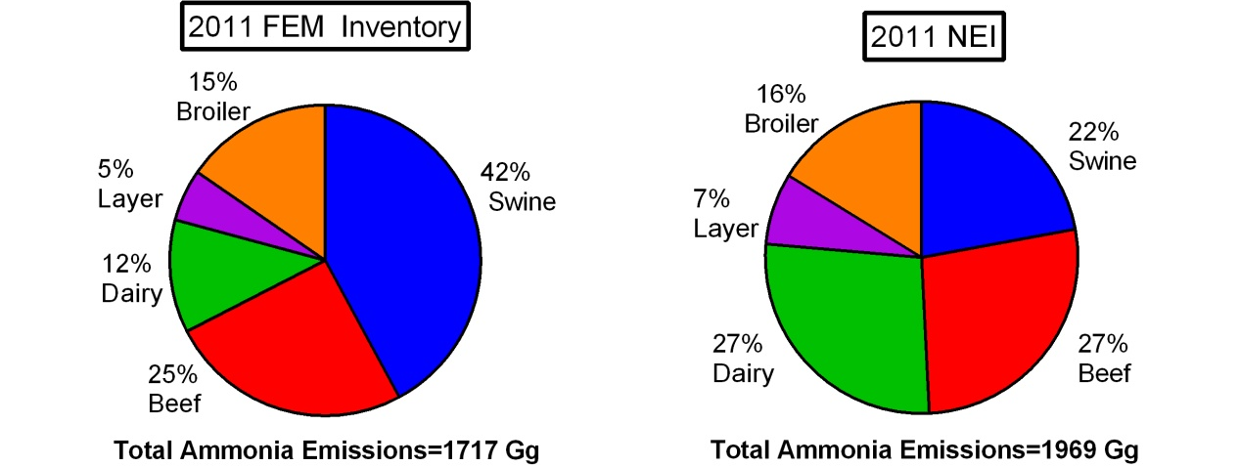
Animal Contributions vs 2011 NEI
Similar magnitude of emissions in 2011 FEM inventory and 2011 NEI
Much greater swine emissions in FEM inventory (swine storage emissions higher in NAEMS compared to prior literature)
Much smaller contribution from dairy
Notes:
Comparison of 2011 FEM results using these methods vs the NEI shows dairy NH3 emissions to be very low via the FEM model and swine to be much higher. Total magnitude of emissions match well. These mismatches need to be investigated further in the 2017 NEI process if we use the same FEM model to estimate NH3 emissions.

Slide 63
Conclusions, observations, caveats
Framework: process-based model tuned to observed emissions factors
  Captures regional and seasonal variability
  Unbiased overall compared to EFs used in tuning
FEM captures seasonal cycle and practice differences; limited on daily variability
The general approach: Measurements -> process model -> prediction EFs everywhere
  …whereas a more traditional approach skips the middle step and just tries to take the measured EF that most closely matches the situation at hand. In the process-model approach, hopefully, the model learns something important, e.g. about T-dependence, and uses that to interpolate (and extrapolate) to other conditions that don’t exactly match those measured.
First national inventory based on process based modeling was 2011
  similar total emissions as NEI 2011
  swine ↑ but dairy ↓
  stronger seasonal cycle
Notes:
Conclusions slide. There are several things we need to attempt to fix with the CMU FEM model moving forward, however it does hold promise for producing reasonable results when compared to measurements of NH3. We need to improve dairy and beef estimates, as well as to find a way to estimate emissions in AK, HI, PR, and VIs.

Slide 64
Conclusions, observations, caveats, continued…
EF measurements more useful if they also report “context”
  meteorology, pH, manure N, etc.
Manure management / farm practice data is as much of a limiting factor as EF measurements
pH is a very important parameter for governing NH3 emissions
  With the current FEM, the Henry’s law constant takes pH into account
  Many sensitivity studies show pH to be very important
  Challenge for inventory building because there is no national database of manure pH
  So, when building the inventory, the model uses a “typical value” for pH.
  When we tune or otherwise evaluate the models against specific measurements, we use the actual manure pH value – if it was measured and reported. Frequently, it’s not. When it’s not reported, we’re forced to use a “typical value” again.
This same methodology was used to develop the 2014 NEI v2, the next section will outline how that was done
Notes:
See previous slide.

Slide 65
2014 NEI v2 Livestock Emissions
Notes:
Introduction slides for this section

Slide 66
U.S. Ammonia Emissions Sources,
2014 NEI v2
Figure A – U.S. ammonia emissions sources (3.6 million tons)
Figure B – U.S. livestock ammonia sources (2.1 million tons)
A)
B)
Notes:
Shown here are two pie charts representative of the 2014 NEI v2. On the left we show all the sectors and it can be seen fertilizer and livestock emit 80% of the total NH3 emissions in the inventory. The chart on the right shows livestock emission by animal type at a national annual level. Swine and beef cattle are seen to be the major contributors.

Slide 67
Livestock waste emissions in the NEI
These are the only five SCCs that EPA reports their data into for the 2014 NEI (there are others that SLTs can choose to report into):
EPA estimates NH3 and VOC emissions for these SCCs
Livestock is inventoried in NonPoint (annual/county totals)
SCC | SCC Level 1 | SCC Level 2 | SCC Level 3 | SCC Level 4
2805002000 | Miscellaneous Area Sources | Agriculture Production - Livestock | Beef cattle production composite | Not Elsewhere Classified
2805018000 | Miscellaneous Area Sources | Agriculture Production - Livestock | Dairy cattle composite | Not Elsewhere Classified
2805025000 | Miscellaneous Area Sources | Agriculture Production - Livestock | Swine production composite | Not Elsewhere Classified
2805007100 | Miscellaneous Area Sources | Agriculture Production - Livestock | Poultry production - layers with dry manure management systems | Confinement
2805030004 | Miscellaneous Area Sources | Agriculture Production - Livestock | Poultry Waste Emissions | Broilers
Notes:
This slides shows the 5 major Source Classification Codes (SCC) that emissions from the CMU model are stored in the Emission Inventory System (EIS). State/Local/Tribal agencies can report to these SCCs or other ones that are available that are more specific. EPA estimates ammonia emissions for five animal types only: beef cattle, dairy cattle, swine, broiler chickens, and layer chickens.

Slide 68
General methods for going to 2014 NEI v2
After reviewing the v1 estimates based on the methods outlined previously, we:
  Found errors in allocations of emissions to counties
  Had several states ask us to use more up-to-date animal population data
In going to the v2 inventory:
  We corrected the county allocation errors
  We estimated revised 2014 county-level animal populations using USDA 2014 Survey and 2012 Census data. Then constructed the v2 inventory using EFs from CMU’s v1 model.
  We did not alter the FEM model in going from v1 to v2, so used the same 2011 meteorology
  We added VOC emissions to this sector
Notes:
In going from v1 to v2, we corrected some errors. These errors included fixing county allocations that were wrong in v1 as well as updating animal counts. In addition, we added Volatile Organic Compounds (VOC) and VOC HAPs to this sector in going from v1 to v2.

Slide 69
2014 NEI v2 – Animal Population Revisions
Animal population data were obtained primarily from the 2014 USDA National Agricultural Statistics Service (NASS) Quick Stats program
  As many counties as possible across the United States
  Single farm counties/types not reported (NR) for confidentiality
  Not as complete as the USDA Census
USDA 2012 Census used to augment the 2014 Survey for NR
  Unclear if NR is 0 or grouped
  If 2014 county/type = NR and 2012 reported,
  2014 pop = 2012 pop x state 2014pop / 2012 pop
County/types with NR in 2012 and 2014
  Diff = 2014 state – Σ 2014 counties
  NR counties = Diff / (Number of NR counties)
Notes:
In revising the animal populations in v2, we used a combination of the 2014 Survey based on USDA’s NASS program, then, as needed, supplemented with 2012 census data and used a statistical procedure to backfill for missing data.

Slide 70
Details – Animal Populations, Chickens
Animal Type | Source
Chicken Broilers | The inventory reflects the 2012 state level totals, because no 2014 data is available in the Survey at either the county or state level. The NR county gap fill described in previous slide used as needed.
Chicken Layers | The inventory is based primarily on the 2012 Census. There were 30 states with 2014 state level population data, and the 2012 county level populations for those states were adjusted to reflect the change in population between 2012 and 2014 state level totals.
Notes:
This details, by animal type, the source of animal count data used in the 2014 NEI v2.

Slide 71
Details – Animal Populations, swine
Animal Type | Source
Swine | The NEI 2014 v1 inventory had four states with 2014 county level data (MT, NC, ND, OK). These states were not changed for v2. The other 46 states were updated to reflect the 2014 state-level total. The county populations were adjusted to reflect the change in population between 2012 and 2014 state level totals.
Notes:
This details, by animal type, the source of animal count data used in the 2014 NEI v2.

Slide 72
Details – Animal Populations, Beef and Dairy
Animal Type | Source
Dairy Cattle | Counts are based on 2014 Survey data where available, and counties with missing data are “gap filled” using the algorithm described earlier.
Beef Cattle | Counts are based on 2014 Survey data where available, and counties with missing data are “gap filled” using the algorithm described earlier.
Notes:
This details, by animal type, the source of animal count data used in the 2014 NEI v2.

Slide 73
Details – Population Gap Filling
 | Beef Cattle | Dairy Cattle | Swine | Chicken Layers | Chicken Broilers
Number of counties with gap filling (3,071 counties in database) | 776 (25%) | 973 (32%) | 643 (21%) | 433 (14%) | 621 (20%)
Number of states with no gap filling | 5 | 4 | 9 | 6 | 3
Notes:
This slide shows the details in the gap filling that we had to employ (if the Census and Survey did not contain animal counts for any animal type). It can be seen the amount of gap filling was quite high for cattle and lower for swine and poultry.

Slide 74
VOC Emissions
Prior to 2014 NEI, VOC emissions had not been estimated by EPA for the livestock waste
Calculated VOC emissions using the ratio of VOC to NH₃ emissions from livestock waste.
Calculated an average VOC/NH₃ ratio of 0.08 using data at the county level where both VOC and NH₃ were reported in 2014 NEI v1 by SLTs (from 3 states, total of about 110 counties)
Applied this ratio to the 2014 NEI v2 NH₃ livestock inventory to develop the county and animal type specific VOC inventory
  About 150,000 tons of VOC nationally estimated using this approach
Notes:
In going to v2 of the 2014 NEI, we added VOCs to this sector. The approach used was to look for co-reported VOC and NH3 by SLTs, and use an average ratio across all animal types and across the US. This ratio was 8% (8% of NH3 emissions are VOCs). This results in about 150K tons of VOC estimated to be emitted by this sector.

Slide 75
Comparisons between EPA’s estimates and SLT submissions
Animal Type | States Submitting NH₃ Emissions | 2014 State NH₃ (tons/year) | 2014 v2 EPA NH₃ in these States (tons/year)
Beef Cattle | CA, GA, ID, IL | 110,107 | 102,717
Dairy Cattle | GA, ID, IL | 38,400 | 14,116
Swine | CA, GA, ID, IL | 35,154 | 50,227
Chicken Layers | CA, GA, ID | 12,424 | 8,804
Chicken Broilers | CA, GA, ID | 56,240 | 45,559
We used the states’ submissions in the NEI when they were submitted over EPAs
The NEI is thus a combination of EPA data and SLT-submitted data
When a SLT submits emissions, they are not required to submit the accompanying activity data
Reasonably good agreement when aggregated across SLTs (EPA estimates low for dairy cattle and chicken categories)
Notes:
This slide shows a comparison between EPA estimates and SLT submissions as a sum across states that emitted NH3 emissions. Aggregate emissions comparisons are good, but EPA estimates are very low for dairy cows and poultry.

Slide 76
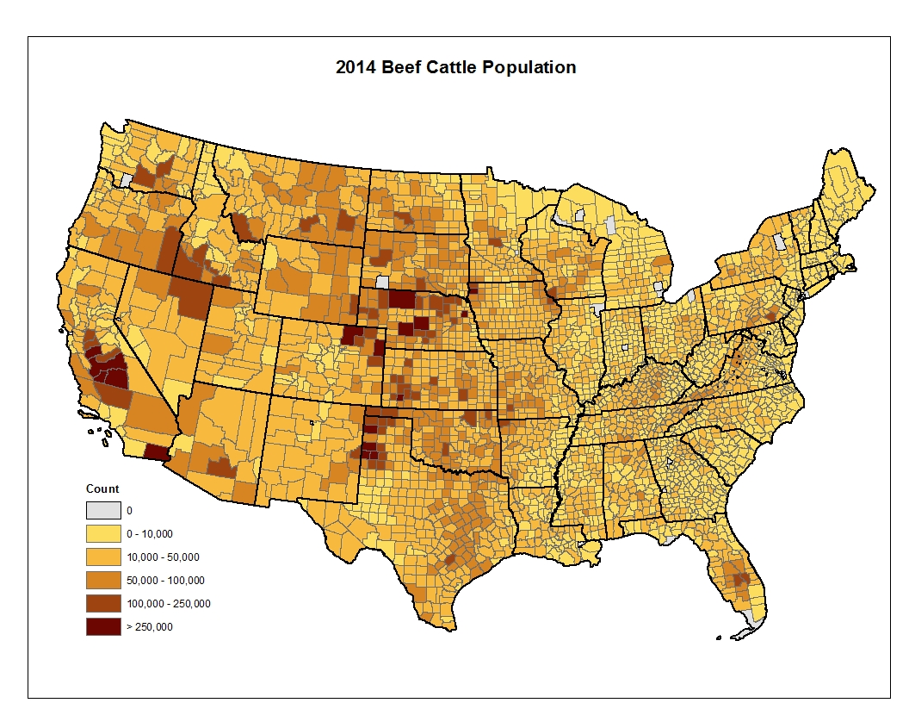
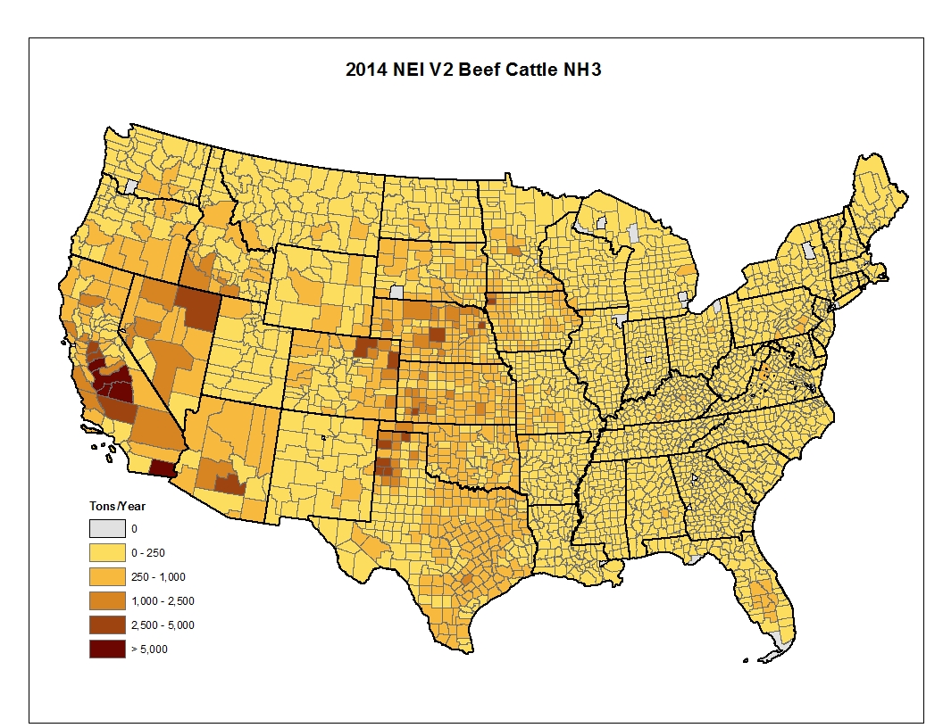
Beef Cattle: Population and NH3 Emissions– 2014 NEI V2
Notes:
There are two maps here. The left shows beef cattle populations and the right shows NH3 emissions. It can be seen that parts of the western US, including the San Joaquin Valley, shows high numbers in both cases.

Slide 77
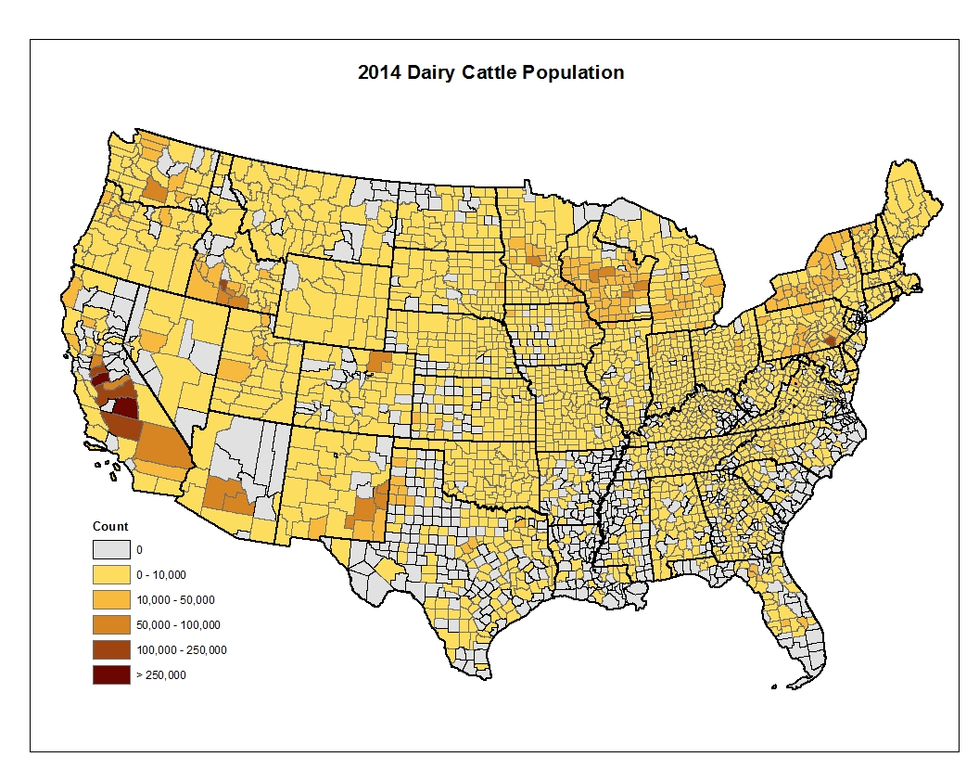
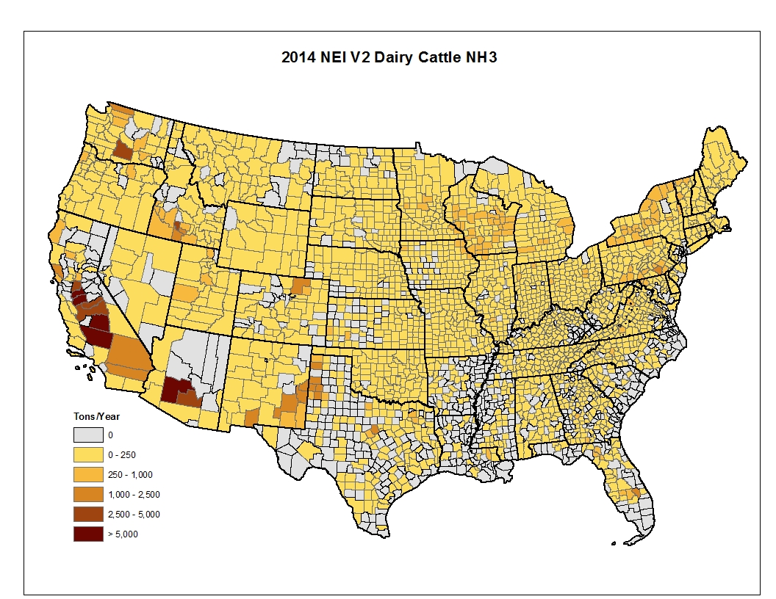
Dairy Cattle: Population and NH3 Emissions– 2014 NEI V2
Notes:
There are two maps here. The left shows dairy cattle populations and the right shows NH3 emissions from dairy cattle. It can be seen that parts of the western US, including the San Joaquin Valley, shows high numbers in both cases.

Slide 78
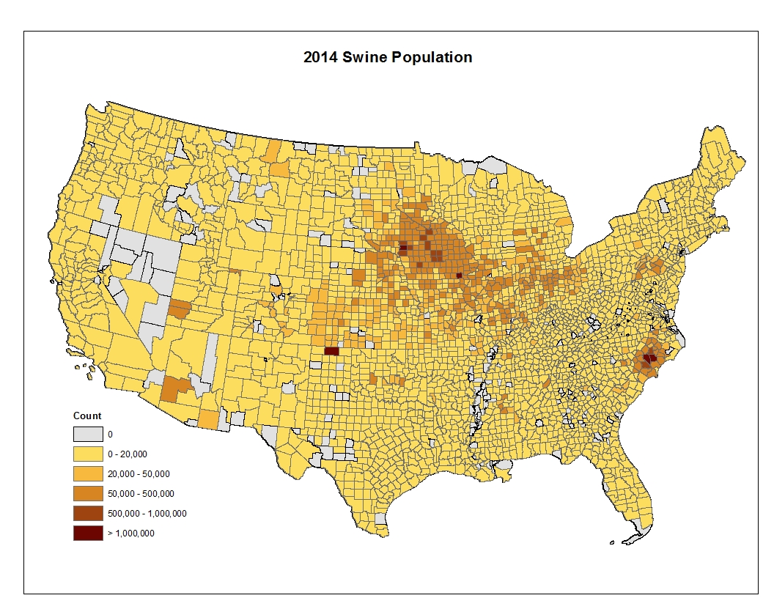
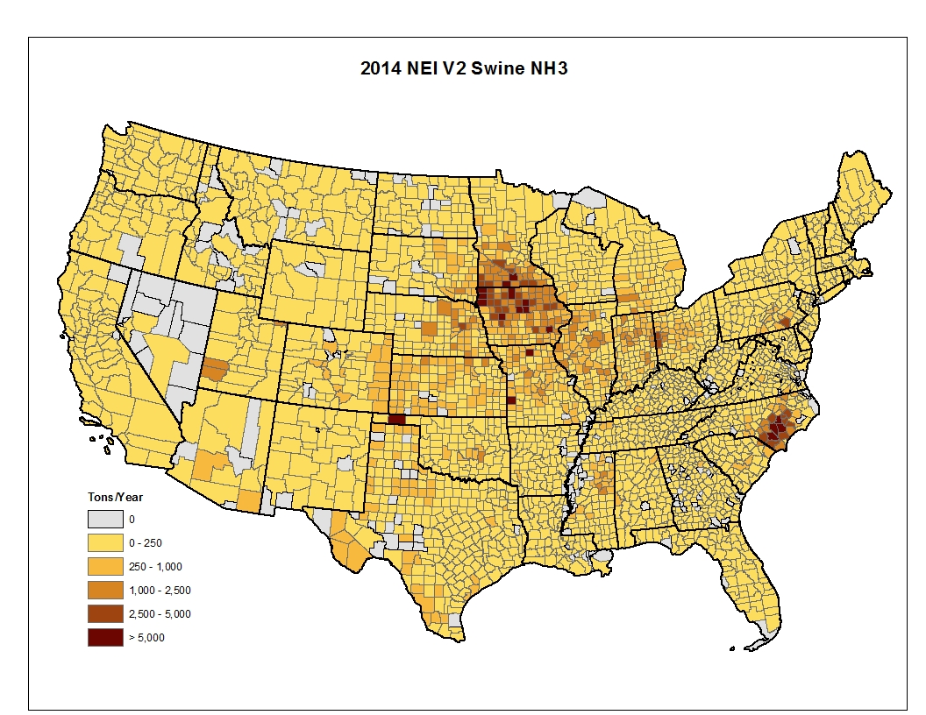
Swine: Population and NH3 Emissions– 2014 NEI V2
Notes:
There are two maps here. The left shows swine populations and the right shows NH3 emissions from swine. It can be seen that parts of IA, MN and NC show high numbers in both cases.

Slide 79
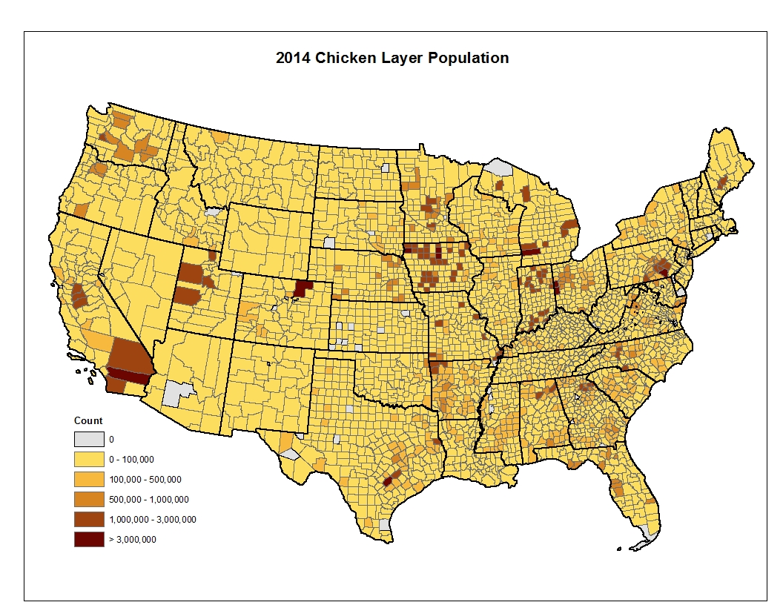
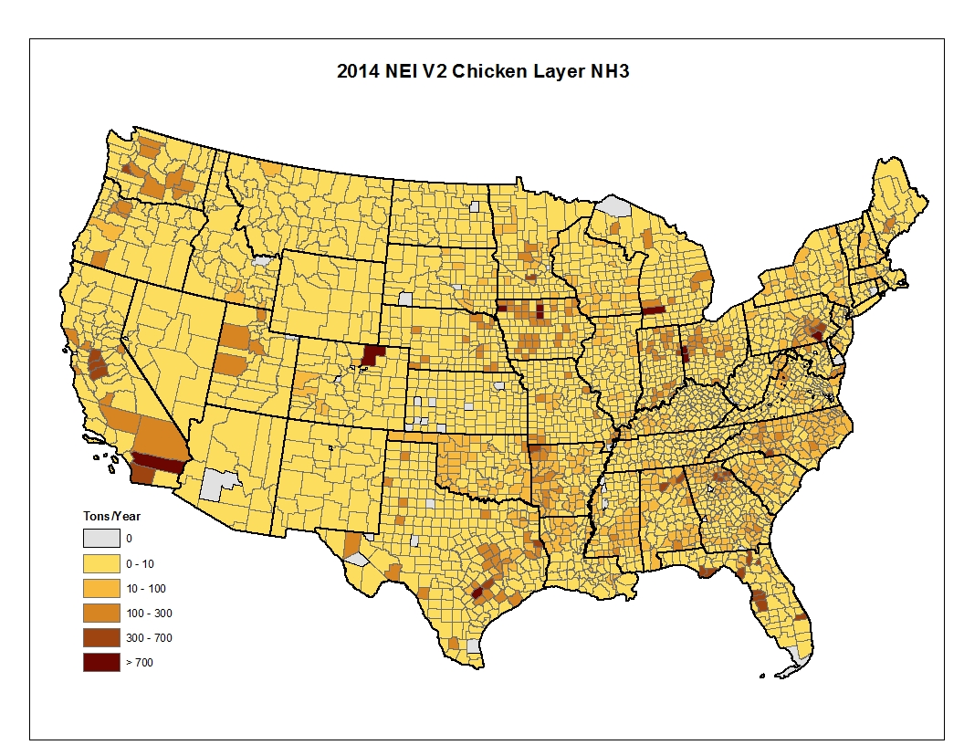
Chicken Layers: Population and NH3 Emissions– 2014 NEI V2
Notes:
There are two maps here. The left shows beef chicken layers and the right shows NH3 emissions from layers. It can be seen that parts of the western US, including the San Joaquin Valley, and some places in the eastern US including NC show high numbers in both cases.

Slide 80
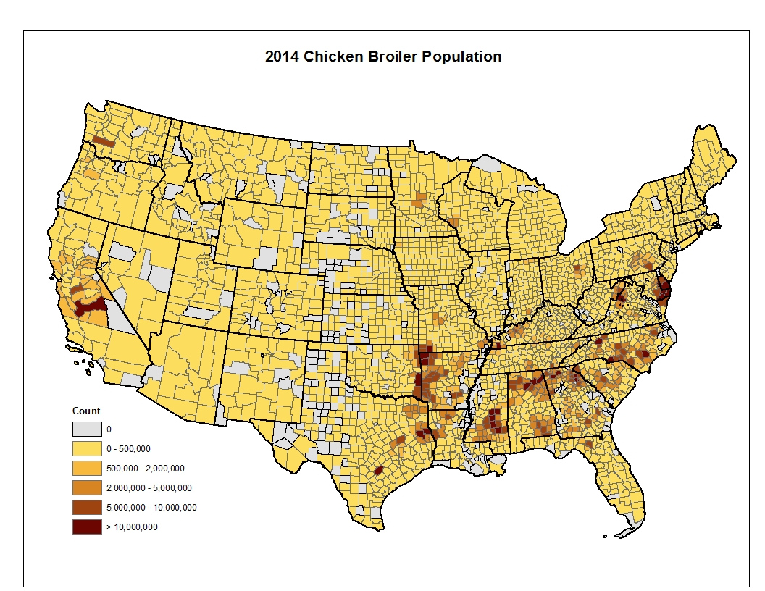
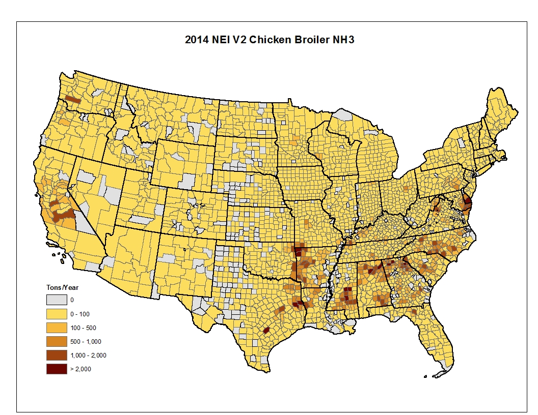
Chicken Broilers: Population and NH3 Emissions– 2014 NEI V2
Notes:
There are two maps here. The left shows chicken broiler populations and the right shows NH3 emissions from broilers. It can be seen that parts of the Eastern and Southeastern US shows high numbers in both cases.

Slide 81
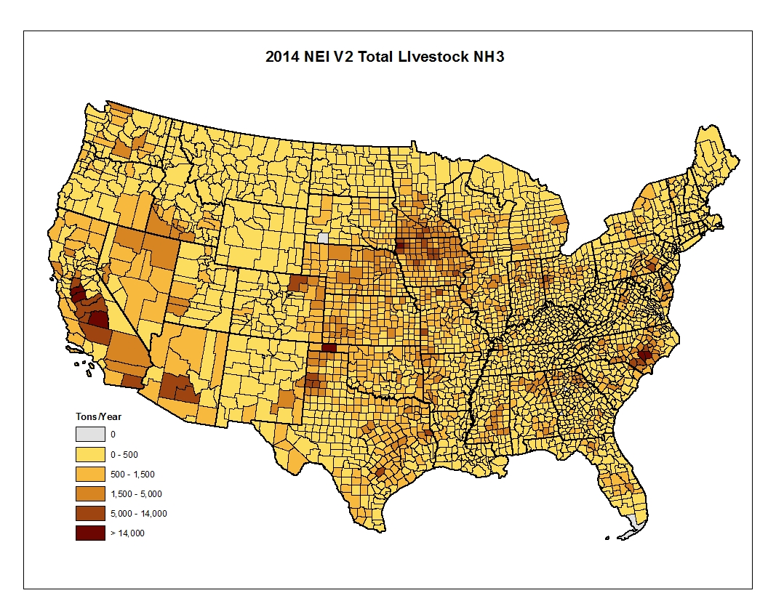
NH3 Emissions from all Livestock – 2014 NEI V2
Notes:
This is a total NH3 emission map for the V2 from all animal types. Note that this map and all the previous ones on emissions reflects the NEI totals, meaning it’s a combination of EPA-generated and SLT-submitted emissions.

Slide 82
Looking forward to the 2017 Process
Apply CMU model code, after testing and revising/updating as needed, as possible, for the final inventory (resource dependent)
Consider options for developing a draft inventory sooner using 2017 census data (collected and compiled by OAP) for animal populations and EFs from the 2014 CMU model
Increase collaboration and science for this sector
Rethink and revise methods for VOC estimates (resources permitting)
Include silage VOC emissions on dairy farms as a source (dependent on resources, data availability and methods development)
Develop methods for AK, HI, PR and VI
Ask SLTs to submit animal count data for their states, after review of draft estimates…
Notes:
Looking forward to the 2017 NEI, we need to apply the CMU model code to the 2017 year of activity and other parameters. We need to improve the shortcomings identified in the 2014 NEI as well as to develop methods for AK, HI and VI. For the 2017 NEI, we will undertake a joint project with the SLTs to first build a robust animal count database for the 2017 NEI.

Slide 83
Fertilizer NH3 Emissions in the 2014 NEI
Notes:
Introduction Slide to next section on NEI methods for the fertilizer sector

Slide 84
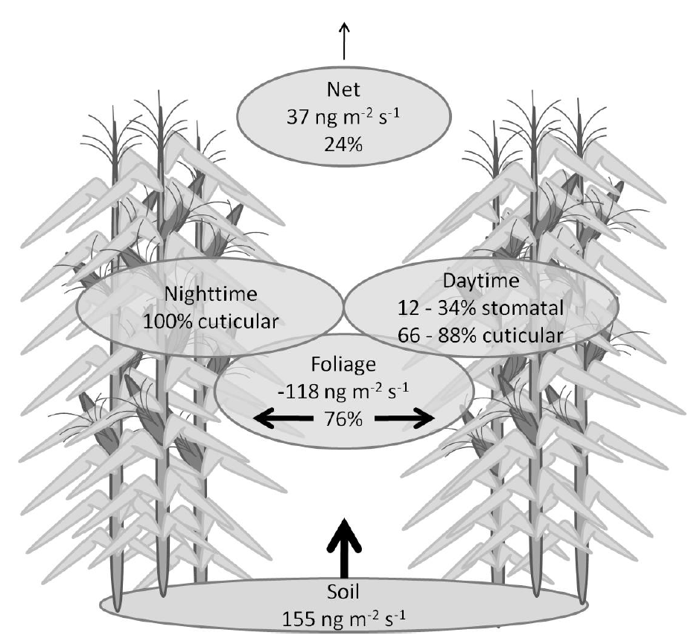
NH₃ Bidirectional Exchange
Measurements show that NH₃ can deposit or emit
  Depending on meteorology and soil, plant nitrogen status, and ambient NH₃ concentration
Traditionally emissions and deposition have been modeled separately
NH₃ bidirectional exchange has been incorporated into the Community Multiscale Air Quality (CMAQ) Modeling system
  Consistent representation of NH₃ emissions and deposition
Walker et al 2013
Notes:
Measurements of the air-surface flux of NH3 have demonstrated that it can be emitted or deposited depending on the atmospheric concentration and the concentration of NH3 in equilibrium with NH4 in the vegetation and soil. Air quality models do not typically model this processes and have separate parameterizations of emissions and deposition. This can result in inconsistent treatment of transport processes that are comment to emissions and deposition and neglect gradient based processes that have been documented in natural vegetation and in agriculture post fertilization. In the EPA’s Community Multiscale Air Quality Model (CMAQ) NH3 bidirectional exchange has been incorporated in the emissions and transport of NH3 to more consistently represent these processes.

Slide 85
NH₃ Fertilizer Emissions
SCC Code 2801700099
EPA was able to leverage work done in an EPA/ORD and USDA Agriculture Research Service (ARS) collaboration
  Develop the methodology to run the USDA’s Environmental Policy Integrated Climate (EPIC) field scale model on a continental domain
EPIC output is used by US EPA’s CMAQ model to estimate NH₃ emissions from fertilizer considering bidirectional exchange
Notes:
The CMAQ model representation of fertilizer NH3 emissions was largely developed in an EPA/ORD and USDA Agricultural Research Service (ARS) collaboration. This work has focused around the large scale application of the USDA’s Environmental Policy Integrated Climate (EPIC) model on the continental US scale. EPIC model output is used by the CMAQ model to estimate NH3 emissions from fertilizer considering bidirectional exchange.

Slide 86
Modeling of NH₃ Emissions in CMAQ
Meteorology (WRF)
Agricultural Modeling (EPIC)
Air Quality Modeling (CMAQ)
Diagnostic Emission Estiamtes
Notes:
This figure shows the processes involved I modeling NH3 emissions from fertilizer in CMAQ. The process starts with Weather Research and Forecast model simulations of meteorology. In the WRF simulations used for the 2014 NIE we ran it in a retrospective mode that assimilated observations to best represent observed conditions rather than in a forecast model. The next step is running EPIC using the simulated WRF meteorology, land use data, and USDA national agricultural statics and survey data. The we run the CMAQ simulation with both EPIC and WRF inputs using the NH3 bidirectional exchange option. This option produces grid cell level NH3 emission estimates from fertilizer which are aggregated to monthly and seasonal county level estimates.

Slide 87
Primary Meteorological Factors Affecting Fertilizer Ammonia Emissions
Temperature – temperature, emissions
  Higher temperature reduces the soil equilibrium ammonium concentration
Wind speed – wind speed, emissions
  Higher wind speed decreases surface resistance
Precipitation – precipitation, emissions
  Precipitation dilutes the ammonium available for evasion in the soil
Soil pH – pH, emissions
  Higher soil pH favors reduces the soil equilibrium ammonium concentration
Notes:
This slide shows the primary factors that affect fertilizer ammonia emissions. Much like the CMU model, fertilizer emissions increase with increasing temperature and wind speed as the models use fundamentally similar parameterizations. Increases in soil pH also results in increased emissions as this increases NH3 in the soil ammonia/ammonium equilibrium. Increases in precipitation typically result in a reduction in emissions due to the dilution of NH3 in the soil water and the decrease in diffusion of NH3 through the soil.

Slide 88
USDA’s Environmental Policy Integrated Climate (EPIC) Simulations for CMAQ
Notes:
Next section introduction slide

Slide 89
USDA EPIC Model
Environmental Policy Integrated Climate (EPIC) Model
  Assess the effect of soil erosion on productivity.
  Predict the effects of management decisions on:
    Soil, water, nutrient, and pesticide movements
    Impact on soil loss, water quality, and crop yields for areas with homogeneous soils and management
We have developed an interface to run EPIC for CMAQ applications
  Fertilizer Emission Scenario Tool for CMAQ (FEST-C)
    Available at https://www.cmascenter.org/fest-c/
  Includes EPIC and data needed to run for the contiguous US
Notes:
The USDA’s EPIC model was initially developed to assess the effect of soil erosion on agricultural productivity and now is used to predict the effect of management decisions on soil, water, nutrient and pesticide transport and fate. It can also assess the impact of soil loss, water quality, and crop yields for areas with homogeneous soils and management.
We have developed the Fertilizer Emissions Tool for CMAQ (FEST-C) to facilitate EPIC simulations for the contiguous US. This tool is freely available online and includes the data necessary for simulations.

Slide 90
EPIC Inputs
Soil hydrological properties, type and pH
  USDA National Resources Inventory agricultural soil survey data
Crop area
  BELD 4 land use data
Crop Type
  2012 census of agriculture survey data
Crop management
  USDA Farm Production Regions based on census of agriculture data
Meteorological data
  Weather Research and Forecast (WRF) precipitation, wind speed, min and max daily temperature
Notes:
This slide details the data needed for US simulations of EPIC. These data are available with the FEST-C tool and the WRF model. Soil hydrological properties, type and pH originate from the USDA’s National Resources Inventory agricultural soil survey. Crop area is from the Biogenic Emissions Land Use Database. Which is based on the USGS’s National Land Cover Database. Crop type data originates from the USDA’s census of agriculture survey data and crop management is from the USDA’s far production regions based on census of agriculture data. Meteorological data is simulated using the WRF model and EPIC uses the daily precipitation, mean wind speed, and min and max temperature.

Slide 91
EPIC Crops Modeled for CMAQ Applications
Fertilizer Emission Scenario Tool for CMAQ (FEST-C)
  Interface to run EPIC on the contiguous US domain and formats EPIC output for CMAQ
  Includes USDA survey data for farm practices and crops grown
    Mapped to CMAQ domain
Set up to models 21 crops
  Hay, Alfalfa, Grass, Barley, Beans Edible, Corn Grain, Corn Silage, Cotton, Oats, Peanuts, Potatoes, Rice, Rye, Sorghum Grain, Sorghum Silage, Soybean, Spring Wheat, Winter Wheat, Canola, Beans, Other Crops
  Other crops modeled as corn
  Crop rotation is modeled
  Biogenic nitrogen fixation and mineralization of organic material are modeled
Notes:
The FEST-C tool is used to simulate US agriculture and maps inputs and results to the CMAQ domain for the 21 major crops listed. Both rain fed and irrigated management practices are simulated for each crop. The other crop category is an aggregate for crops grown on a smaller scale and treated as corn in these simulations. Crop rotation, biogenic nitrogen fixation, and mineralization of organic material are modeled in the system.

Slide 92
NH₃ in the Nitrogen Cycle
Cooter et al 2012
Processes considered in CMAQ coupled to the USDA Environmental Policy Integrated Climate (EPIC) model
Notes:
This illustration shows the processes simulated by EPIC. This includes a full carbon and nitrogen cycle, a plant growth model, decomposition of organic material, runoff and infiltration of nitrogen, and agricultural management practices. The soil NH4 pool is modeled in CMAQ to ensure mass balance, NH3 emissions cannot exceed fertilizer applications.

Slide 93
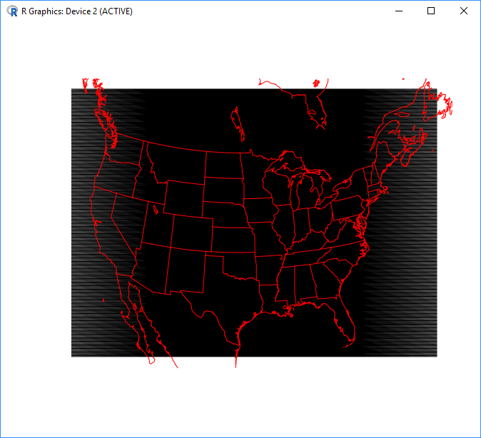
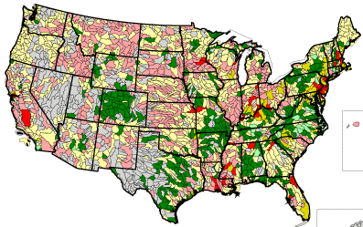
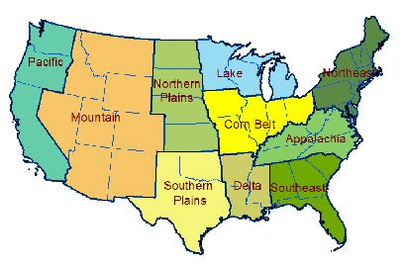
Scale of input data
Model Grid Resolution
  Meteorology
  Land use
Hydrologic Unit Code 8
  Subbasin level soil properties
County (census of agriculture data)
  Crop and associated fertilizer types
  Cropping system practices (e.g. injected versus broadcast)
  Irrigation
USDA Production Regions
  Similar cropping methods
Cooter et al 2012
Notes:
This modeling system ingests data at different scales as shown in the figures on the right. Meteorology and land use data is at the grid cell, 12km in the case of the NEI simulation. Soil properties are from crop specific observations at the Hydrologic Unit Code 8 level which is a similar spatial scale as county data. Census of agricultural data is used at the county scale and the 10 USDA production regions are used for agricultural management practices.

Slide 94
Running EPIC with FEST-C for CMAQ
What input data do I need?
  Simulation cell size, domain extent and projection
  MCIP formatted meteorological data on same domain as you will run CMAQ
  MODIS and NLCD data layers
What data are provided/generated
  Land use coverage (location of agricultural land)
  Soils (pH, texture, nutrient status)
  Agricultural management
What do I get out?
  Land use file required for bidirectional CMAQ
  Daily agricultural depth of fertilizer application and fertilizer amount
  Initial soil chemistry status
  Fertilizers application rates and estimated crop yields
Available at https://www.cmascenter.org/fest-c/
Notes:
When running EPIC with FEST-C the user must provide the grid size, projection and geographic extent of the simulation, Meteorology Chemistry Interface Processor (MCIP) formatted meteorology and the MODerate resolution Imaging Spectroradiometer (MODIS) and NLCD data layers. The location of agricultural data, soil data and agricultural practices are provided with the tool. The output is a gridded land use file, daily agricultural fertilizer application method, injected or surface applied, and amount. Initial soil chemistry status and estimated crop yields.

Slide 95
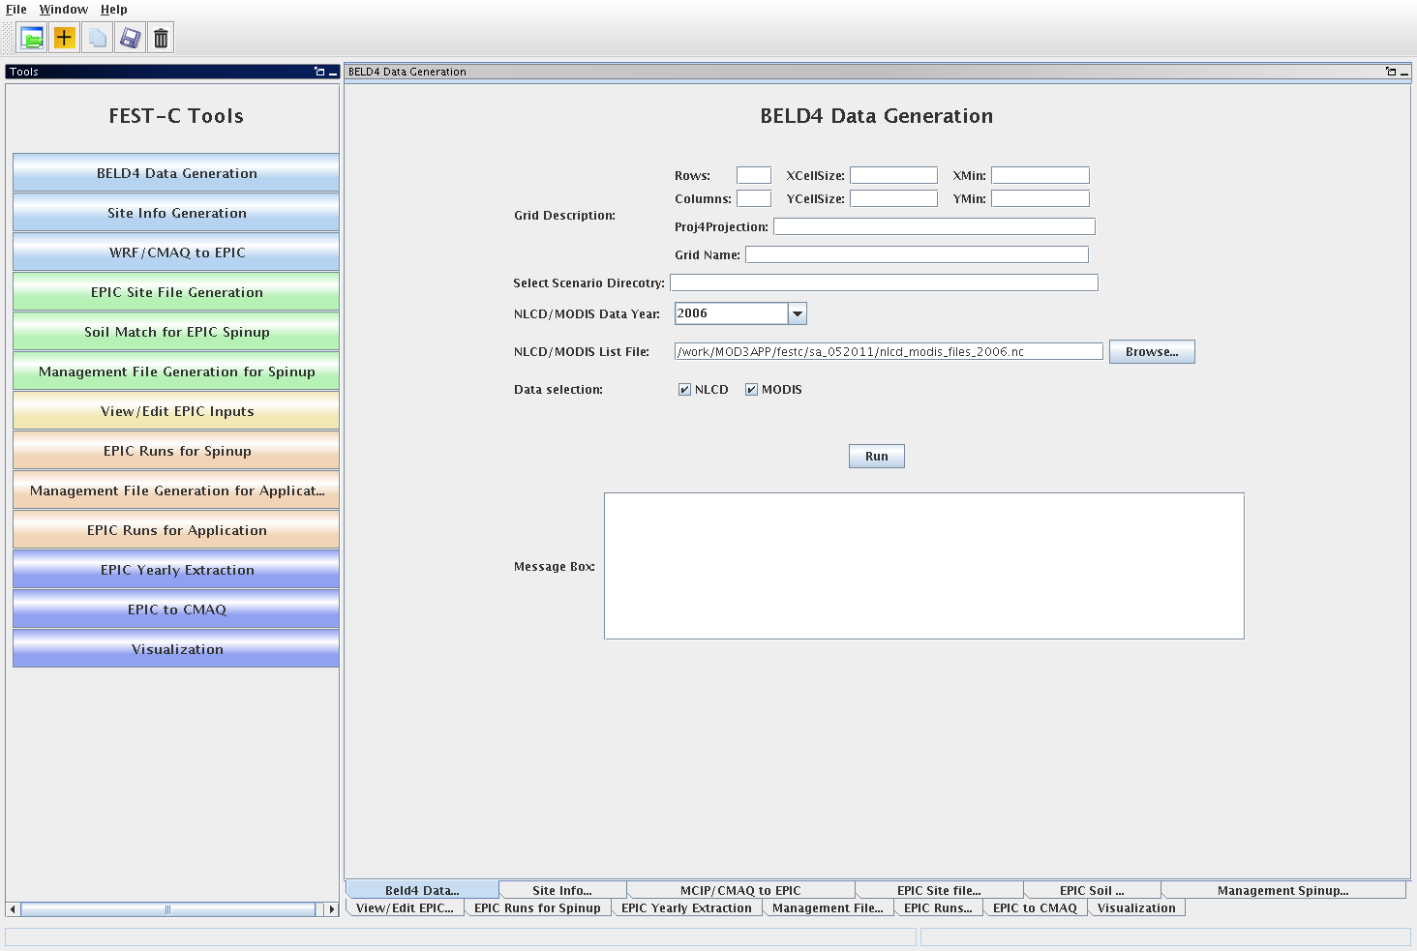
FEST-C User Interface
The FEST-C User Interface – facilitates user-generated CMAQ-ready fertilizer input for any gridded domain, grid cell resolution and weather year by creating and submitting executable scripts.
Notes:
This figure is the interface for the FEST-C tool and EPIC is run by sequentially working down the buttons on the left hand side of the window.

Slide 96
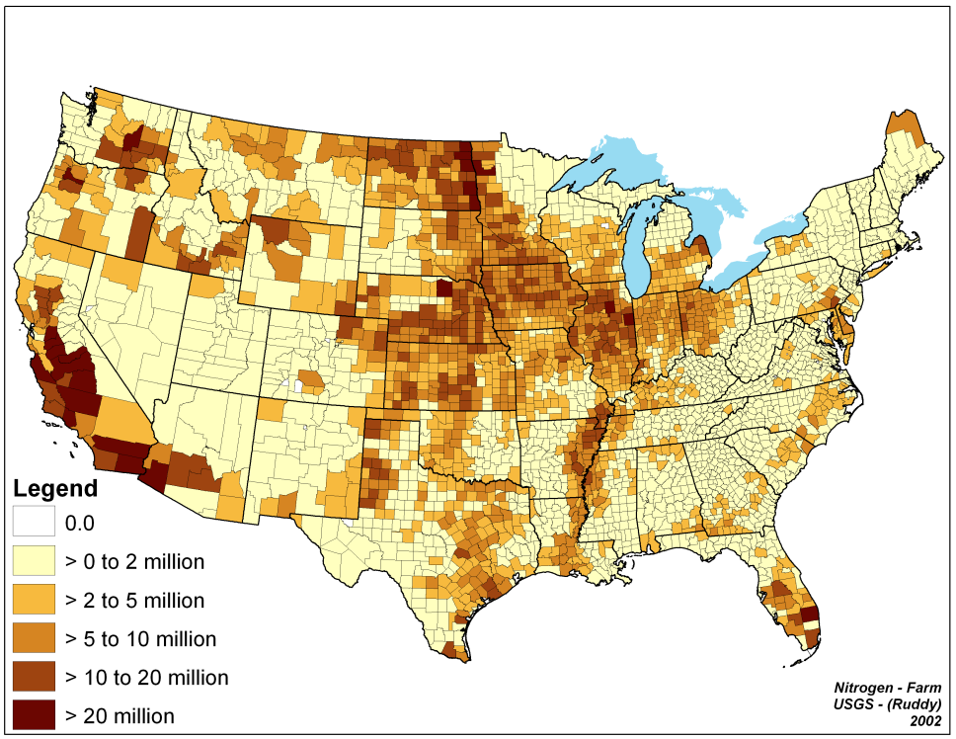
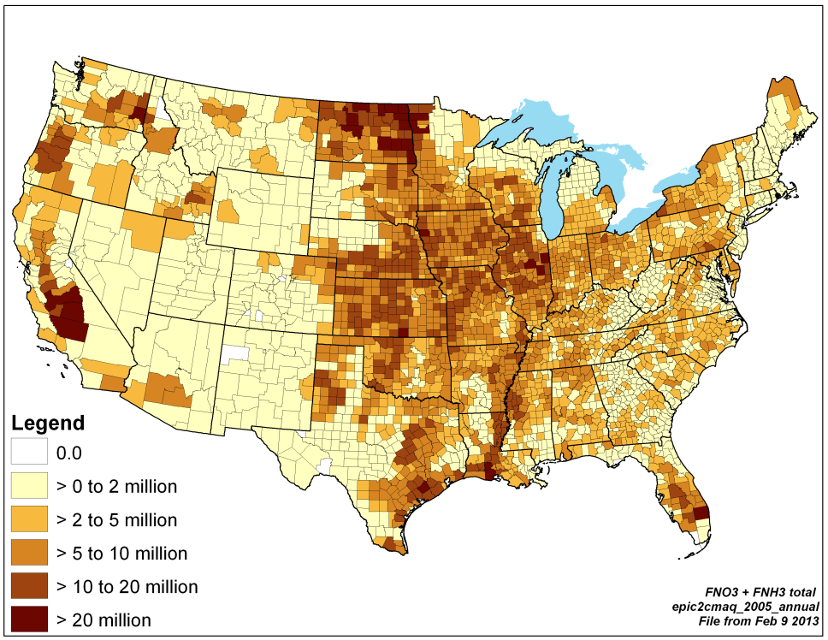
Running EPIC for CMAQ
Fertilizer Sales
EPIC Application
Gronberg and Spahr (2012)
The system does a reasonable job reproducing regional patterns of reported agricultural fertilizer purchases and use
Notes:
Simulations of fertilizer use have generally shown good agreement with fertilizer sales data. The figure on the left shows county level fertilizer sales and the EPIC estimates are shown in the figure on the right. The system does a reasonable job reproducing regional patterns of reported fertilizer purchases and use.

Slide 97
CMAQ Bidirectional NH₃ Simulations
Notes:
Introduction slide to next section

Slide 98
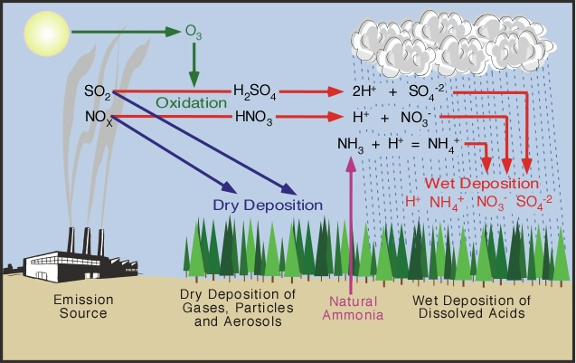
Modeling NH₃ exchange
CMAQ with bidirectional exchange connects the emission and deposition of NH3 from cropping systems to ambient concentrations
  Important for emissions and deposition weeks to months following fertilization
  Captures the impact that vegetation coverage has on emissions
Notes:
Running CMAQ with bidirectional NH3 exchange connects fertilizer NH3 emissions and deposition with atmospheric NH3 and other pollutant concentrations, transport, and fate. This system can capture the dynamics of NH3 emissions following fertilizer application and the impact that crop vegetation coverage has on the emissions. The figure to the right illustrates the processes in the multipollutant emissions, transport, transformation, and fate modeled in CMAQ.

Slide 99
CMAQ with Bidirectional NH₃ Exchange
Ammonium, pH, and
application method
Modeled
EPIC
Data
Fertilizer Applied?
CMAQ Modeled
Atmospheric NH₃
Yes
Modeled
WRF
Data
Soil Moisture
& Temperature
CMAQ Modeled Soil NH₄
Atm NH₃ > soil NH₃?
Emissions
No
NH₄→NO₃
Yes
Nitrification
Deposition
Notes:
This flow diagram steps through the processes in generating fertilizer NH3 emissions using CMAQ with bidirectional NH3 exchange. The processes start at the left with EPIC agriculture and WRF meteorology simulations. CMAQ then reads in the meteorology and fertilizer application data. CMAQ then calculates the NH3 flux and soil NH4 nitrification simultaneously. If the atmospheric NH3 concentration is greater than the soil NH3 concentration, then the model estimates deposition. If the soil concentration is greater than the atmospheric concentration, then emissions are estimated.

Slide 100
CMAQ with Bidirectional NH₃ Exchange, details…
Requires setting a few environmental variables
  Setting the soil N file, EPIC outputs, and flags to run the model
Currently works only with WRF in a retrospective simulation mode, the Pleim-Xu land surface scheme
  CMAQ v5.3 will have options to work with WRF land surface schemes capable of forecasting
Emissions, NH3_Emis in kg ha hour, are output in the CMAQ Dry Deposition file
  Currently estimates agricultural and natural emissions
Emissions are removed from the soil pool in the model
  Ensures emissions cannot exceed nitrogen input
Notes:
Running CMAQ with bidirectional exchange requires setting a few environmental variables in the run script to point to EPIC output. Currently it only works with WRF simulations using the Pleim-Xu land surface scheme. The next version of the model will support more WRF physics options. Emissions and deposition are output in the CMAQ dry deposition file. Current estimates aggregate natural and agricultural sources. These emissions are removed from the soil pool in the model to ensure that emissions cannot exceed nitrogen input.

Slide 101
NEI V2 Fertilizer NH₃ Emissions
Notes:
Introduction slide for next section

Slide 102
2014 NEI V2 estimates
Ran EPIC with updates to fertilizer application to pasture and hay
  Reduced application in the Southeast US
Emission estimates from a 2014 CMAQ v5.1 simulation
Tabulated monthly and annual emission estimates
Emissions reduced in Southeast and TX, increases in parts of CA and Upper Midwest
Cooler spring temperatures in 2014 accounted for some emission reductions
Notes:
The 2014 NEIv1 estimates were generated with a 2011 EPIC and CMAQ simulation with emission factors generated as the annual emissions divided by the annual fertilizer application applied to a 2014 EPIC simulation annual fertilizer totals. The 2014 NEIv2 estimates were generated by running EPIC with updates to correct for over application of fertilizer to pasture and hay using WRF v3.8 meteorology for 2011 and CMAQ v5.1 with bidirectional NH3 exchange using the 2014 NEI emissions inventory. CMAQ estimated fertilizer emissions were then tabulated for county level monthly and annual values. This differed from the 2014 NEIv1 in the following ways. 1) NH3 fertilizer emissions were reduced in the Southeast due to EPIC pasture/hay correction. 2) A reduction in emissions in TX and the Upper Midwest due to cooler temperatures in 2014 in those areas than 2011. 3) An increase in the emissions in California due to an increase in temperature in 2014 in those areas.

Slide 103
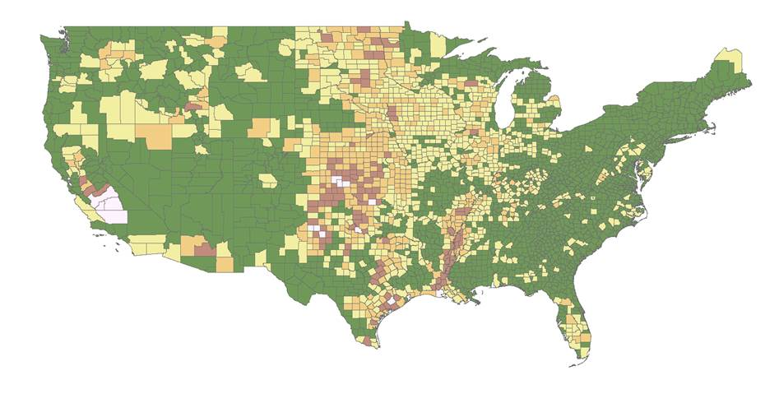
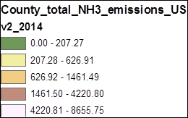
2014 NEI V1 (version 1) estimates
(Ton per County)
Notes:
This is the 2014 NEI V1 county level annual fertilizer NH3 emission estimate. Generated emission factors generated from a 2011 EPIC and CMAQ simulation applied to the 2014 EPIC fertilizer application estimate. These emission factors are a function of the meteorology and differences between 2011 and 2014 meteorology should influence the 2014 NEI V1 fertilizer emissions. An off year was used for the first round of emissions due to the lack of data to run CMAQ.

Slide 104
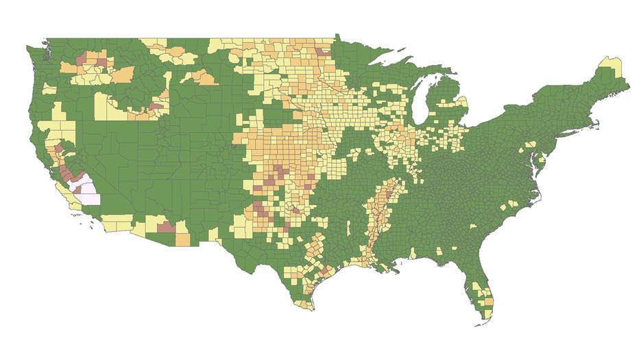
2014 NEI V2 (version 2) estimates
(Ton per County)
Notes:
This is the 2014 NEI V2 county level annual fertilizer NH3 emission estimate generated by running EPIC and CMAQ for 2014. The direct emission estimate from CMAQ were used in this estimate. Notice the lower emissions in the upper Midwest and Southeast and higher emissions in California.

Slide 105
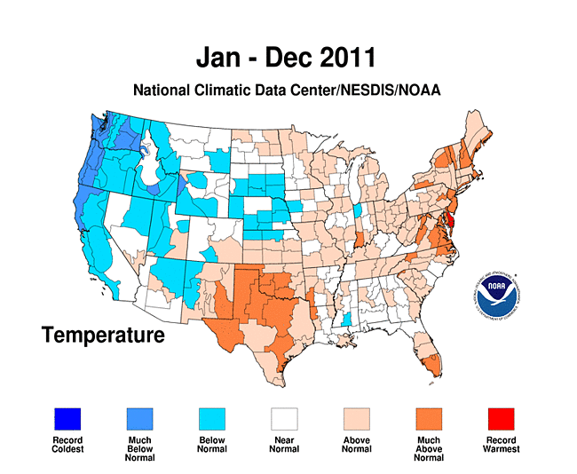
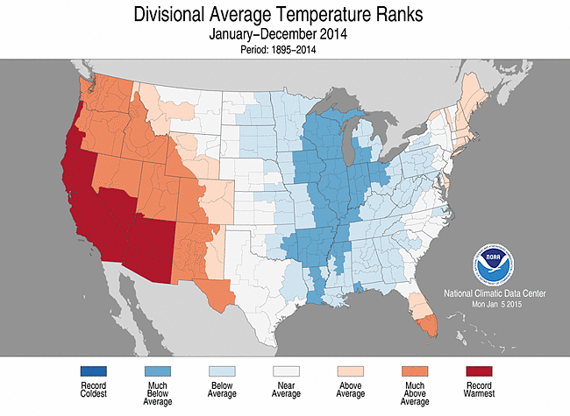
2011 versus 2014 Meteorology
Differences in emissions are due to meteorological dependence on emission factor and improvements to EPIC pasture and hay management
Notes:
The emissions difference between the 2014 NEI V1 and V2 match the change in temperature between those years well. The right side figure is the National Climatic Data Center’s 2011 divisional temperature deviations. Notice that in the West the temperatures were lower than average and higher than average in the Midwest and Northeast. This pattern was nearly reversed in 2014 with higher than average and record temperatures in the West and lower than average temperatures in the Midwest. Given the difference in the meteorology in the two years with EPIC simulations, the model is behaving as we would expect, with higher emissions with higher temperatures.

Slide 106
Looking forward to 2017 NEI
Similar as 2014 NEIv2
NH₃ emission model is being made more consistent with representation of fluxes in the Comprehensive Air Quality Model with Extensions (CAMx) and for other pollutant species in CMAQ
  Higher emissions in some agricultural regions due to more explicit modeling of agriculture and updated algorithms
Additional evaluation of technique against observations to give more credibility to 2017 NEI, if successful
  Agricultural and non-agricultural field observations
Biogenic and agricultural NH₃ emissions output explicitly
Updating FEST-C to use 2016 Census of agriculture activity data to better represent current farm management practices
Notes:
Looking forward to the 2017 NEI, we are proposing to use a similar methodology as the 2014 NEIv2. We are refining our CMAQ NH3 emissions estimate by making the parameterization more consistent with other CMAQ species and parameterizations in CAMx. We will also have additional observational data to better evaluate the emission estimate and its impact on air quality. The revised modeling system will also allow for explicit agricultural and biogenic NH3 emissions. If the data is available, we will also update the fertilizer use and management practices in FEST-C to use the latest census of agriculture

Slide 107
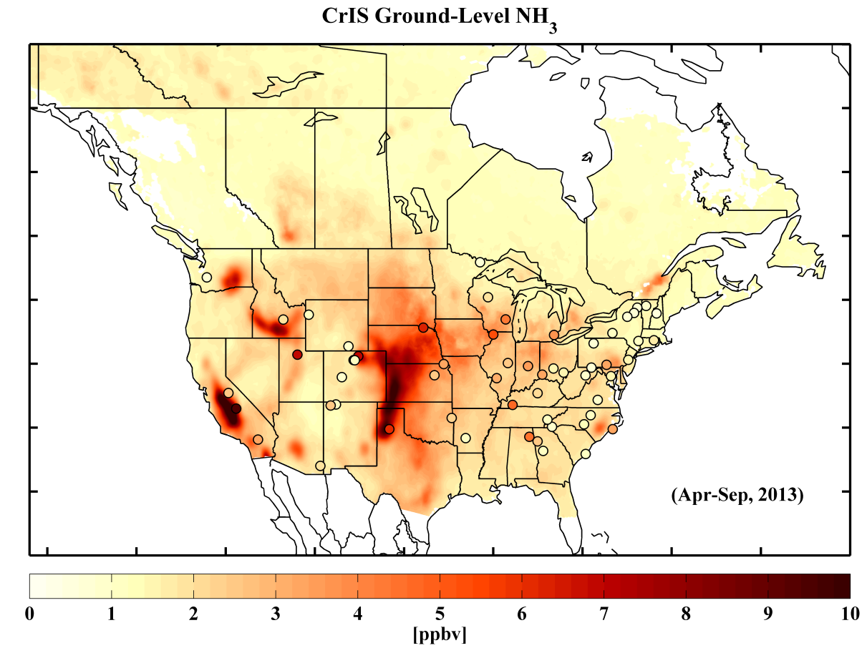
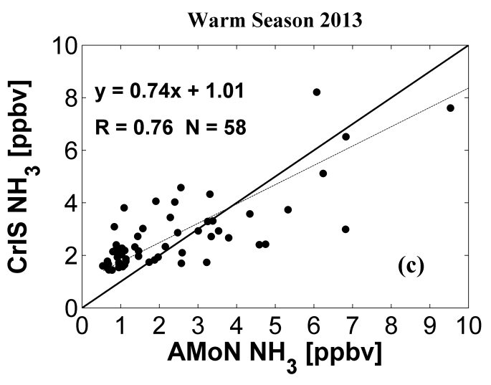
Data that could help 2017 NEI development
EPIC activity data
  Fertilization rates, types and application depths, planting and harvesting dates, crop types
Cross Infrared Sounder (CrIS) NH₃ retrieval
  Daily satellite NH₃ data, ~1 ppb detection limit, 15-8 km grid resolution
  Retrieval algorithm delivered to NASA
This data will help in identifying source areas and seasonality of NH₃ emissions
  Spatial and temporal allocation of animal sectors
  Identify areas where more detail may be necessary to improve fertilizer emissions
Shailesh Kharol et al. In prep. 2018
Notes:
We are currently collecting data to help the 2017 NEI NH3 emissions estimates. We intend to provide activity data for the fertilizer emissions. These data are fertilizer rates, types, application method, planting and harvesting dates, and crop types. NASA Cross Infrared Sounder (CrIS) data is being generated for the evaluation of NH3 emissions in CMAQ. These data consist of daily satellite NH3 observations with an approximate 1ppb detection limit and 15-8 km footprint averaged to monthly means. An example of CrIS data is given to the right with the top image being a map with surface Ammonia Monitoring Network (AMoN) observations plotted on top and the lower figure is a scatter plot of the CrIS and AMoN data. The satellite is able to capture the variability in the surface observations well with a slight overestimate at low concentrations and an underestimate at high concentrations. The CrIS biases are likely due to the spatial extent of the observation compared to point measurements with AMoN. These data will help us better evaluate the spatial and temporal emissions in the 2017 NEI.

