Slide 1
EIS Non-Point Survey
Jennifer Snyder & Jonathan Miller
USEPA

Slide 2
NOMAD Training
Module 1: Nonpoint Survey, Sept 19th at 2 pm ET
Module 2: Wagon Wheel, Sept 26 at 2 pm ET
Module 3: QA and the Selection, Sept 27 at 2 pm ET
Training will be recorded and posted here:
https://www.epa.gov/air-emissions-inventories/air-emissions-inventory-training
Refer to Word Document “Instructions for Connecting to the NOMAD Training Conference Call” if you have trouble, or contact Aimee St. Clair: 919-541-1063

Slide 3
Topics
Why do we have a survey?
What has changed in the survey from the 2014 inventory?
Process flow for completing the survey
How the survey is laid out
Survey features
Navigation
How to answer
How to get Information on what’s been answered
Upcoming changes related to the survey
Demo

Slide 4
Why Do We Have a Survey?
EPA creates a dataset that is parallel to those that SLTs develop, for the purpose of gap filling.
EPA needs to prevent double-counting of emissions or insertion of data where it doesn’t belong
State may cover the source in Point
State may not have a source at all
State may use a different SCC
“Our state doesn’t use coal for commercial boilers”
“All of our state’s gas stations are already recorded in the inventory as point sources”
“We report all of our burning under more specific leaf types than EPA does”

Slide 5
What Has Changed in the Survey
What we heard last time:
Comment: “The survey takes a long time to fill out.”
Response: Only 1 question!!
Comment: “My session timed out and I lost my entries.”
Response: Minimal clicks and time required to answer. “Easy Button” to accept EPA estimates (for the whole survey or a category).
Comment: “I can’t easily see all of my answers / why am I not “Complete”?”
Response: Reports available to see general status or detailed information of your survey responses.

Slide 6
Process Flow for Completing Survey
Step 1: Access the NP survey
Through “My Agency” OR
Through link Under “View/Add/Edit”
Step 2: Fill out survey. Submit / Save frequently!!
Step 3: Status will be shown on the survey, but you can run reports to see your entries.
You may make changes to your survey until the window closes (March 31, 2019).
EIS
My Agency
Non-Point Survey
SLT User
View/Add/Edit
Non-Point Survey
Reports
Standard Reports
NP Survey - Summary
NP Survey - Detail
Inventory
Developer

Slide 7
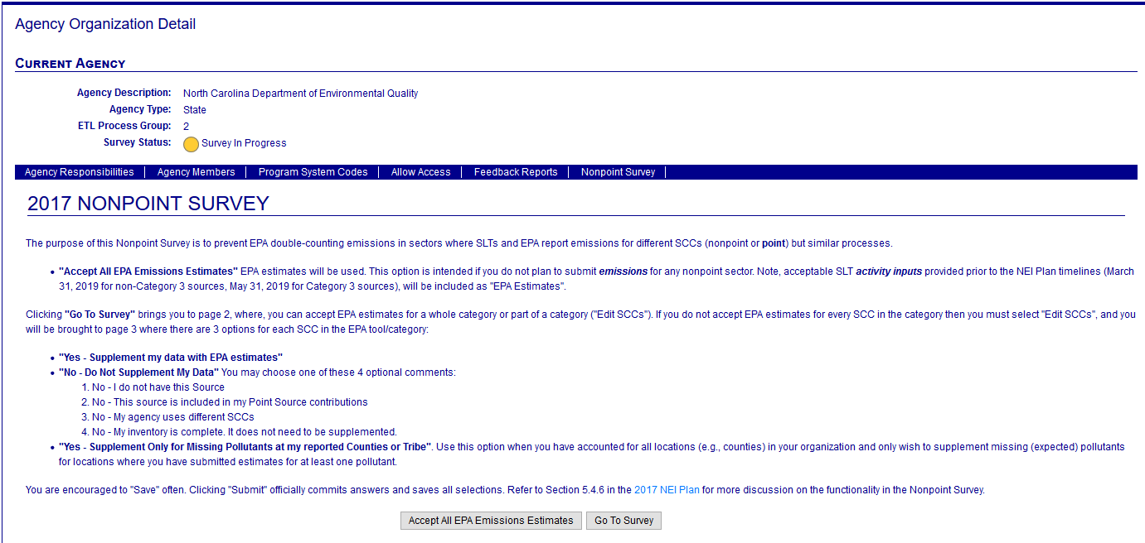
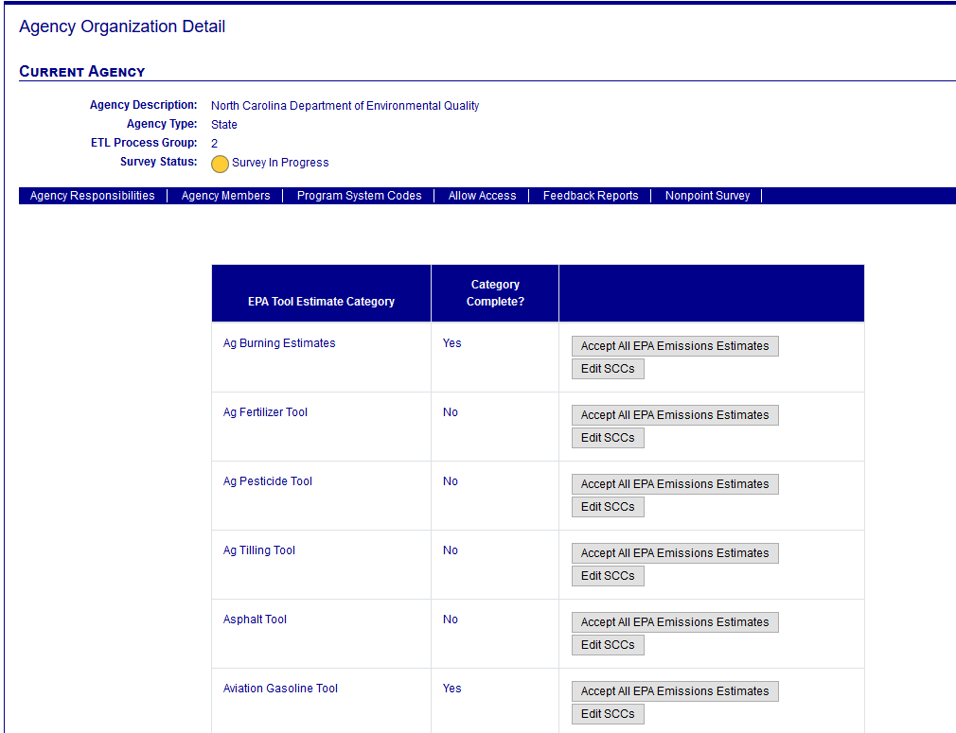
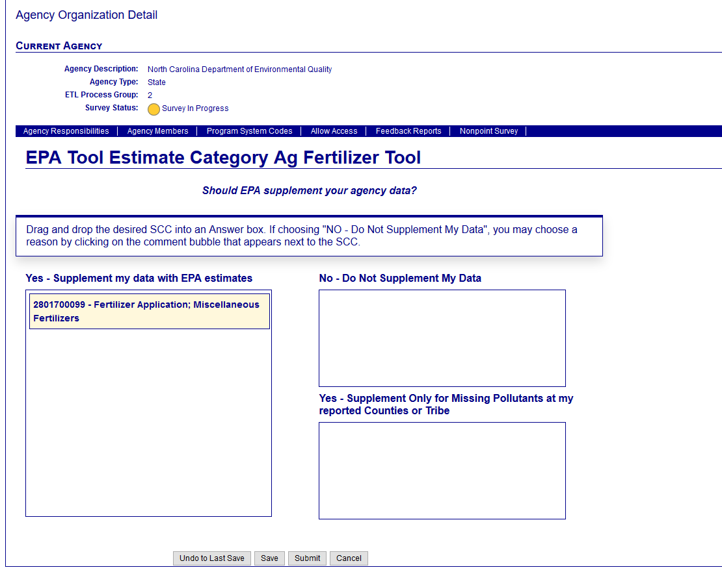
How the Survey is Laid Out
Page 3
Estimate Category Detail
Page 1
General Instructions
Page 2
Estimate Category Summary

Slide 8
How the Survey is Laid Out – Page 2
1 Question; 3 possible answers
Question: Should EPA supplement your agency data?
Possible Answers:
Yes - Supplement my data with EPA estimates: EPA Will “Fill In” for all SCC-pollutants for all areas within your agency where estimates through the tool are available.
No - Do Not Supplement My Data: No EPA data will be used at any location for your agency. If this option is chosen, you may specify why you don’t want the data supplemented:
No – I do not have this Source
No – This source is included in my Point Source contributions
No – My Agency Uses Different SCCs
No – My Inventory is Complete. It does not need to be supplemented.
Yes - Supplement Only for Missing Pollutants at my reported Counties or Tribe: EPA data will be used but only at locations where the agency has provided at least 1 value

Slide 9
Survey Features - Navigation
Accessing the Survey
Through “My Agency” then click on the “Nonpoint Survey” tab
Under the “View/Add/Edit” is a link to “Nonpoint Survey”
Page 1: “Go To Survey” takes you to page 2
Page 2: “Edit SCCs” takes you to page 3 for that estimate category
Page 3
“Undo to Last Save” – Clears all changes since the last time you saved and keeps you on page 3. This is not a “start over” Feature. Just takes you back to the last saved point.
“Save” – Saves your results and keeps you on page 3. This will not change the category status.
“Submit” – Saves your results and sends you back to page 2. You must “Submit” in order to see if estimate category is “Complete”.
“Cancel” - Clears all changes since the last time you saved and sends you back to page 2

Slide 10
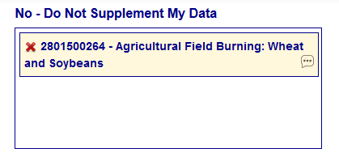
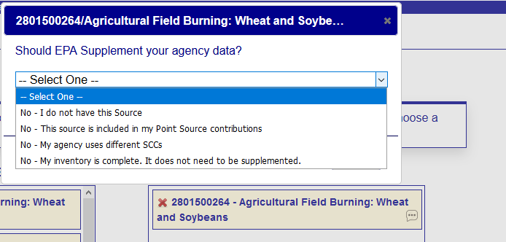
Survey Features – How to Answer Questions
If you submit activity inputs (for the new Wagon Wheel tool), you should accept EPA estimates
Your activity inputs become the EPA estimates
Use of “Easy Buttons”
From Page 1 – Will apply an answer of Yes - Supplement my data with EPA estimates to ALL SCCs (even if you previously said “No” to some SCCs earlier).
From Page 2 - Will apply an answer of Yes - Supplement my data with EPA estimates to ALL SCCs within the estimate category.
You may edit answers after using “Easy Button”. So if you wanted “Yes” for all SCCs except a few, use the easy button, and then go into the specific category and “tweak” answers.
Page 3
The default answer is Yes - Supplement my data with EPA estimates. Drag and drop the SCC from the left list Into the appropriate answer box in the form.
For No - Do Not Supplement My Data, click on the answer bubble to say “why” you answered “No”.

Slide 11
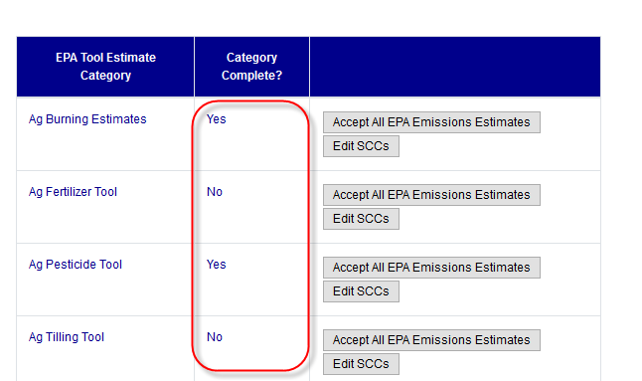
Survey Features - How to Get Information on What’s Been Answered
Standard reports
NonPoint Survey Summary Report
NonPoint Survey Detail Report
Survey status is available at top of each page
Red / Pink: Not started
Yellow: At least 1 SCC has an answer
Green: All categories are “Complete” (they all have answers)
You may continue to change answers even if “Complete”
Category status is available on the screens
Yes: All SCCs in the category have answers
No: At least 1 SCC in the category does not have an answer

Slide 12
Recent / upcoming changes related to the survey
September 14
Non-Point survey reports (Summary and Detail)
Minor text changes
“Nonpoint Survey” link moved to “View/Add/Edit” area
September 28
Additional filtering capabilities for the NP survey reports
Filter by the Status (category or overall survey status)
Filter by estimate category
Have the survey work with Internet Explorer

Slide 13
Final notes…and any questions?
“Easy button” does the following (good or bad):
Completes the survey quickly & this cannot be undone
Answers “Yes” for every Non-Point estimate category
Any changes must be made SCC by SCC
We strongly suggest reviewing the methodology and estimates before you agree to accept EPA estimates (where it does not overlap with your submittal)
SharePoint site for NOMADs—here’s where you can find NEMOs, Wagon Wheel (next week’s training)
https://usepa.sharepoint.com/sites/oar_Work/NEI/NOMAD/SitePages/Home.aspx

