Slide 1
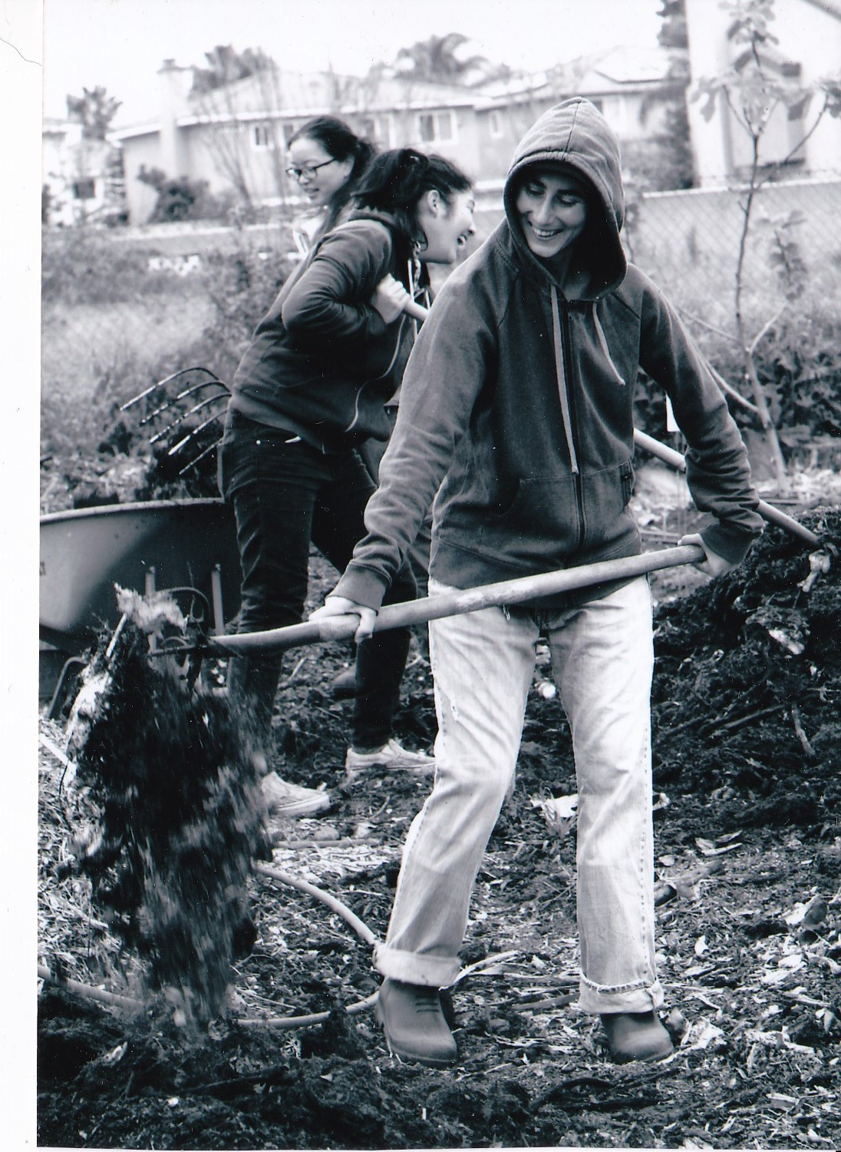
Elinor Crescenzi
LA Compost
Operations & Policy Coordinator
ECOFARM
Project Coordinator
Pomona Community Farmer Alliance
Logistics Coordinator
Alta Pasa Green Circle
Zero Waste Advocate & Project Anchor
ecrescenzi@gmail.com
Notes:
Recording 0:00-1:30
Intro
Community-based solutions to environmental justice issues
United Voices
Community-based waste management and Food Justice project funded through CalEPA Environemental Justice Small Grant

Slide 2
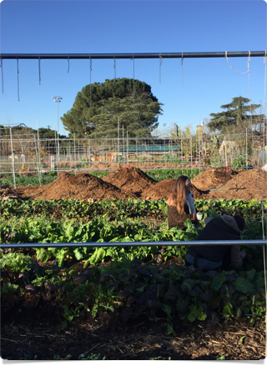
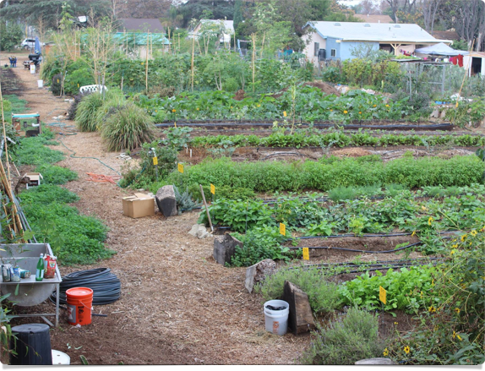
On the Ground, In the Community
Community Projects as Social & Environmental Justice Solutions
Notes:
Recording 0:00-1:30
Intro
Community-based solutions to environmental justice issues
United Voices
Community-based waste management and Food Justice project funded through CalEPA Environemental Justice Small Grant

Slide 3
Why don’t “big” solutions prioritize community and the environment?
Notes:
What stops big projects from prioritizing community and the environment? (Invite reflection)
What is it about our current structure and culture which allows for environmental injustice to occur so frequently and routinely?

Slide 4
We aren’t asking the right questions.
Notes:
We can ask different questions!
It is human beings who are making the decisions that impact the community and the environment.
If we can engage the thoughtfulness of the human beings who are planning, developing, and collaborating to create projects around some different questions, then we might end up with some different projects.

Slide 5
How does the structure of the business/organization benefit the environment and protect the community?
What values is the project rooted in?
How does the project promote social justice, equity, beauty, sustainability, health?
How do we measure the success of a project? Do we look at all the community and environmental benefits and impacts?
How do we understand innovation?
What kind of work is attracted by incentives? Who gets the opportunities to develop in our communities?
Notes:
Dialog with project creators about what the project promotes in the community helps project developers realize that projects should be creating things like equity, beauty, health, etc. not just money or certain targets.
Providing development criteria up front related to community and environmental impacts and benefits, shapes the project proposal goals and contributions.
Innovation is often only for ideas that can be monetized. We need to recognize and support ideas that achieve the results that we wish to see even if they cannot be monetized. We need to provide funding for these kinds of projects as well.
Use of financial incentives to launch projects, guarantees that you will get projects that are motivated by money. Other reasons need to be the focus for inspiring the project--such as justice, beauty, sustainability, equity, and health--and the funds treated as pragmatically instrumental to the success of those goals.
Large (state) incentives offered to big businesses, guarantee that the developers differ significantly on racial and class backgrounds from the community members where environmental justice problems tend to emerge.

Slide 6
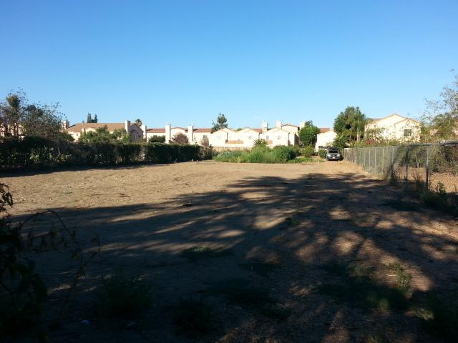
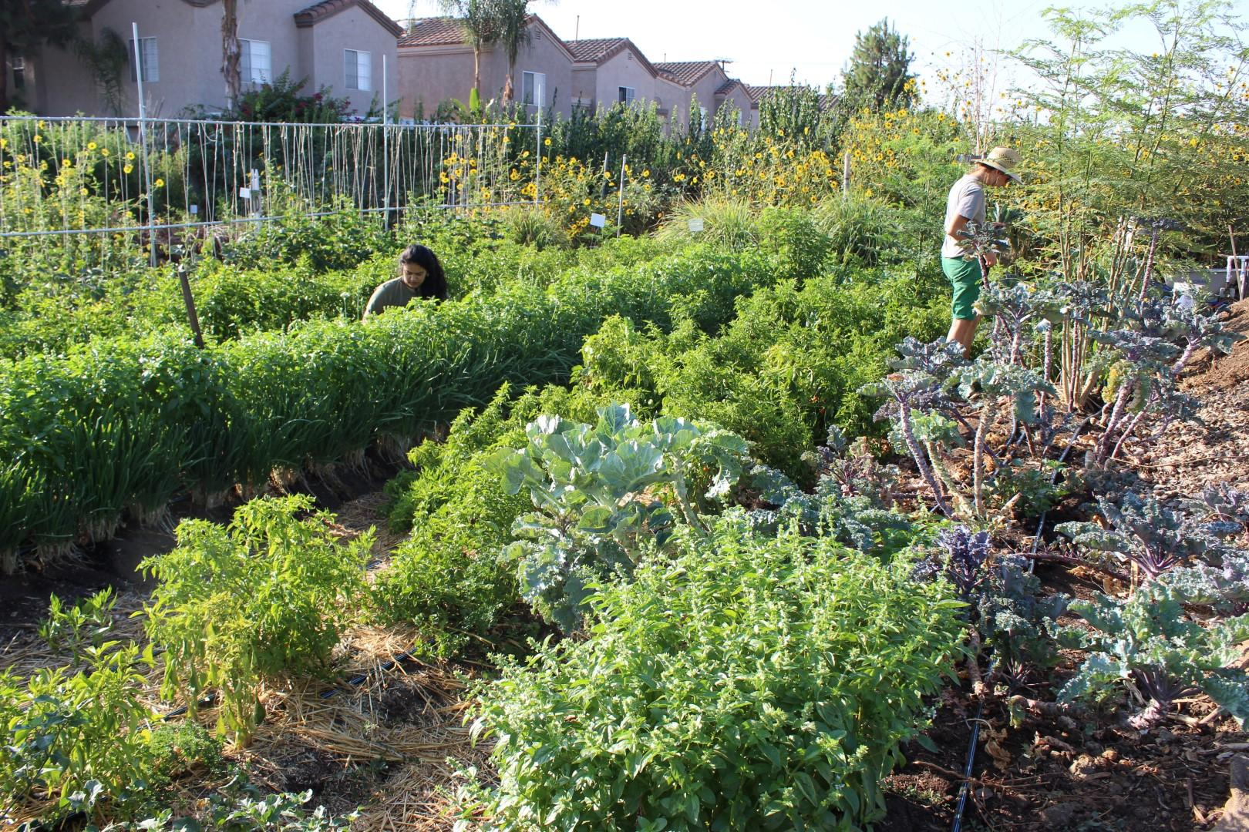
We need to reimagine
The empty and barren as full and vibrant

Slide 7
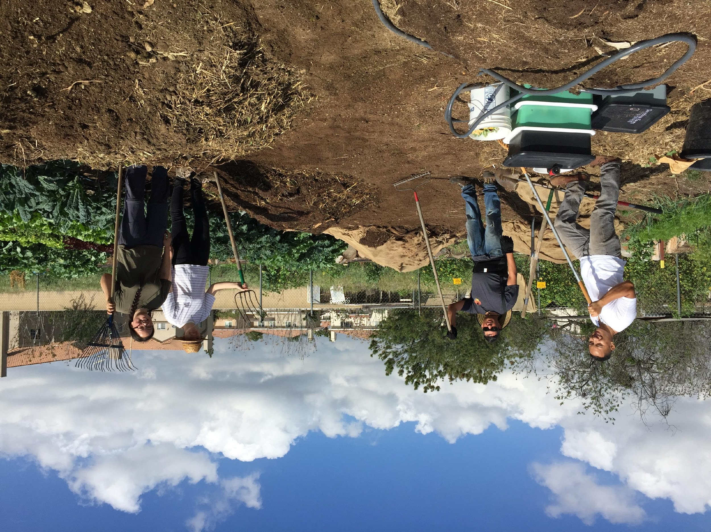
We need to reimagine
The industrial and destructive as productive and community scaled

Slide 8
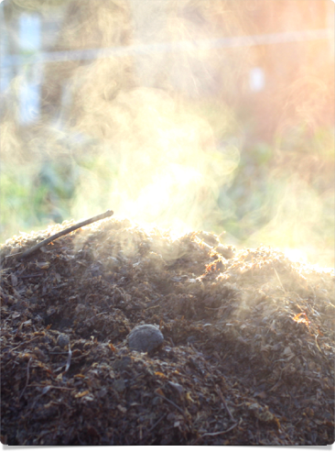
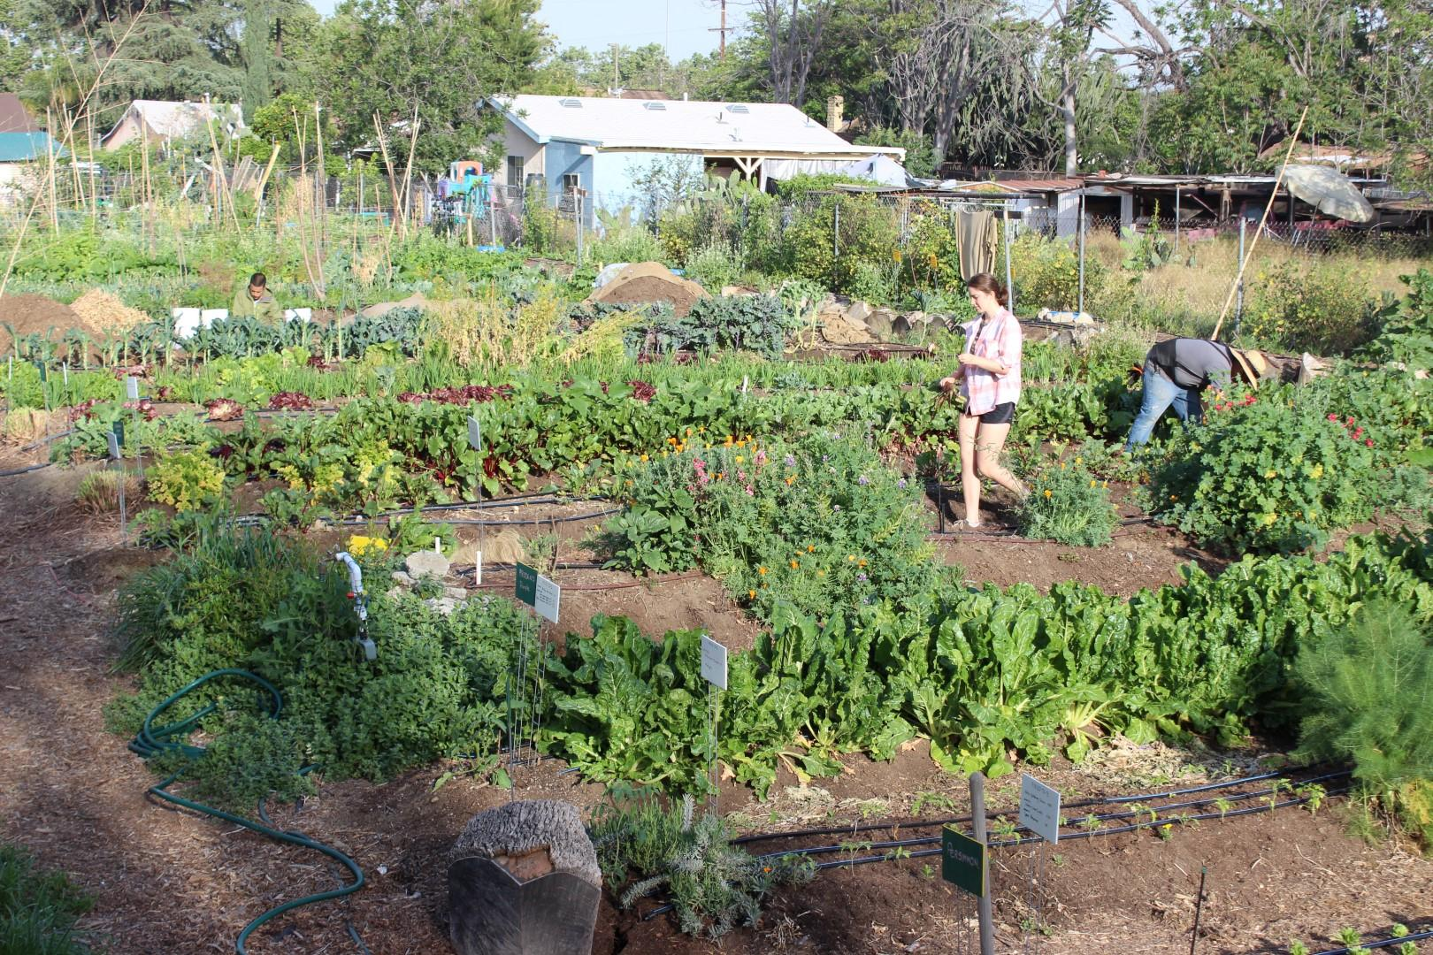
ECOFARM

Slide 9
What is an ECOFARM?
Ecological & Community-Oriented Farm and Resource Management project
Innovative, multi-dimensional, community-based approach to building environmental justice through:
Creating access to healthy food
Creating access to green space
Reducing exposure to toxins
Creating a safe gathering space
Empowering the community

Slide 10
What does an ECOFARM do?
Promotes new sources of healthy, fresh, organic, affordable & accessible fruits and vegetables
Provides safe, welcoming, green, gathering spaces
Facilitates the clean & sustainable disposal of waste
Offers programming around environmental issues, and community decision-making
Shares knowledge about farming, environmental justice & health
Notes:
How does this get done logistically?
Small (half acre) site serving 30 families, feeding approximately 120 people fresh fruits and vegetables.
Non-monetary model with respect to produce--straight labor for produce exchange. 4 hours per week per family for a box of veggies.
Waste collected from families and local community, using youth bike haulers, brought to farm where it is composted without heavy machinery.
2000 lbs of food per week with 2-3 volunteers donating 2-3 hours of time. [our methods have improved, and we can do this more efficiently because we have changed our bin washing system]
Compost used on site on the farm.

Slide 11
By the numbers...
What can a small, half-acre urban ecological composting farm do?
Compost:
30,000 lbs food waste
120,000 lbs organic matter
Mitigate:
34.44 metric tons CO2
Like taking 7.3 passenger vehicles off the road
Grow:
Community
10,000+ lbs of vegetables
Notes:
A lot of people think community based solutions are cute, but can’t actually do the numbers, but small sites can have quite a large impact on waste diversion and climate change mitigation.
Tiny area dedicated to composting, less than 1/30 acre, including storage--active composting approximately 750 sq. ft..
We could compost up to 2000 lbs of food waste per week, but we didn’t always have that much waste to compost.
This was the data from our first year in operation; subsequent years would easily have had greater metrics in terms of composting and food production.

Slide 12
South Pomona ECOFARM
Community-civic partnership
Model development for municipal expansion for mid-size city
Community led design process, EJ focus
360,000 lbs organic matter diverted
Projected annual food waste diversion: 100,000 lbs

Slide 13
Sustainable Claremont ECOFARM
NGO-Faith Community Civic-NGO partnership
Micro-site
Year 1: 7000 lbs
Year 2: 14000 lbs
Time commitment
2 hours weekly
ZERO transportation miles

Slide 14
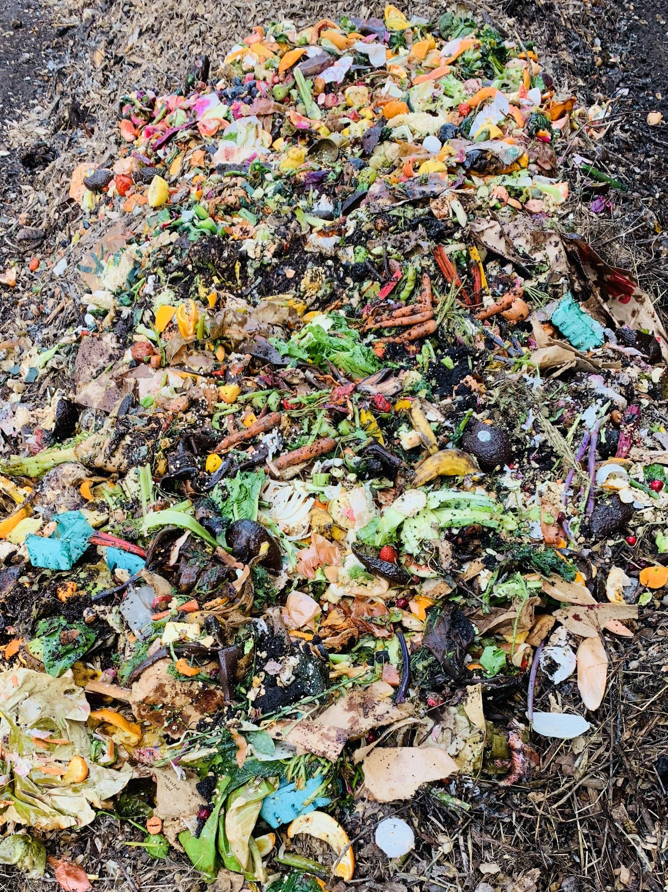
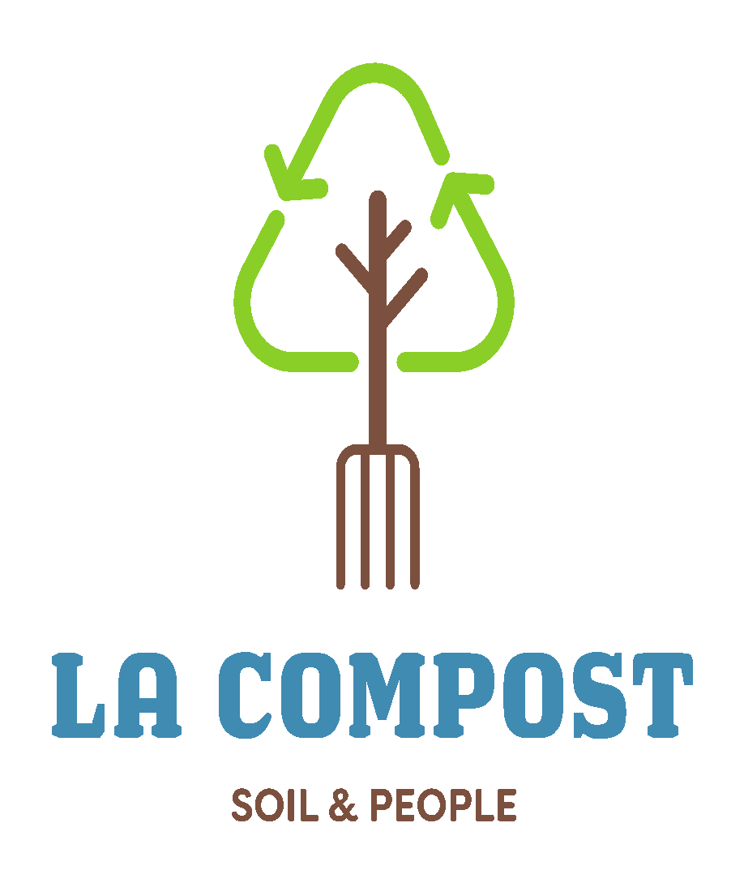

Slide 15
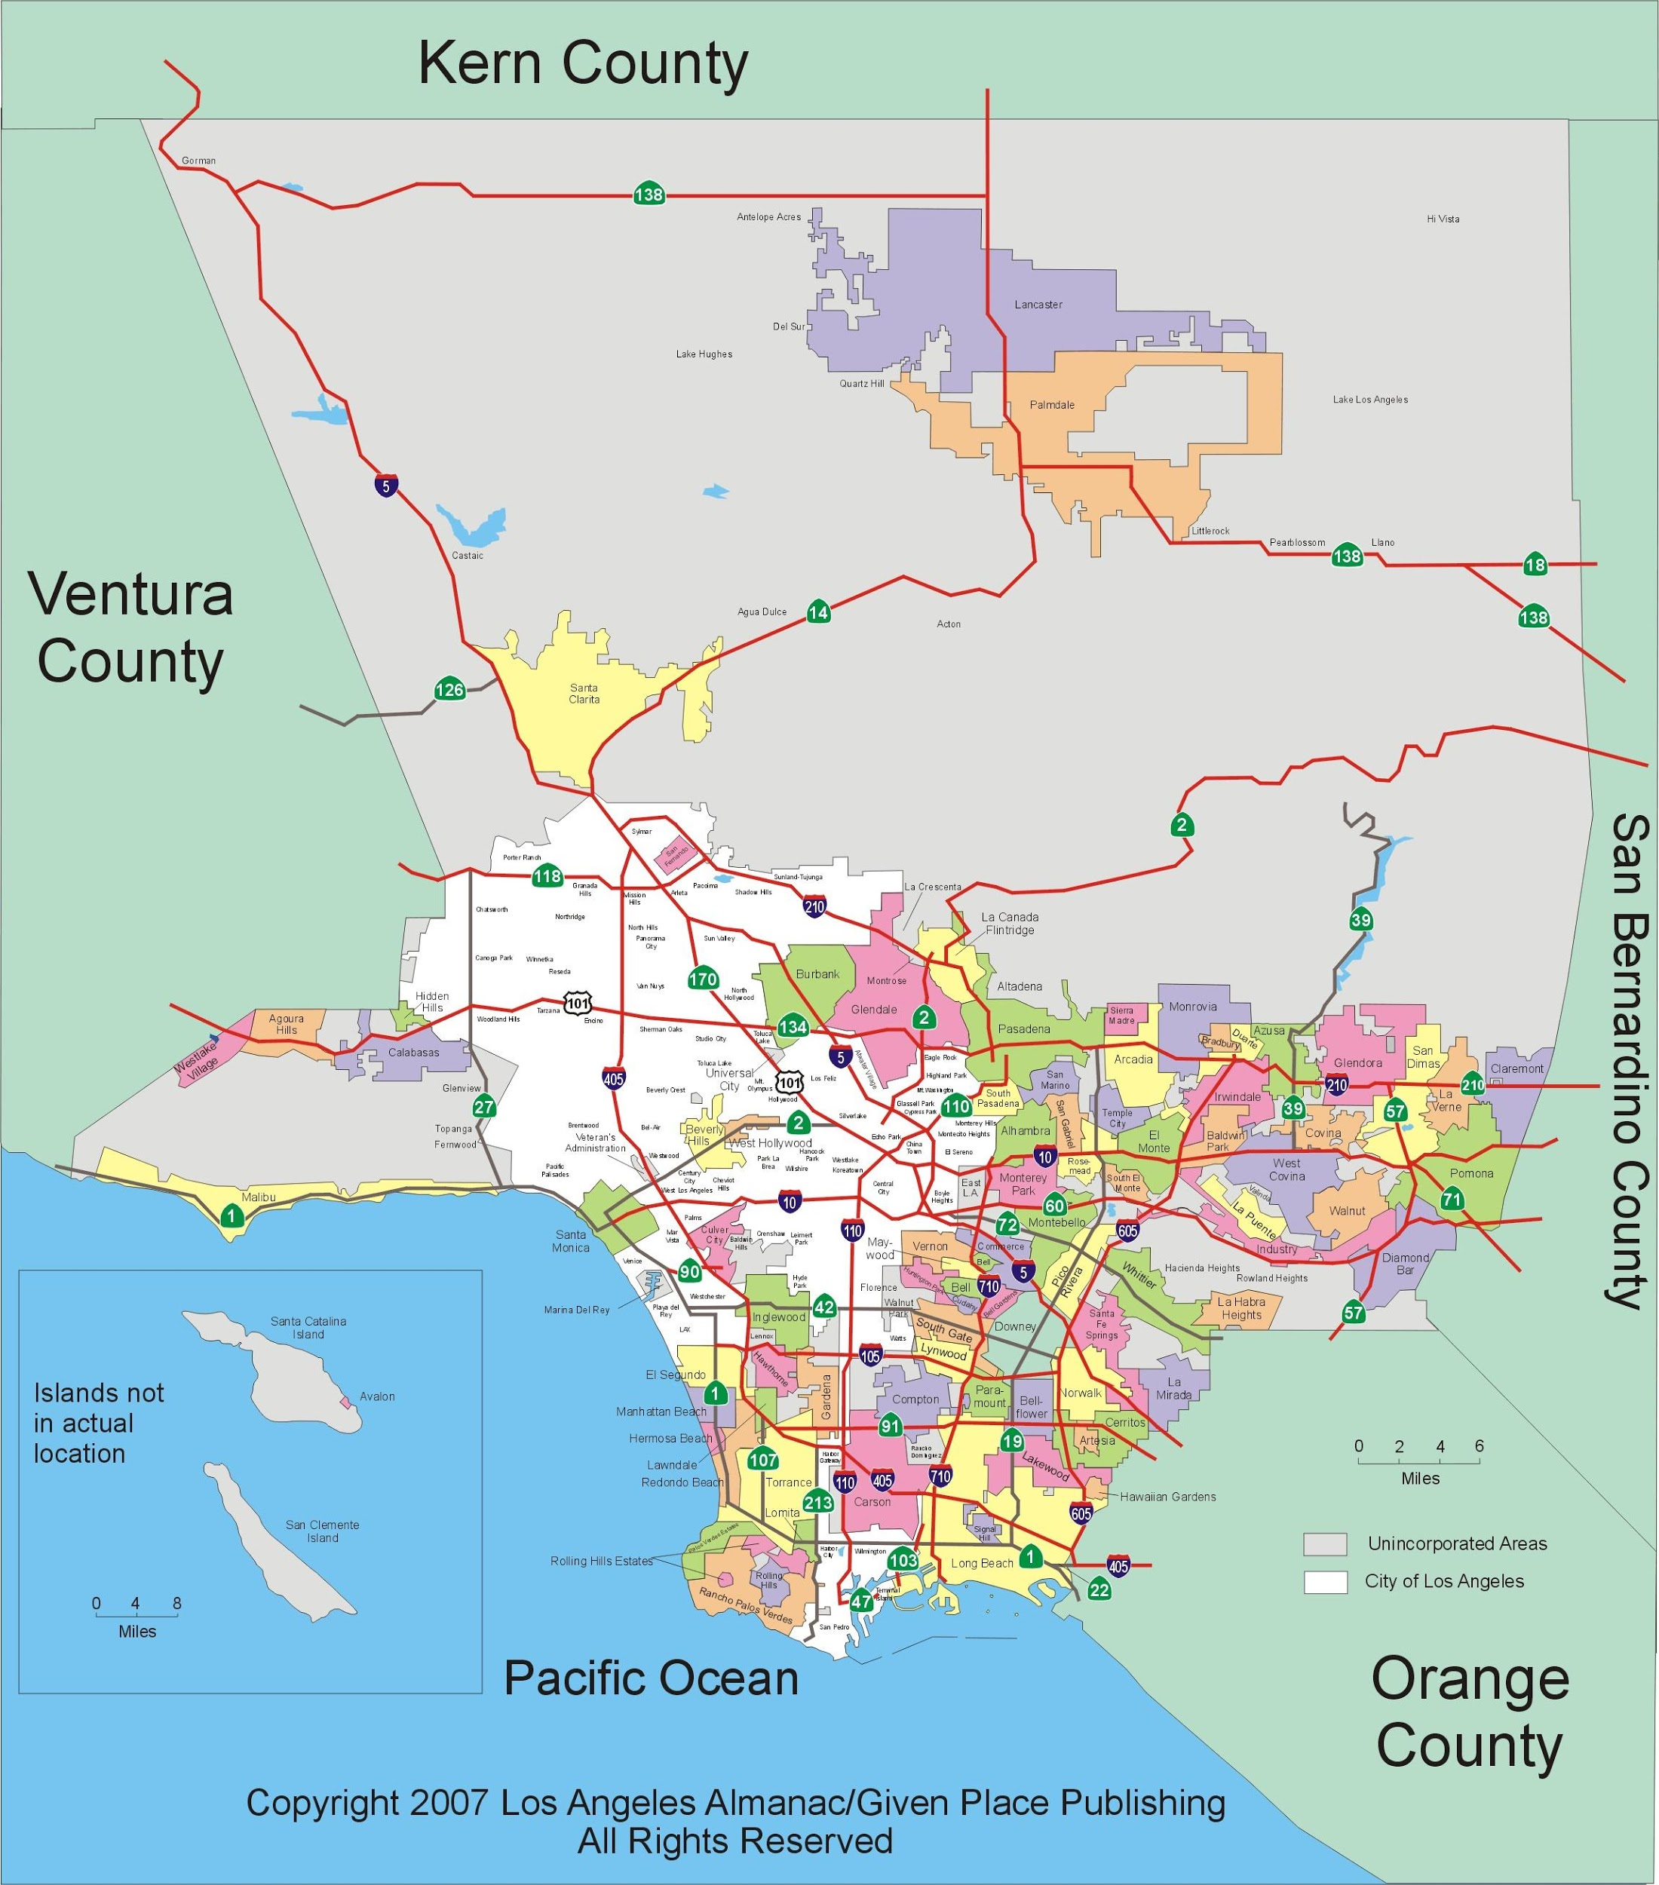

Slide 17
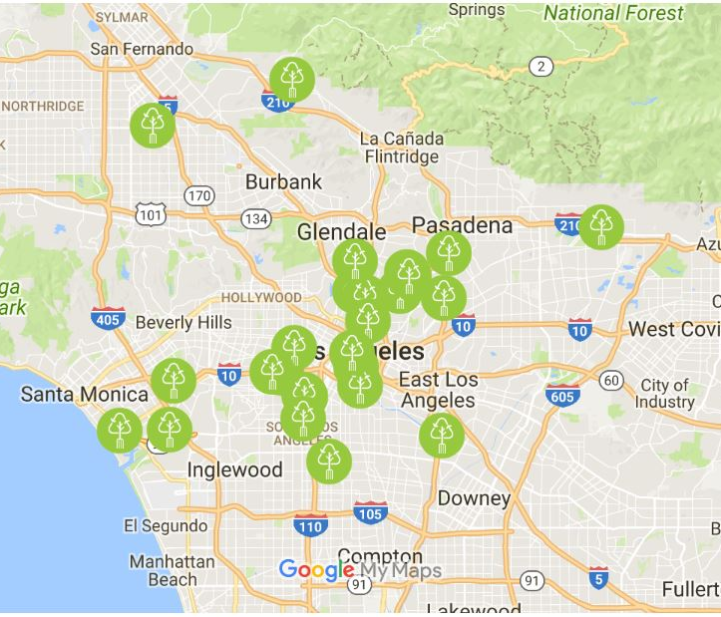
30 Community Hubs
3 Regional Hubs
Food scrap drop off
Compost Education
Community Leads
Volunteer hours
Current annual diversion--1 million lbs

Slide 18
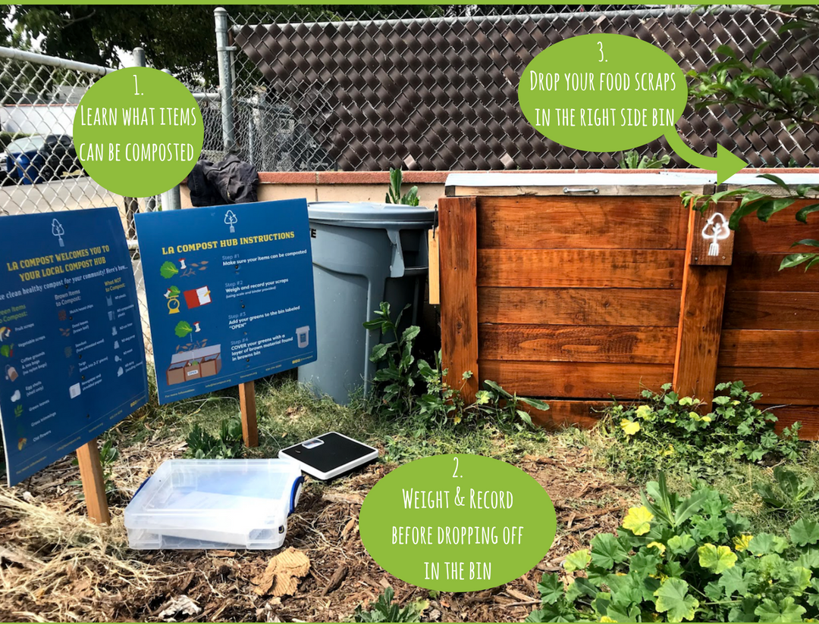
Community Hub
Established with a partner organization.
10 tons annually
75-100 active drop off members
Metrics collection
2 annual workshops
Oversight by LA Compost management

Slide 19
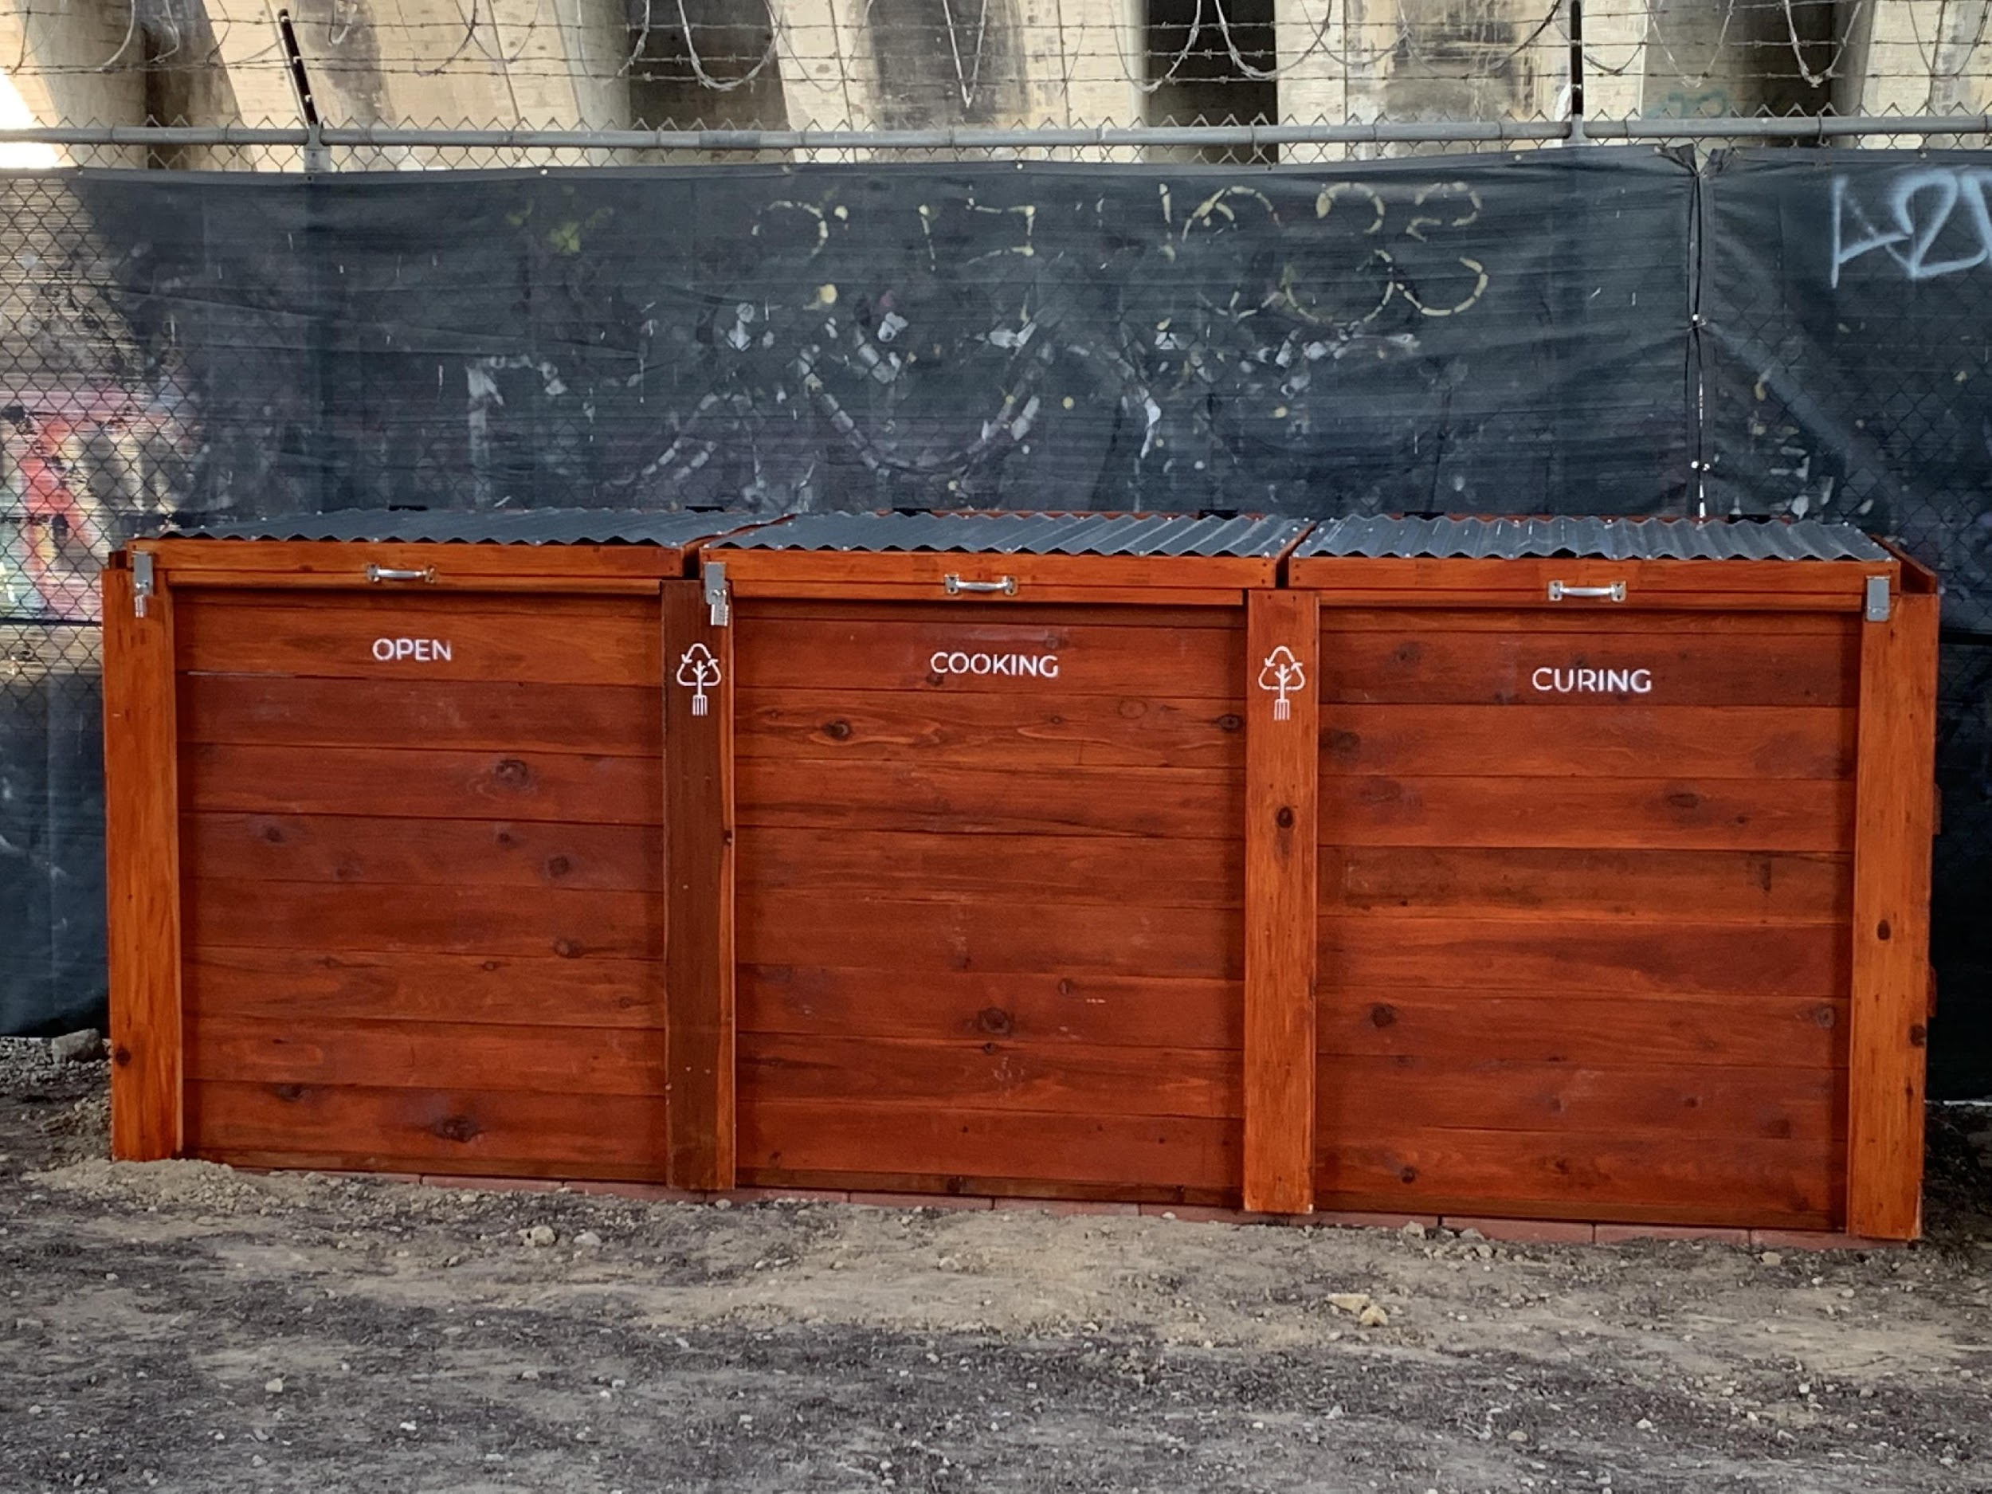

Slide 20
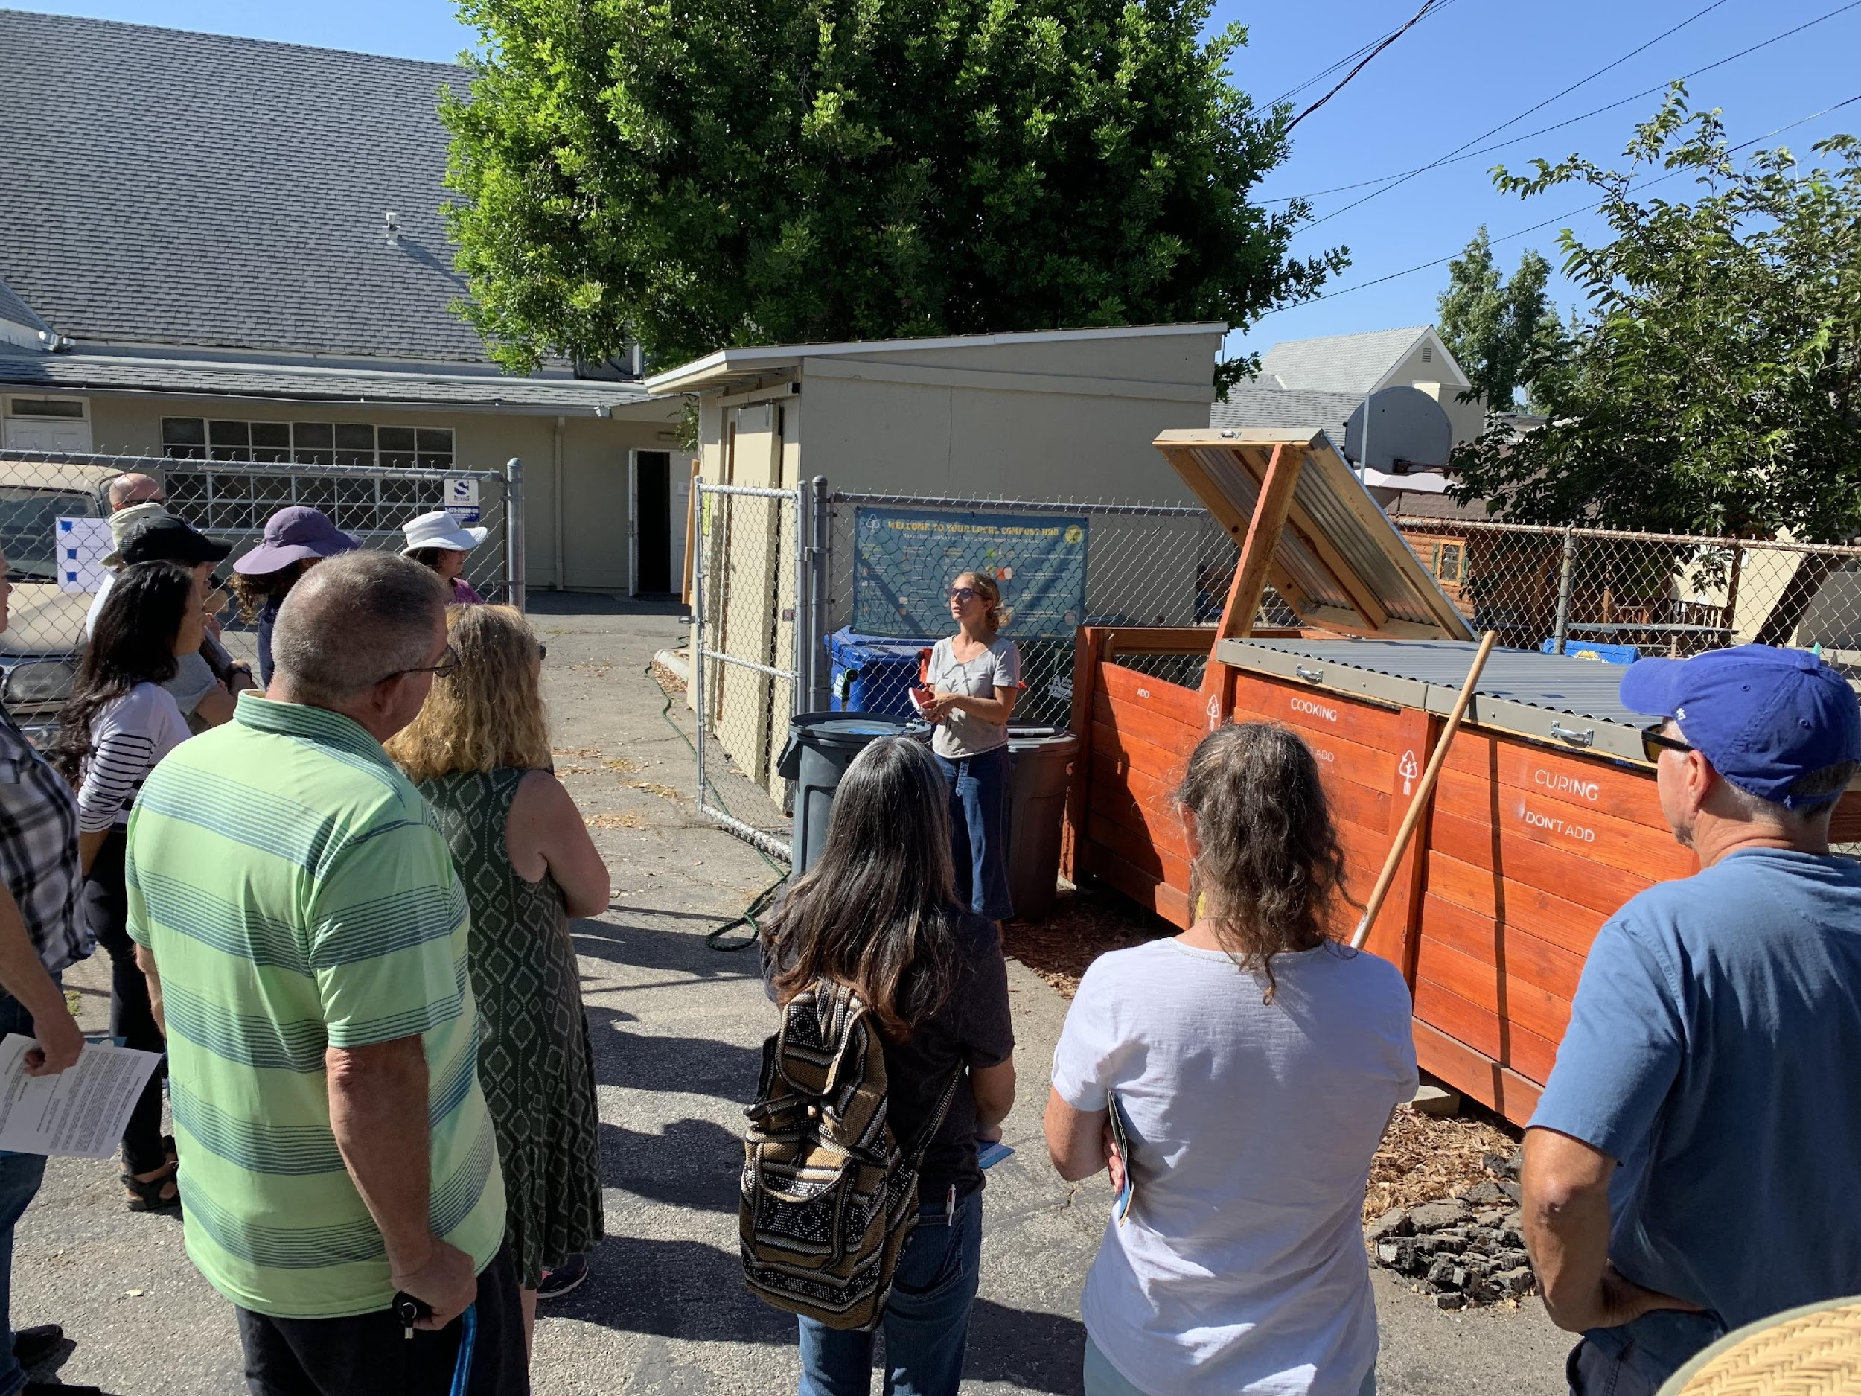

Slide 21
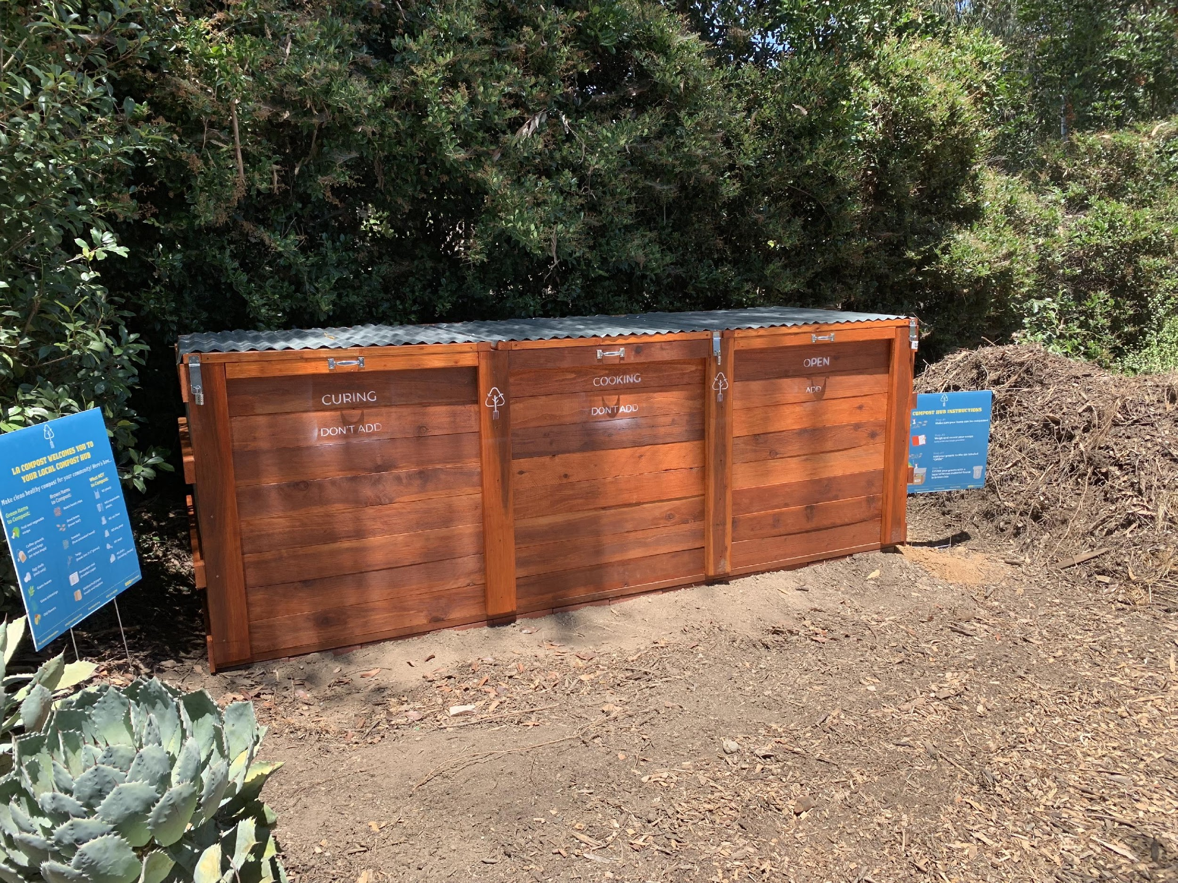

Slide 22
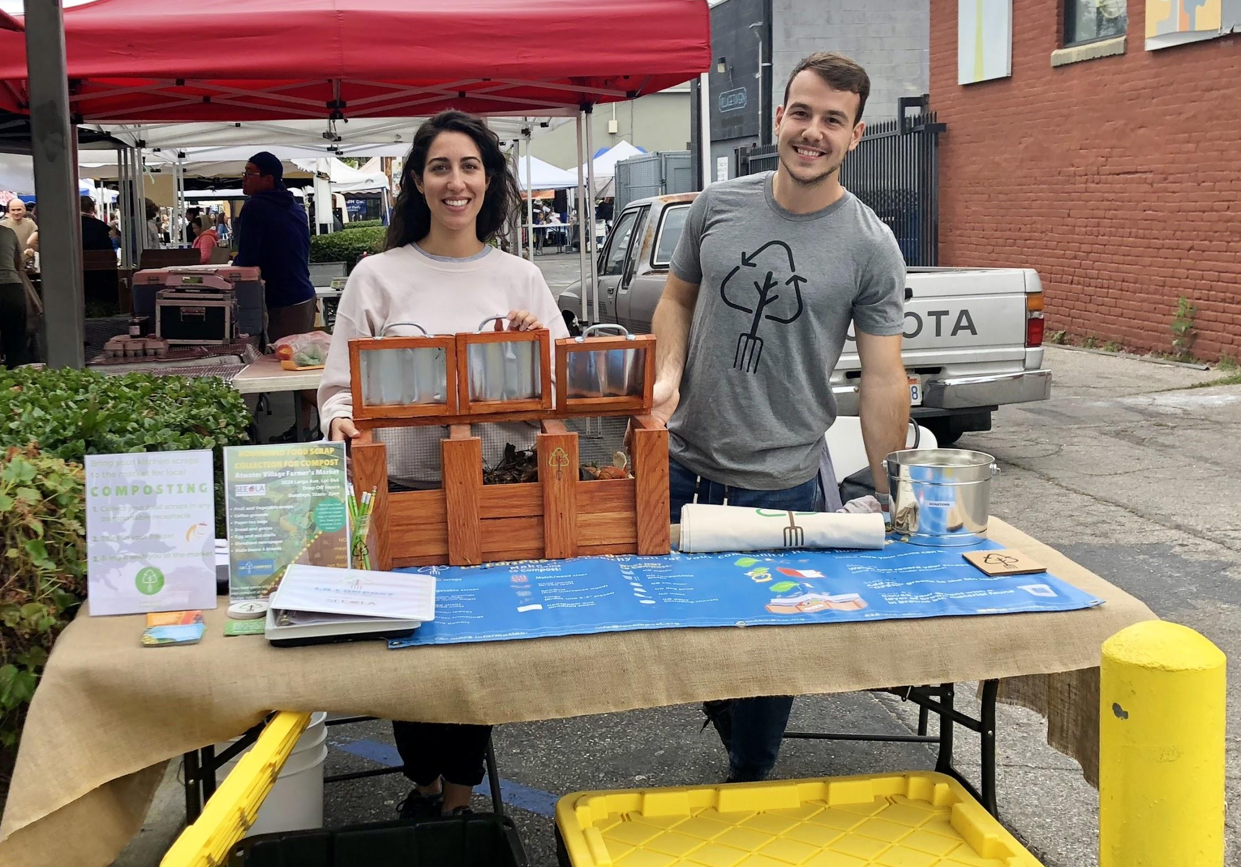
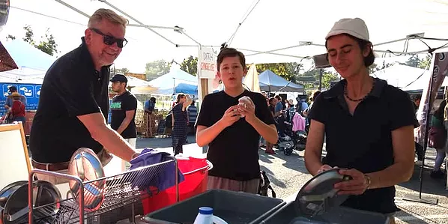
Community Engagement
Farmers Markets
Collection
Event BMP
Community drop off
Zero Waste Practice
Education & Outreach
Volunteer Engagement
Workshops

Slide 23
What happens when we work with the community and the environment?
Notes:
(open discussion)

Slide 24
Benefits

Slide 25
Environmental Benefits
Reduced methane emissions
Reduced transportation emissions
Soil carbon sequestration
Improved soil health
Improved water retention
Improved groundwater infiltration
Wildlife habitat restoration
Notes:
Methane--non-landfilling
Transportation--e.g. 40% reduction in transport emissions from local composting in Claremont vs. hauling to Fontana
Soil Carbon Sequestration--applied compost increases carbon sequestering capacity of environments from 25-70% (see Ryals & Silver 2013)
Increase in Soil Organic matter--pilot data showed organic matter increases from 1% to 11% and a 5x increase in water holding capacity
Ecological diversity helps to mitigate pest pressure, resulting in less pesticide use

Slide 26
Social Benefits
Reduces burden on disadvantaged communities
Provides responsible municipal resource management
Provide opportunities for community building and social interaction
Opportunities for public service and volunteerism
Provides an educational and community gathering space
Demonstrates ecological principles
Notes:
Programming desirable in both communities of disadvantage and advantage--projects can be evenly distributed across all communities. This allows folks who are more educated/wealthy/politically-engaged/doing government work to be better informed about the nature of the work that is done, because it is something that is done in their communities.

Slide 27
Public Health Benefits
Increased access to locally grown organic food
Opportunities for physical activity
Increased green space / park space
Increased sunlight exposure (vitamin D production)
Increased exposure to natural environments
Improved sense of mental health and well-being

Slide 28
What if a network of small, hyper-local community composting hubs could absorb all of a city’s organic waste?

Slide 29
In many cities, they can.

Slide 30
How many community compost sites will be built out if we do not imagine them?
Notes:
35 will!

Slide 31
You are an advocate for community-based solutions.
Notes:
24:40

Slide 32
We need your ingenuity to shine brightly alongside ours envisioning what is possible, what is sustainable, what is just, in the community where you live.
Notes:
No matter who you are or what position you hold, you can shift any dialog by raising issues related to social justice, sustainability, beauty, health, compassion.
You can ask the questions that really need to be asked and propose the solutions that are really going to work.
We need to collaborate and stand in solidarity with one another to ensure we build robust solutions that work for everyone.
“Please be involved in your communities. We have the power to shift any dialog by the questions we ask. When you find yourself in a place that is getting dominated with the discussions of profit margins and logistics, you have the power to ask the questions about social justice, about equity, about beauty, about sustainability, about community health. And, when you ask those questions, you will shift the dialog and you will advocate for [the] holistic, community-based, environmental solutions that we need.”

Slide 33
We need your courage to have your boots on the ground to advocate for what is sustainable, what is just, what is healthy, for all communities, including the ones where you don’t live.
Notes:
No matter who you are or what position you hold, you can shift any dialog by raising issues related to social justice, sustainability, beauty, health, compassion.
You can ask the questions that really need to be asked and propose the solutions that are really going to work.
We need to collaborate and stand in solidarity with one another to ensure we build robust solutions that work for everyone.
“Please be involved in your communities. We have the power to shift any dialog by the questions we ask. When you find yourself in a place that is getting dominated with the discussions of profit margins and logistics, you have the power to ask the questions about social justice, about equity, about beauty, about sustainability, about community health. And, when you ask those questions, you will shift the dialog and you will advocate for [the] holistic, community-based, environmental solutions that we need.”

