Slide 1
Green Bonds for BioResources
California BioResources Alliance Symposium
Sacramento, California
November 15, 2019
Michael Paparian
California Representative
Climate Bonds Initiative

Slide 2
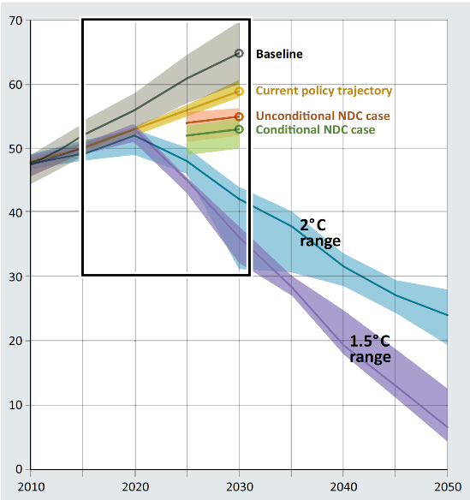
The next 10 years will determine how bad it will get.
Annual Global Total Greenhouse Gas Emissions (GtCO2e)

Slide 3

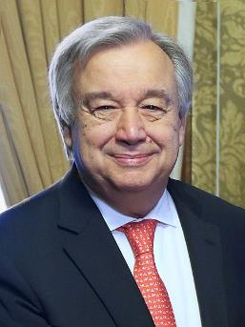
If it isn’t green, it shouldn’t be given the green light …
“We need to build trust and reduce risk, make the best use of available resources, and find innovative ways of financing, such as green bonds whose viability and success are already realities,” the Secretary-General said. Finance is the key to successful climate action. We need more ambition – climate change is moving faster than we are and this is a war we cannot afford to lose.”
"The world should adopt a simple rule: If big infrastructure projects aren’t green, they shouldn’t be given the green light. Otherwise we will be locked into bad choices for decades to come. Investing in climate-friendly development is where the smart money is needed."
António Guterres
UN Secretary General

Slide 4

Quick Bond Primer
Borrower agrees to pay investor back over an understood rate and time.
Enable many investors to lend and get repaid for the borrower’s project.
Unlike stocks, bonds are not a form of ownership of a business.
Typically considered safer investment than equity.
Transaction costs are more than conventional loan.
Taxable vs. Tax Exempt
More Info: CDIAC’s Debt Financing Guide

Slide 5

Green Bond Definitions
There are several accepted definitions, including:
Fixed income securities which finance investments with environmental or climate related benefits.
Bis.org
Bonds issued by municipal entities, private sector or multilateral institutions (e.g., the World Bank) to finance projects with an environmental or climate impact. For example, green bonds might be issued to finance renewable energy and energy efficiency projects, clean public transportation, pollution prevention and control, conservation, sustainable water and wastewater management, and green buildings.
Green bond projects, generally, are intended to have material, positive net benefits for the climate or environment. Projects that are not primarily climate-focused typically contribute to conservation and/or sustainable and efficient management of natural resources; reduce waste or pollution; and otherwise enhance environmental quality and contribute to sustainable living.
MRSB, About Green Bonds

Slide 6
Essentially….
Green Bond
Regular “Vanilla” Bond
Green Label
+
=
The bond needs to be financing or refinancing, in whole or in part, a project or asset that benefits the climate or environment.
Later in this presentation, we will discuss taxonomies that are being developed to help identify qualifying projects or assets.
Throughout this series we will discuss considerations of adding a green label.
Later in this presentation, we will cover standards and certification of the use of funds to qualify attaching the green label. This will continue into the second webinar where with a deeper dive into how the issuer attaches the green label prior to issuance, and the ongoing administration.

Slide 7


Self
Certification
Versus
External
Review
7

Slide 8
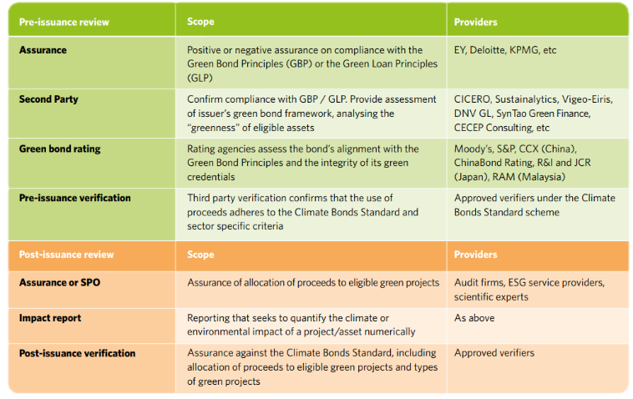
Types of Reviews
8

Slide 9



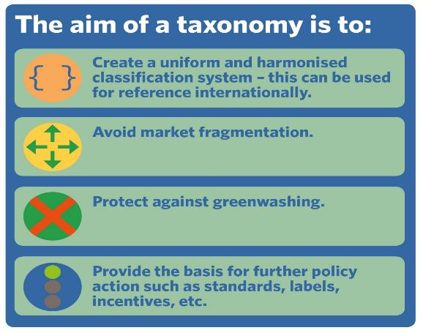
The Need To Define ‘Green’

Slide 10
Comparison of Approaches
Summary of the most common approaches to standards and best practice recommendations: Green Bond Principles; Climate Bonds Initiative Standards; European Union proposed standards.
 | GBP | CBI | EU GBS
Eligibility Criteria | High-level | CBI Taxonomy | EU Taxonomy
External Review | Recommended Not Required | Required | Required
Publication of External Review | No | Required | Required
Accreditation of Reviewers | No | Yes | Yes New EU system
Impact Reporting | Recommended Not Required | Recommended Required Eligibility Reporting | Required
Use of Proceeds in Legal Documentation | Recommended Not Required | Required | Required
10

Slide 11
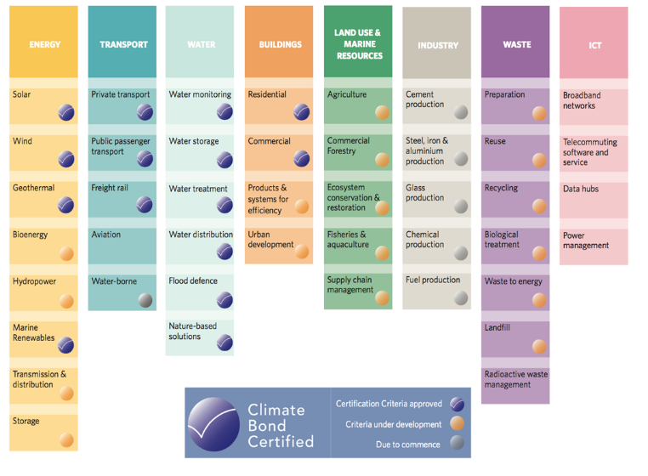
Climate Bond Standards Taxonomy

Slide 12
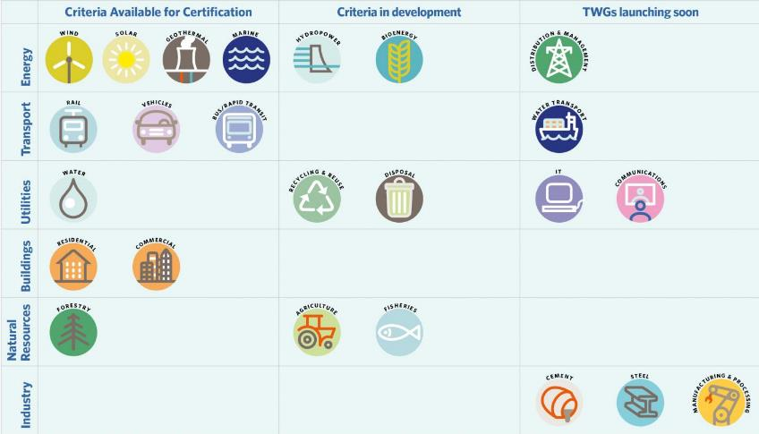
Climate Bonds Sector Criteria

Slide 13

Developing Sector Criteria
Formula
Process
Climate Science
Stakeholder Engagement
Technical and industry working groups
Working groups draft criteria
Draft criteria for public review
Climate Bond Standard Board approval
Publish final criteria for Certification use
Ongoing review
Paris Agreement Goals
Practicality
+
Industry and Market Acceptance
CBI’s Sector Criteria
13

Slide 14
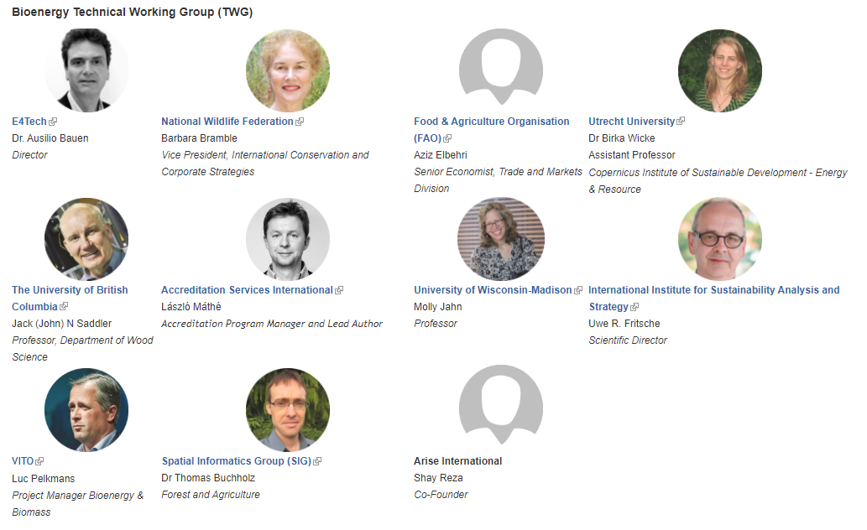
More on BioEnergy Standard & Working Group: https://www.climatebonds.net/standard/bioenergy

Slide 15
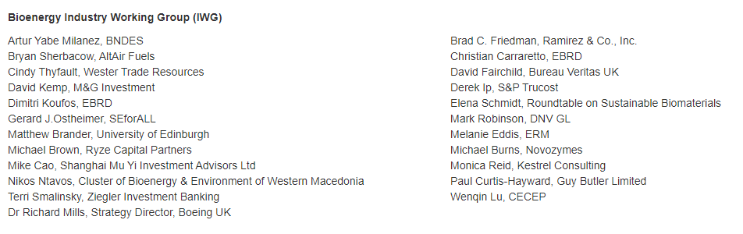
More on BioEnergy Standard & Working Group: https://www.climatebonds.net/standard/bioenergy

Slide 16
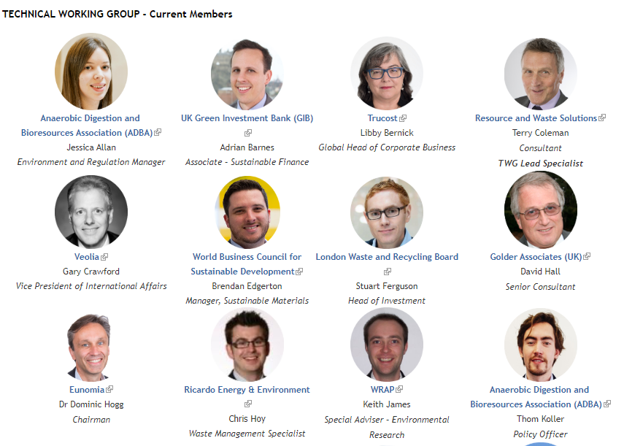
Waste Management Technical Working Group 1 of 2
https://www.climatebonds.net/standard/waste

Slide 17
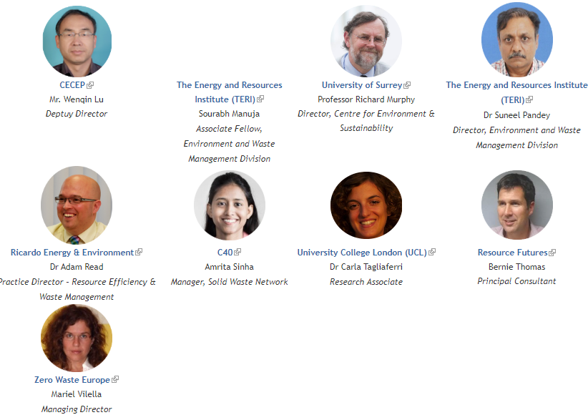
Waste Management Technical Working Group 2 of 2

Slide 18
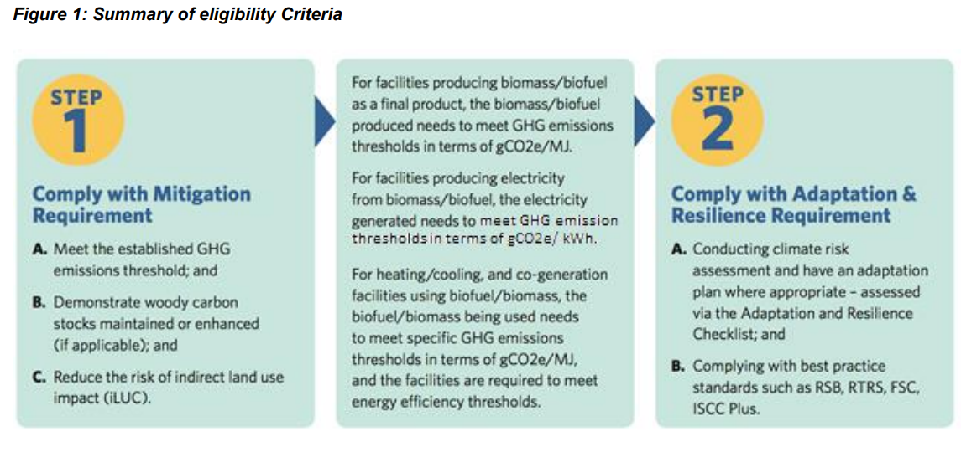
BioEnergy Criteria
More: https://www.climatebonds.net/standard/bioenergy

Slide 19
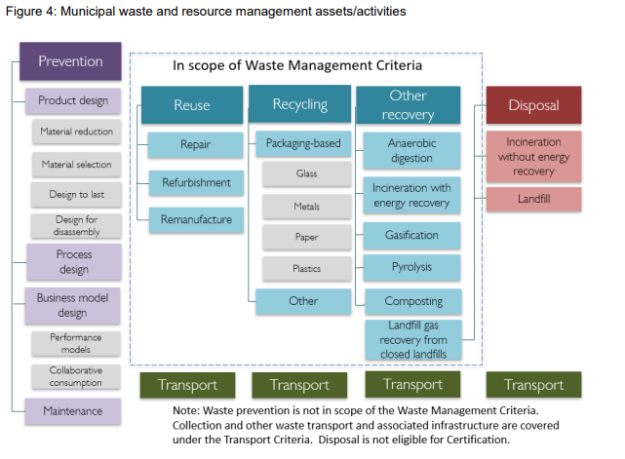
Waste Criteria
More: https://www.climatebonds.net/standard/waste

Slide 20

CBI Certification Mark
20

Slide 21
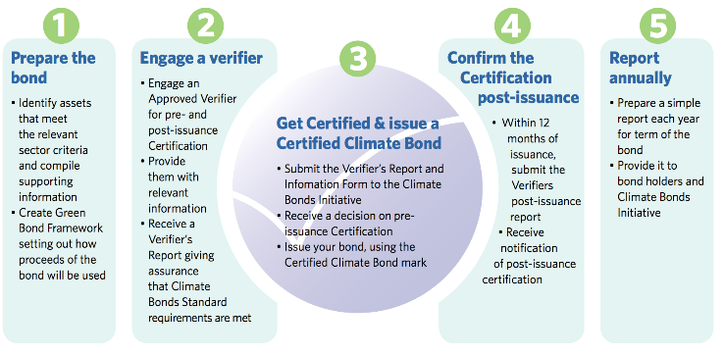


CBI Standard Certification Scheme
21

Slide 22







CBI Standards Board
Office of the California State Treasurer,
Fiona Ma, CPA
State Teacher’s Retirement System (CalSTRS)
Institutional Investors Group on Climate Change (IIGCC)
International Cooperative and Mutual Insurance Federation (ICMF)
Investor Group on Climate Change
Natural Resources Defense Council
Ceres Investor Network
22

Slide 23

External Review Costs Per One Active Verifier
Costs
Second Party Opinion or Verifiers Report
$1,000-$25,000, could be more if complex
CBI Certification Fee
1/10th of a basis point of the bond principal. Example: $500M bond, the certification fee is $5,000
Impact Reporting
Could be as low as $500/year for basic report
35

Slide 24
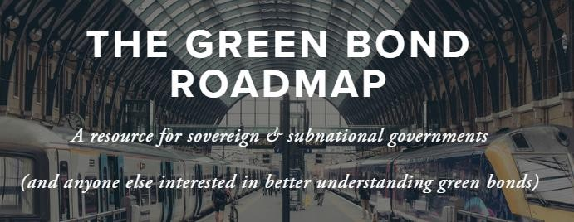
Great Overview of Green Bonds 1
Global Green Bond Partnership’s Green Bond Roadmap
Provides users with a basic outline of green bonds and their role in mobilizing capital for climate change action. It is intended to help government officials quickly get oriented to the world of Green Bonds and provides curated tools and information from organizations around the world that play an active role in the Green Bonds market.
Link: www.globalgreenbondpartnership.org
Green Bonds Overview
Green Bonds Checklist
Types of Green Bonds
Framework, Labeling, Certification, Verification, Standards
Resources

Slide 25
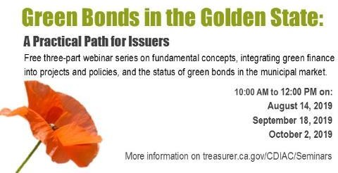


Great Overview of Green Bonds 2
California Treasurer’s Green Bond Webinar Series
Powerpoints, Background Docs, Webinar Replay
Go to California Treasurer Debt and Investment Advisory Commission & click on “Education” at:
https://www.treasurer.ca.gov/cdiac/
Or use direct link:
https://www.treasurer.ca.gov/cdiac/webinars/2019/greenbonds/description.asp

Slide 26
Michael Paparian
California Representative
Climate Bonds Initiative
Mike.Paparian@climatebonds.net
Web page: https://www.climatebonds.net/
Twitter: https://twitter.com/ClimateBonds
LinkedIn: https://www.linkedin.com/company/climate-bonds-initiative

