Slide 1
Risk Assessment & Emergency Response Plan 101 Training
Name, Organization
Date

Slide 2



Introductions
Poll Everywhere setup
Instructors
Students
  Name
  Position
  Organization
  What do you expect to learn today?
Notes:
Note: Be sure to state some very encouraging words to everyone in the class to validate their ability to conduct a risk assessment and develop/update an emergency response plan in order to motivate them to model positive learning behaviors.
In preparation for the course, have a copy of attendee names and call out names and organization while in discussion to make course participants comfortable.

Slide 3





Administrative Notes
Breaks
Emergency Exits
Lunch & Building Re-access
Restroom Locations
Q&A Facilitation
Notes:
Review slide based on location and the schedule

Slide 4
Training Outline
Section 1: AWIA Section 2013 Overview
Section 2: Risk and Resilience Assessments
Section 3: Emergency Response Plan Guidance and Template
Section 4: Certification Process
Q & A AWIA Section 2013 Requirements
Section 5: AWIA Section 2018

Slide 5
Training Materials Review
Poll Everywhere – Smartphone test
Participant Activities
AWIA Section 2013 & 2018 Fact Sheets (web-accessible)
  https://www.epa.gov/waterresilience/overview-new-risk-assessment-and-emergency-response-plan-requirements-community
  https://www.epa.gov/waterresilience/americas-water-infrastructure-act-2018-spill-notification-and-access-chemical
Notes:
You can opt to use a different polling mechanism for the class, even a show of hands.

Slide 6
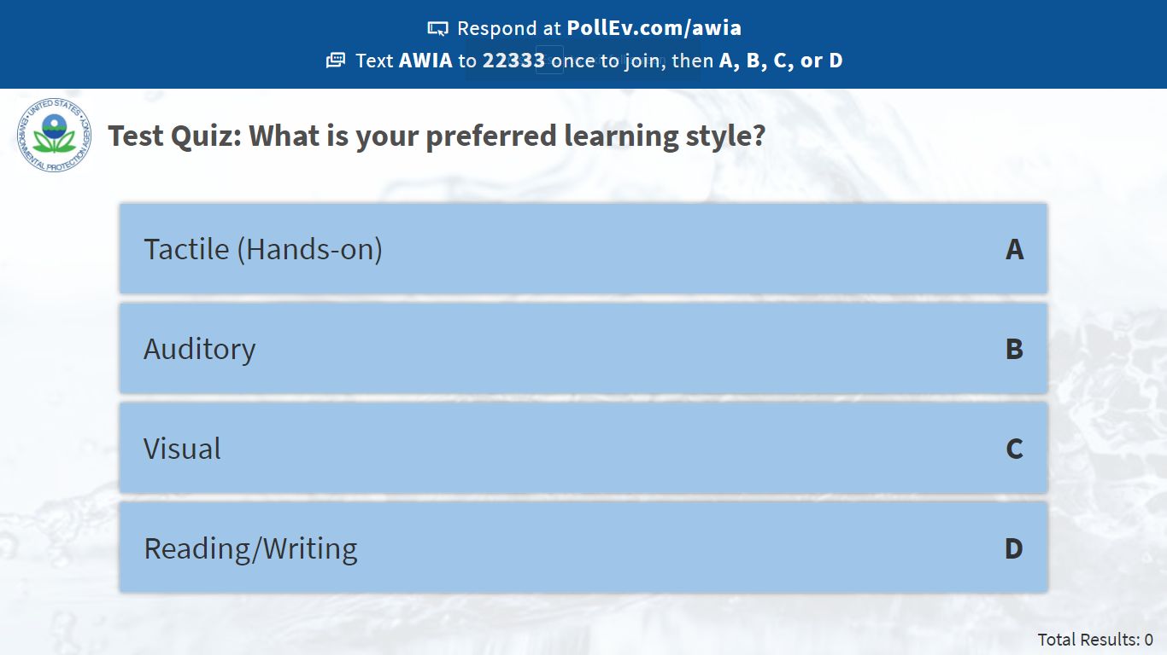
Notes:
Poll Title: What state or tribal land do you represent today?
https://www.polleverywhere.com/multiple_choice_polls/N5IX2kKqEnjJztOmXzqpD

Slide 7
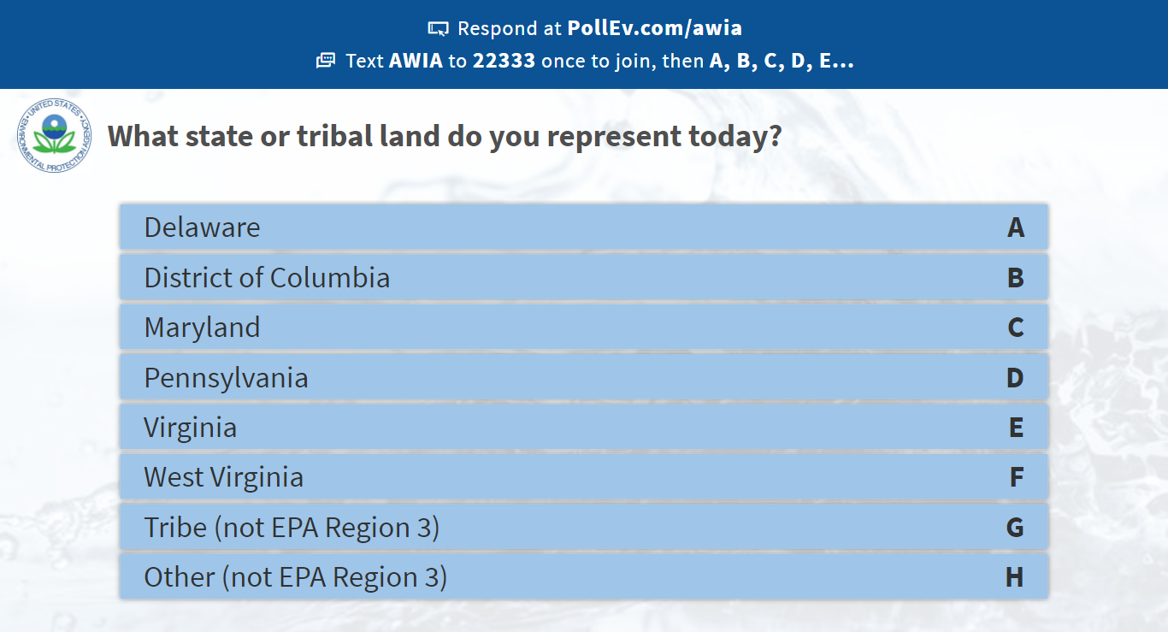
Notes:
Poll Title: What state or tribal land do you represent today?
https://www.polleverywhere.com/multiple_choice_polls/N5IX2kKqEnjJztOmXzqpD

Slide 8
Learning Objectives
Participants will understand the requirements of a risk assessment and know how to use the Vulnerability Self-Assessment Tool to complete one for your facility or train a utility on how to complete one.
Participants will understand the requirements of an emergency response plan and know how to use the Emergency Response Plan Guidance and Template to complete one for your facility or train a utility on how to complete one.
Participants will learn about the new release notification requirements and how community water systems can access chemical inventory data.
Notes:
We have 3 main goals for today:
Understand the requirements of a risk assessment and with that, know how to use the Vulnerability Self-Assessment Tool
Understand the requirements of an emergency response plan and with that, know how to use the Emergency Response Plan Guidance and Template
Learn about the new release notification requirements and accessing chemical inventory data

Slide 9
AWIA SECTION 2013 (A-F):
Amendment to Safe Drinking Water Act Section 1433
Notes:
First we will discuss AWIA Section 2013 sections a-f. which replaces the Safe Drinking Water Act Section 1433.

Slide 10



Purpose
History – Replaces 2002 Bioterrorism Act
RA and ERP completion help utilities to address hazards in your community
Examples of utility emergencies
Who does it apply to?
Funding
Notes:
This purpose of this training is to ensure that you are aware of the AWIA 2018 updates to SDWA Section 1433, which was added by the Public Health Security and Bioterrorism Preparedness and Response Act of 2002.
AWIA Section 2013 expands the risk types addressed in a public water system's assessment to include risks of natural hazards and malevolent acts. In addition, community water systems are required to evaluate the resilience of their current physical infrastructure and their management practices, including financial capacity to respond to these risks. Based on the assessment, public water systems must also develop emergency response plans that address the risks and resilience issues that systems may face.
We will also review the common types of emergencies faced by utilities in your region.
The risk assessment and emergency response plan certification requirements only apply to community drinking water systems serving 3,300 or more person
We will also discuss the funding available to date.

Slide 11
Bioterrorism Act of 2002
Public Health Security and Bioterrorism Response Act was signed into law by President Bush on June 12, 2002.
  Added SDWA Section 1433.
Initial requirement for community water systems to conduct a vulnerability assessment by set deadlines (submit a copy to EPA) and develop an emergency response plan (certify completion to EPA).
  Assessment of system to terrorist attack or other intentional acts designed to disrupt the water system.
Required EPA to develop stringent measures to protect the information found in or derived from the Vulnerability Assessments.
Required EPA to provide technical assistance to certain community water systems.
EPA is the primary agency responsible for enforcing Section 1433.
Notes:
Prior to AWIA, the Bioterrorism Act of 2002, which added Section 1433 to the SDWA, required water systems to assess their vulnerabilities to terrorist or other intentional acts and, based on the assessment, prepare emergency response plans.
The statute required community water systems to conduct a vulnerability assessment by set deadlines and submit a copy to EPA as well as develop an emergency response plan and certify completion to EPA, but did not require them to periodically update their risk assessments or emergency response plans.
The vulnerability assessments were meant to identify risks associated with terrorist attacks or other intentional acts designed to disrupt the water system.
This also required that EPA protect the information in those vulnerability assessments submitted by water systems.
EPA also provided technical assistance to certain community water systems based on these assessments.
EPA was named as the primary agency responsible for enforcing this section of SDWA.

Slide 12
America’s Water Infrastructure Act of 2018: Section 2013
Amends SDWA Section 1433.
Initial risk and resilience assessment and emergency response plan completion and certification by set deadlines, based on utility service size.
  Includes malevolent acts and natural hazards.
Utility must re-certify every 5 years.
Required EPA to provide guidance to systems serving populations of 3,300 or less.
EPA is the primary agency responsible for enforcing Section 1433.
Notes:
AWIA Amends the SDWA Section 1433 and requires not only an initial risk assessment and emergency response plan, but the new requirement includes re-certification every 5 years.
EPA will also provide guidance to small systems who are not required to comply with the certification requirements.
EPA directly enforces Section 1433

Slide 13

Are You a Community Water System Serving a Population >3,300?
Notes:
Who does the new requirements apply to?
If you are a drinking water system that serves a population greater than 3,300 and you are considered a community water system, then this applies to you.
If you are a wholesale utility, this also applies to you.

Slide 14
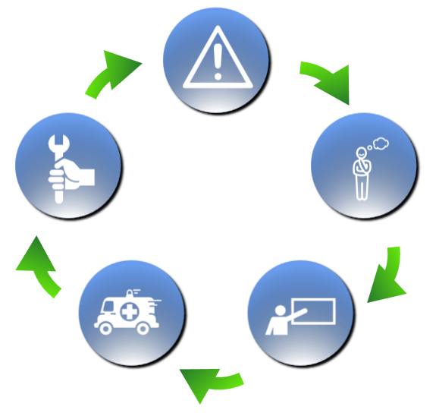
Water Resilience Framework
ASSESS
RECOVER
PLAN
RESPOND
TRAIN
Notes:
Lots of utilities ask how to start building resilience. Here is a basic framework with steps to help you along the way. We recommend that you start with:
Assessing risks. To prepare for emergencies, we must understand utilities’ threats and vulnerabilities. The risks that are most relevant to your utility will determine the planning steps you take. (sample actions here include vulnerability assessments and risk assessments)
Planning for an emergency: this involves developing and updating emergency response plans, initiating mitigation projects, and taking other key actions to reduce the impact of a future disaster. (sample actions here include developing an Emergency Response Plan)
Training: this can involve training staff on emergency response protocols and conducting exercises to practice coordination at the local, state, and national levels. (samples examples here include participating in tabletop or Full-scale exercises)
Emergency response: when a disaster occurs, you must have the right tools available to respond. (whether that be routine such as water main breaks or natural disasters such as hurricanes or earthquakes) such as our Response on the go app
Recovery: having resources available to restore service as quickly as possible. ( working with the right partners to return to normal operations as quickly as possible) like the FedFUNDs tools that we have available to help find federal funding
EPA has developed tools to assist in all these steps of becoming more resilient. If you are not sure where to start.

Slide 15
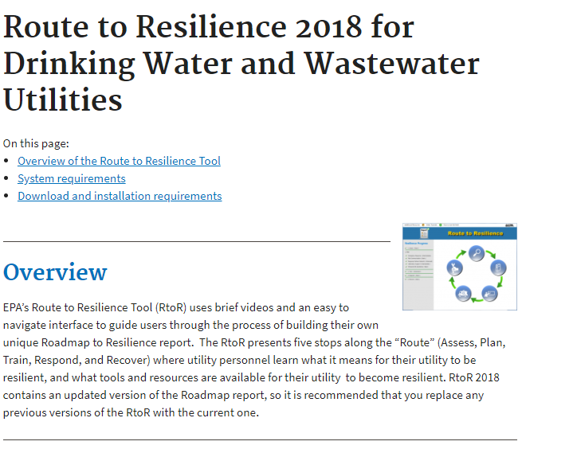
Route to Resilience Tool
https://www.epa.gov/waterresilience/route-resilience-2018-drinking-water-and-wastewater-utilities
Notes:
Download the Route to Resilience Tool to get started.
EPA’s Route to Resilience Tool (RtoR) uses brief videos and an easy to navigate interface to guide users through the process of building their own unique Roadmap to Resilience report. The RtoR presents five stops along the “Route” (Assess, Plan, Train, Respond, and Recover) where utility personnel learn what it means for their utility to be resilient, and what tools and resources are available for their utility to become resilient.

Slide 16
All Hazards Resilience
Region 4 Natural Hazards
  Flooding
  Winter Storm
  Hurricanes
  Drought
Malevolent Acts
  Cyber intrusion
  Contamination
  Vandalism
  Active Shooter
Notes:
NOTE TO TRAINER: Please use natural hazards for your area.

Slide 17
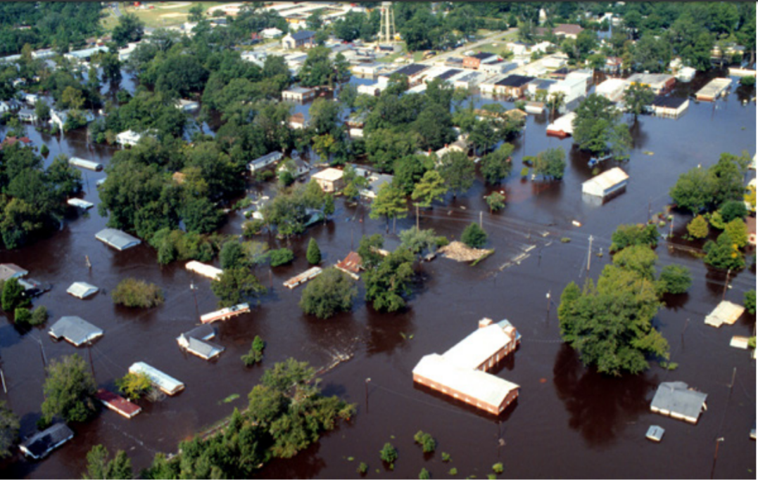
All Hazards Resilience
FLOODING EVENTS
Notes:
NOTE TO TRAINER: Please use natural hazards for your area.

Slide 18

All Hazards Resilience
Flood Resilience Guide
Notes:
Please view this video as an example of one of tools that EOA has developed to support utilities in planning to mitigate against the threat of flooding. EPA has other guides to address drought, power outages, earthquake and other hazards you utility might face.

Slide 19
What Types of Funding Are Available?
Currently the grant funding that is stated in the law has not been appropriated by Congress.
What is available for use?
  Drinking Water State Revolving Fund program can be used to conduct a risk assessment since it addresses resilience of the system and the risk assessment may yield a project that the utility may want to invest in to improve the overall system resilience.
  Both parts of the program can be used. Each state will manage this differently. Please check with your state to see if they have set aside funds for this function specifically either with direct contractors or with reimbursements.
Notes:
The grant funding that is stated in the law has not yet been appropriated by Congress.
Alternatively, water systems can access funding through the drinking water state revolving fund program. These funds can be used to conduct a risk assessment since it addresses resilience of the system and the risk assessment may yield a project that the utility may want to invest in to improve the overall system resilience.
Each state will manage this differently. Please check with your state to see if they have set aside funds for this function specifically either with direct contractor or with reimbursements.

Slide 20
Enforcement
SDWA Section 1414 is an enforcement provision EPA may invoke to address an owner/operator of a public water system's noncompliance with an "applicable requirement" under the Act.
Section 1414(i) defines "applicable requirement" broadly and it expressly includes Section 1433. If a CWS fails to comply with a requirement under Section 1433 (e.g., fails to certify they have conducted a risk and resilience assessment by the statutory deadline), then EPA may exercise its enforcement discretion by initiating an action under Section 1414.
Under Section 1414, EPA may bring an action to require compliance and may also seek a civil penalty of not more than $57,317* per day of violation. (*This number is adjusted annually for inflation. See 40 CFR 19.4.)
EPA’s main goal is returning the system to compliance and protecting public health.
Notes:
Read the slide directly

Slide 21
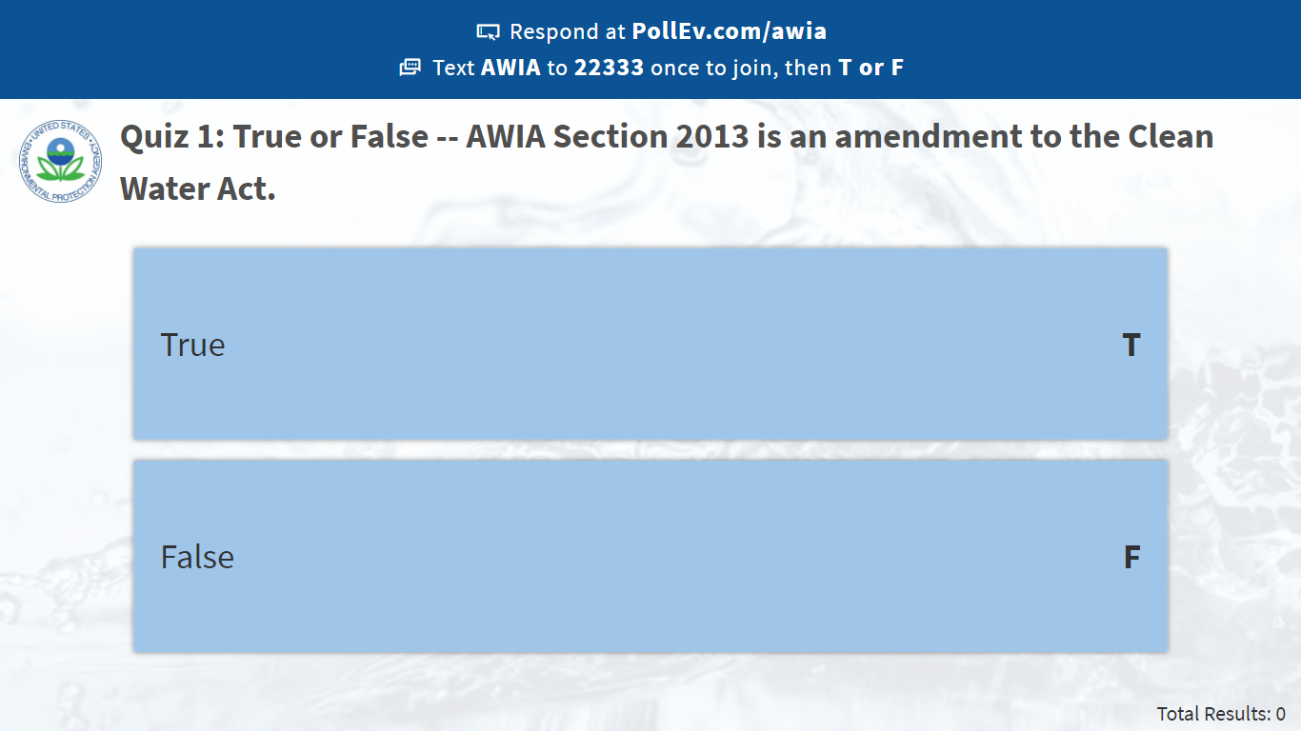
Notes:
Poll Title: Quiz 1: True or False -- AWIA Section 2013 is an amendment to the Clean Water Act.
https://www.polleverywhere.com/multiple_choice_polls/XIetpifQA6fB5Q3aAkCtA

Slide 22
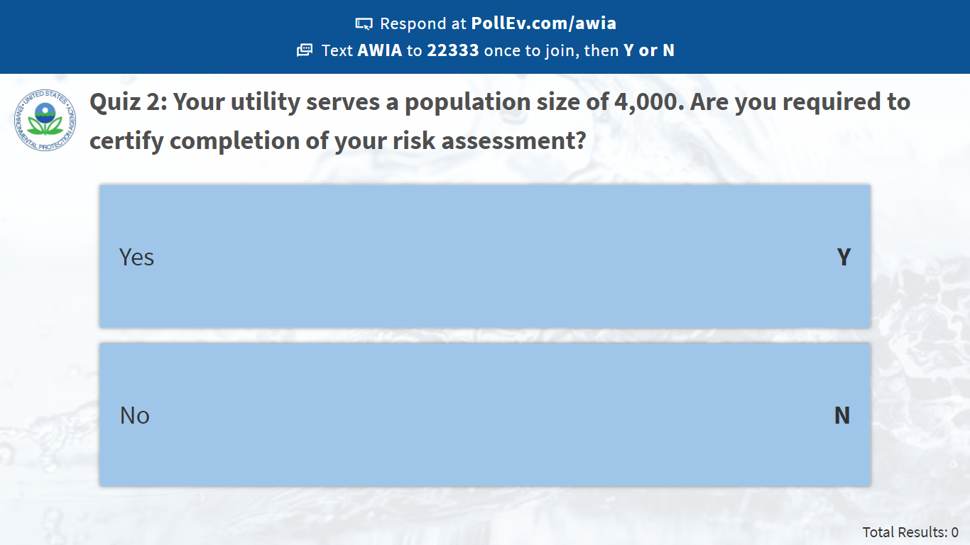
Notes:
Poll Title: Quiz 2: Your utility serves a population size of 4,000. Are you required to certify completion of your risk assessment?
https://www.polleverywhere.com/multiple_choice_polls/SZdIDAgWzlU21W25FNRbd

Slide 23
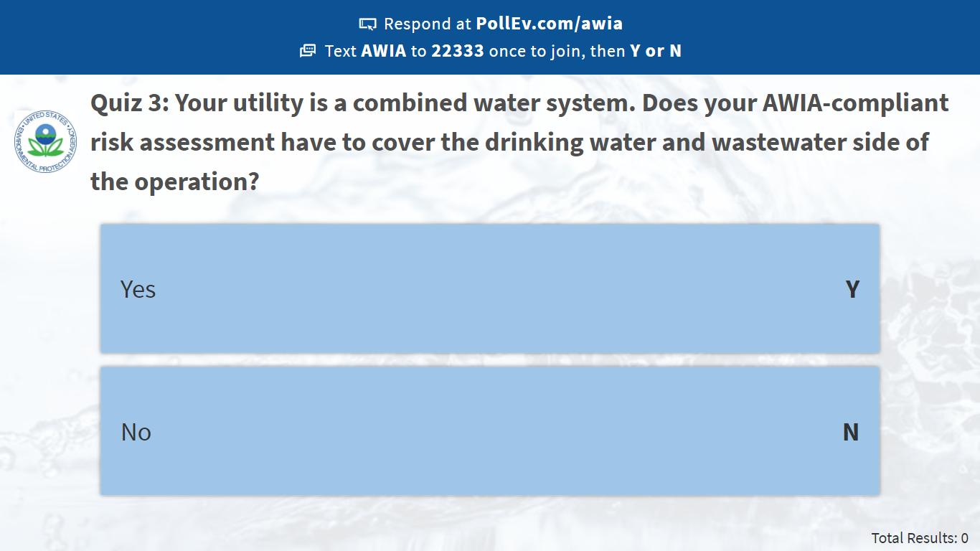
Notes:
Poll Title: Quiz 3: Your utility is a combined water system. Does your AWIA-compliant risk assessment have to cover the drinking water and wastewater side of the operation?
https://www.polleverywhere.com/multiple_choice_polls/RrlTYAWqhznvYPqAaTJ2l

Slide 24
Risk and Resilience Assessments
Section 2
Notes:
With that as an overview of AWIA and the importance of these new requirements, let’s move on to discussing your risk and resilience assessments.
(NOTE: Ask this question of the audience before explaining to see if they have sufficient knowledge of the concepts)
Before we jump in, how do you think that a risk assessment can help your utility? (Call on several people to provide responses)

Slide 25
How Does a Risk Assessment Help Your Utility?
Information is power – utilities who identify their risk can create plans and prioritize resources around specifics.
Awareness of frequency/rate of natural hazards in your area – use data to inform the likelihood of natural hazards occurring in your area.
Evaluate potential improvements that serve multiple purposes to enhance your operations and resilience.
Notes:
Correct! You don’t know what you don’t know, so a risk assessment will help to identify those risks specific to your utility. Knowing the types of risks and potential for those risks is crucial for developing plans to prepare for those risks. For natural disasters, use data from your area to determine the likelihood of earthquakes, floods, drought, etc.
Once you know all your risks, you can put measures in place to mitigate those risks and make your utility more resilience.

Slide 26
AWIA Section 2013 - Risk Assessment
Basic Requirements
Each community water system serving a population of greater than 3,300 persons shall assess the risks to, and resilience of, its system. Such an assessment shall include:
The risk to the system from malevolent acts and natural hazards;
Pipes/conveyances, source water, water collection/intake, pretreatment, treatment, storage and distribution, electronic, computer, or other automated systems (including security);
Monitoring practices;
Financial infrastructure;
Use, storage or handling of chemicals;
Operation and maintenance; and
May include capital and operational needs for risk management.
Notes:
A risk and resilience assessment shall include:
-the risk to the system from malevolent acts and natural hazards;
-the resilience of the pipes and constructed conveyances, physical barriers, source water, water collection and intake, pretreatment, treatment, storage and distribution facilities, electronic, computer, or other automated systems (including the security of such systems) which are utilized by the system;
-the monitoring practices of the system;
-the financial infrastructure of the system;
-the use, storage, or handling of various chemicals by the system; and
-the operation and maintenance of the system.
The assessment may include an evaluation of capital and operational needs for risk and resilience management for the system.
In addition, the risk assessment should consider and address risks at any consecutive systems that could impact the water system.

Slide 27
Risk = Consequences x Vulnerability x Threat Likelihood
Notes:
Assessing risk from a malevolent act to a water system asset requires estimating three parameters:
Threat likelihood: the annual probability that a perpetrator will attempt to carry out the malevolent act against the facility;
Vulnerability: the probability that the malevolent act will have an adverse impact on the facility; and
Consequences: the public health and economic consequences resulting from the impact of the malevolent act on the facility.

Slide 28
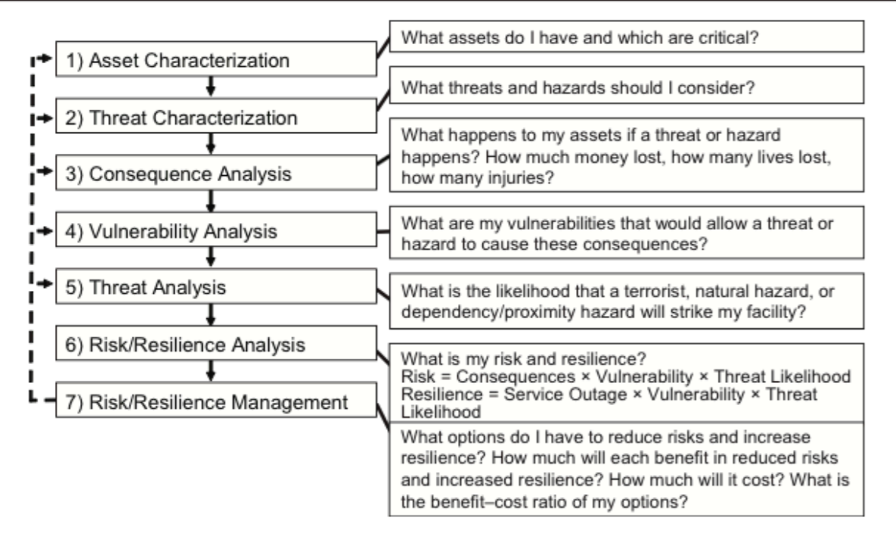
RAMCAP 7-Step Process
Notes:
Here is the RAMCAP 7-Step Process for analyzing and managing risk and the framework that is being applied in the J100 Standard and the Baseline Threat document.
Step 1: Asset Characterization is determining which assets are the most critical in order to understand the assets that if compromised could result in prolong or widespread service interruption, injuries, fatalities, detrimental economic impact or any combination thereof.
Step 2: Threat Characterization is identifying the threats and hazards that your utility might face based on the frequency of natural events, manmade events, dependency and proximity hazards paired with the assets identified.
Step 3: Consequence Analysis is determining the worst reasonable consequence for each threat-asset pair. For example which is the highest number of people who may suffer fatality or become seriously injured if an identified threat where able to impact the critical assets of the facility.
Step 4: Vulnerability Analysis Is the process of estimating the probability of the resulting consequences if a certain hazard occurred. In the case of a malevolent attack is would be the probability that an attack would successfully result in an estimated number of facilities or serious injury. What are the vulnerabilities that would allow the attack to be successful?
Step 5: Threat Analysis is the determining the probability that a threat will occur in a year. The calculations for each of threat category is different based on different factors.
For malevolent attacks the analysis is based on the adversary’s objectives, capabilities and attractiveness of the facility relative to alternative targets.
For natural hazards the analysis is based on historical records for the specific location of the asset and future trends
For dependency hazards it is based on local historical records for the frequency, severity and duration of service denials. A dependency hazard example is a water utilities reliance on the supply chain
For proximity hazards it is based on local situation and historical records for the frequency, severity and duration of service denials
Step 6: Risk/Resilience Analysis is the actual calculation of your current level of risk and resilience based on the products from Step 3 (Consequences), Step 4 (Vulnerability Analysis) and Step 5 (Threat Analysis)
Step 7: Risk/Resilience Management is where you decide what actions you may need to take to reduce risk and increase resilience, analyze cost associated with those actions and identify the cost-benefit ration.

Slide 29
Baseline Information on Malevolent Acts Relevant to CWS
Notes:
Now we will cover the Baseline Information on Malevolent Acts Relevant to Community Water System document that was released by EPA on August 1, 2019. This release was a statutory deadline established by AWIA Section.

Slide 30
Purpose
Identify the types (categories) of malevolent acts that could impact CWSs.
  Cover the reference threats from the AWWA J100-10 standard.
    Threats adapted from the Risk Analysis and Management for Critical Asset Protection (RAMCAP), developed by the American Society of Mechanical Engineers and endorsed by the Department of Homeland Security.
    Scenarios include physical assaults launched from the air, land and water; cyber attacks and intentional contamination; sabotage, theft and natural hazards.
Assist CWSs with estimating the threat likelihood for malevolent acts at their facility.
Notes:
The purpose of the Baseline Threat for Malevolent Acts document is to assist CWS in identifying the types of malevolent acts that could impact CWSs and also to assist CWSs with estimating the threat likelihood.
In order to cover the types of malevolent acts that can occur, the Baseline Threat document pulls from the AWWA J100-10 Standard for Risk and Resilience Management of Water and Wastewater Systems which provides an extensive set of malevolent threat scenarios. These scenarios were adapted for water systems from the Risk Analysis and Management for Critical Asset Protection methodology, or RAMCAP. This methodology was developed by the American Society of Mechanical Engineers and later endorsed by the Department of Homeland Security. It is an all-hazard risk and resilience management process for critical infrastructure.
The J100 scenarios include physical assaults launched from the air, land or water, cyber attacks, intentional contamination; sabotage and theft. In addition the appendices include natural hazard threats

Slide 31



Why is this document needed?
  Threat likelihood for a malevolent act is the most difficult risk parameter to estimate because it requires projecting the actions of a perpetrator.
    For water systems, the difficulty of estimating malevolent threat likelihood can be a barrier to including malevolent threats in risk assessments.
Notes:
Why do we need this document?
Read slide

Slide 32
How The Baseline Threat Document Helps You?
Estimating the likelihood of malevolent threats at your facility is difficult
  The occurrence of physical assaults against CWS facilities and of intentional drinking water contamination is too low to establish likelihood based on historic frequency.
  Other types of malevolent acts, such as vandalism, theft and cyber-attacks, are more common, but CWSs may lack the data to estimate the likelihood that a specific facility will be targeted.
  Reports from intelligence and law enforcement agencies, combined with public and private sector resources, may indicate the intent and capabilities of malicious actors, patterns of criminal activity and other factors that affect the risk of malevolent acts. These sources typically do not address the likelihood of a malevolent act at a CWS facility.
Notes:
While your utility is tasked with conducting a comprehensive risk assessment for malevolent acts and natural hazards it can be challenging for utility staff who have limited knowledge in assessing physical and cyber security risk.
Physical attacks and intentional contamination incidents at water utilities do not occur frequently enough to establish like hood based on historic frequency.
Vandalism and theft occur more frequently but most systems do not have the data to estimate the likelihood that their utility will be targeted.
Although the intelligence and law enforcement agencies have information to identify patterns of criminal activity and other factors these sources do not focus on the likelihood of these types of incidents occurring at water utilities.

Slide 33
Baseline Information on Malevolent Acts Approach
  Limit the number of malicious acts that a CWS must assess by combining specific attacks into broader categories.
    Example: Physical assault and cyber attack on operational technology.
  Provide order-of-magnitude threat likelihood estimates as a starting point to help CWSs consider the relative likelihood of different types of malevolent acts.
    Using the frequency of reported events in combination with public intelligence information can show the likelihood of different types of malevolent acts.
  Identify both general and threat-specific factors that may increase or decrease the likelihood of different types of malevolent acts being perpetrated against a CWS facility.
  List available resources for CWSs to find more information about malevolent acts that may impact their facility.
Notes:
The Baseline Information on Malevolent Acts Approach document assists utilities by:
Limiting the number of malicious acts that a CWS must address. The document has grouped several individual malicious acts into broader categories to make the process simpler for the utility. On the next slide, I will show you an exert from the document to demonstrate how the groups were developed.
The document also provides the threat likelihood estimates for CWSs to use as a starting point to help CWSs calculate the likelihood of malevolent acts at their facility. The basis of the calculation is provided as background information.
The document also asks questions concerning general and threat-specific factors to help utilities determine if the threat likelihood at their respective utility is increased or decreased.
Finally the document provides a list of available resources to assist the utility in finding out additional information about malevolent acts.

Slide 34
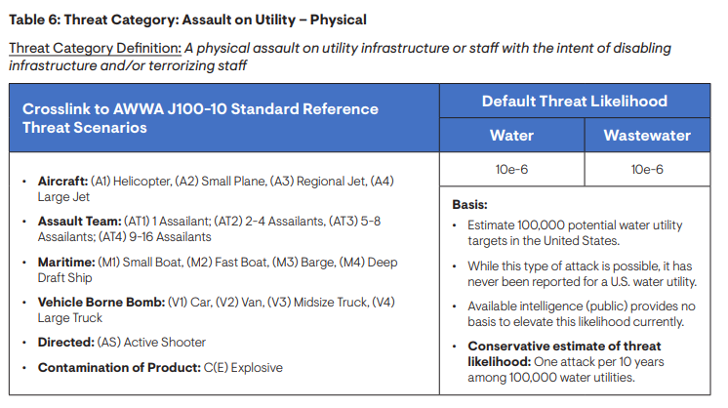
Notes:
On this slide is a depiction of Table 6 from the Baseline Information on Malevolent Acts for Community Water System. This table covers the threat category for assault on utility-physical. The AWWA J100-10 scenarios that have been grouped into this threat category are indicated on the left. On the right, the calculated threat likelihood for water and wastewater utilities is provided along with a basis for the calculation below.

Slide 35
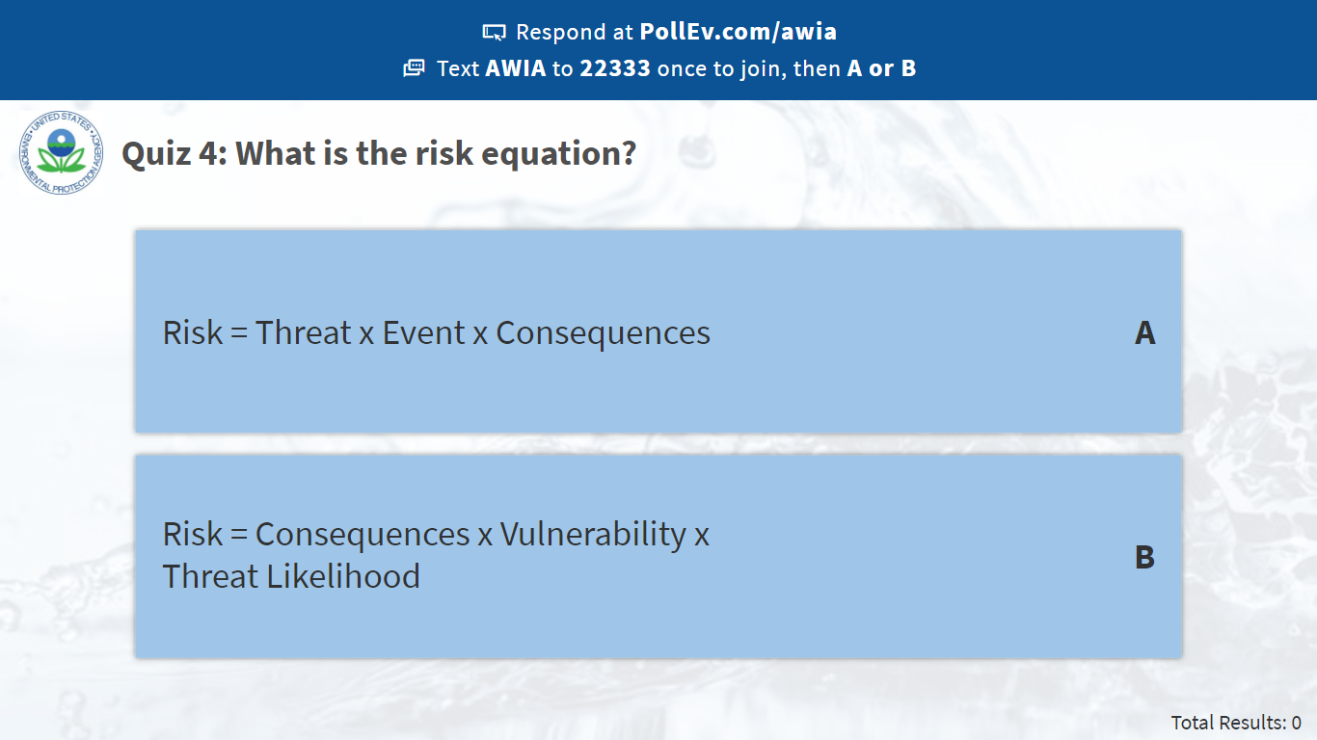
Notes:
Poll Title: Quiz 4: What is the risk equation?
https://www.polleverywhere.com/multiple_choice_polls/H6HkMgPrBeCh8HCa5DRWS

Slide 36
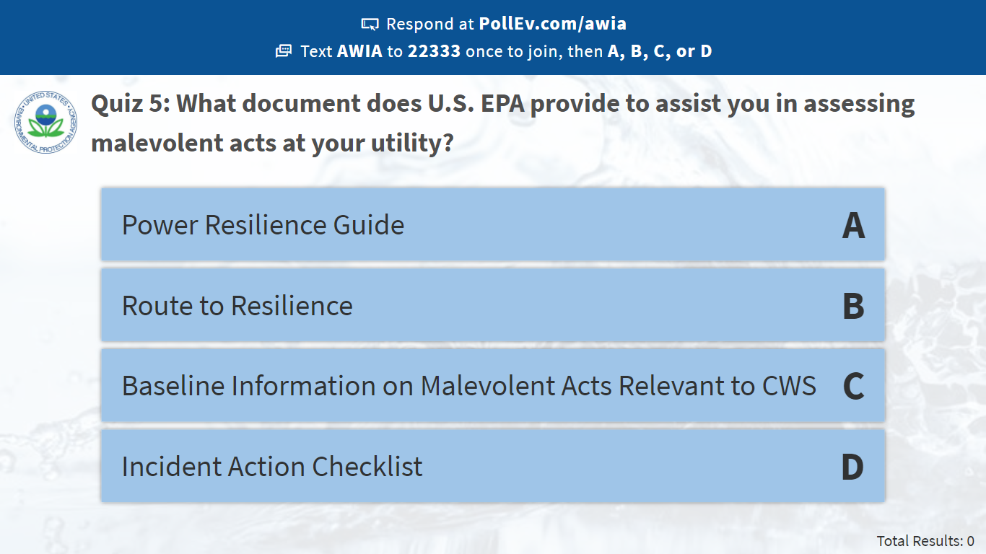
Notes:
Poll Title: Quiz 5: What document does U.S. EPA provide to assist you in assessing malevolent acts at your utility?
https://www.polleverywhere.com/multiple_choice_polls/DRco2He55QtCuK17UvL0i

Slide 37
BREAK – 15 minutes

Slide 38
Vulnerability Self-Assessment Tool Web 2.0

Slide 39



What is VSAT Web 2.0?
Tool for assessing risk and resilience at drinking water and wastewater systems.
Estimate risks from malevolent threats and natural hazards.
Evaluate improvements for increased security and resilience.
6-steps to complete your Risk and Resilience Assessment.
Notes:
I’ll now talk through the Vulnerability Self-Assessment Tool (or V-SAT) Web 2.0. Have any of you used VSAT before? (Look for a show of hands)
This updated version can help you to develop a risk and resilience assessment for your utility.

Slide 40


STEP 1: Start Analysis
Select drinking water utility (for those complying with AWIA Section 2013)
Enter key information about your utility:
  Name
  Location
  Average daily water service (MGD)
  Average water rate ($/1,000 Gallons) – Default rate is $4.00
Notes:
Step 1 is where you start your analysis

Slide 41
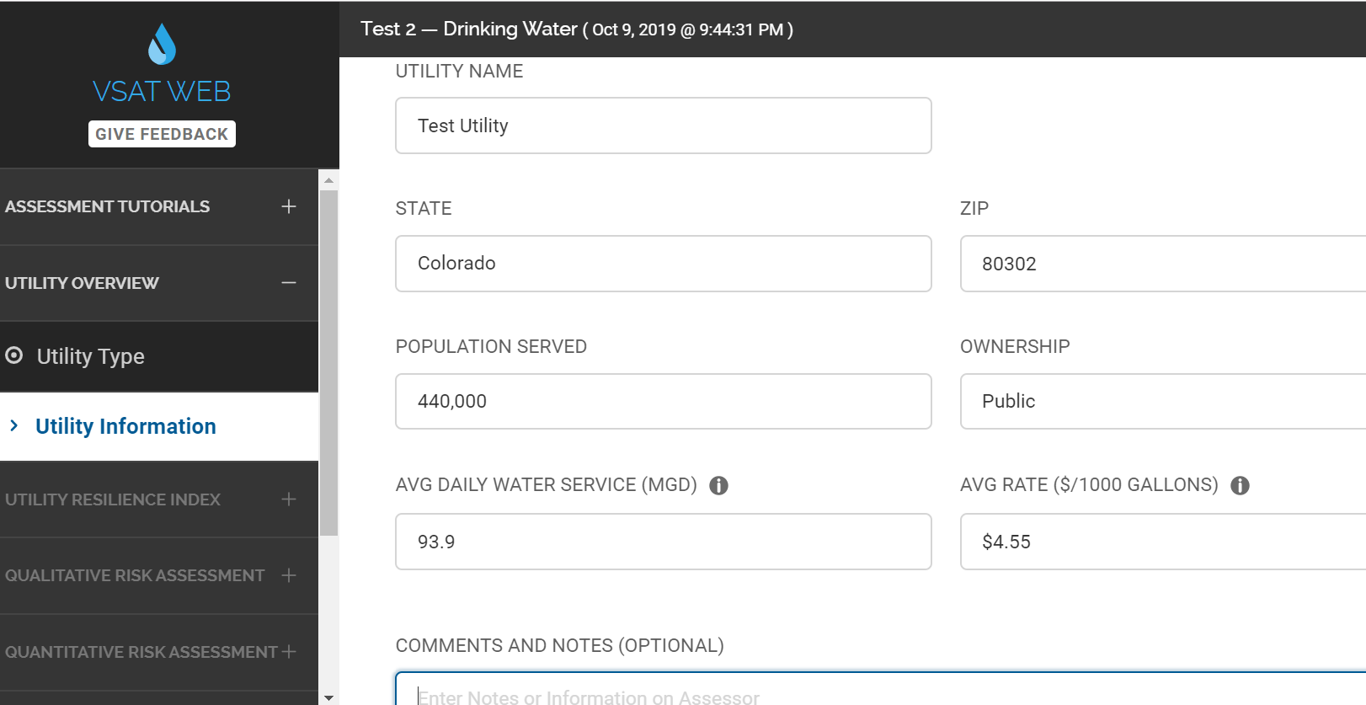
Notes:
Here is a sample utility in Colorado with a population service size of 440,000 and avg water rate of $4.55. You must enter an accurate zip code as well.

Slide 42

STEP 2: Utility Resilience Index
Utility Resiliency Index (URI) is a risk management tool that can assess a utility's capability to respond to and recover from an incident that impacts critical operations.
Utility will select statements that best match the utility’s current capabilities with respect to 12 indicators.
VSAT will calculate an overall value for the URI and include them in the risk and resilience assessment report.
The URI can be used when developing the overall risk management plan.
Notes:
Utility Resiliency Index (URI) is a risk management tool that can assess a utility's capability to respond to and recover from an incident that impacts critical operations.
It is calculated based on the user’s response to 12 indicator questions (which I will discuss in the next few slides

Slide 43
Utility Resilience Index Components
Emergency Response Plan – Does your utility have a plan for immediate response to all types of incidents and have you trained on it?
National Incident Management Systems (NIMS) Compliance – What level of NIMS training does your utility have in order to better integrate into the local, state and national level response?
Mutual Aid and Assistance – Does your utility participate in a Mutual Aid and Assistance agreement such as WARN to assist in receiving or providing rapid response between water utilities?
Emergency Power for Critical Operations – What length of time is your utility prepared to support back-up power for critical operations and assets (72 hours is optimal)?
Notes:
Where is your emergency response plan?
Have you conducted a full-scale exercise?
How many of you are trained in NIMS compliance?

Slide 44
Utility Resilience Index Components
Minimum Daily Demand/Treatment (MDDT) – How long can your storage capacity meet minimum daily demand or treatment when the production or treatment plant is non-functional?
Critical Parts and Equipment – What is the lead time for repair, replacement or recovery for operationally critical parts or equipment?
Critical Staff Resilience (CSR) – What percentage of your staff is cross-trained in critical operations and maintenance positions as backup if necessary?
Business Continuity Plan – Does your utility have a business continuity plan to assist your utility in mitigating the impacts of an incident on your financial and other portions of your organization?
Notes:
Review each component

Slide 45
Utility Resilience Index Components
Utility Bond Rating – What is your Utility Bond Rating? How are you rated in terms of your ability and willingness to satisfy financial obligations?
Government Accounting Standards Board Assessment – What portion of your utility has been evaluated to provide an indication of the commitment to proper asset management?
Unemployment – What is the unemployment rate compared with the national average in your service area to determine the socioeconomic health of the community?
Median Household Income – What is the median household income in your service area compared with the state and how might that impact the financial stability of the utility if affected by a significant incident?
Notes:
Review each component

Slide 46
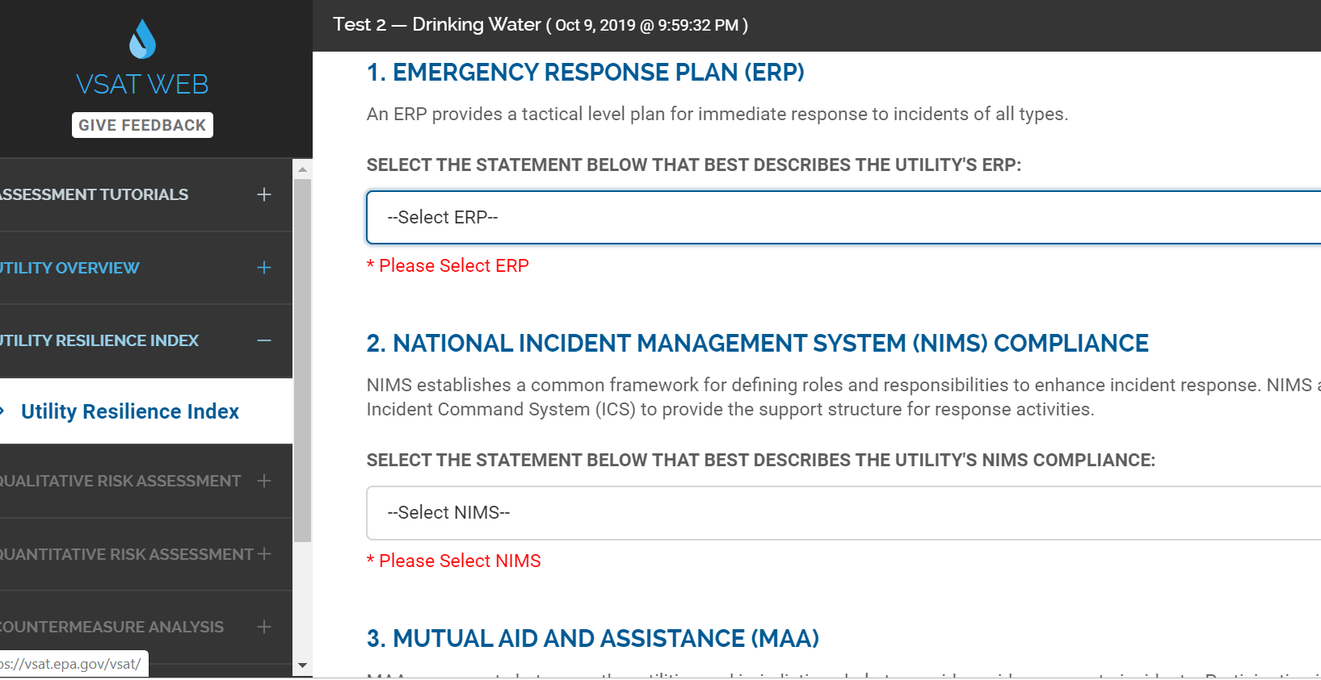
Notes:
This is what these questions will look like on the screen.

Slide 47
STEP 3: Qualitative Risk Assessment
Add in the assets that your utility owns and identify the threat type that you want to assess; These should be determined based on the information received from the Baseline Information on Malevolent Acts Relevant to CWSs.
  Malevolent Act - Malevolent acts are intentional acts carried out against the CWS. Perpetrators may be an individual, group or state, and attacks may be motivated by theft, terrorism, vandalism, or other objectives. A CWS should consider potential impacts of the following types of malevolent acts on their critical operations in each asset category: Assault on Utility, contamination of Finished Water, Theft or Diversion, Cyber Attack, Sabotage, Contamination of Source Water.
  Natural Hazard - Natural hazards refer to climatic, geologic, or other natural phenomena. A CWS should consider potential impacts of the following types of natural hazards on their critical operations in each asset category: Earthquake, Flood, Hurricane, Ice storm, Tornado, Wildfire.
Notes:
Step 3 you are looking at your system qualitatively to identify which assets you have and which are critical, and also which threat categories you should consider. If you choose not to assess an identified asset with one of the threat categories, there is a section where you explain why. This is helpful for others who may see the final risk and resilience assessment.

Slide 48
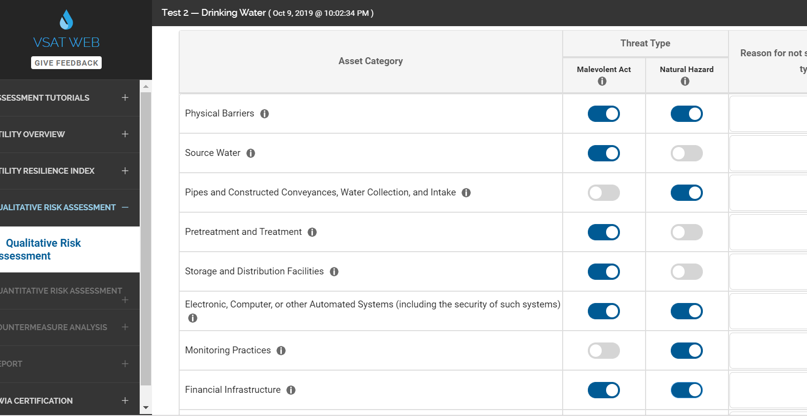
Notes:
This is how it appears on the VSAT tool

Slide 49
STEP 4: Quantitative Risk Assessment
Evaluate the estimated financial or health impacts to your facility for each asset/threat pair.
High-risk asset categories are those where a malevolent act or natural hazard presents a high risk to disrupt critical operations or to cause significant public health or economic impacts. Baseline risk assessments can be completed in four steps:
    Define a specific asset that is at risk. This could be the asset category itself (e.g., physical barriers), a piece of equipment or a facility (e.g., a storage tank) or an entire system (e.g., a treatment train).
    Select at least one specific threat, which may be a malevolent act, natural hazard, or dependency/proximity threat, for each asset you define.
    By assigning a specific threat to an asset, you create an asset/threat (A/T) pair. For each A/T pair, you can assess risk.
    Once a baseline risk assessment for one A/T pair is complete, you may conduct baseline risk assessments for other A/T pairs. EPA recommends that you complete at least one baseline risk assessment for one A/T pair in each high-risk asset category.
    You may choose to skip the countermeasure analysis for some or all high-risk asset categories at this time and go directly to your final report.
Notes:
Step 4 of VSAT is the quantitative part of the risk assessment where you look at the financial or health impacts to your facility for each asset/threat pair.

Slide 50
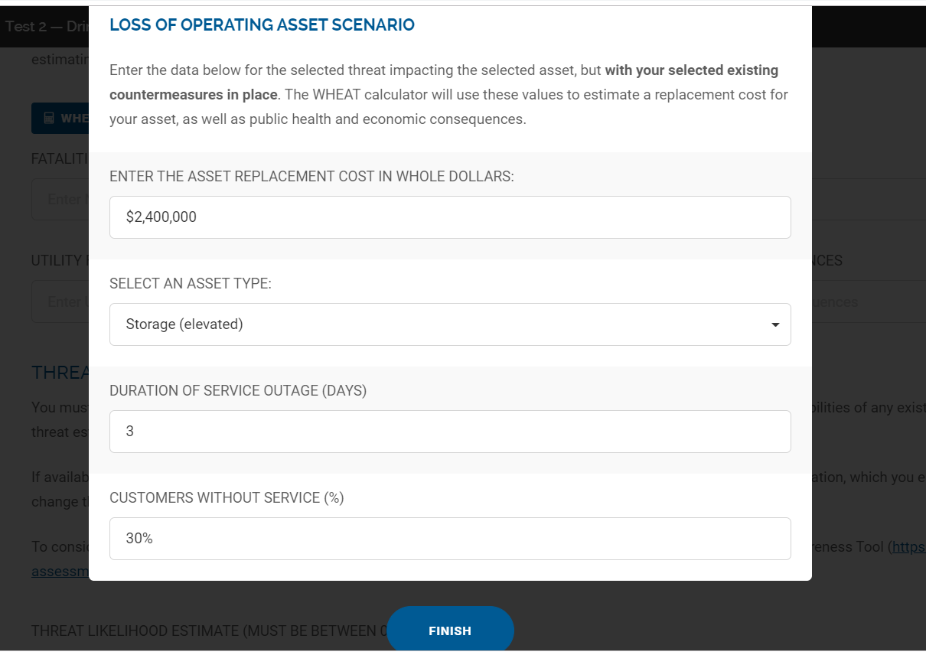
Notes:
In this case, I have used a storage tower as the asset and my threat is a 100-yr flood.
This is the WHEAT section of the tool where it will use the information such as replacement cost, outage duration and service outage percentage to calculate the consequences.

Slide 51
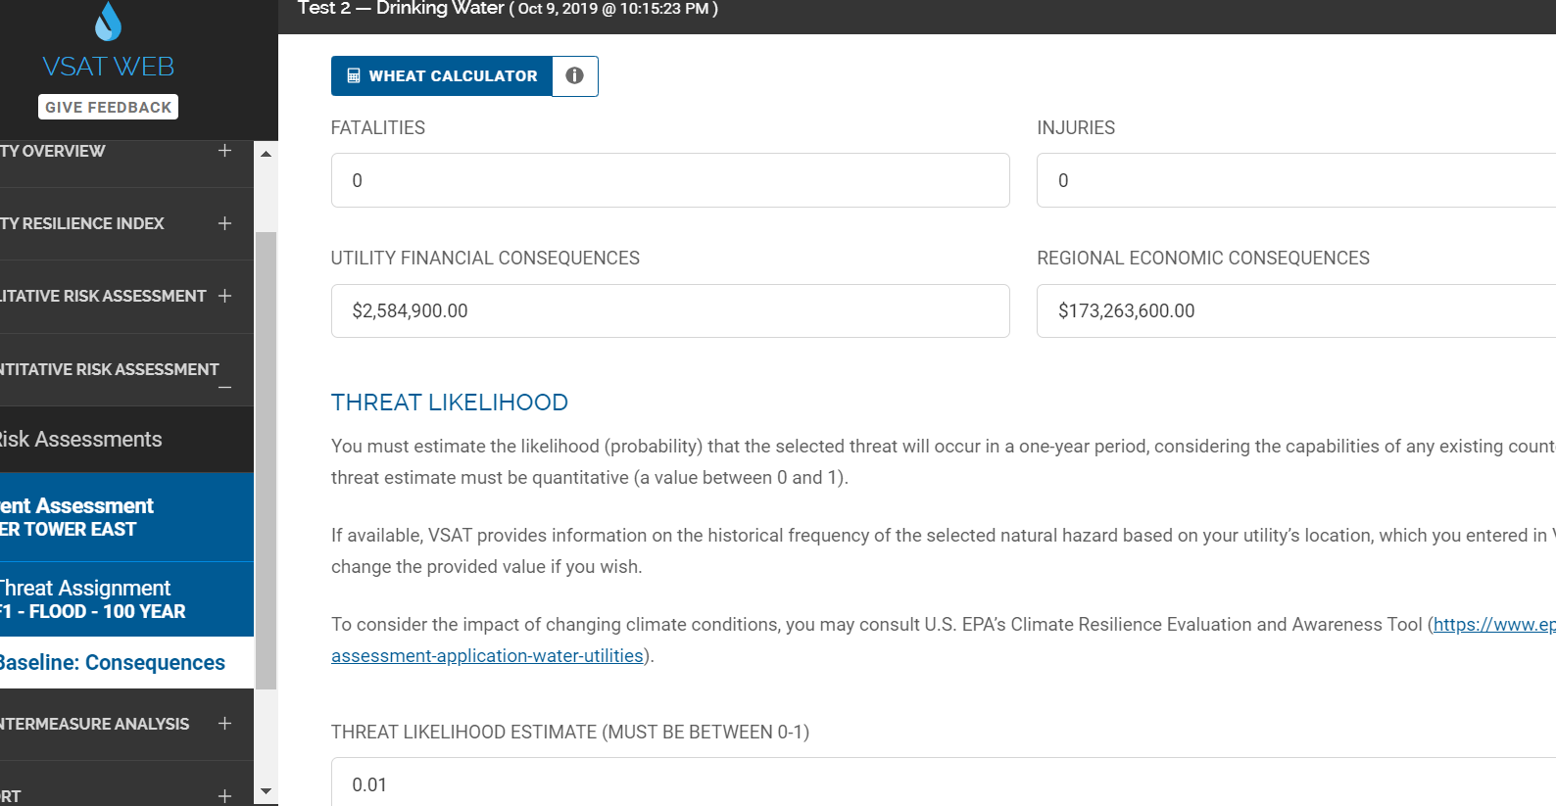
Notes:
This is the section of VSAT that calculates the threat likelihood variable for the risk equation. In most cases for most threats it will be prepopulated.
For this example, the VSAT tools has pulled in FEMA flood map data and used my zip code to identify the correct estimate for a 100-yr flood for my water tower.

Slide 52
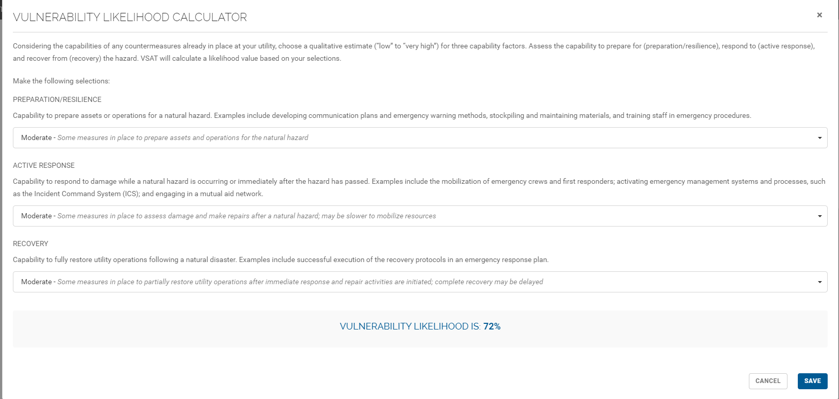
Notes:
Finally the tool calculates the vulnerability variable by asking you to respond to your utility's ability to prepare, respond and recover to the threat that you are assessing.

Slide 53
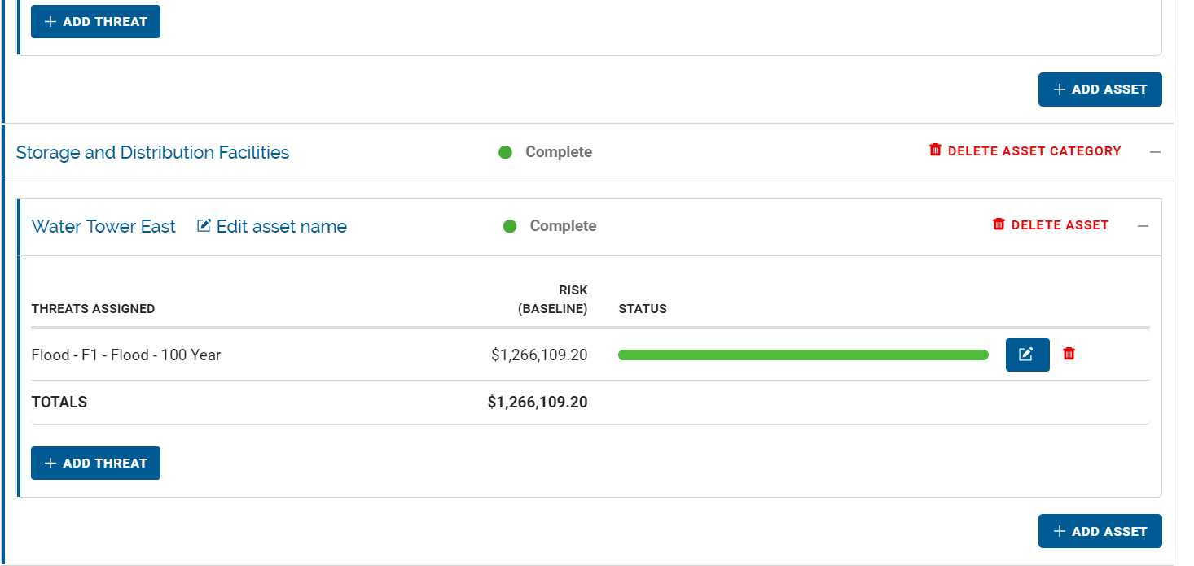
Notes:
As you can see here, the tool has taken those variables and calculated your baseline risk for the identified threat/asset pair.

Slide 54
STEP 5: Countermeasure Analysis
Countermeasure Risk Assessment
  Identify existing countermeasures in place at the facility.
  Select potential countermeasures that you wish to evaluate for further risk reductions.
  Determine the improvement risk.
Countermeasure Cost
  Enter the capital and the operations and maintenance costs associated with the potential countermeasure.
  VSAT calculates an annualized cost (using 4% finance rate over 10 years).
  These costs will be compared against the monetized benefit in risk reduction that the potential countermeasures achieve.
Countermeasure Packages
  It may be helpful to group countermeasures into bundles/packages for analysis and comparison.
  You may also want to consider bundling countermeasures as a single package against multiple threats.
Notes:
Step 5 is consistent with step 7, Risk and Resilience Management within RAMCAP where utilities can decide what actions you may need to take to reduce risk and increase resilience, analyze cost associated with those actions and identify the cost-benefit ration.

Slide 55
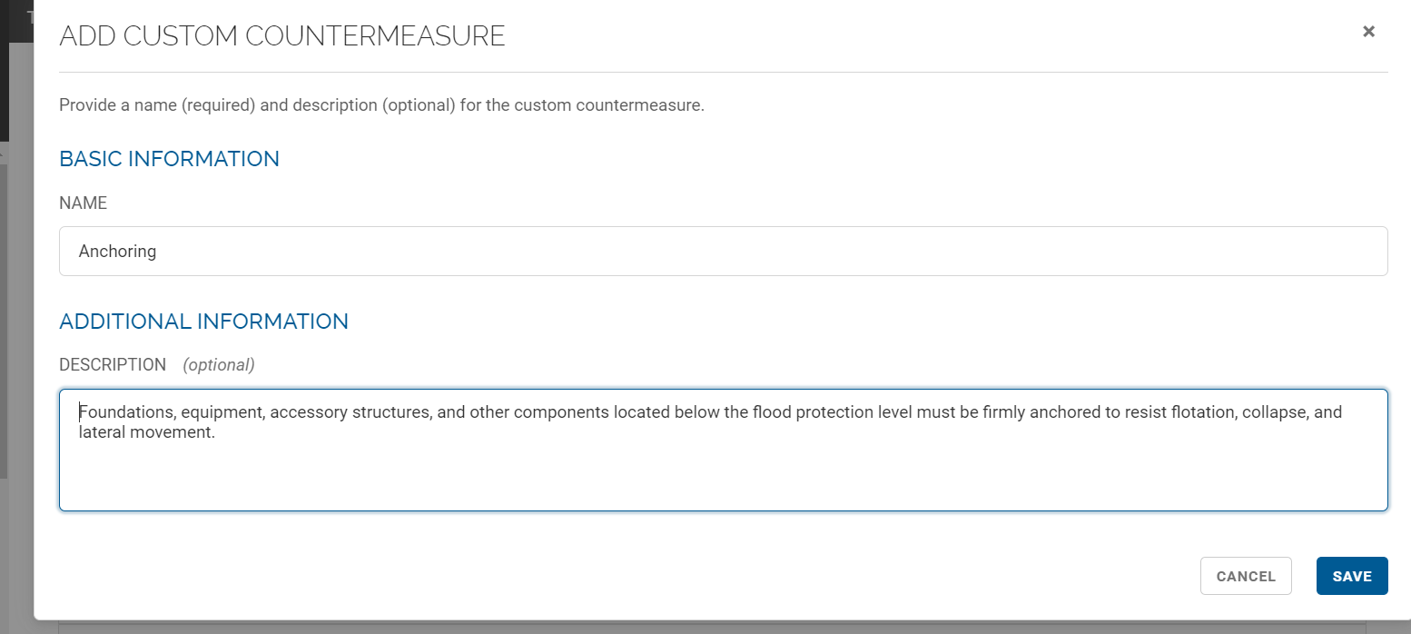
Notes:
IN VSAT you can also add custom countermeasures that you have in place. For example, here we have added anchoring and described the existing countermeasure.

Slide 56
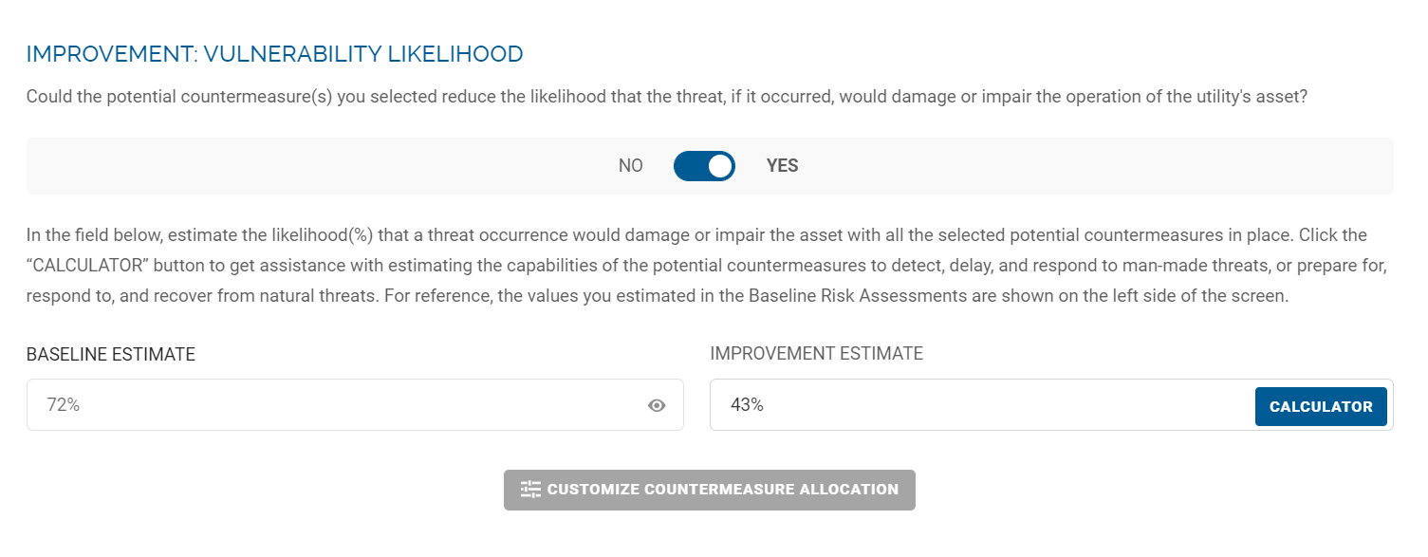
Notes:
I have added a potential countermeasure of adding in a redundant water supply to address the 30% who would lose service.
As you can see, the improvement estimate for the vulnerability variable is lowered, which will result in lower risk.

Slide 57

STEP 6: Obtain Your Report
The report is your Risk and Resilience Assessment.
What are your next steps?
  Certify to U.S. EPA that you have completed your Risk and Resilience Assessment.
  Identify key information from the report to update your emergency response plan.
Notes:
The final step is a report. This is your risk and resilience assessment. The next step after VSAT is to certify the assessment and use it to develop or update your emergency response plan.

Slide 58
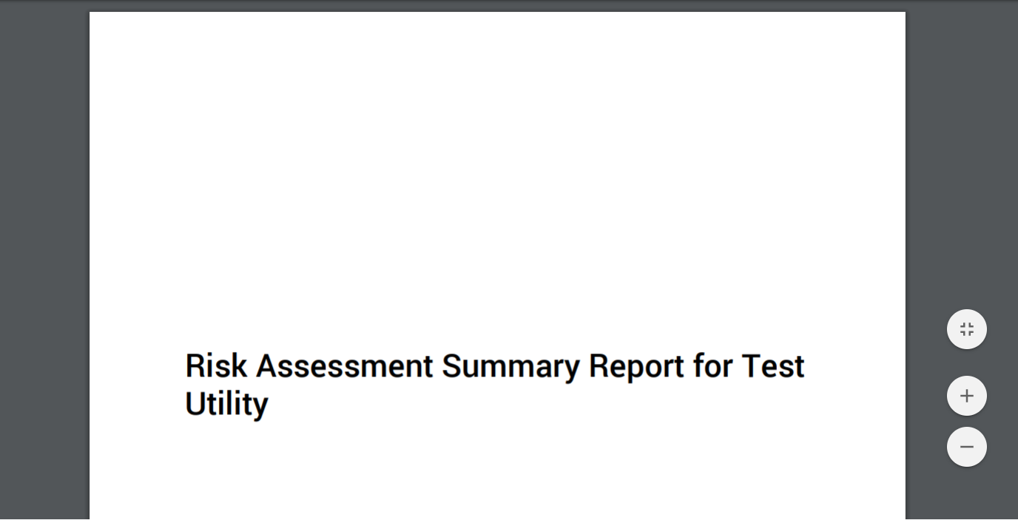
Notes:
This is what your report will look like

Slide 59
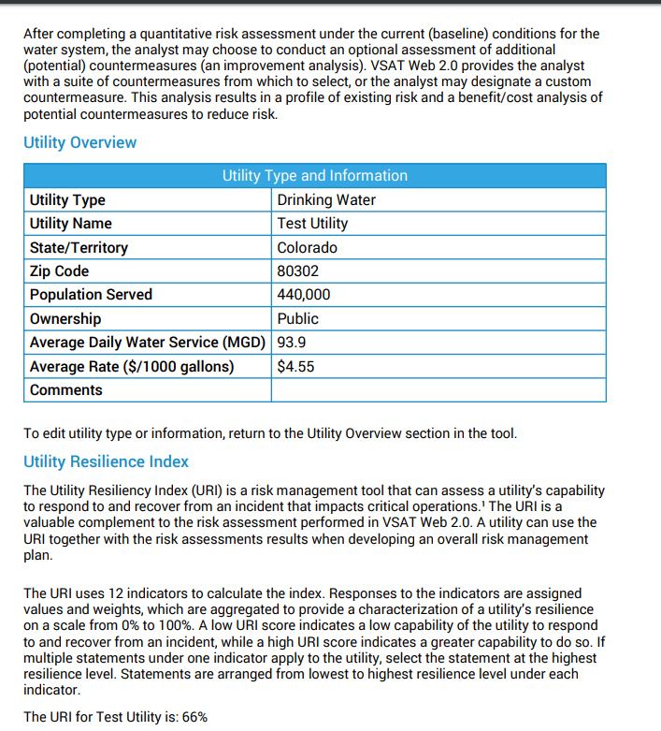
Notes:
The information entered will be included in the report in each section

Slide 60
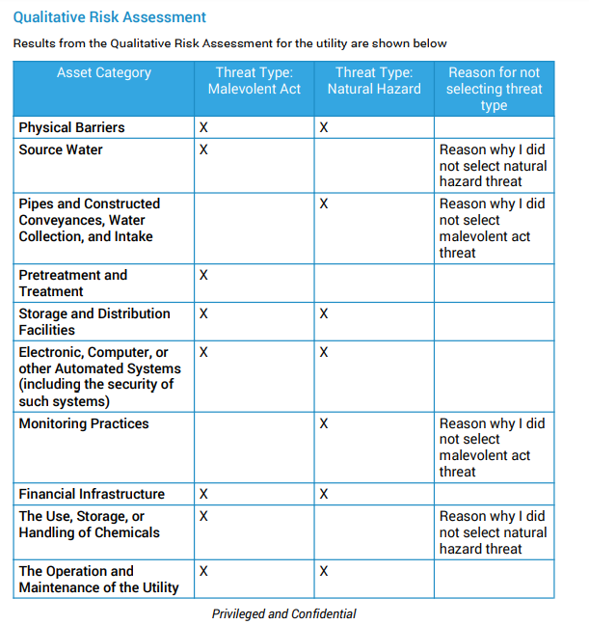

Slide 61
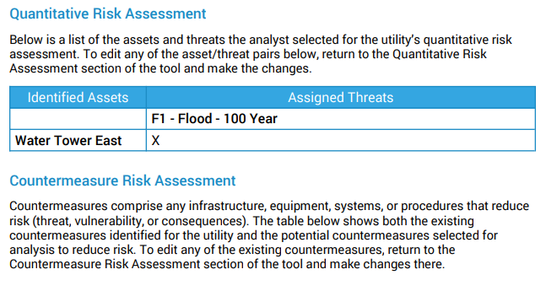

Slide 62
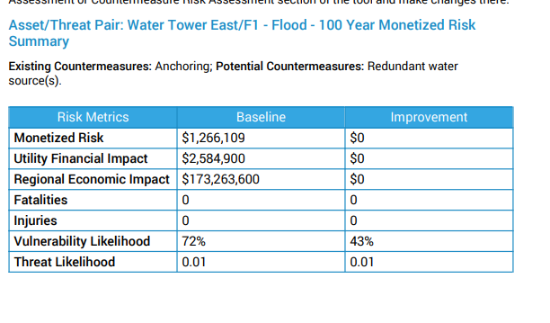

Slide 63
BREAK – 1 Hour

Slide 64
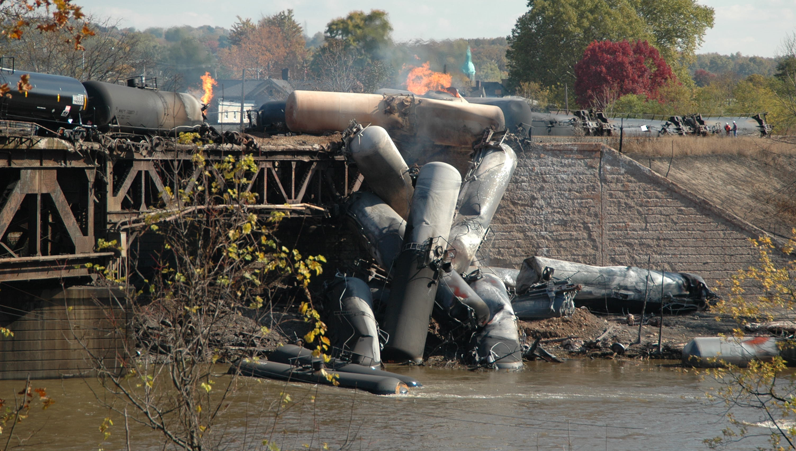
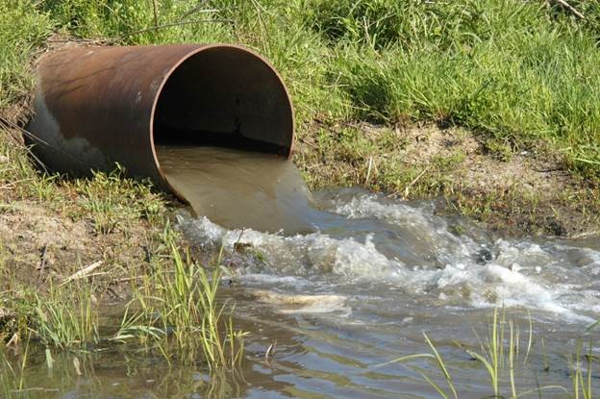

Questions?

Slide 65
EPA WARN
Notes:
This video depicts the benefits of the Water and Wastewater Agency Response Networks established in states for utilities to share resources with other utilities.

Slide 66
Emergency Response Plan
Section 3
Notes:
The results of your risk assessment should feed into the development or update of your system’s emergency response plan.

Slide 67
Background
An ERP describes your utility’s strategies, resources, plans and procedures to prepare for and respond to an incident, natural or man-made, that threatens life, property, or the environment.
Incidents can range from small main breaks or localized flooding to large scale hurricanes, earthquakes or system contamination, among other examples.
Notes:
Read slide

Slide 68
Background - continued
When an incident occurs that requires a response, you will need to activate the procedures and protocols described in your ERP. This can include:
  Implementing personnel emergency roles and responsibilities.
  Setting up your utility’s Incident Command System (ICS) structure.
  Recalling personnel on vacations and notifying external agencies such as your local emergency management agency, police, fire department and state regulatory agency.
Notes:
Read slide

Slide 69
AWIA Section 2013 - ERPs
  Applies to all community water systems serving more than 3,300 people.
  Develop or update ERPs.
  Submit certifications to EPA by specified deadlines.
      For ERPs, no later than 6 months after certification of completion of Risk Assessments.
  Review ERPs every five years.
  Coordinate with local emergency planning committees.
  Maintain records.
Notes:
So just to provide an overview or big picture look at Section 2013 for ERPs:
It applies to all community water systems (CWSs) serving more than 3,300 people, similar to the Bioterrorism Act
It requires that these systems use findings from their Risk and Resilience Assessments (RA) to develop or update Emergency Response Plans (ERPs)
These systems must submit certification to EPA by specified deadlines for both the RA and ERP
And must continue to review risk assessments and ERPs every five years
These systems must also coordinate with local emergency planning committees, to the extent possible, when developing the RA and ERP-discuss in next slides.
Maintain Records: Systems must maintain a copy of their ERP for five years after the certification date. Since ERPs may contain sensitive information, it should be stored safely and securely. Consider storing one copy on-site and one copy off-site in case you are unable to access your offices or facilities during an incident. Systems may also store an electronic copy on a shared drive or other digital platform (protected by a firewall) easily accessible by your utility personnel. Similarly, up-to-date plans and schematics of your treatment and distribution systems, as well as current operations manuals, could be maintained and kept in at least two secure locations.

Slide 70
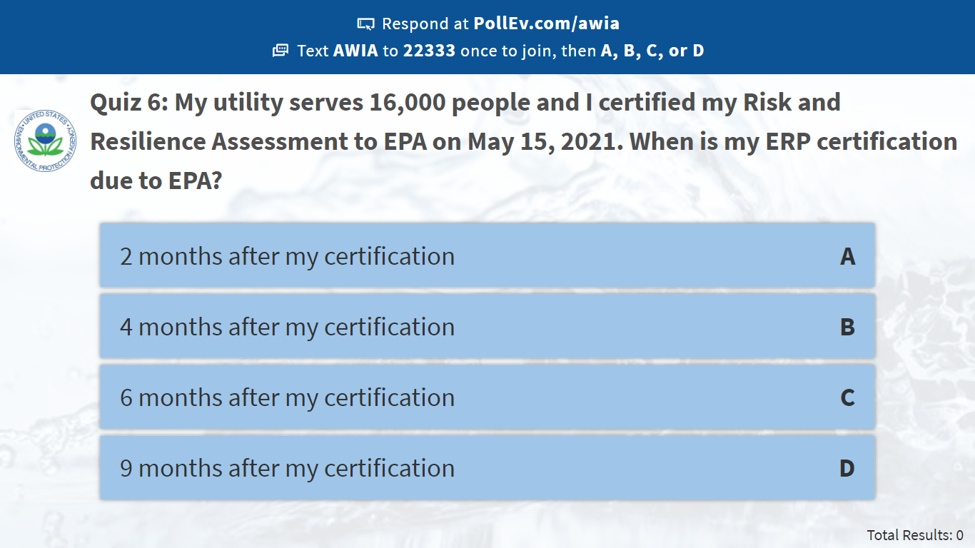
Notes:
Poll Title: Quiz 6: My utility serves 16,000 people and I certified my Risk and Resilience Assessment to EPA on May 15, 2021. When is my ERP certification due to EPA?
https://www.polleverywhere.com/multiple_choice_polls/lF8xzPXjuULdbKEx6eHvY

Slide 71
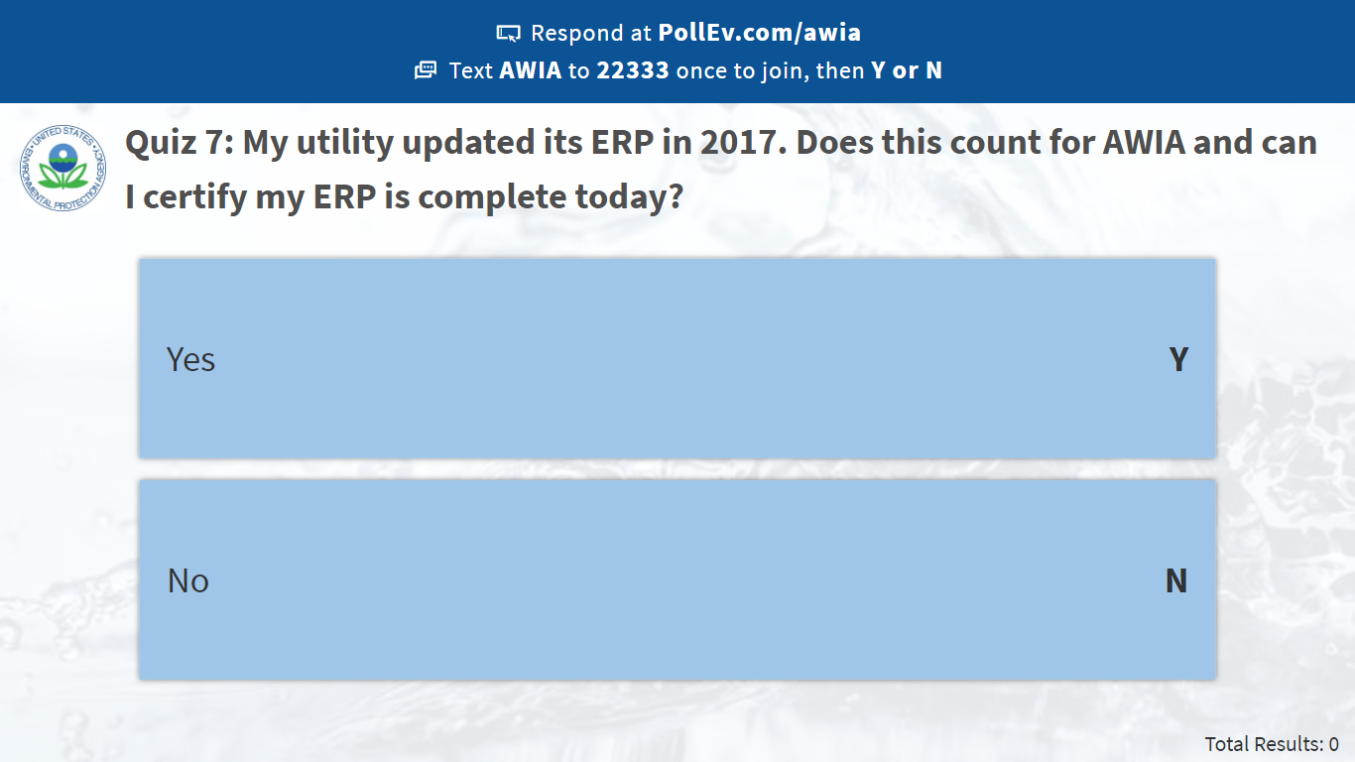
Notes:
Poll Title: Quiz 7: My utility updated its ERP in 2017. Does this count for AWIA and can I certify my ERP is complete today?
https://www.polleverywhere.com/multiple_choice_polls/C0sKXRnCNPIHqjP0mJmxd

Slide 72
AWIA ERP Criteria
Prepare or revise an ERP that incorporates findings from the risk assessment and include:
  Strategies and resources to improve resilience, including physical security and cybersecurity (Resilience Strategies);
  Plans, procedures and equipment for responding to a malevolent act or natural hazard (Emergency Plans & Procedures);
  Actions, procedures and equipment to lessen the impact of a malevolent act or natural hazard, including alternative source water, relocation of intakes and flood protection barriers (Mitigation); and
  Strategies to detect malevolent acts or natural hazards (Detection Strategies)
Notes:
The actual language for the ERP requirements in the law is pretty short. Th law states that ERPs shall include the following information:
(Resilience Strategies): Strategies and resources to improve system resilience
(Emergency Plans & Procedures): Plans, procedures and equipment to use in the event of a malevolent act or natural hazard that threatens the utility’s ability to provide safe drinking water
(Mitigation): Actions and procedures that can be used to reduce the impacts of malevolent acts or natural hazards
(Detection Strategies): Strategies in place to detect malevolent acts or oncoming natural hazards that threaten the system.

Slide 73
Preparing for ERP Development
Conduct a risk and resilience assessment.
Identify state regulatory requirements.
Identify and integrate local plans.
Coordinate with Local Emergency Planning Committees (LEPCs) and response partners.
Plan for resources.
Notes:
Before beginning your ERP, follow these steps to gather the key information you’ll need to develop or update your ERP.
Conduct a risk and resilience assessment: The findings identified in your RA will enhance the effectiveness of your ERP and must be incorporated. For example, your RA may identify hurricanes as a significant risk for your utility and outline cost-effective countermeasures to lower your risk. Your ERP, grounded in the results of the RA, then describes the processes and procedures that can be implemented to mitigate hurricane impacts (e.g., flooding) to your utility.
Identify state regulatory requirements: Many states have specific regulatory requirements for ERP content and provide their own ERP templates. However, your utility is responsible for checking with your state to be sure that any state-provided templates also meet the AWIA ERP requirements.
Identify and integrate local plans: Your ERP should dovetail with other emergency plans in your community as much as possible.
Coordinate with local emergency planning committees and response partners: AWIA Section 2013 requires that CWSs, to the extent possible, coordinate with their existing LEPC when preparing or revising their ERP. Partnering with stakeholders like LEPCs allows all parties to understand response processes & procedures used during a drinking water incident.
Plan for resources: the resources (i.e., personnel, equipment, supplies, and facilities) your utility owns or has access to will influence how you develop your ERP procedures. Resource Typing, defined as categorizing by capability the resources requested, deployed, and used in incidents, is a key activity in identifying resource gaps.
Question: Has your utility coordinated in the past or currently coordinating with your Local Emergency Planning Committee (LEPC)? What did you find as the most beneficial aspect of that interaction?

Slide 74
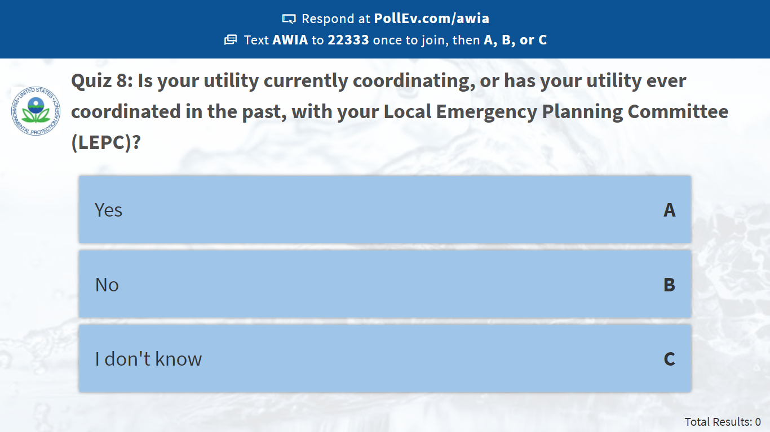
Notes:
Poll Title: Quiz 8: Is your utility currently coordinating, or has your utility ever coordinated in the past, with your Local Emergency Planning Committee (LEPC)?
https://www.polleverywhere.com/multiple_choice_polls/wFP2N0Z3gFuq5XjuGL3Pv

Slide 75
ERP Guidance TEMPLATE AND INSTRUCTIONS
Notes:
Now that we have discussed the AWIA ERP requirements, let’s go into detail about EPA’s ERP Guidance Template and Instructions to help utilities meet the requirements.
If doing the full training, this section is after lunch so check-in with the group, ask questions if need be, to keep people awake and engaged.

Slide 76
ERP Guidance - Features
The ERP template and instructions assist water utilities with developing an ERP in accordance with AWIA Section 2013(b).
A single PDF document provides guidance on what information should be provided in each section of the ERP template.
  Includes useful links for additional information and guidance
A blank ERP template in Word format is embedded in the PDF document and can be easily accessed and modified to meet your own utility’s needs.
The user-friendly template features fillable tables, checklists and charts to use as a starting point for utilities to develop their own plans.
Notes:
As you will see, the ERP guidance is structured after the criteria specified in AWIA that all ERP’s must include.
So as for features of the guidance:
It is formatted as a single PDF document that provides instructions on what information should be provided in each section of the ERP template.
It also includes useful links for additional information and guidance
The blank ERP template is in Microsoft Word format, which is embedded in the PDF document and can be easily accessed and modified to meet your own utility’s needs.
The template is very user-friendly and features fillable tables, checklists and charts to use as a starting point for utilities to develop their own plans.

Slide 77
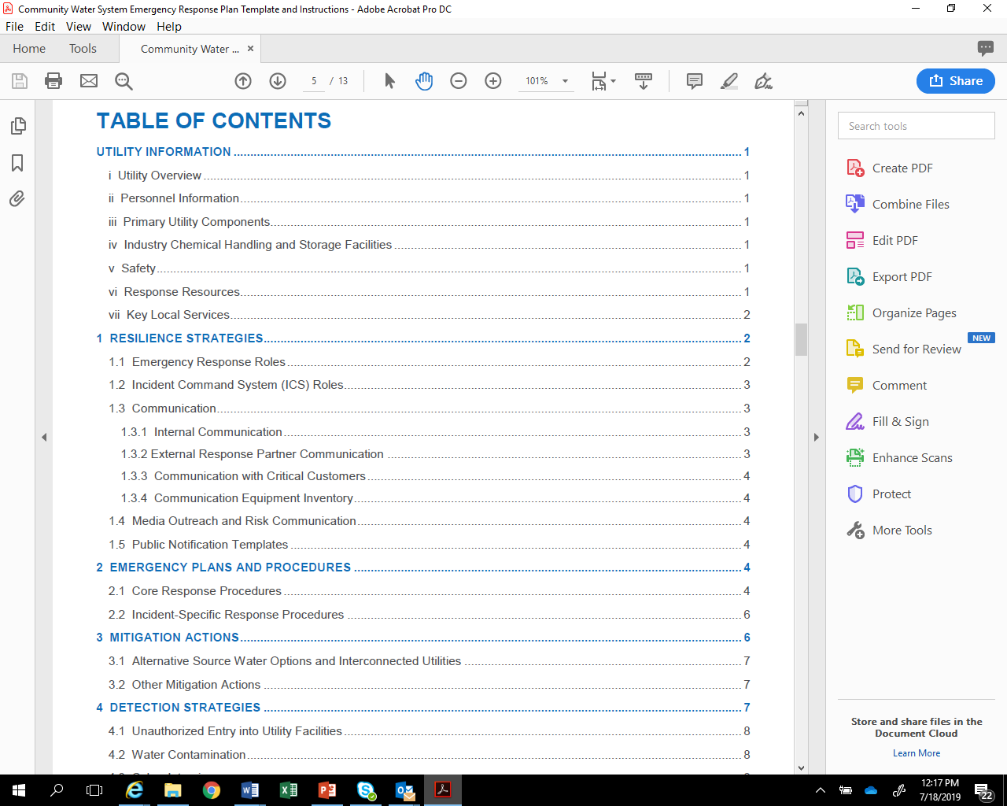
ERP Template Outline
Utility Information
Resilience Strategies
Emergency Plans and Procedures
Mitigation Actions
Detection Strategies
Notes:
This next slide shows the overall outline for the guidance and, as I mentioned, it is structured around the ERP criteria identified in AWIA.
This includes:
Utility Information
Resilience Strategies
Emergency Plans and Procedures
Mitigation Actions, and
Detection Strategies
I will provide more information on each of these sections in the next few slides.

Slide 78
Utility Information
During an incident, you need to have system information about your water utility readily available for your personnel, first responders, repair contractors/vendors, the media and other response partner agencies, including:
    Utility Overview
    Personnel Information
    Primary Utility Components
    Industry Chemical Handling & Storage Facilities
    Safety
    Response Resources
    Key Local Services
Notes:
Utility Overview: Provide basic information about your utility in the table in this section. The information required here should be readily available.
Personnel Information: Have a personnel roster available during an incident to quickly contact your employees.
Primary Utility Components: List, as appropriate, all the components necessary to maintain effective operation of your utility. This includes information on wells, intakes, treatment plants, storage/distribution systems (e.g., tanks, primary mains, pumping stations), and treatment chemical storage, as appropriate.
Industry Chemical Handling & Storage Facilities: Industry surrounding your utility can also be impacted by incidents such as accidental releases, hurricanes or earthquakes. It is important that you understand what chemicals may be released in your area during an incident and how they may impact your utility operations.
Safety: Having easy access to safety materials and important safety information and procedures will help protect utility personnel during an incident.
Response Resources: Having an accurate inventory of available resources (e.g., equipment, supplies) either maintained onsite or readily available offsite (e.g., neighboring water system) allows utility responders to know what resources are immediately available during an incident.
Key Local Services: Note the closest locations of key logistical and medical services that you or mutual aid and assistance providers may need during an incident.

Slide 79
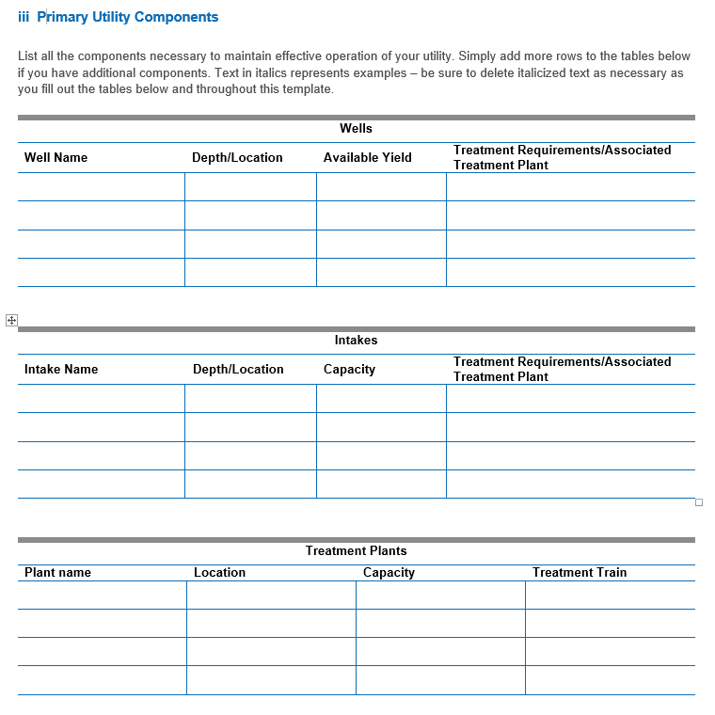
Utility Information - Template Example (1)
Notes:
This next slide provides an example of the fillable tables in the template for the primary utility components section.
It includes tables to enter key information for wells, intakes, treatment plants, storage and distribution system (e.g., Tanks, Primary Mains and Pumping Stations), treatment chemical storage facilities and other components as appropriate for your utility.
As you can see, the tables are very easy to fill out.
Again, the template is in Word format so if your system doesn’t have wells you can simply delete this section.

Slide 80
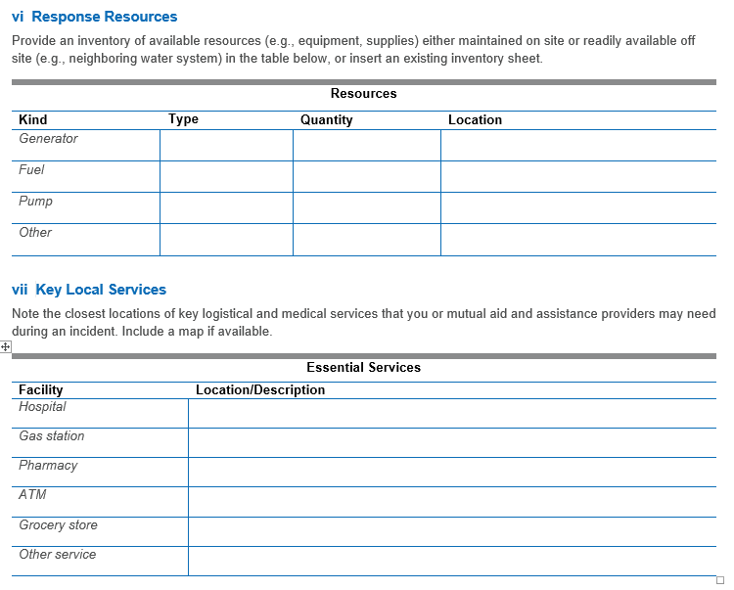
Utility Information - Template Example (2)
Notes:
Here is an example table for Response Resources and Key Local Services
For response resources, provide an inventory of available resources (e.g., equipment, supplies) either maintained on-site or readily available off-site (e.g., neighboring water system) in the table, or insert an existing inventory sheet.
For key local services, note the closest locations of key logistical and medical services that you or mutual aid and assistance providers may need during an incident. Include a map if available. Remember that external help that is brought in may not know the area.

Slide 81
Resilience Strategies
This section of your ERP should contain strategies and resources to improve the resilience of your system, including:
    Emergency Response Roles
    Incident Command System (ICS) Roles
    Communication (e.g., internal, external, critical customers, equipment)
    Media Outreach & Risk Communication
    Public Notification
Resilience strategies incorporate how you will assign roles and responsibilities, how you will work with response partners and how you intend to communicate during an incident.
Notes:
The next section of your ERP, Resilience Strategies, should contain strategies and resources to improve the resilience of your system.
Overall, resilience strategies incorporate how you will assign roles and responsibilities, how you will work with response partners, and how you intend to communicate during an incident.
Emergency Response Roles: An effective ERP involves active participation of a variety of both utility and external response partner agency personnel, each having well-defined roles and responsibilities.
ICS Roles: Your utility should consider integrating a standardized incident management structure, such as the ICS, into your response procedures.
Communication: Communication during an incident is critical to relay information to employees, government agencies, the public, the media, and others about potential risks to health, infrastructure, and the environment.
Media Outreach: List contact information in the table provided for all media outlets that your utility may coordinate with during notification efforts. This may include newspapers, social media sites, television, and radio stations, etc.
Risk Communication: RC is a tool that helps water utilities deal with public messaging during emergencies to enhance knowledge and understanding of an incident, build trust and credibility, encourage constructive dialogue, and provide guidance on appropriate protective actions.
Public Notification: insert your templates for PNs in this portion of the ERP template, or reference where they may be found. Be sure that your templates are consistent with the regulatory requirements for public notification.
Question to the class if you choose: By a show of hands, who has taken ICS training in this class? What did you find to be the most valuable aspect of that training?

Slide 82
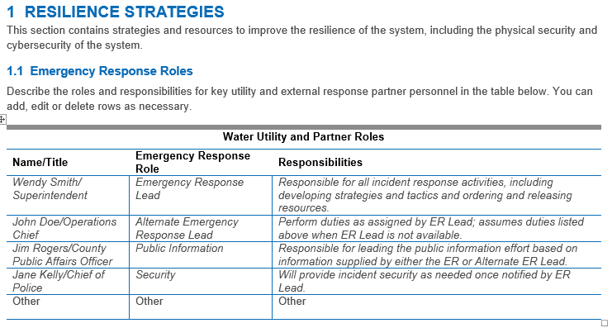
Resilience Strategies - Template Example
Notes:
Remember, the resilience strategies section of your ERP contains strategies and resources to improve the resilience of the system, including the physical security and cybersecurity of the system.
This next slide provides an example of the fillable tables in the template for Resilience Strategies, particularly for ER roles.
Here you can list the name and title of the utility or response partner personnel along with their specific role and a descriptions of their responsibilities.
Italicized text in the table represents examples you may use as a starting point.

Slide 83
Emergency Plans & Procedures
This section of your ERP should contain plans, procedures and equipment that can be used in the event of a malevolent act or natural hazard that threatens your utility’s ability to deliver safe drinking water.
Two types of emergency response plans and procedures should be considered as part of your ERP:
    Core Response Procedures
    Incident-Specific Response Procedures (ISRPs)
Notes:
The next section of your ERP pertains to Emergency Plans and Procedures.
It should contain any plans, procedures, and equipment that can be used during an incident.
There are 2 types of Emergency Plans and Procedures: Core Response Procedures and Incident-Specific Response Procedures (ISRPs), which we will discuss in the next few slides.

Slide 84

Core Response Procedures
Core procedures are the “building blocks” for incident-specific procedures, since they apply across a broad variety of incidents (e.g., hurricane, earthquake, flood).
Core procedures include:
    Access
    Physical Security
    Cybersecurity
    Power Loss
    Emergency Alternate Drinking Water Supplies
    Sampling & Analysis
    Family and Utility Personnel Well Being
Notes:
Core procedures are the “building blocks” for incident-specific procedures since they apply across a broad variety of incidents (e.g., hurricane, earthquake, flood).
These include:
Access - A significant challenge your utility may face after a major incident is gaining access to critical facilities and other locations to assess damage and implement repairs.
Physical Security - Protecting utility facilities, equipment, and vital records is essential to restoring operations once an incident has occurred.
Cybersecurity – Your utility should consider adopting cybersecurity best practices to reduce vulnerabilities to cyber-attacks and develop, implement, and drill response and recovery procedures for cyber incidents to minimize impacts in the event of a successful attack.
Power Loss - Your utility should consider preparing for a loss of power and know what to do to respond and recover from such an incident
Emergency Drinking Water Supplies - Your ERP should consider clearly defining how your utility, along with other external response partners such as emergency management, would supply alternate drinking water to your community during both short-term (hours to days) and long-term (weeks to months) outages.
Sampling and Analysis- include pre-identified sampling sites, procedures for sample collection of both known and unknown contaminants, chain of custody, sample preservation, sample transport, as well as a list and locations of contract analytical laboratories.
Family-Your personnel are more likely to report for duty or stay on the job during an incident if they know they and their families are safe and cared for. Identify actions that could be taken before, during, and after an incident that are unique to each hazard (e.g., hurricanes, floods, earthquakes).

Slide 85
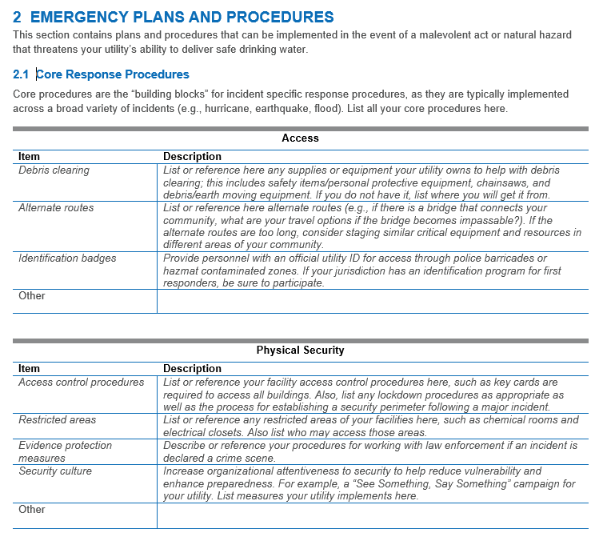
Core Procedures - Template Example
Notes:
This next slide provides an example of the fillable tables in the template for the Core Response Procedures.
This particular slide shows the tables for Access procedures and Physical Security procedures.
Again, the gray italics are examples to get you started. Feel free to delete them if you don’t need them or if they don’t apply to your system.

Slide 86
Incident Specific Response Procedures (ISRPs)
Cyber-Attack | Hurricane
Drought | Tornado
Earthquake | Tsunami
Extreme Cold/Winter Storms | Volcanic Activity
Extreme Heat | Wildfire
Flooding | Source Water Contamination
Harmful Algal Blooms | Distribution System Contamination
ISRPs are specialized procedures tailored to a particular type of incident and typically align with those vulnerabilities identified in your risk assessment.
They provide a quick approach for responding to a specific incident and complement actions already initiated under your ERP.
Notes:
An Incident Specific Response Procedure (ISRP) should be an accessible (i.e., “rip and run”) document that can be detached and taken to the field.
You may only need one or two pages to cover specific response information in these procedures since you have already addressed basic emergency response steps under your core response procedures.
EPA has developed a type of ISRPs (called Incident Action Checklists) for 12 different types of incidents listed in the table. Your system can use these or use them as a guide to create your own ISRP for areas where you are at risk.

Slide 87
Quiz 9
Sunbelt Utility is located in the southeastern United States. Although they are far away from the coast and they are not located in a floodplain, they have experienced several impacts lately from increasing extreme precipitation events. In some of these events, rainfall amount have averaged 2-3 inches per hour, creating many operational challenges. What ISRP could they use? (Quiz on next slide)
Notes:
Discussion: Sunbelt Utility should probably consider developing a Flood ISRP and use EPA’s Flood IAC as a starting point . This would accommodate their situation and allow them to have a written procedure to better prepare for and respond to extreme precipitation and flooding events that generate large amounts of runoff and standing water. Go through Flood IAC on next slide.

Slide 88
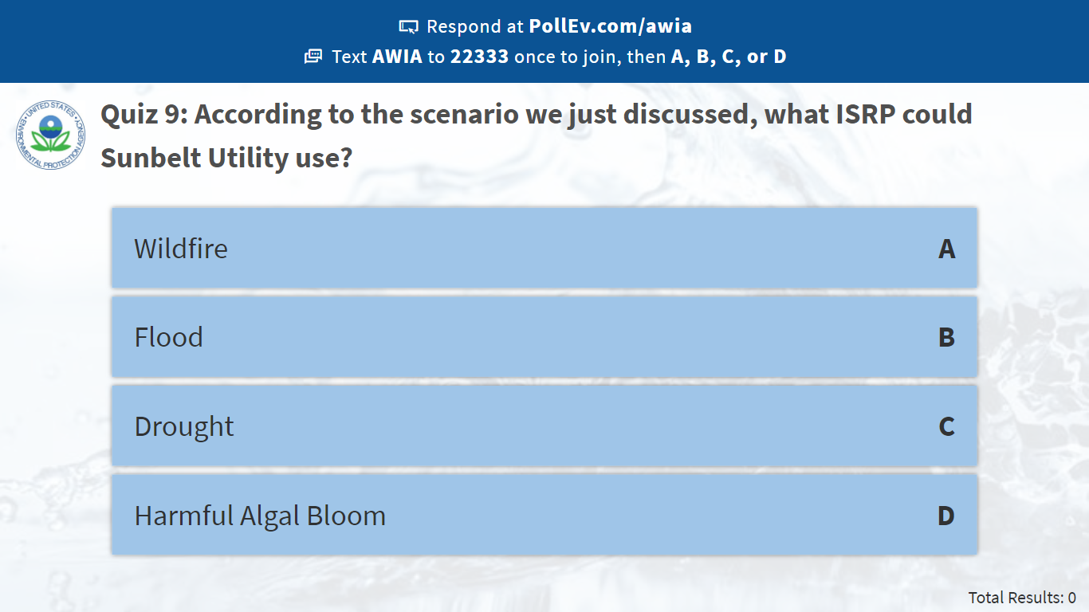
Notes:
Poll Title: Quiz 9: According to the scenario we just discussed, what ISRP could Sunbelt Utility use?
https://www.polleverywhere.com/multiple_choice_polls/GJ9X6q1rkOGJv4ytWiEmE

Slide 89
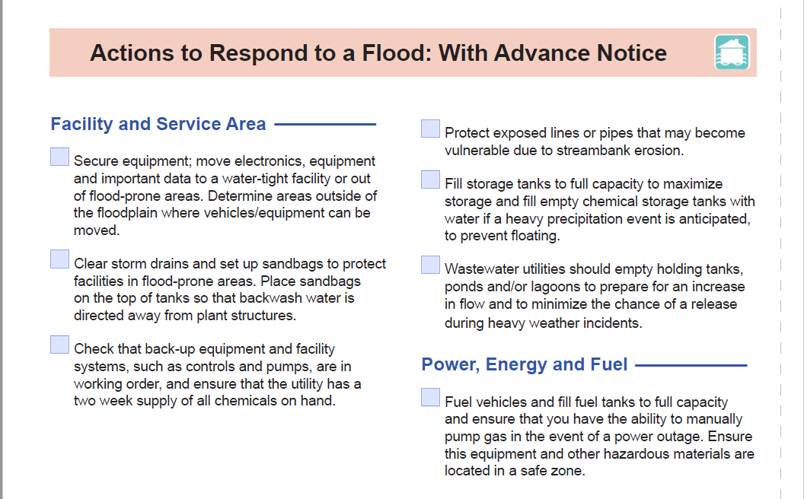
ISRPs - Template Example
https://www.epa.gov/waterutilityresponse/incident-action-checklists-water-utilities
Notes:
This is an incident action checklist for flooding. This is not from the actual ERP template, but again can be found on EPA’s website. https://www.epa.gov/waterutilityresponse/incident-action-checklists-water-utilities
This particular incident action checklist shown in the slide includes actions to take to prepare, respond and recover from a flood related incident.

Slide 90
Mitigation Actions
This section of your ERP should include actions, procedures and equipment which can obviate or significantly lessen the impact of a malevolent act or natural hazard on the public health and the safety and supply of drinking water provided to your community and individuals, including:
    Development of alternative source water options
    Relocation of water intakes
    Construction of flood protection barriers
These mitigation actions, procedures and equipment help your utility to better withstand and rapidly recover from incidents (e.g., flooding, earthquake), thereby increasing overall resilience.
Notes:
The next section of your ERP pertains to mitigation actions, or more specifically as AWIA states: actions, procedures, and equipment which can obviate and significantly lessen the impact of an incident on the public health and the safety and supply of drinking water provided to your community.
This includes:
Development of alternative source water options
Relocation of water intakes
Construction of flood protection barriers
Since these three mitigation options are specifically included in the law, you should indicate in your utility’s ERP that you considered these three specific mitigation actions, but the actions do not have to be implemented if they are not consistent with your utility’s risk profile, as defined by your risk assessment.
Remember, it is more cost-effective to mitigate the risks from natural disasters than it is to repair damage after the disaster. Examples of mitigation projects include:
Elevation of electrical panels at a lift station to prevent flooding damage
Replacement of piping with flexible joints to prevent earthquake damage
Reinforcement of water towers to prevent tornado damage
Overall, mitigation measures require financial investment by the utility; however, mitigation could prevent more costly future damage and improve the reliability of service during a disaster.
Question to ask participants if you choose: Who here has participated in their community’s or county’s hazard mitigation planning process? What projects did you get put into your jurisdiction’s hazard mitigation plan? Have you seen funding yet?
Discussion: Participating in your jurisdiction’s hazard mitigation planning process is a good way to help fully develop this portion of your ERP. Mention Hazard Mitigation Guide.

Slide 91
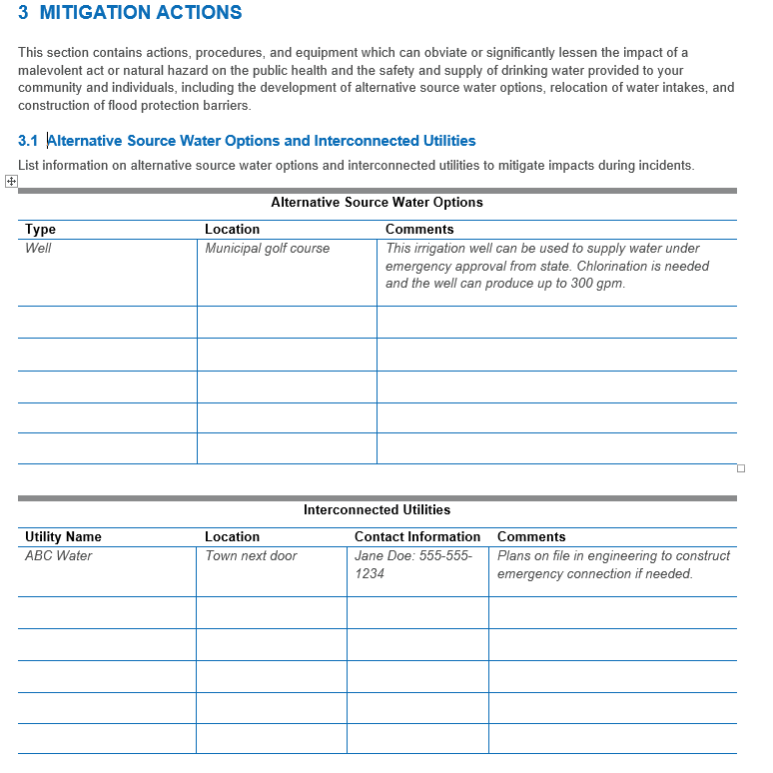
Mitigation Actions - Template Example
Notes:
This next slide provides an example of the fillable tables in the template for the Mitigation Actions.
It shows the table for alternative source water options your system has in place and an area to list interconnections with other utilities.

Slide 92
Mitigation Resources
Hazard Mitigation Guide: Helps utilities with coordinating with community's local mitigation planners, identifying potential disaster-specific mitigation projects and funding proposed mitigation projects.
Flood Resilience Guide: Helps utilities know the local flooding threat and identifies practical mitigation options to protect critical assets. Provides worksheets, instructional videos and flood maps to help utilities through a simple 4-step process.
Drought Response and Recovery Guide: Provides worksheets, best practices, videos and key resources for responding to drought emergencies and building long-term resilience. It relays lessons learned from seven small- to medium-sized utilities nationwide that have responded to extreme drought conditions.
Earthquake Resilience Guide: Helps utilities to be more resilient to earthquakes. It contains best practices from utilities that have used mitigation measures to address the earthquake threat.
https://www.epa.gov/waterutilityresponse
Notes:
EPA has multiple guides published that water systems can use to address mitigation options for hazards they may be at risk to. Those guides are listed on this slide, as well as a quick description. You can find the EPA website where you can go to download them for more information.

Slide 93
Mitigation Resources - continued
Power Resilience Guide: Helps utilities identify how to increase their resilience to power outages.
https://www.epa.gov/communitywaterresilience
Resilient Strategies Guide: Helps utilities understand how extreme weather events can impact utility operations and missions and provides examples of different actions utilities can take to prepare for potential impacts.
https://www.epa.gov/crwu/resilient-strategies-guide-water-utilities#/
Notes:
Here are a few more mitigation resources from EPA.

Slide 94
Detection Strategies
This section of your ERP should contain strategies that can aid in the detection of malevolent acts or natural hazards that threaten the security or resilience of your utility.
These detection strategies can be almost no-cost (e.g., instituting a “See Something, Say Something” campaign at your utility) or require more resources (e.g., installing motion sensors and video cameras to monitor for facility break-ins or tampering) to implement.
Effective response to an emergency requires timely detection, which allows your utility to implement its ERP as soon as possible.
Notes:
The last section of your ERP, that is required by AWIA, pertains to Detection Strategies that can aid in the detection of incidents that threaten your utility.
They can range from no-cost strategies (like instituting a “See Something, Say Something” campaign at your utility) or ones requiring more resources to implement (like installing motion sensors and video cameras to monitor for facility break-ins or tampering).
Keep in mind that effective response to an emergency requires timely detection, which allows your utility to implement its ERP as soon as possible.

Slide 95
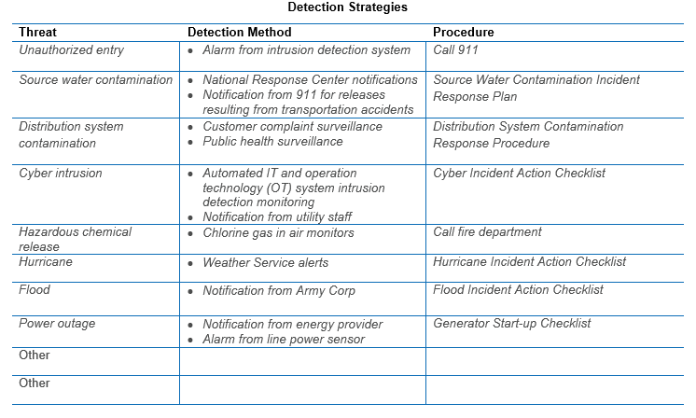
Detection Strategies - continued
Examples of effective strategies for detecting common threats include:
  Unauthorized Entry
  Water Contamination
  Cyber Intrusion
  Hazardous Chemical Release
  Natural Hazards
  Power Outages
Notes:
This next slide again comes from the EPA ERP template and shows some examples of effective strategies for detecting common threats including:
Unauthorized Entry: properly installed & maintained intrusion detection systems provide almost instantaneous notification of break-ins and other unauthorized access into your utility facilities, but notifications from local law enforcement officers and community watch groups are also effective.
Water Contamination: notification of source water contamination may come from many different agencies and organizations including your primacy agency, 911, LEPC, etc. Potential contamination in your distribution system can be detected through tracking of CC, PHS, PSM at access points to finished water, grab S&A, OWQM, and AMI that can alert your utility of potential backflow events or meter tampering.
Cyber Intrusion: learning about and reporting cyber threats helps all utilities be better prepared to detect and respond to this kind of malevolent act.
Hazardous Chemical Release: routine inspection of your hazardous chemical storage facilities will aid in detecting problems that could lead to an unexpected chemical release.
Natural Hazards: such as extreme weather can cause severe damage to your utility. Real-time tools such as EPA’s online On-The-Go Mobile Application can help you track severe weather and access other information for an efficient response.
Power Outages: your utility can detect impending power outages more effectively by signing up to receive notifications from your power provider for any planned maintenance activities or brown outs.

Slide 96
Quiz 11 – Open Ended
Small Town Utility has an extremely limited budget and minimal staff. The utility does record customer complaints in a logbook to be sure that they are followed-up by staff. They also have a local police force that responds to 911 calls and patrols the community on a regular basis. How could Small Town Utility leverage their complaint log and the local police force into detection strategies?
Notes:
Discussion: The complaint log is an under-utilized resource. For example, Small Town Utility could use a map with pushpins to start tracking the locations of complaints and potentially identify clusters of complaints in certain parts of town that may be indicative of a larger infrastructure problem. Additionally, if complaints were classified by categories such as taste & odor or visual appearance, that could serve as an early warning for other problems that may be developing within the system or for a previously unknown contamination event. This could be very helpful for Small Town Utility, especially if the utility phone is answered by “whoever hears it first” which makes it hard for a single staff person to spot patterns.
Additionally, Small Town Utility could give their local police force a tour of their facilities around town and ask the patrol officers to specifically pay attention to the facilities while out on their patrols. An additional set of eyes would help Small Town Utility to detect things like vandalism or breaches sooner and may even prevent these kinds of incidents from happening once word got around town that the police regularly patrol the facilities in addition to the visits made by Small Town Utility staff.

Slide 97
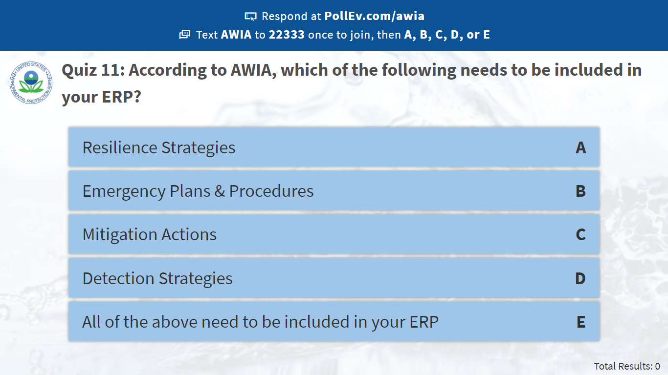
Notes:
Poll Title: Quiz 11: According to AWIA, which of the following needs to be included in your ERP?
https://www.polleverywhere.com/multiple_choice_polls/W7wQ1GegXuxLVvhEOtle8

Slide 98

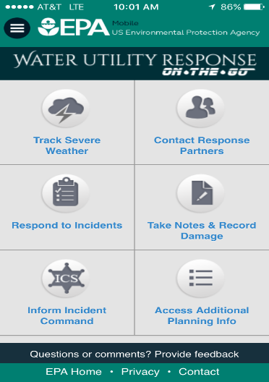
Final Thoughts
Documenting the Response:
  As you respond to an incident, you should immediately begin documenting your decisions, actions and expenditures.
  This is important for justifying incident costs and potentially seeking reimbursement once the incident is resolved.
  Good incident documentation involves creating a paper trail for receipts, records, photographs and personnel timesheets.
Water Utility Response
On-The-Go!
A Mobile App for a Mobile Response
www.epa.gov/waterutilityresponse/water-utility-response-go-mobile-application-and-website
Notes:
Question: What forms could you use to document your response actions?
Answer: EPA Response O-t-G and the complete ICS form series, available at FEMA’s ICS Resource Center (https://training.fema.gov/emiweb/is/icsresource/index.htm).

Slide 99
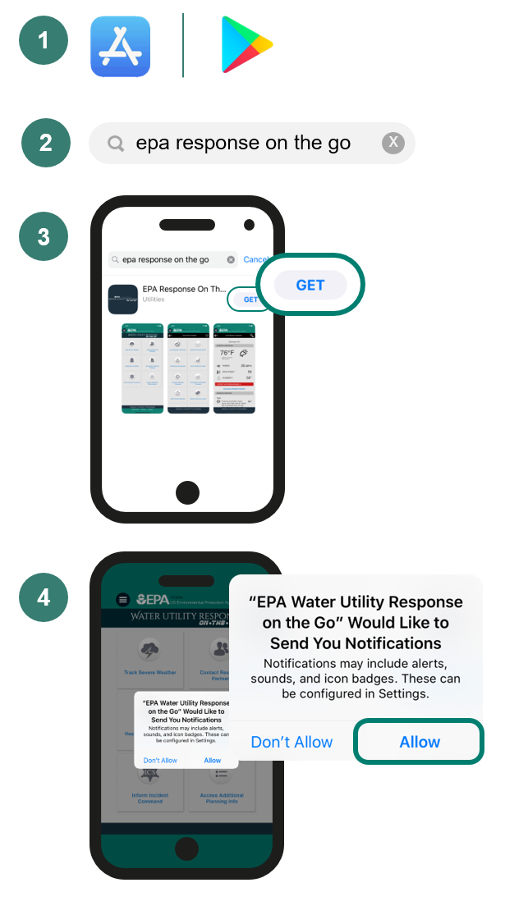

Response On-The-Go Mobile Application
How to download the application:
www.epa.gov/waterutilityresponse/water-utility-response-go-mobile-application-and-website

Slide 100
Final Thoughts - continued
Training:
  Once your ERP is complete, consider training your utility personnel and response partners on its contents and their individual roles and responsibilities
  Conducting periodic trainings (e.g., seminars, workshops, tabletops, functionals) for both senior and new personnel helps ensure that your ERP procedures will be effectively implemented during actual response
Training Tools:
  How to Develop a Multi-Year Training & Exercise (T&E) Plan: A Tool for the Water Sector
  Tabletop Exercise Tool
  Exercise Development Toolbox
  https://www.epa.gov/waterresiliencetraining
Notes:
Question: What tool does EPA have they can help you develop a training program?
Answer: How to Develop a Multi-Year Training & Exercise (T&E) Plan: A Tool for the Water Sector (https://www.epa.gov/sites/production/files/2015-05/documents/how_to_develop_a_multi-year_training_and_exercise_plan_a_tool_for_the_water_sector.pdf)
Also, for those looking to develop exercises, EPA offers both a Tabletop Exercise Tool (https://www.epa.gov/waterresiliencetraining/develop-and-conduct-water-resilience-tabletop-exercise-water-utilities) and an Exercise Design Toolbox (https://www.epa.gov/waterqualitysurveillance/water-quality-surveillance-and-response-system-exercise-development-toolbox).

Slide 101
BREAK – 15 minutes

Slide 102
Certify Your Risk Assessment/Emergency Response Plan
Section 4
Notes:
Welcome back! Let’s take a few minutes to review some of the key points from earlier. Call on several people in the audience to share what they learned and how they plan to utilize that information at their utility. (e.g., they can talk about how a risk assessment or ERP would have helped at their utility during a specific natural disaster)
Great! Now I’ll walk through how to certify your risk assessment and emergency response plan.

Slide 103

Risk Assessment Certification Deadlines
  Population
  served
  ≥100,000
  Population
  served
  50,000-99,999
  Population
  served
  3,301-49,999
March 31,
2020
December 31,
2020
June 30,
2021
Effective Date of System Size:
    U.S. EPA is using the SDWIS database from 4th quarter of 2018 to determine the population size served by each utility and the corresponding deadline.
Notes:
This slide shows the certification deadline for your risk assessment based on the population served by your utility.
For utilities serving a population of greater than or equal to 100,000, you must certify your risk assessment no later than March 31, 2020.
For utilities serving a population of 50,000 to 99,999, you must certify your risk assessment no later than December 31, 2020.
For utilities serving a population of 3,301 to 49,999, you must certify your risk assessment no later than June 30, 2021.
Note that population served size is being determined using the SDWIS date from the fourth quarter of 2018.
Address penalties if not submitted:
The Water Security Division is working with OECA (Office of Enforcement and Compliance Assurance) to define the process for enforcement. It will likely be very similar to the process used for the Bioterrorism Act of 2002.

Slide 104
ERP Certification Deadlines
ERP
Certify ERP no later than 6 months after certification of the risk assessment.
Notes:
The emergency response plan certification is due no later than 6 months after certifying the risk assessment. So, while I reviewed the deadlines for the risk assessment; if your utility certifies earlier than the deadline, the six months starts from the date of submission vs the deadline dates. For example, if my utility serves a population of 75,000, and I certify completion of my risk assessment on July 31, 2020, then the certification of the emergency response plan is due no later than January 31, 2021.

Slide 105


Three Ways To Certify
Electronic Submission (preferred method)
Email
Regular Mail
Notes:
There are three ways to certify completion of your risk assessment and emergency response plan. These include the secure online electronic submission which is the most preferred method and it is the easiest to complete. You will also receive reminders and a confirmation for your records.
Email and regular mail submission is also available using designated certification forms.

Slide 106
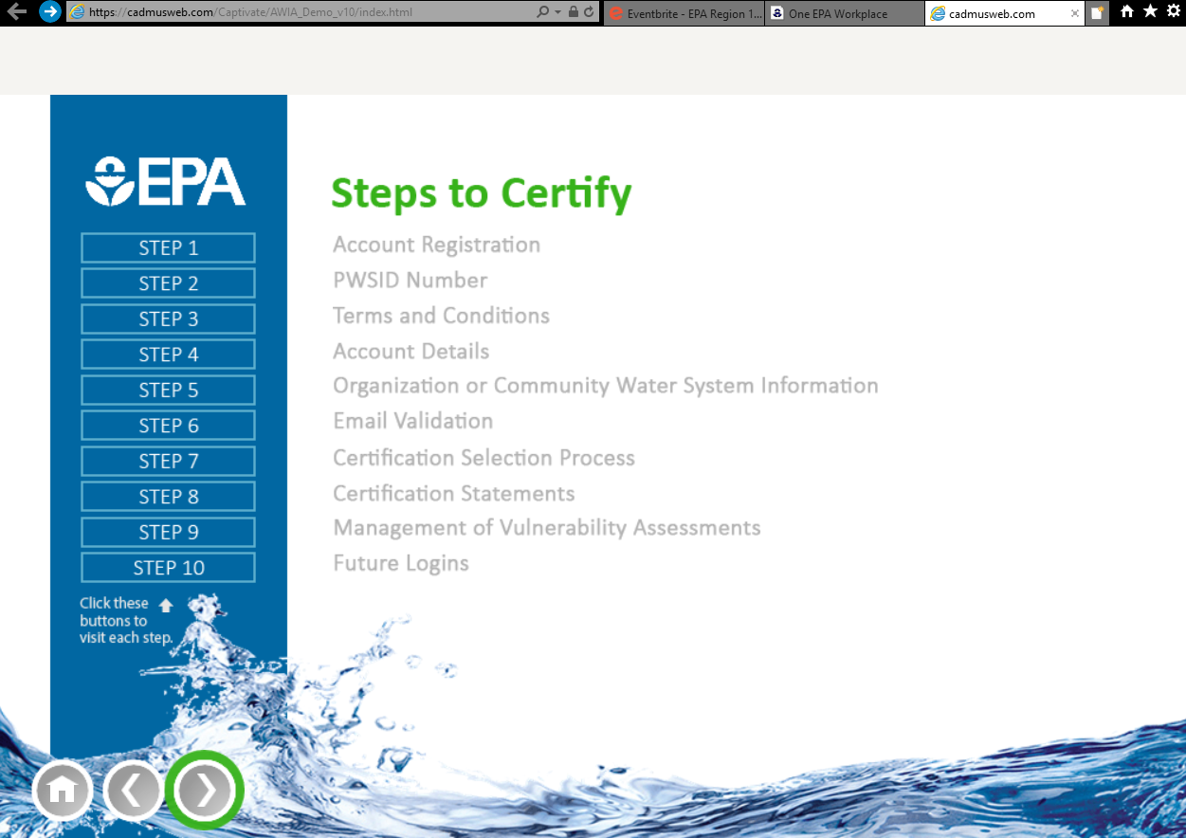
Notes:
We will review the 10-step process to complete you certification online using the electronic submission process.

Slide 107
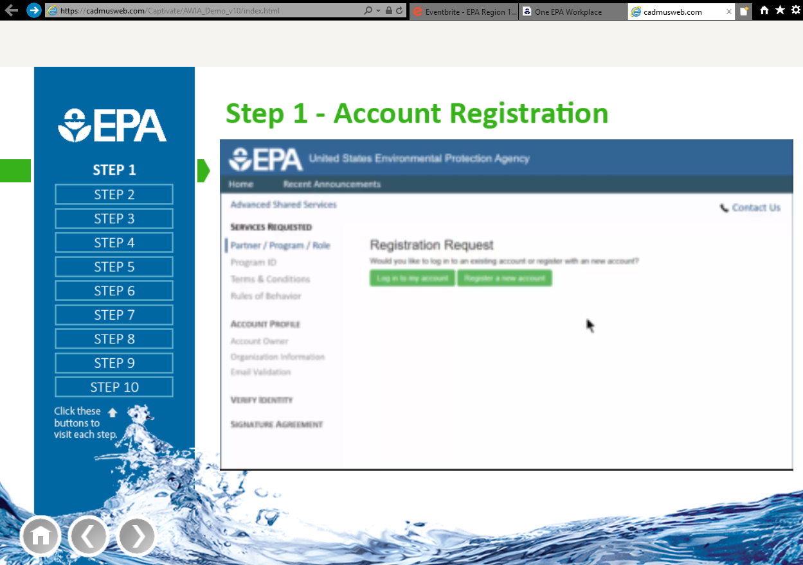
STEP 1: Account Registration
Notes:
Step 1
Begin by registering your community water system. If you do not have an existing U.S. EPA CDX account, select “Register a new account” to sign up, otherwise login with your User ID and password.
Once you register, future risk and resilience assessment or emergency response plan certifications can be completed in a few simple clicks. If you need assistance or have questions about the certification process, please reach out to the U.S. EPA via email at scs@epaecdx.net or call 888-890-1995.

Slide 108
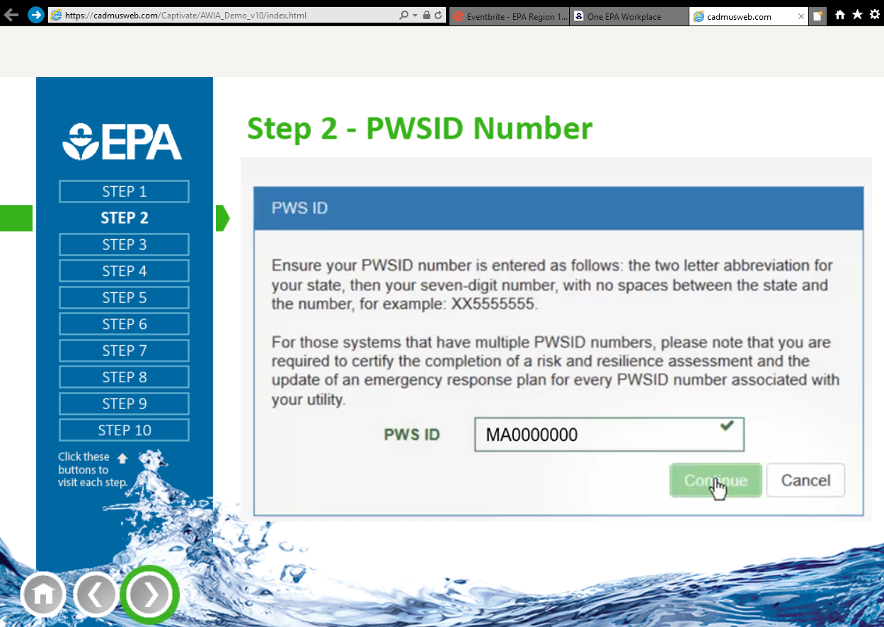
STEP 2: PWSID Number
Notes:
Step 2
Next enter your community water system’s PWSID number, including your two-letter state or territory abbreviation followed by the full seven-digit identification number, with no spaces in between, then select “Continue.” You’ll see a pop-up to ensure your PWSID number is correct, recheck your input, then select “Continue” again.

Slide 109
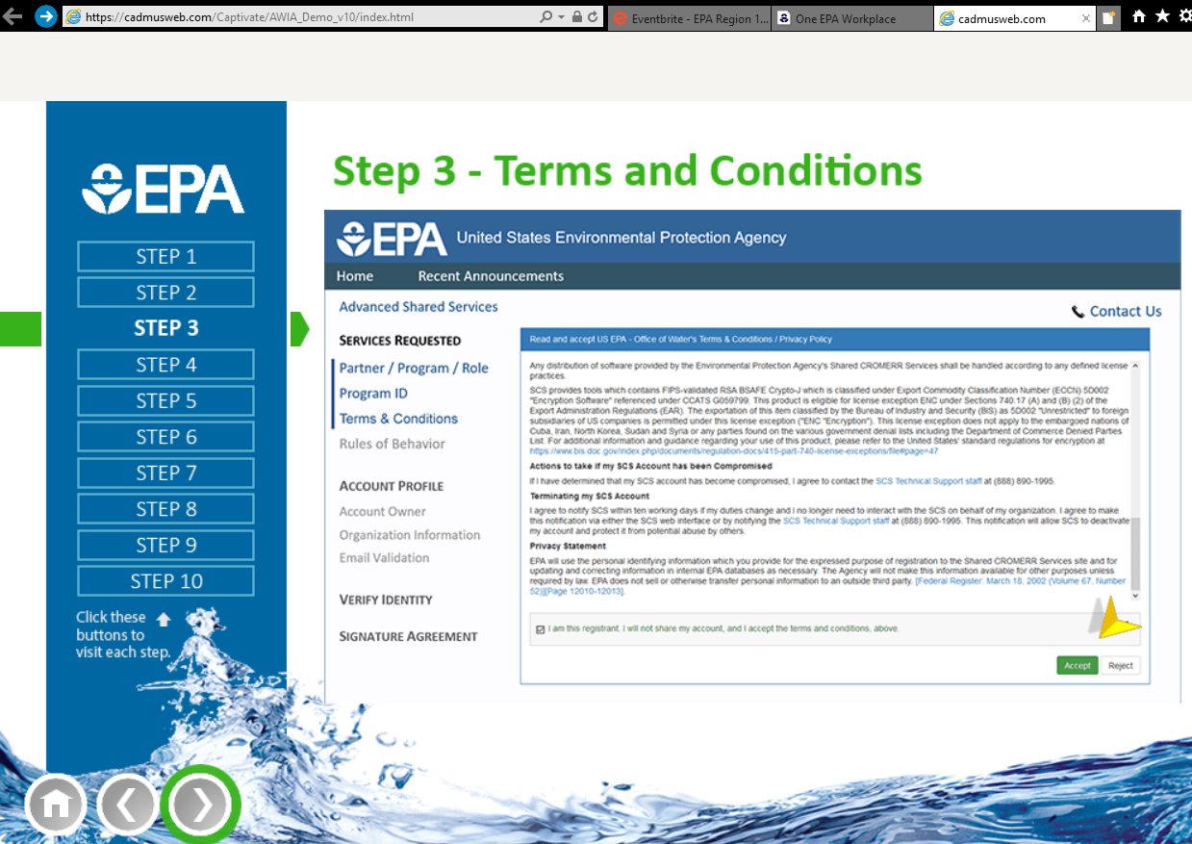
STEP 3: Terms and Conditions
Notes:
Step 3
Read and accept the terms and conditions.

Slide 110
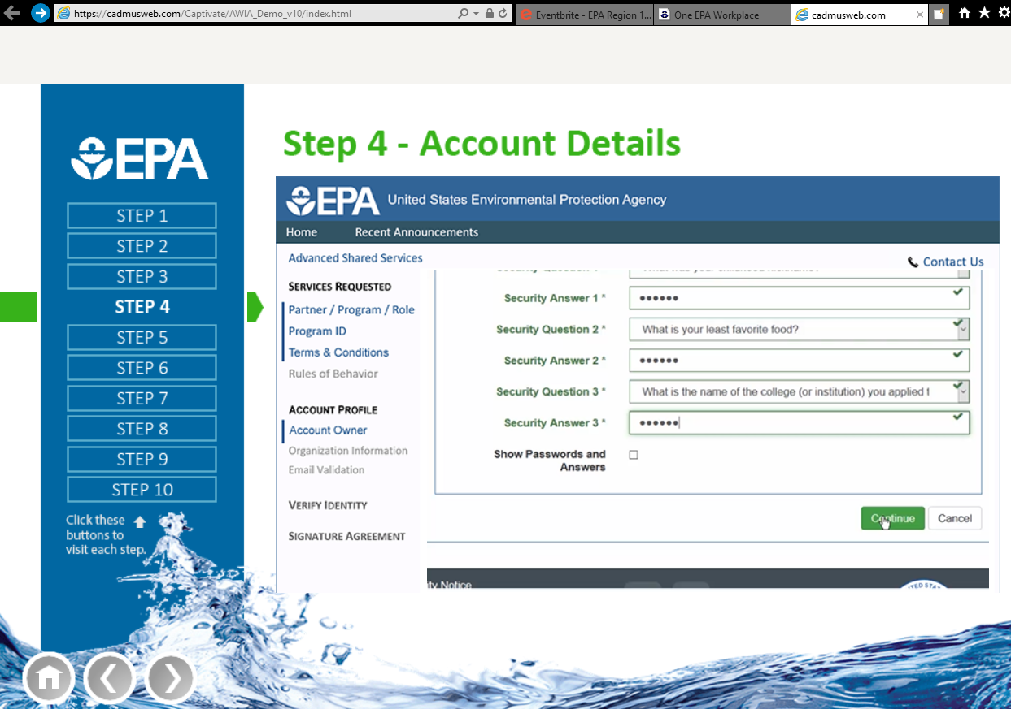
STEP 4: Account Details
Notes:
Step 4
Then you will build your “Account Profile.” Enter the required information in the Account Owner section. Required fields are indicated with an asterisk (*). The system does require your First and Last names, as well as your email address.
Create your User ID and password. The password must be least eight characters long and contain at least one uppercase letter, one lowercase letter, and one number. Confirm your password, then select and complete the three security questions. The answers to these questions will be used to recover your password if it is forgotten. You may click the box on the bottom left-hand side of the screen to Show Passwords and Answers to ensure that you have typed in the correct entries. Note that you may create a PDF of your answers and keep a password protected digital copy or print your responses and keep them in a safe place. Now select “Continue” to move on to the next screen.

Slide 111
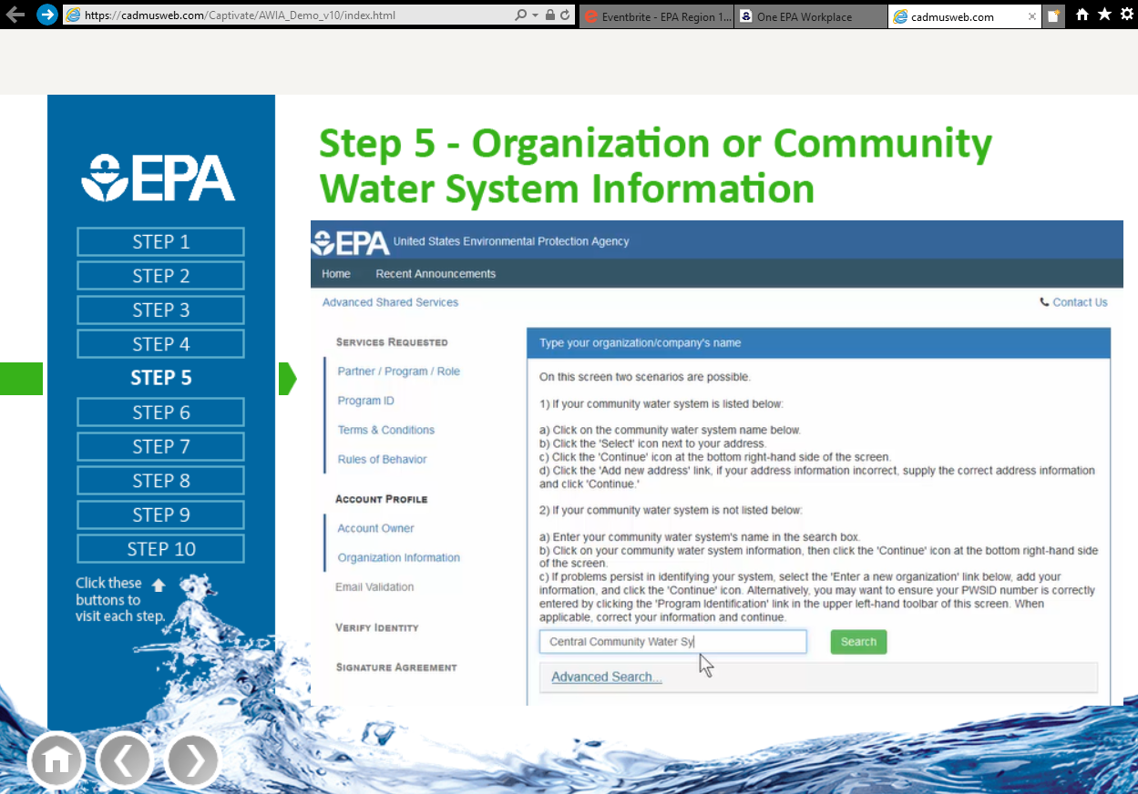
STEP 5: Organization or Community Water System Information
Notes:
Step 5
On this page you’ll encounter one of two scenarios:
Scenario 1: If your community water system is listed in the system, click on the community water system name. Click the address if the correct address shows up, or Add New Address if not. Once your information is submitted, you can move on in the system.
Scenario 2: If your community water system is not listed in the system, you'll enter all the information by Adding a New Organization.

Slide 112
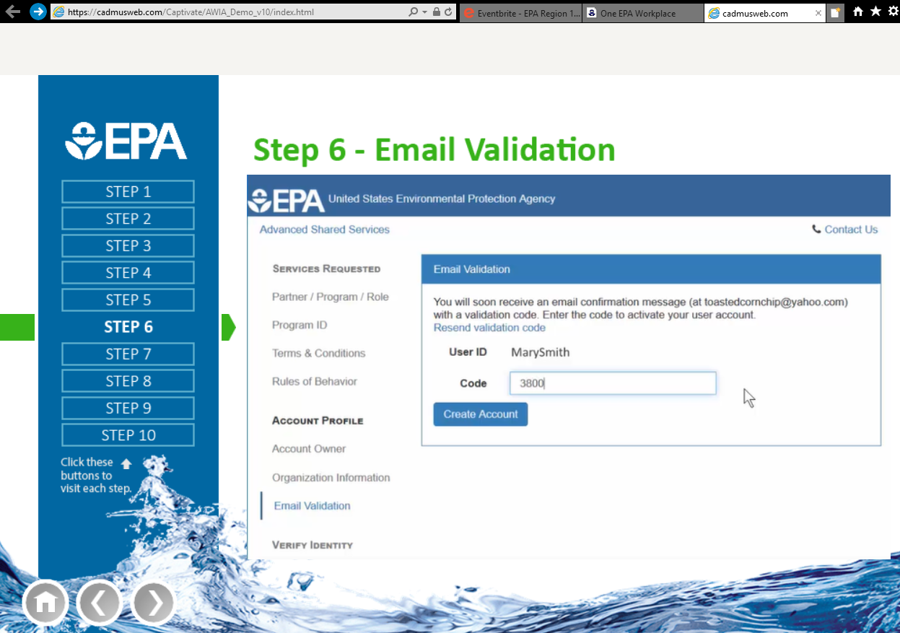
STEP 6: Email Validation
Notes:
Step 6
After entering your community water system’s information, you will receive an automated email from SCS Administrator in your email inbox containing an account validation code. Enter the validation code into the “Code” field under your User ID and select “Create Account.” This code is only used for account creation and you do not need to save it.
Your account is now created. You will be directed to your Dashboard where you will see your pending actions. A second email is also sent to your email inbox from SCS Administrator stating that your account has been activated.

Slide 113

STEP 7: Certification Selection Process
Notes:
Step 7
The next step is to certify your pending actions. Your Risk and Resilience Assessment or Emergency Response Plan certification processes are very similar, so for demonstration purposes, we will we will choose to click on “Certify your Risk and Resilience Assessment.”

Slide 114

STEP 8: Certification Statements
Notes:
Step 8
You will be presented with your standard risk and resilience assessment certification statement, which is based on the language in Section 2013 of America’s Water Infrastructure Act. Your name, community water system’s name, and population served will be auto-populated into the certification statement. Please review the statement. You may edit your community water system’s name and its population served, then select the “Certify Now” icon on the bottom left of your screen.
Prior to certification, you may also print this page as a record for your files and you will receive an acknowledgement of receipt email from U.S. EPA (scs@epaecdx.net) when your certification is completed.

Slide 115

STEP 9: Management of Vulnerability Assessments
Notes:
Step 9
Under the Public Health Security and Bioterrorism Preparedness and Response Act of 2002, your community water system likely submitted a vulnerability assessment to U.S. EPA. On this screen you will be asked if you want that vulnerability assessment: 1) permanently disposed of by U.S. EPA; 2) returned to you; or 3) if the scenario is not applicable.
Once you have certified your risk and resilience assessment and addressed the existing vulnerability assessment matter, a pop-up message will appear on your screen asking if you want to certify your emergency response plan now or later. You may not be ready to certify your emergency response plan at this time, so you may select “Certify Later;” this selection will return you to the homepage.
If you are ready to certify your emergency response plan, select “Certify Now.” This will open a page that prompts you to enter your PWSID number and “Select1” your Organization or Community Water System as you did under the Enter Organization Information process above.
Once you have opened the certification page, as before, you will have the ability to edit your community water system’s name and population served before submitting. Prior to certification, you may also print this page as a record for your files and you will receive an acknowledgement of receipt email from U.S. EPA (scs@epaecdx.net) once certification is completed.

Slide 116

STEP 10: Future Logins
Notes:
Step 10
Once these steps are completed, you will be able to simply login with your established User ID and password to certify and recertify your risk and resilience assessment or emergency response plan every 5 years.

Slide 117


Help and Technical Support
Help Desk: scs@epacdx.net
1-888-890-1995
Notes:
Users can also receive support via the help desk by calling the number provided here as well as emailing the email provided here.
There will be a short tutorial video showing users how to go through each step. In addition, EPA will post a one-pager that walks through these steps as well.

Slide 118
Email Submission
Complete the Risk and Resilience Assessment Certification Statement or Emergency Response Plan Certification Statement fillable pdf provided online at epa.gov/waterresilience.
Email statement to awiasupport@epacdx.net
Notes:
While the online certification platform is the preferred method for submission, your utility may also email to certify.
Complete the fillable PDF certification system on EPA's website and email it.

Slide 119

Certification Statement
Notes:
Here is the form

Slide 120
Mail Submission
Complete the Risk and Resilience Assessment Certification Statement or Emergency Response Plan Certification Statement fillable pdf provided online at epa.gov/waterresilience.
Mail statement to the following address:
U.S. EPA Data Process Center
ATTN: AWIA
C/O CGI Federal
12601 Fair Lakes Circle
Fairfax, VA 22033
Notes:
Alternatively, you may complete the fillable PDF and send it to this address.

Slide 121

Renewal & Record Maintenance
Access to public (FOIABLE) – depends on the state
Retention time = 5 year
  CWS must maintain a copy of the RA and ERP 5 years after the date it was certified.
Notes:
Freedom of Information Act – The protection of your risk and resilience and emergency response plan is based on the laws in each state.
Community water systems must maintain a copy of their risk assessment and emergency response plans for 5 years after the date it was certified. You will not submit a copy of either document to EPA.

Slide 122

Notes:
Poll Title: Quiz 8: Which is the easiest option to use when certifying your risk assessment and emergency response plan?
https://www.polleverywhere.com/multiple_choice_polls/tfUv0GLhdC5kUnm6AQm5g

Slide 123
QUESTION & ANSWER

Slide 124
FAQs
Will my information be protected? b) Sensitive information.—
(1) PROTECTION FROM DISCLOSURE.—Information submitted to the Administrator of the Environmental Protection Agency pursuant to section 1433 of the Safe Drinking Water Act, as in effect on the day before the date of enactment of America’s Water Infrastructure Act of 2018, shall be protected from disclosure in accordance with the provisions of such section as in effect on such day.
Do I need to send a copy of the RA or ERP? No, you only need to certify that you have completed them in accordance with the legal requirements.
Notes:
Read slide

Slide 125
Third Party Standards
EPA does not require water systems to use any designated standards, methods, or tools to conduct the RA or to prepare the ERP required under AWIA Section 2013.
Water systems must conduct RAs and prepare ERPs in accordance with all the requirements of AWIA Sections 2013 requirements.
Water systems may use any standards, methods, or tools that aid the water system in meeting the requirements of AWIA Sections 2013(a) and (b).
Regardless of the use of any standard, method, or tool, the water system is responsible for ensuring that its risk and resilience assessment and ERP fully address all AWIA requirements.
Notes:
Read slide

Slide 126
AWIA Section 2018
Section 5
Background
Notes:
Good afternoon, we are at the last topic of the day, so stay with me for just a little longer
During this presentation, I’ll discuss Section 2018 of America’s Water Infrastructure Act, but we should first start with some background information.

Slide 127







Risks to Water Security & Resilience
Threats
Terrorism
Criminal activity
Cyber attack
Spills/Releases
Natural disasters
Climate change
Consequences
Water contamination
Physical damage
Disruption in service
Notes:
As all of you in this room are aware, the water sector is at risk to various hazards. Some of these threats range from intentional acts such as terrorism and cyber attacks to natural disasters and accidents.
The consequences of these threats can include water contamination with ensuing consequences to the public from exposure to contaminated water, physical damage to water system assets, or a disruption in water service.
Section 2018 focuses on spills/releases, whether they be intentional or accidental, and the potential contamination that could be caused to a community water system.

Slide 128
Overview of America’s Water Infrastructure Act
Sec 2005: Drinking water resilience and sustainability grant program
Sec 2007: Innovative water technology grant program
Sec 2008: Improved consumer confidence reports
Sec 2012: Asset management
Sec 2013: Community water system risk and resilience
Sec 2014: Authorization for grants for State programs
Sec 2015: State revolving loan funds
Sec 2018: Source water
Sec 2020: Assistance for areas affected by natural disasters
Notes:
Signed into law on October 23, 2018, AWIA is a sweeping law aimed at improving the resilience of community drinking water systems and is in effect as we speak today.
While the EPA Water Security Division (WSD) is responsible for overseeing implementation of AWIA Section 2013: Community Water System Risk and Resilience, which amends the Safe Drinking Water Act and has already been discussed today; EPA’s Office of Emergency Management is responsible for overseeing implementation of the law that is amended by AWIA Section 2018: Source Water, which we will get to in a moment. The Water Security Division is working closely with the Office of Emergency Management to help the state drinking water agencies and community water systems implement the requirements of Section 2018 since WSD already has a working relationship with the primacy agencies and water sector.
During this presentation, we will focus on Section 2018 of AWIA – Source Water

Slide 129



AWIA Section 2018: Source Water
Amends the Emergency Planning and Community Right to Know Act (EPCRA).
Intended to mitigate risk of source water contamination.
Motivated by several recent source water contamination incidents, such as the MCHM spill into the Elk River in Charleston, WV in 2014.
  “Do Not Use” order in place for 10 days.
  369 individuals sought medical care at hospital EDs.
  Financial cost of incident was more than $72M.
Notes:
While most provisions in AWIA that affect the “water sector” amend the Safe Drinking Water Act (SDWA), Section 2018 is different in that it amends the Emergency Planning and Community Right to Know Act, or EPCRA
The purpose of these revisions is to mitigate the risk of acute contamination to sources of drinking water, specifically the threat of spills or releases into sources of drinking water.
The Section 2018 provisions were motivated by several spills that occurred within the past several years that impacted drinking water supplies.
The most notable being the spill of 10,000 gallons of MCHM (4-methylcyclohexane methanol) into the Elk River, the drinking water source for Charleston, West Virginia, in 2014. When that contaminated water passed through the treatment plant and into Charleston’s drinking water distribution system, it caused significant consequences even though the chemical was relatively non-toxic.

Slide 130

Overview of EPCRA
EPCRA was created to help communities plan for chemical emergencies
EPCRA regulates facilities that store or handle hazardous chemicals above threshold planning quantities
EPCRA administration and oversight:
  U.S. EPA Office of Emergency Management
  State Emergency Response Commissions (SERCs)
  Local Emergency Planning Committees (LEPCs)
Notes:
EPCRA was signed into law in 1986. It was created to help communities plan for chemical emergencies and address concerns regarding the environmental safety hazards posed by the storage and handling of toxic chemicals.
Concerns were triggered by the accidental release of methylisocyanate in Bhopal, India in 1984, which killed or severely injured more than 2,000 people.
The community regulated by EPCRA are the facilities that produce, use or store hazardous chemicals in quantities above specified threshold planning quantities.
EPCRA is administered by USEPA’s Office of Emergency Management and implemented by State Emergency Response Commissions (or SERCs) and Local Emergency Planning Committees (or LEPCs).
While this is a federal regulation, EPA does not have enforcement authority over the SERCs and LEPCs.

Slide 131


Key Provisions of EPCRA
Sec 301-303: Emergency Planning
Sec 304: Emergency Notification
Sec 311-312: Chemical Inventories
Sec 313: Toxic Release Inventory
Sec 322: Trade Secrets
Notes:
The specific sections of EPCRA amended through Section 2018 of AWIA are the two shown in bold: Section 304, Emergency Notifications, and Section 312, Chemical Inventories and we will talk about those in more detail later
Several other key sections of EPCRA include:
Sec 301-303: Emergency Planning, requires local emergency planning committees (LEPCs) to prepare chemical emergency response plans and update them annually.
Section 311: requires facilities handling or storing OSHA hazardous chemicals to submit material safety data sheet (MSDS) (or safety data sheet (SDS)) to the SERC, LEPC, and local fire department.
Sec 313. requires facilities to submit an annual report of releases of designated toxic chemicals. Certain facilities that meet specific criteria must submit a toxic chemical release form annually for each of the TRI chemicals manufactured, processed or used above threshold quantities.
And Sec 322. allows facilities to withhold the identity of proprietary substances in their annual Tier 2 reports, if their trade secret request is approved by USEPA. (The request for this exemption must be made every year. Very small percentage of records. Is not applicable to Sec 304.)

Slide 132
AWIA Section 2018(a)
Section 5
Amendments to the Emergency Planning and Community Right-to-Know Act (EPCRA) Section 304 (42 U.S.C. 11004)
Notes:
Now that we have some background on EPCRA, let’s talk about EPCRA Section 304 and the amendments required under AWIA Section 2018

Slide 133
EPCRA Section 304: Emergency Notification
Section 304 requirements cover approximately 355 Extremely Hazardous Substances (EHSs) and more than 700 hazardous substances subject to the Comprehensive Environmental Response, Compensation and Liability Act (CERCLA, also known as Superfund).
  Some chemicals are common on both lists.
Requires facilities to immediately (within 15 minutes) notify the LEPC and SERC (or TERC) if there is a release into the environment of a hazardous substance that is equal to or exceeds minimum reportable quantities set in regulation.
  Report should be via phone call, radio or in-person.
  CERCLA releases also require notification to the National Response Center (NRC).
Emergency notification requirements for transportation incidents can be met by calling 911.
Notes:
First, what is EPCRA Section 304?
Section 304 requirements cover approximately 355 Extremely Hazardous Substances (EHSs) and more than 700 hazardous substances subject to the Comprehensive Environmental Response, Compensation and Liability Act (CERCLA, also known as Superfund)
Some chemicals are common on both lists
There is a list out there called “The List of Lists” which helps facilities keep track of what chemicals are on each list, which overlap, and the requirements. This is not an official document and the only official list is what is codified in regulations
Section 304 requires facilities to immediately (within 15 minutes) notify the LEPC and SERC (or TERC) if there is a release into the environment of a hazardous substance that is equal to or exceeds minimum reportable quantities set in regulation.
Emergency notification requirements for transportation incidents can be met by calling 911

Slide 134
EPCRA Section 304: Emergency Notification
The emergency notification needs to include:
  The chemical name or identity of any substance involved.
  An indication of whether the substance is on the EHS list.
  An estimate of the quantity released into the environment.
  The time and duration of the release.
  The medium or media into which the release occurred.
  Any known or anticipated acute or chronic health risks associated with the emergency and advice regarding medical attention necessary for exposed individuals.
  Proper precautions to take, including evacuation.
  The name and telephone number of a contact person for further information.
Notes:
The emergency notification needs to include:
The chemical name or identity of any substance involved.
An indication of whether the substance is on the EHS list.
An estimate of the quantity released into the environment.
The time and duration of the release.
The medium or media into which the release occurred.
Any known or anticipated acute or chronic health risks associated with the emergency and advice regarding medical attention necessary for exposed individuals.
Proper precautions to take, including evacuation.
The name and telephone number of a contact person for further information.

Slide 135
EPCRA Section 304: Emergency Notification
As soon as practicable, a written follow-up notice must be provided to the SERC (or TERC) and LEPC:
  The written notice shall provide updates to the information provided in the original notification, as well as additional information with respect to:
    Actions taken to respond to and contain the release;
    Any known or anticipated acute or chronic health risks; and
    Where appropriate, advice regarding medical attention necessary for exposed individuals.
Failure of a person in charge of a facility to comply with the EPCRA Section 304 immediate notification requirements may result in criminal penalties, per offense, of up to $25,000 and prison sentences of up to two years (or up to $50,000 and five years for second and subsequent convictions).
Notes:
As soon as practicable, a written follow-up notice must be provided to the SERC (or TERC) and LEPC:
The written notice shall provide updates to the information provided in the original notification, as well as additional information with respect to:
Actions taken to respond to and contain the release;
Any known or anticipated acute or chronic health risks; and
Where appropriate, advice regarding medical attention necessary for exposed individuals
Failure of a person in specifically in charge of a facility with knowledge of a reportable release who fails to comply with the EPCRA Section 304 immediate notification requirements, or submits information that he or she knows is false or misleading, may result in criminal penalties, per offense, of up to $25,000 and prison sentences of up to two years (or up to $50,000 and five years for second and subsequent convictions). This is specific to that facility only.

Slide 136
Section 2018 (a): Amends Emergency Notification
Amends EPCRA Section 304 (42 U.S. Code 11004) to add subsection (e) Addressing Source Water Used for Drinking Water:
(e)(1) Applicable State Agency Notification
(e)(2) Community Water System Notification
Notes:
Now onto the amendments

Slide 137



SERC (or TERC) Notification Requirements
A State or Tribal Emergency Response Commission (SERC or TERC) shall:
  Promptly notify the applicable State agency (i.e., the drinking water primacy agency) of any reportable release of an EPCRA extremely hazardous substance (Appendices A and B of 40 CFR Part 355) or a CERCLA hazardous substance (40 CFR Part 302.4(a)).
Notes:
The amended Section 304 requires SERCs, once they get that initial notification from a facility, to notify the agency in the state that is responsible for the implementation of the Safe Drinking Water Act (i.e., drinking water primacy agency) of a release of an EPCRA Extremely Hazardous Substance or a CERCLA Hazardous Substance. This includes both the initial, “prompt” notification as well as follow-up reporting.
CERCLA: Comprehensive Environmental Response, Compensation, and Liability Act, known also as Superfund.
EHSs are the same in both appendices - Appendix A in alphabetically and Appendix B by CAS number

Slide 138
SERC (or TERC) Notification Requirements
A State or Tribal Emergency Response Commission (SERC or TERC) shall provide the primacy agency with the following information (same information provided by the facility with the release):
  The chemical name or identity of any substance involved.
  An indication of whether the substance is on the EHS list.
  An estimate of the quantity released into the environment.
  The time and duration of the release.
  The medium or media into which the release occurred.
  Any known or anticipated acute or chronic health risks associated with the emergency and advice regarding medical attention necessary for exposed individuals.
  Proper precautions to take, including evacuation.
  The name and telephone number of a contact person.
Notes:
Once again, the same information that was provided by the facility to the SERC needs to be provided to the drinking water primacy agency

Slide 139

SERC (or TERC) Notification Requirements
As soon as practicable, the SERC (or TERC) shall provide the drinking water primacy agency a written follow-up notice (same information provided by the facility with the release):
  The written notice shall provide updates to the information provided in the original notification, as well as additional information with respect to:
    Actions taken to respond to and contain the release;
    Any known or anticipated acute or chronic health risks; and
    Where appropriate, advice regarding medical attention necessary for exposed individuals.
Notes:
As soon as practicable, the SERC (or TERC) shall provide the drinking water primacy agency a written follow-up notice (same information provided by the facility with the release):
The written notice shall provide updates to the information provided in the original notification, as well as additional information with respect to:
Actions taken to respond to and contain the release;
Any known or anticipated acute or chronic health risks; and
Where appropriate, advice regarding medical attention necessary for exposed individuals.

Slide 140

Primacy Agency Notification Requirements Notice to Community Water Systems
The drinking water primacy agency receiving notice from a SERC (or TERC) shall:
Promptly forward the initial notice and all information provided to any community water systems whose source waters are affected by the release.
Forward the written follow-up emergency notice provided to the affected community water systems.
Notes:
The drinking water primacy agency receiving notice from a SERC (or TERC) shall then:
Promptly forward the initial notice, and all information provided, to any community water systems whose source waters are affected by the release.
Forward the written follow-up emergency notice provided to the affected community water systems.
Note that the requirement is to notify community water systems (25 connections supplying water to the same population year-round), not all public water systems. Not required to notify Non-transient Non-community Water Systems (supplies water to the same people at least six months per year, such as schools, hospitals, office buildings with their own water system); or Transient Non-Community Water System (e.g., gas stations, rest stops, campgrounds)

Slide 141


Direct Notification:
Notice to Community Water Systems
If a state does not have a drinking water primacy agency:
The SERC (or TERC) shall provide the required notices and information to the community water systems affected by the release.
Notes:
Wyoming, Washington DC, and several tribal nations do NOT have state primacy agencies.

Slide 142
Visual of Amended Notification Requirements
Release Occurs and Facility Provides all Information Required Under EPCRA 304(b)(2) and 304(c)
EPCRA 304(b)(2)
304(c)
EPCRA 304(b)(2)
304(c)
SERC & TERC
State Drinking Water Primacy Agency
Community Water System(s) whose source water is affected
Promptly notify of reported release(s)
Promptly notify of reported release(s)
EPCRA 304(b)(2)
304(c)
If no State Drinking Water Primacy Agency, directly notify Community Water System
Notes:
This visual provides all of the requirements of the amendments to EPCRA Section 304 (e)(1) and (2) in one place.
It visually describes how the amended Section 304 requires SERCs to notify the drinking water primacy agency of a release of an EPCRA Extremely Hazardous Substance or a CERCLA Hazardous Substance. This includes both the initial, “prompt” notification as well as follow-up reporting. The State drinking water primacy agency is required to provide all information about the release received from the SERC/TERC to any/all community water systems whose source water is affected by the release. If there is no applicable State agency, the SERC is responsible for directly notifying affected community water systems.

Slide 143
QUIZ 14 – DISCUSSION
The law requires prompt notification. What do you think is considered “prompt” notification?
Do all release reports to the National Response Center (NRC) need to be reported to the state primacy agency and to community water systems?
Do you think community water systems that use ground water need to be notified of releases?
Notes:
These are thought provoking questions to ask the audience if you wish. These are questions that have been coming into EPA and the law doesn’t contain many details.
What is considered “prompt” notification? A: There is no legal definition of “prompt” in the context of EPCRA or AWIA, however the intent is that notifications to the state drinking water primacy agency and community water systems occur as quickly as possible so that utilities have time to implement actions to mitigate the impact of the spill on their operations and customers.
Do all release reports made to the National Response Center (NRC) need to be reported to the state drinking water primacy agency and community water systems whose source water is affected by the release? A. No, the NRC receives reports of releases that are not required to be reported under EPCRA section 304.
Do community water systems that use ground water need to be notified about a release? A. Yes. Community water systems using any type of water (e.g., surface water, ground water, purchased water) must be notified about releases that affect their source water. In the case of systems that use ground water, releases to the ground in a ground water protection area would need to be reported to any community water system that is currently being affected or could potentially be affected by the release.

Slide 144
AWIA Section 2018(b)
Section 5
Amendments to the Emergency Planning and Community Right-to-Know Act (EPCRA) Section 312(e) (42 U.S.C. 11022(e))
Notes:
Now let’s move onto EPCRA Section 312 as well as the amendments required under AWIA Section 2018

Slide 145
EPCRA Section 311-312: Chemical Inventories
Under Occupational Safety and Health Administration (OSHA) regulations, employers must maintain a material safety data sheet (MSDS) (now called a safety data sheet (SDS)) for any hazardous chemicals stored or used in the work place. Approximately 500,000 products are required to have SDSs.
EPCRA Section 311 requires facilities that have SDSs for chemicals held above certain threshold quantities to submit either copies of their SDSs or a list of these chemicals to the SERC or TERC, LEPC and local fire department.
  If the facility owner or operator chooses to submit a list of chemicals, the list must include the chemical or common name of each substance and must identify the applicable hazard categories.
Notes:
OSHA regulations require facilities to maintain a material safety data sheet (MSDS) (now called a safety data sheet (SDS)) for any hazardous chemicals stored or used in the work place. Approximately 500,000 products are required to have MSDSs.
Section 311: requires facilities handling or storing OSHA hazardous chemicals to submit material safety data sheet (MSDS) (or safety data sheet (SDS)) to the SERC, LEPC, and local fire department.
If the facility owner or operator chooses to submit a list of chemicals, the list must identify the applicable hazard categories.
Hazard categories are:
Physical Hazards Flammable (gases, aerosols, liquids, or solids) Gas under pressure Explosive Self-heating Pyrophoric (liquid or solid) Oxidizer (liquid, solid, or gas) Organic peroxide Self-reactive In contact with water emits flammable gas Corrosive to metal Hazard Not Otherwise Classified (HNOC)
Health Hazards Carcinogenicity Acute toxicity (any route of exposure) Reproductive toxicity Skin Corrosion or Irritation Respiratory or Skin Sensitization Serious eye damage or eye irritation Specific target organ toxicity (single or repeated exposure) Germ cell mutagenicity Aspiration Hazard Hazard Not Otherwise Classified (HNOC)
If a list is submitted, the facility must submit the SDSs for any chemical on the list upon request by the LEPC.
Facilities that start using a hazardous chemical or increase the quantity to exceed the thresholds must submit SDSs or a list of SDSs chemicals within three months after they become covered. Facilities must provide a revised SDS to update the original SDS or list if significant new information is discovered about the hazardous chemical.

Slide 146
EPCRA Section 311-312: Chemical Inventories
EPCRA Section 312 requires those facilities handling or storing the OSHA hazardous chemicals above certain threshold quantities to submit an annual (by March 1) emergency and hazardous chemical inventory form to the SERC or TERC, LEPC and local fire department.
Inventory forms include:
  The chemical name or the common name as indicated on the SDS;
  An estimate (in ranges) of the maximum amount of the chemical present at any time during the preceding calendar year and the average daily amount;
  A brief description of the manner of storage of the chemical;
  The location of the chemical at the facility; and
  An indication of whether the owner elects to withhold location information from disclosure to the public.
Notes:
Sec 312: requires facilities handling or storing OSHA hazardous chemicals to submit an annual chemical inventory (including chemical identity, quantities and locations in facilities) to the SERC, LEPC, and local fire department.
If anyone in the class asks about Tier I versus Tier II, here is some information:
Section 312 includes a two tier approach. Tier I requires information (such as maximum amount of hazardous chemicals at the facility during the preceding year, an estimate of the average daily amount of hazardous chemicals at the facility, and the general location) be aggregated and reported by hazard categories. Tier II not only requires the information mentioned above, but also requests information on specific chemicals and specific location and storage.
Tier I is required by federal law; Tier II is federally required only upon request by the local emergency planning committee or the state emergency response commission. However, a covered facility may submit Tier II forms instead of Tier I forms. Many (most) states already require facilities to submit Tier II forms or forms created by the states under their own state legislation.

Slide 147
Section 2018(b): Amends Chemical Inventory Data Availability
Amends Emergency Planning and Community Right-to-Know Act (EPCRA) Section 312(e) to add:
(4) Availability to Community Water Systems
Notes:
The other important provision of Sec 2018 of AWIA amends Section 312(e) of EPCRA to require SERCs and LEPCs to provide community water systems with the chemical inventory data collected under Tier 2
Section 312 provides availability of Tier 2 information to:
SERCs or TERCs, LEPCs, and Fire Departments
Other State and Local Officials
The public (with some specific timelines and caveats)
Community Water Systems – NEW because of AWIA

Slide 148
Chemical Inventory Data Availability
EPCRA Sec 312(e)(4) requires SERCs (or TERCs) and LEPCs to provide affected* community water systems with chemical inventory data submitted under Tier 2 of EPCRA for their source water area, upon request from the system.
  Upon receipt of the request, the SERC or LEPC will provide the information or request the information from the facility and forward any information received to the community water system
  * In this Section, affected is defined as a community water system (as defined in SDWA Section 1401(15)) that receives supplies of drinking water from a source water protection area delineated under SDWA Section 1453, in which a facility that is required to prepare and submit an inventory form under EPCRA Section 312 is located.
Notes:
The amended Section 312 requires SERCs and LEPCs to provide affected community water systems with the chemical inventory data collected under Tier 2 for the system’s source water area, upon request.
* In this Section, affected is defined as a community water system (as defined in SDWA Section 1401(15)) that receives supplies of drinking water from a source water protection area delineated under SDWA Section 1453, in which a facility that is required to prepare and submit an inventory form under EPCRA Section 312 is located.
The community water system must request the data.
This is a beneficial change for the water sector because in the absence of this provision, access to Tier 2 chemical inventories was subject to interpretation by SERCs and LEPCs, and water utilities were not always successful in obtaining the data they needed without extensive measures, such as requesting data facility by facility. Or the data was provided in formats not well suited to analysis, such as scanned hard-copy records.

Slide 149
EPCRA Chemicals
From OLEM EPCRA Fact Sheet November 2017
 | Section 302 Emergency Planning | Section 304 Emergency Notification | Sections 311/312 Chemical Inventory
Chemicals Covered | 355 Extremely Hazardous Substances as codified in Appendices A and B of 40 CFR Part 355. | >1,000 hazardous substances including the 355 EHSs and >700 CERCLA hazardous substances codified in 40 CFR Part 302.4(a) | Approximately 800,000 hazardous chemicals (any facility required to maintain an SDS under OSHA Hazardous Chemical Standard)
Thresholds | Threshold Planning Quantity (TPQ) 1-10,000 pounds onsite at any one time | Reportable quantity, 1-5,000 pounds, released in a 24-Hr period | 500 pounds or TPQ whichever is less for EHSs; gasoline greater than or equal to 75,000 gallons (all grades combined)*; diesel greater than or equal to 100,000 gallons (all grades combined)*; 10,000 pounds for all other hazardous chemicals
*These thresholds are only applicable for gasoline and diesel present at retail gas stations in tank(s) entirely underground and was in compliance at all times during the preceding calendar year with all applicable Underground Storage Tank (UST) requirements at 40 CFR part 280 or requirements
Notes:
Just wanted to provide this table and link to the EPA EPCRA Fact Sheet from November 2017 for everyone’s reference

Slide 150
QUIZ 14 – Discussion
Are SERCs/LEPCs required to identify all the facilities reporting under Tier II that might impact sources of drinking water?
How are interstate requests for Tier II data handled when my source water area crosses state boundaries?
How can I find out how to make a request for Tier II data that’s best formulated to ensure an accurate, complete and efficient fulfillment of the request?
Notes:
Some questions we’ve received on these provisions of AWIA:
Are SERCs/LEPCs required to identify facilities reporting under Tier II that might impact sources of drinking water? A: No, that is not the responsibility of the SERC or LEPC. The water system or state drinking water primacy agency should provide the SERC/LEPC with the source water protection area, and the SERC or LEPC should provide the water system with the chemical inventory data for that area.
How are interstate requests for Tier II handled? A: A community water system should be able to obtain Tier II chemical inventory data for its entire source water protection area, as defined by the delineations established under the requirements of SDWA section 1453. If the source water protection area falls in multiple states, the community water system should request Tier II chemical inventory data from each state that contains a portion of its source water protection area.
How are requests for Tier II chemical inventory data formulated to ensure an accurate, complete, and efficient fulfillment of the request? A: A community water system should contact the appropriate SERC or LEPC to learn how the data is managed and stored. In many cases, Tier II chemical inventory data are aggregated at the county level, in which case a community water system should provide a list of counties that fall completely or partially within its source water protection area. If data are maintained in a GIS system or contain specific location information, it may be possible to use digital boundaries (e.g., a shape file, a KML file) to identify the facilities that fall within the source water protection area.

Slide 151
AWIA Section 2018
Section 5
Connection with AWIA Section 2013
Notes:
Since we discussed Section 2013 already today, I wanted to quickly mention the connections between Section 2018 and Section 2013

Slide 152
Connection with AWIA Section 2013
Encourage water systems to join their LEPC:
  To ensure the community ERP includes any chemicals at the water system.
  To ensure access to Tier 2 data and obtain emergency release notifications under EPCRA Section 304.
  Systems are required to coordinate with their LEPC, to the extent possible, under Section 2013.
Gathering Tier 2 chemical data can inform the risk assessment required under Section 2013.
Results of the risk to a chemical spill can be incorporated into the ERP required under Section 2013, as well as procedures for notification in chemical release incidents.
Notes:
Encourage the community water systems reps to become members of the LEPC to ensure the community emergency response plan include community water systems that also handle EHSs (ex: Chlorine).
Becoming part of the LEPC organization would make it easier for obtaining Tier II information easily and immediately. After 9/11 incident, many states safeguard their Tier II information according to the state homeland security procedures. It would also ensure they get emergency release notification under 304 that may affect their water systems.

Slide 153
Products and Outreach for Section 2018
EPA Workgroup:
Comprised of staff from the Water Security Division and Drinking Water Protection Division in the Office of Water and the Regulatory Implementation Division in the Office of Emergency Management.
Published a fact sheet for SERCs, TERCs and LEPCs to provide guidance on the EPCRA revisions required by AWIA.
Published companion fact sheet for state primacy agencies and community water systems on the EPCRA revisions required by AWIA.
Compiling a list of frequently asked questions and plan to publish a document to ensure consistency of responses.
Providing webinars and in-person training to community water systems, state primacy agencies, EPA emergency responders, SERCs, TERCs and LEPCs.
Notes:
EPA Workgroup:
Comprised of staff from the Water Security Division and Drinking Water Protection Division in the Office of Water and the Regulatory Implementation Division in the Office of Emergency Management
Published a fact sheet for SERCs, TERCs and LEPCs to provide guidance on the EPCRA revisions required by AWIA
Published companion fact sheet for state primacy agencies and community water systems on the EPCRA revisions required by AWIA
Compiling a list of frequently asked questions and plan to publish a document to ensure consistency of responses
Providing webinars and in-person training to community water systems, state primacy agencies, EPA emergency responders, SERCs, TERCs and LEPCs

Slide 154
Products and Outreach for Section 2018
The Source Water Collaborative:
The Source Water Collaborative (SWC) is comprised of 28 organizations that have united to protect drinking water at its source.
A subgroup of the SWC was formed to work on outreach for AWIA Section 2018. It is comprised of 10 agencies.
Hold calls to provide updates on training and products, go over goals of the subgroup and brainstorm ideas for outreach. Will continue to hold meetings to determine the best ways to coordinate and conduct outreach to the water sector.
Notes:
The Source Water Collaborative:
The Source Water Collaborative (SWC) is comprised of 28 organizations that have united to protect drinking water at its source
A subgroup of the SWC was formed to work on outreach for AWIA Section 2018. It is comprised of 10 agencies
The 10 agencies are:
EPA,
American Water Works Association (AWWA)
Association of State Drinking Water Administrators (ASDWA)
Rural Water Association (RWA)
Ground Water Protection Council (GWPC),
Clean Water Action (CWA)
Rural Community Assistance Partnership (RCAP)
Association of Metropolitan Water Agencies (AMWA)
Water Systems Council
Association of State and Territorial Health Offices (ASTHO)
U.S. Geological Survey
The former president of the National Association of SARA Title III Program Officials (NASTTPO)
Hold calls to provide updates on training and products, go over goals of the subgroup and brainstorm ideas for outreach. Will continue to hold meetings to determine the best ways to coordinate and conduct outreach to the water sector

Slide 155
Final Thoughts
AWIA Section 2018 amends EPCRA to:
  Require emergency notifications to be forwarded to the state drinking water primacy agencies and for those primacy agencies to forward the notifications to affected community water systems.
  Require community water systems to be granted access to Tier 2 chemical data.
  Increase the resilience of the water sector and to mitigate effects from any hazardous chemical releases on a community’s source of drinking water.
Notes:
AWIA Section 2018 amends EPCRA to:
Require emergency notifications to be forwarded to state drinking water primacy agencies, and for those primacy agencies to forward the notifications to affected community water systems
Require community water systems to be granted access to Tier 2 chemical data
Increase the resilience of the water sector and to mitigate effects from any hazardous chemical releases on a community’s source of drinking water

Slide 156
Questions?

Slide 157

Contact Information
Dawn Ison
Emergency Notification
ison.dawn@epa.gov
(513) 569-7686
Steve Allgeier
Chemical Inventory Availability
allgeier.steve@epa.gov
(513) 569-7131

Slide 158
Thank you!
For more information or any questions about the material presented, please contact EPA at dwresilience@epa.gov.
For information about the upcoming AWIA webinars and Regional trainings, visit https://www.epa.gov/waterresilience/americas-water-infrastructure-act-2018-risk-assessments-and-emergency-response-plans.
Notes:
Read slide

