Slide 1
20 Years Of Progress Closing LUST Sites
% Of LUST Sites Closed (Cumulative) By State
U.S. Environmental Protection Agency
Office of Underground Storage Tanks
www.epa.gov/ust March 2020

Slide 2
The Problem
Contamination from leaking underground storage tank (UST) sites threatens groundwater, the source of drinking water for nearly half of all Americans. Addressing the backlog of leaking UST sites remaining to be cleaned up continues to be a high priority for EPA and our state, territorial, and tribal partners.
Good News
EPA and our partners reduced the backlog of leaking UST sites from approximately 168,400 in 1999 to 64,800 in 2019*. The maps on the following slides show progress each state and territory made closing leaking UST sites over the past 20 years. The maps display the percentage of sites closed in 5-year intervals. As of 2019, 34 states have closed over 90 percent of their leaking UST sites.
*U.S. EPA’s UST Performance Measures Reports; www.epa.gov/ust/ust-performance-measures
EPA Office of Underground Storage Tanks, March 2020

Slide 3
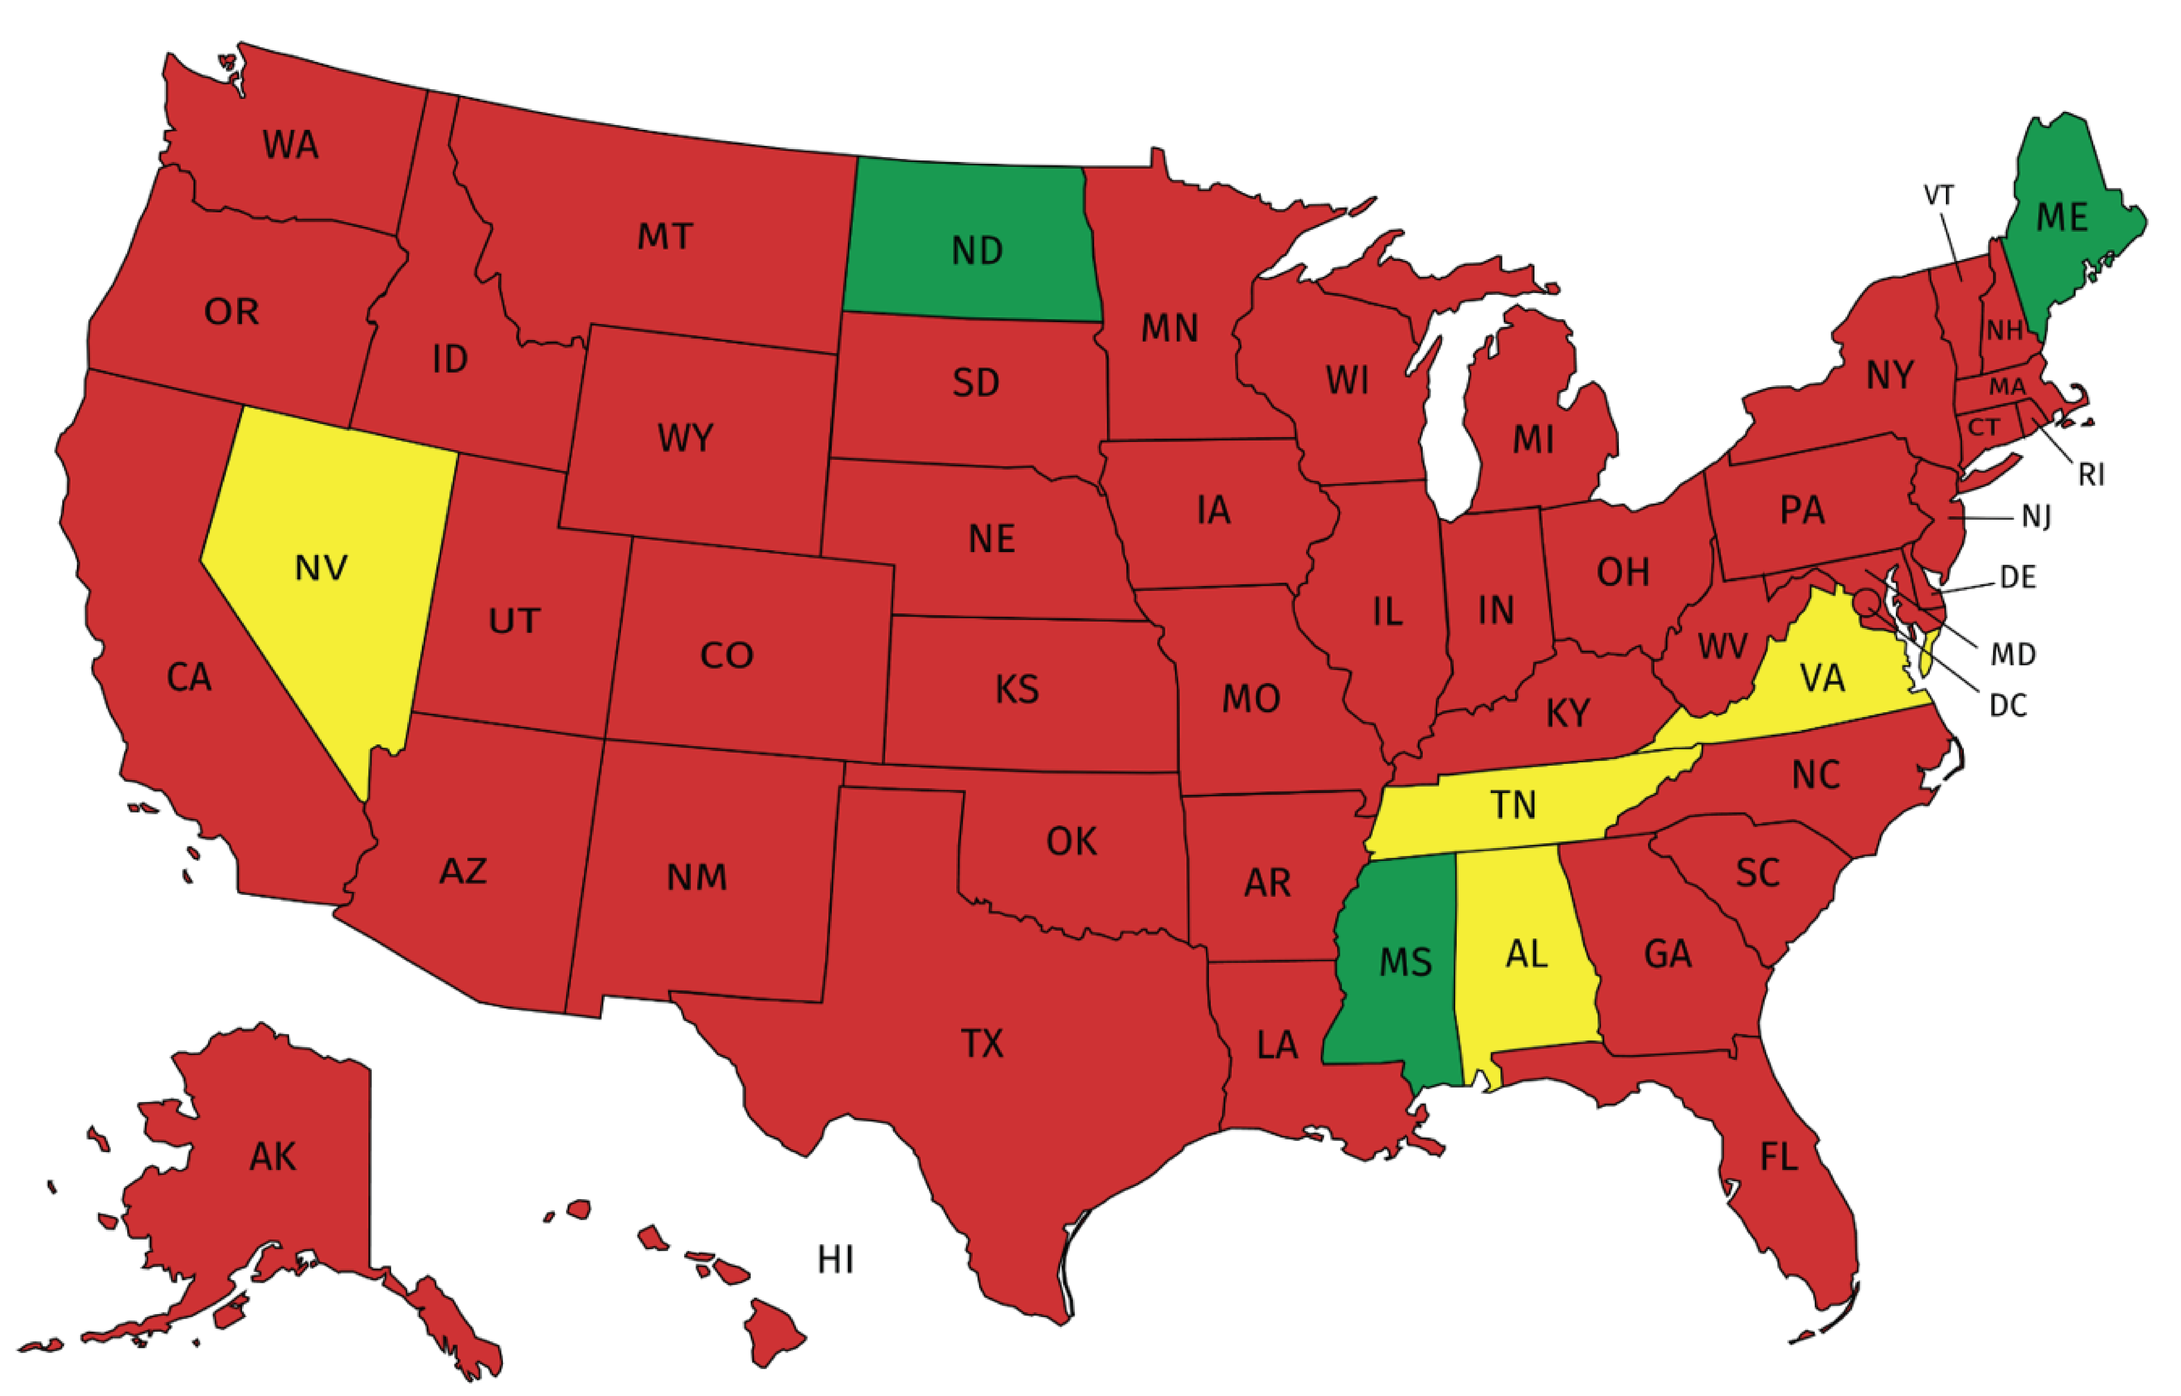
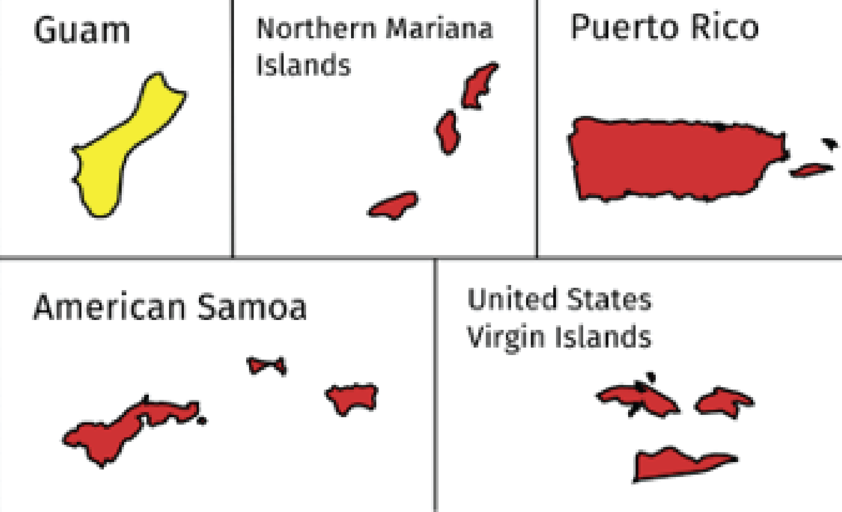
1999
% Backlog Reduction
≤79%
80-89%
90-100%
EPA Office of Underground Storage Tanks, March 2020

Slide 4
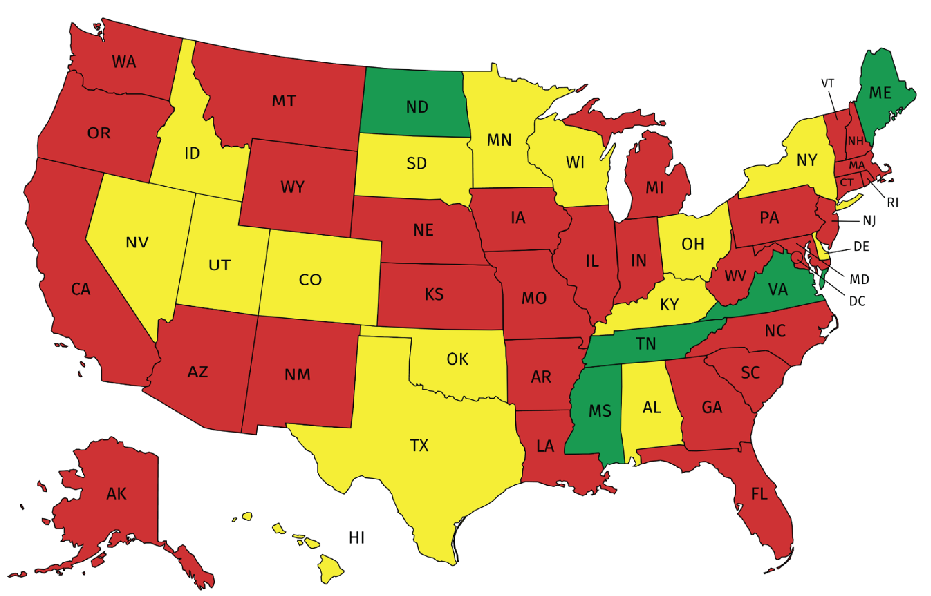
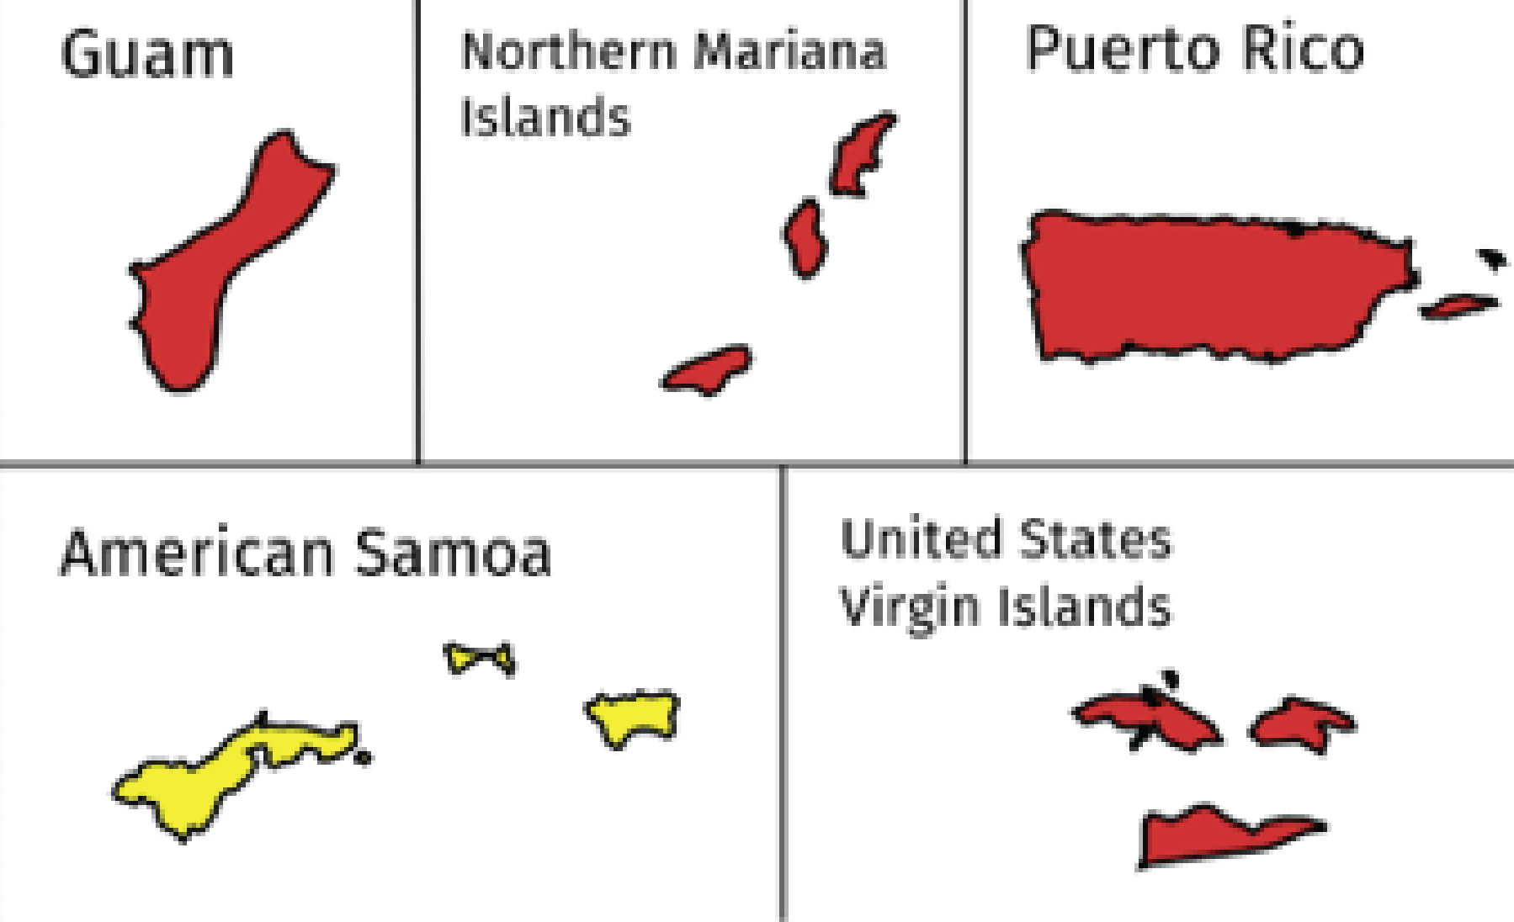
2004
% Backlog Reduction
≤79%
80-89%
90-100%
EPA Office of Underground Storage Tanks, March 2020

Slide 5
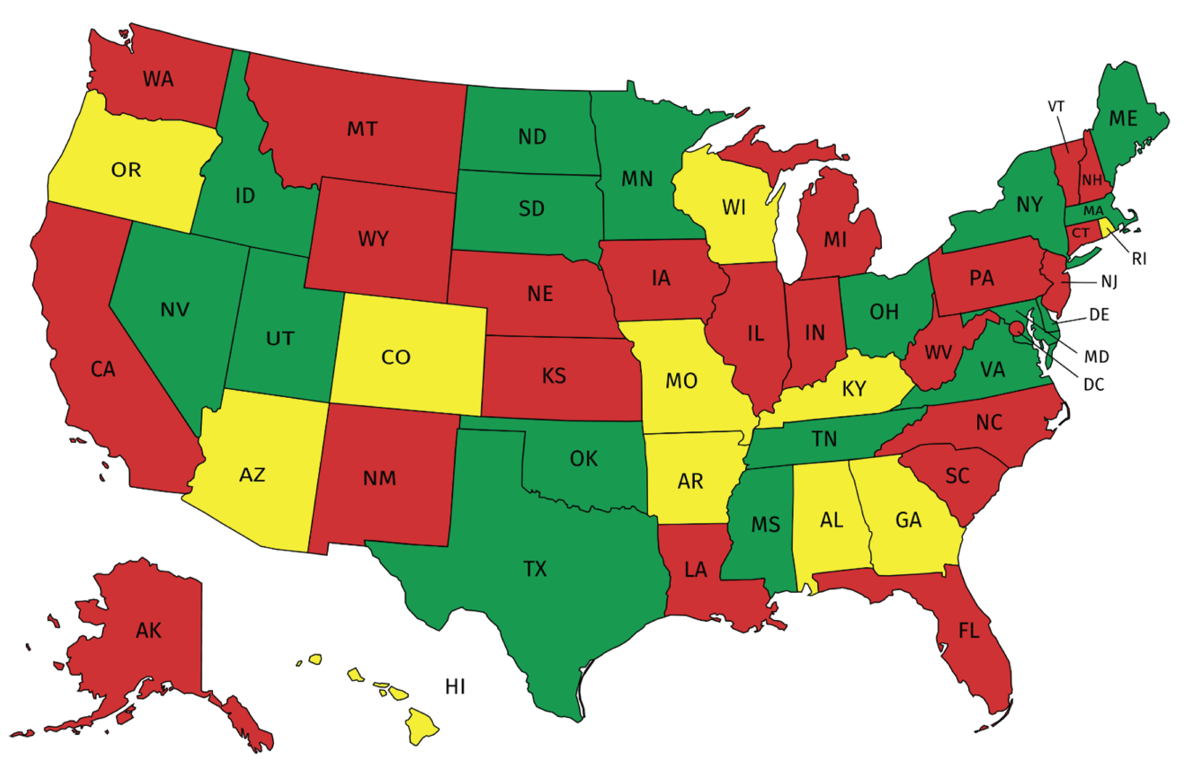
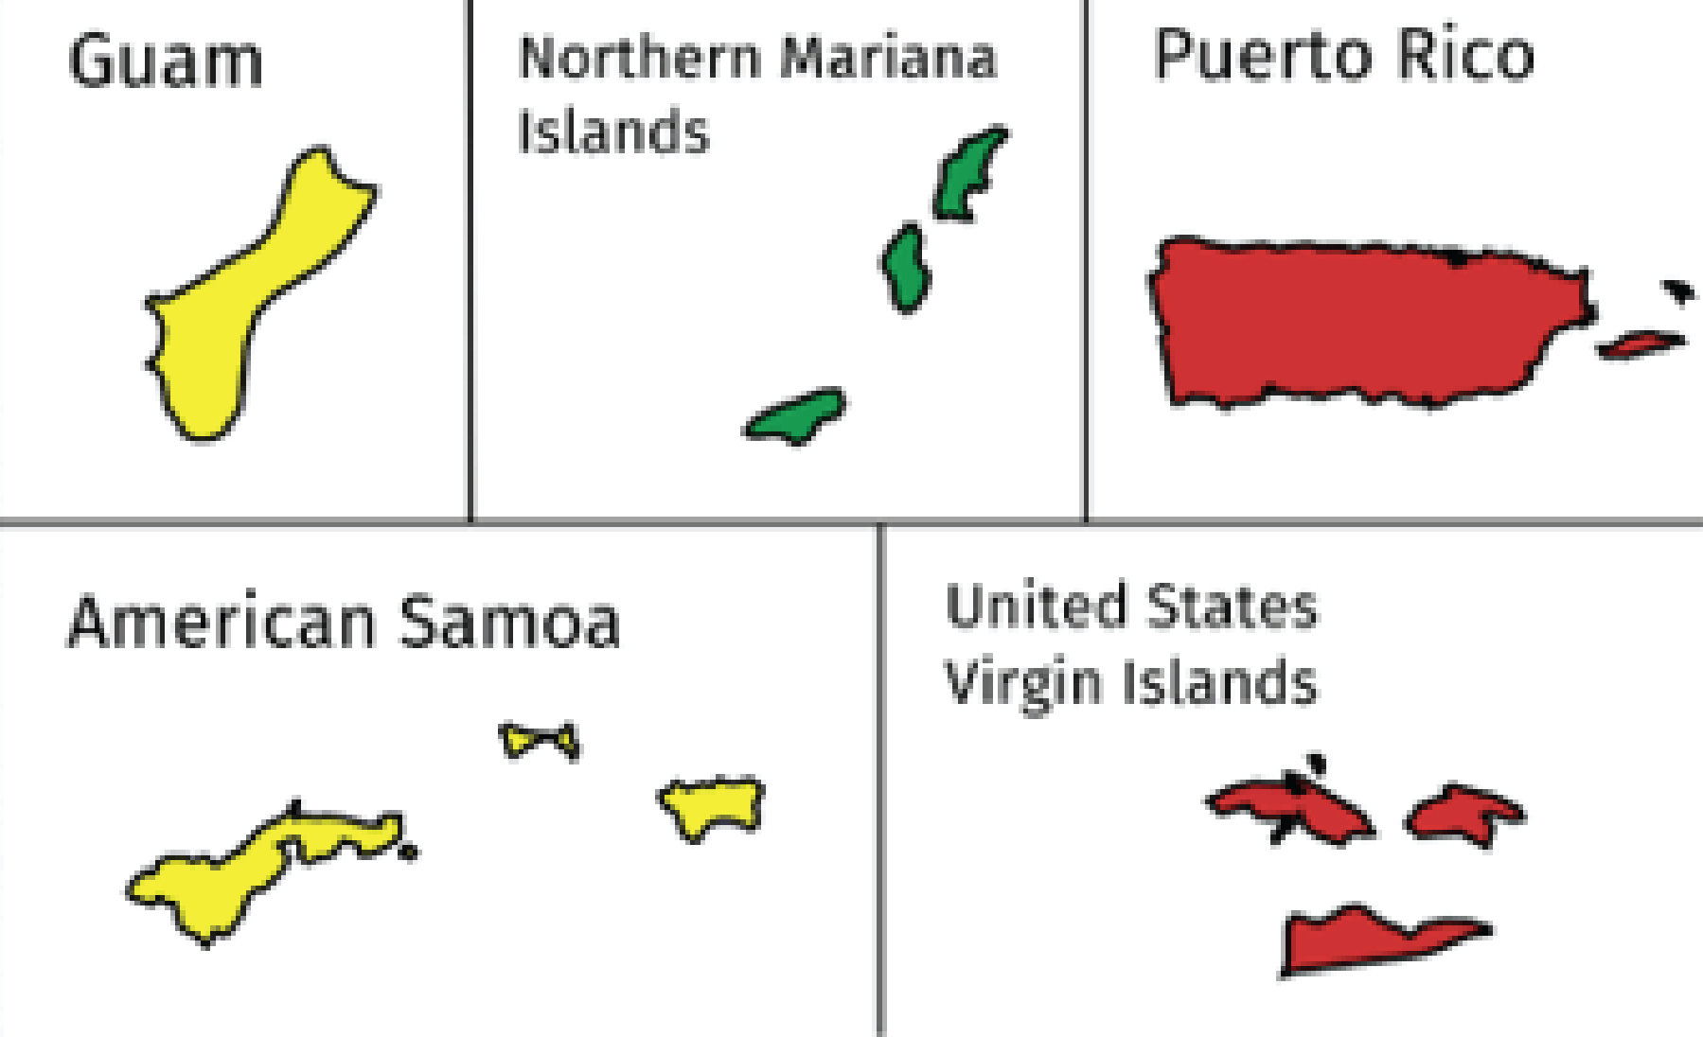
2009
% Backlog Reduction
≤79%
80-89%
90-100%
EPA Office of Underground Storage Tanks, March 2020

Slide 6
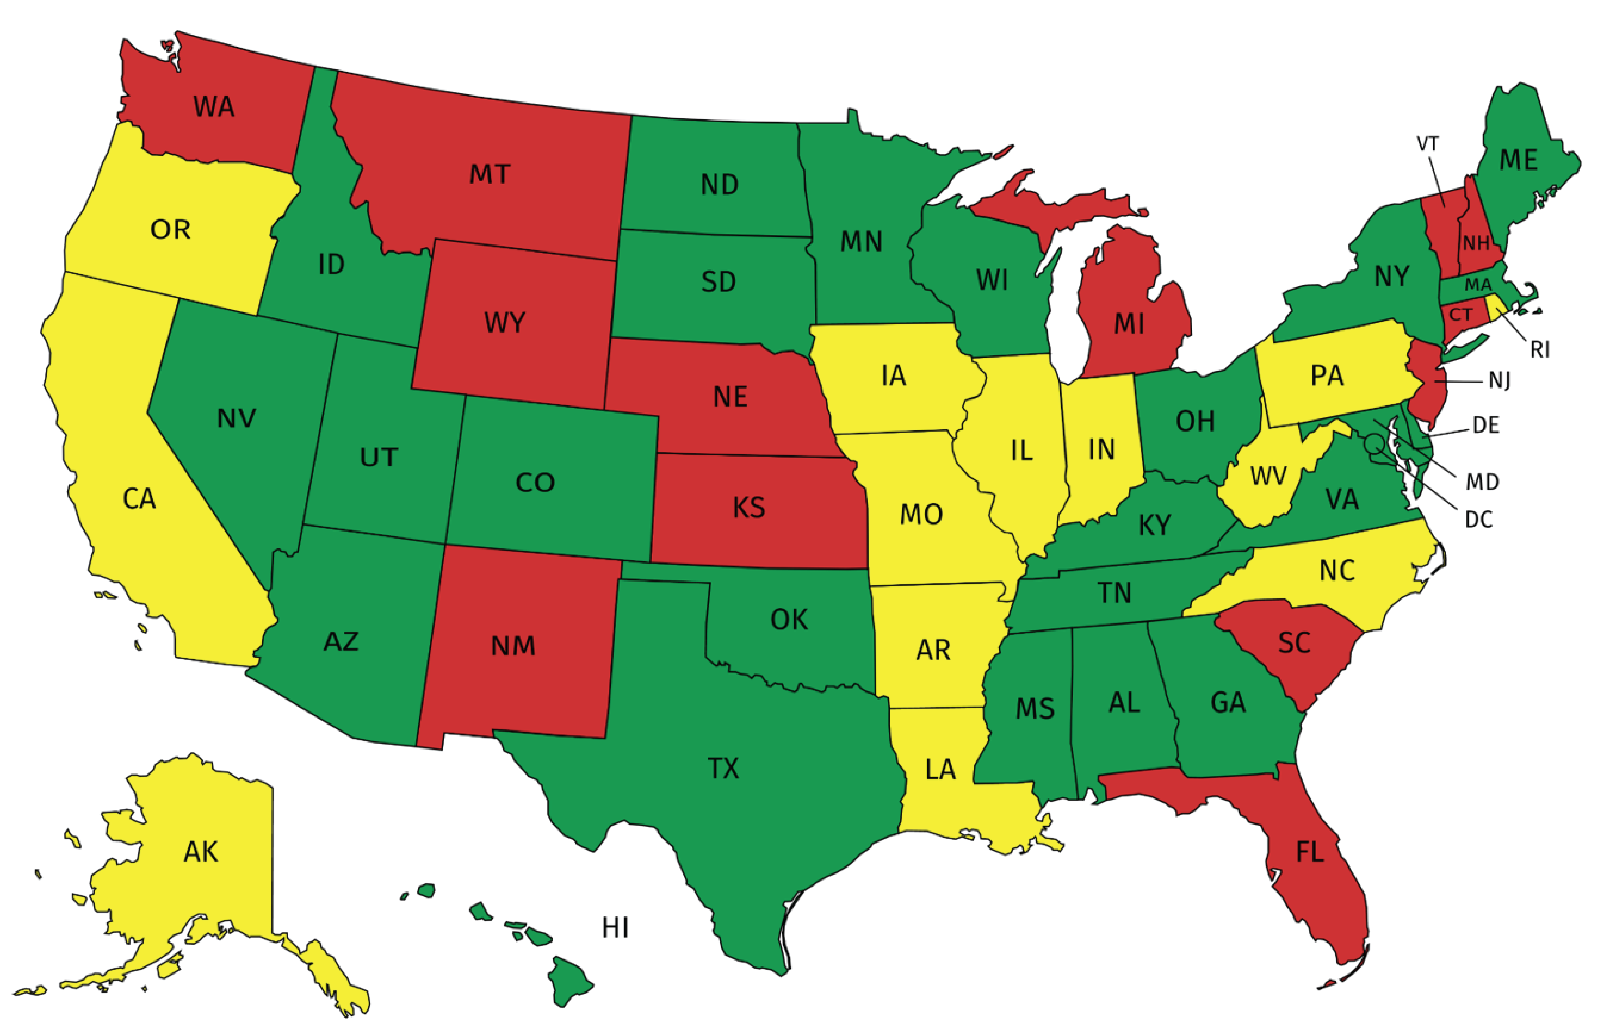
2014
% Backlog Reduction
≤79%
80-89%
90-100%
EPA Office of Underground Storage Tanks, March 2020

Slide 7
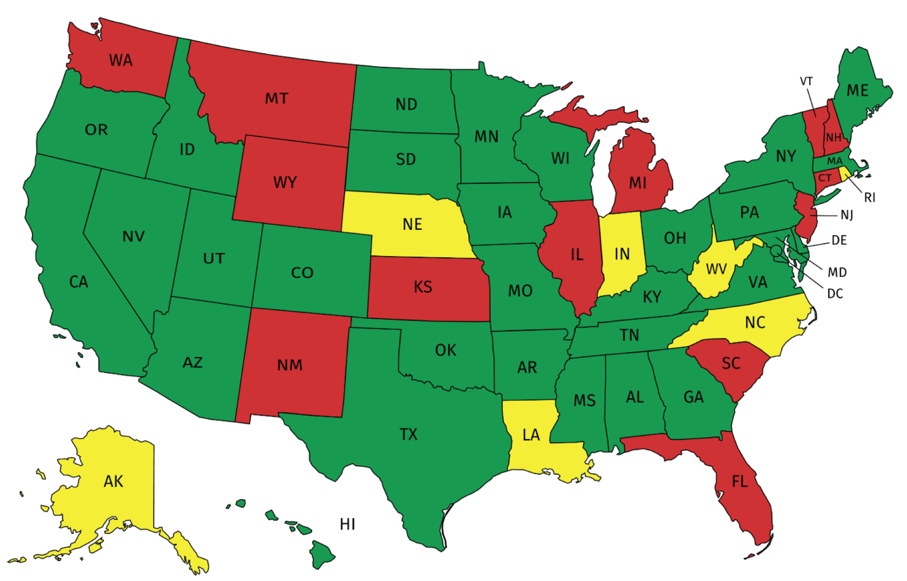
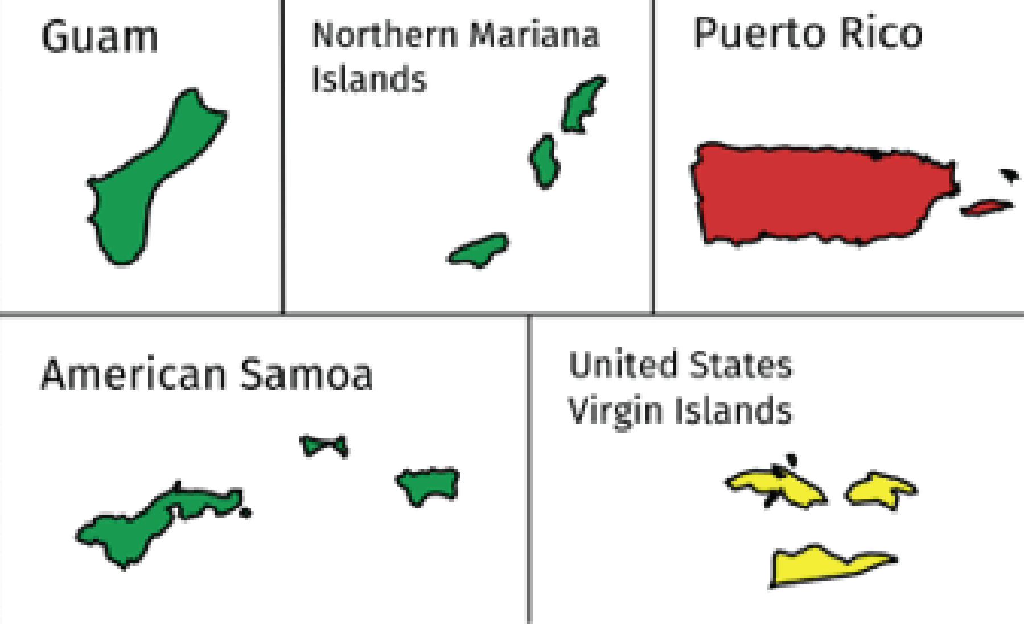
2019
% Backlog Reduction
≤79%
80-89%
90-100%
EPA Office of Underground Storage Tanks, March 2020

Slide 8
20 Years Of Progress
1999
% Backlog Reduction
≤79%
80-89%
90-100%
2019
EPA Office of Underground Storage Tanks, March 2020

